Slide 1
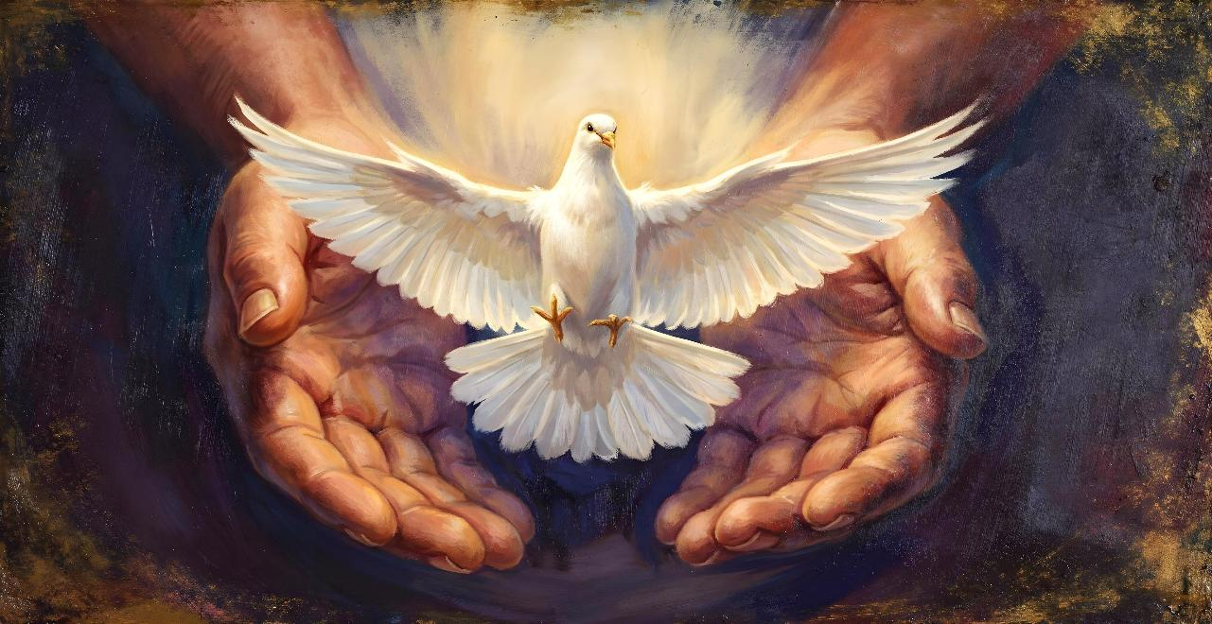
Lesson 6 for
August 8, 2026
SPIRITUAL GIFTS

Slide 2
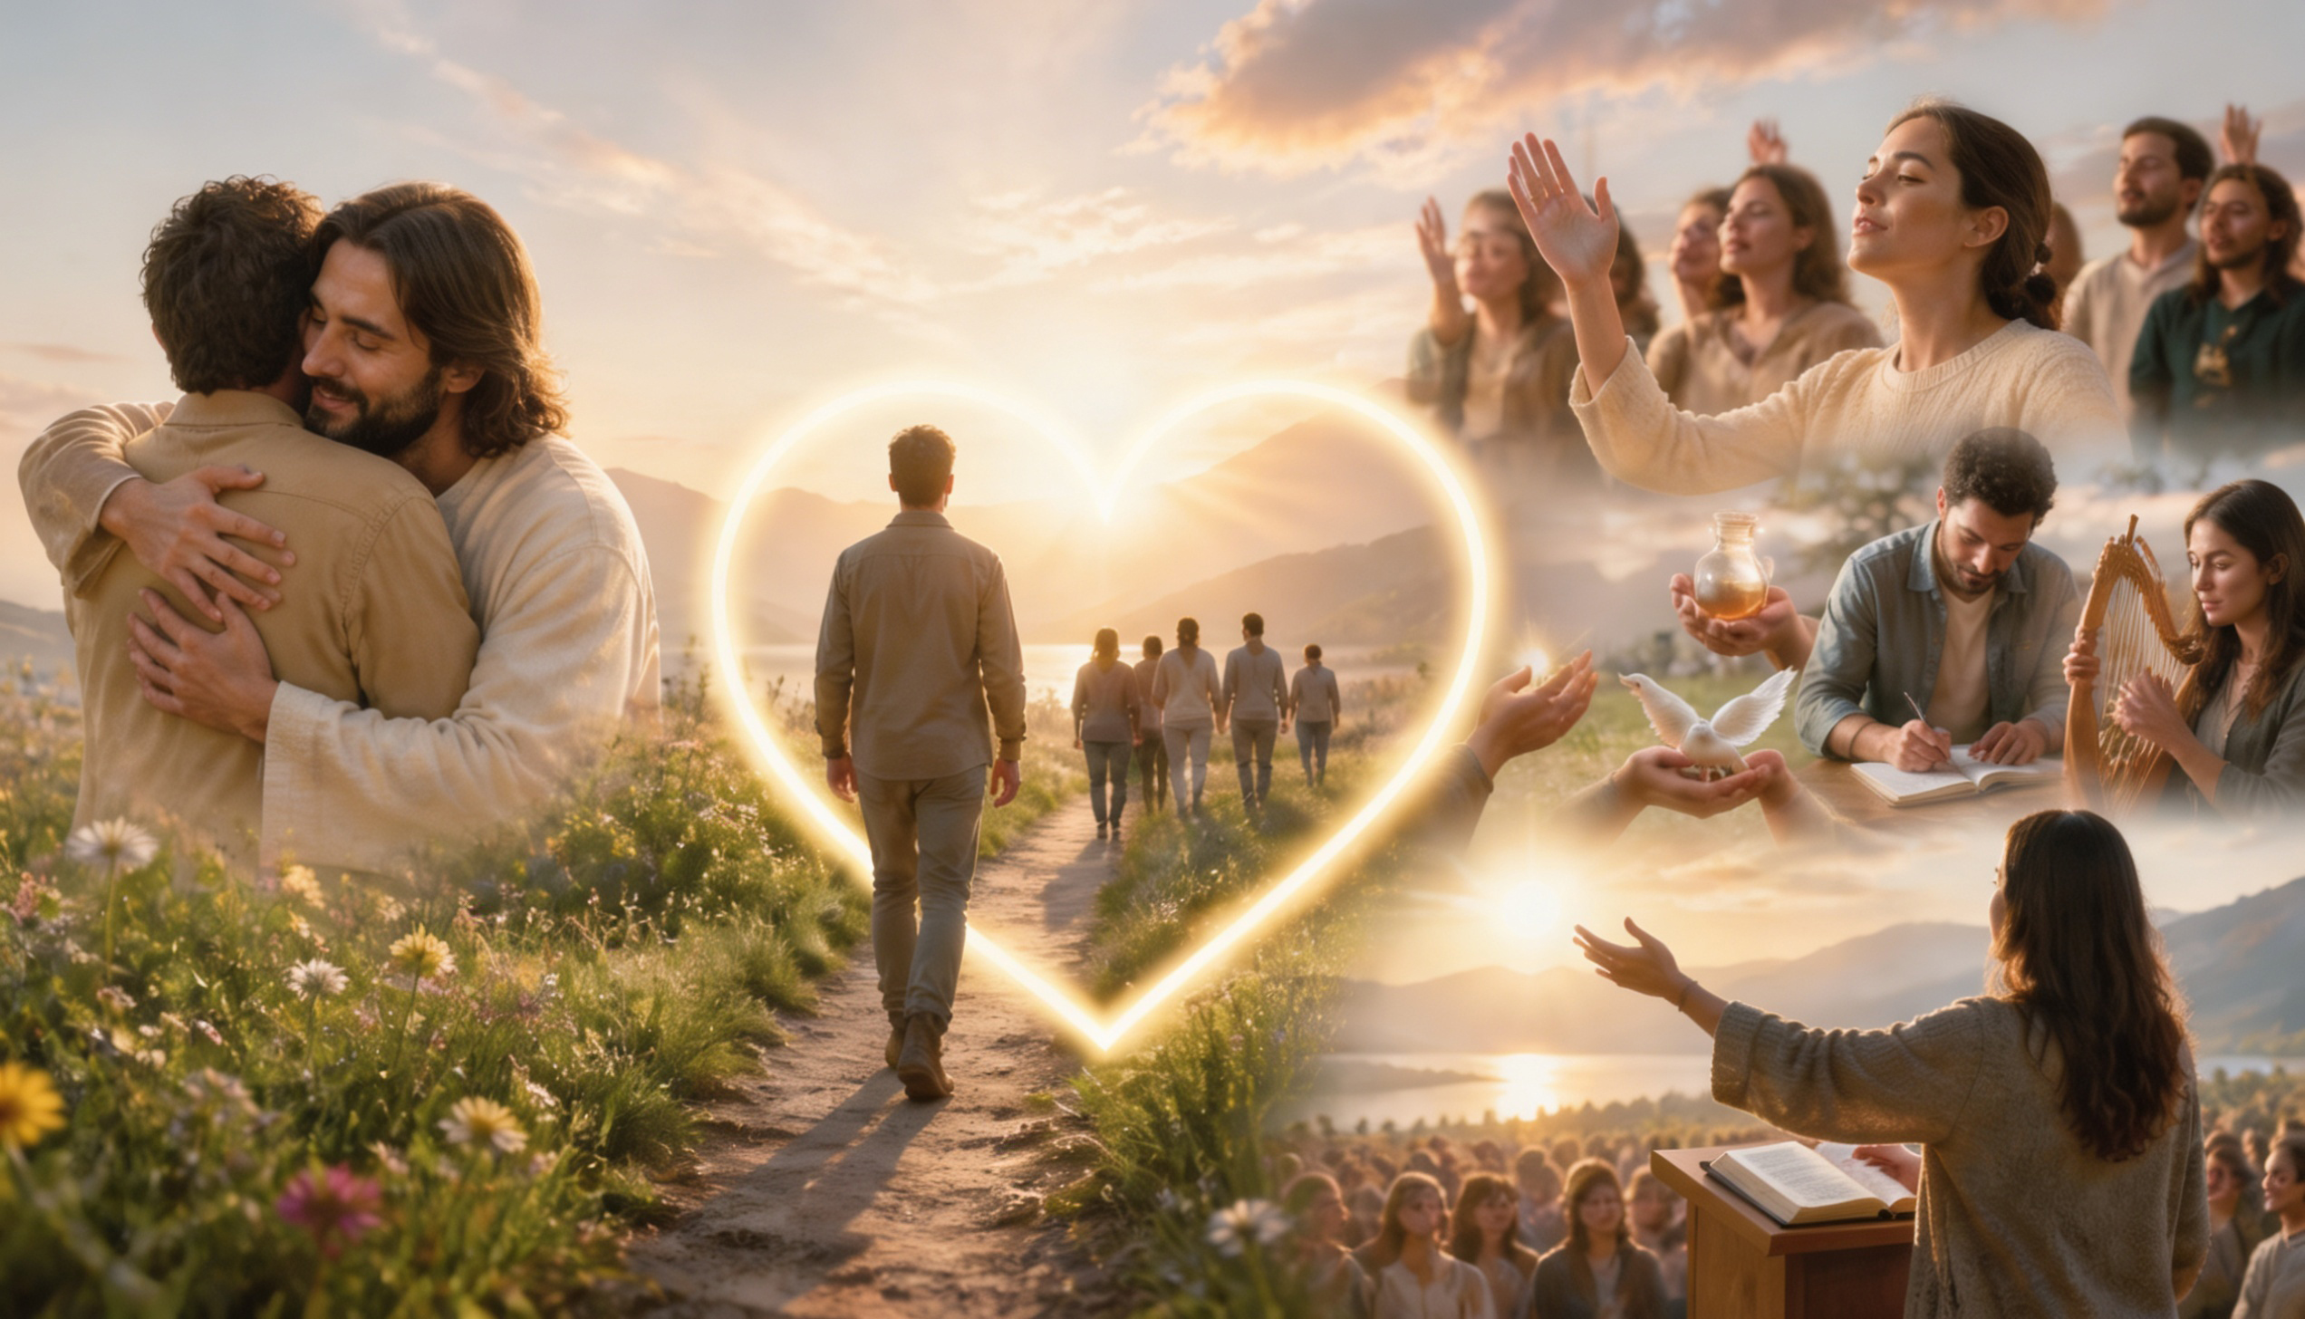
“Pursue love, and earnestly desire the spiritual gifts, especially that you may prophesy”
(1 Corinthians 14:1, ESV)

Slide 3

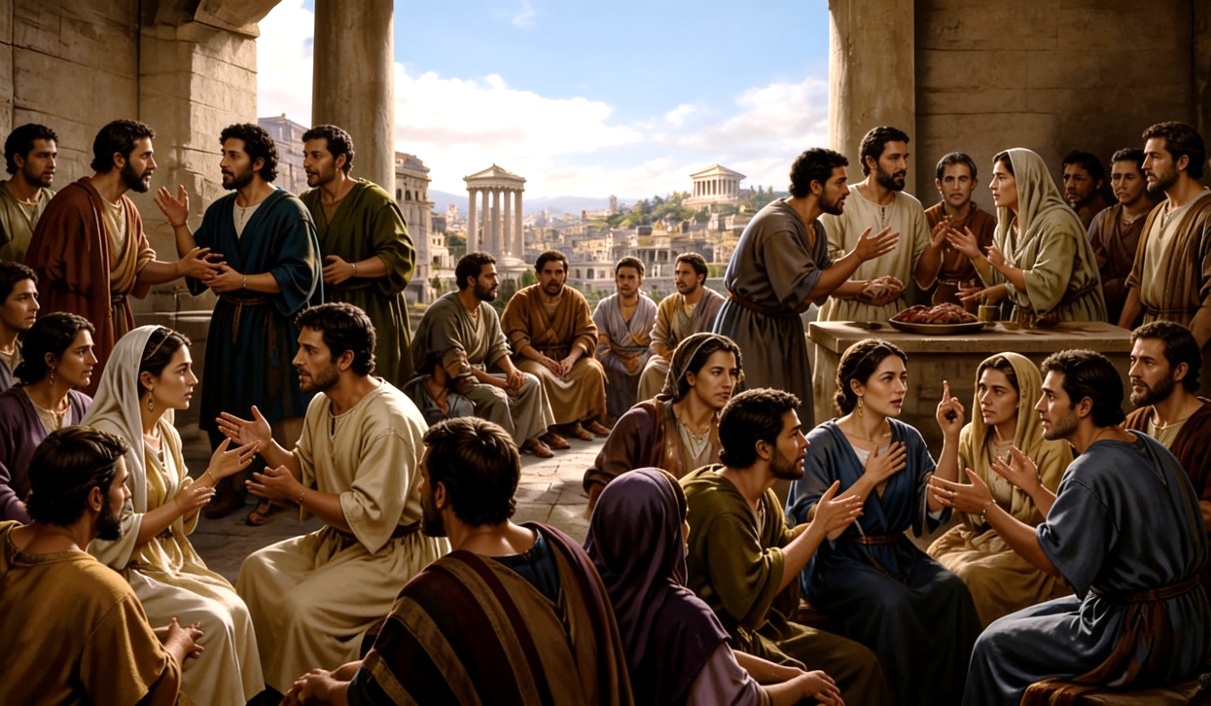




It is clear that the church in Corinth was divided on various issues. They disagreed about the preachers; about how to eat; about whether to marry or remain single; and about which of the spiritual gifts should be most honored.
Once he has answered the initial problems, Paul shows how spiritual gifts go from being a problem to being a means of unity (1 Cor. 12-14).
Which gift is the best? None! Why?
Spiritual gifts:
  Many gifts, one Giver.
  Many members, one body.
The unifying element:
  The excellence of love.
Special gifts:
  The gift of tongues.
  The gift of prophecy.

Slide 4

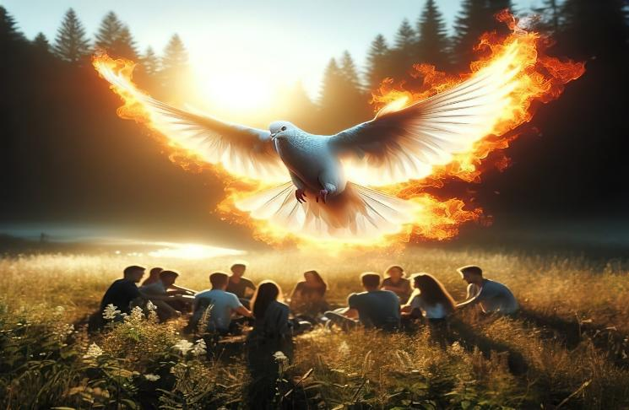
SPIRITUAL GIFTS

Slide 5

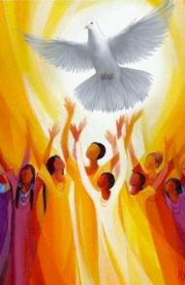
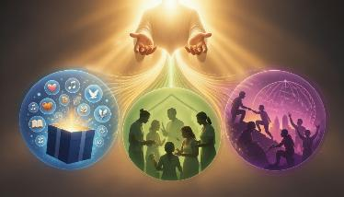
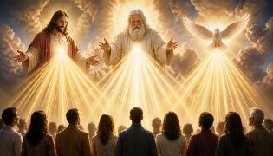

MANY GIFTS, ONE GIVER
“But there are differences of gifts, but the same Spirit” (1 Corinthians 12:4)
Who gives spiritual gifts? (1 Cor. 12:4-6)
1 Cor. 12:4 | there are differences of | gifts | But the same | Spirit
1 Cor.12:5 |  | ministries |  | Lord
1 Cor.12:6 |  | workings |  | God
Spiritual gifts
The Giver
To help us understand the relationship between spiritual gifts and their Giver, Paul uses three terms to identify them, highlighting their diversity: gifts; ministries; and operations.
However, the Giver is One: the [Holy] Spirit; the Lord [Jesus]; and God [the Father]. That is to say: the Deity working in unison (John 14:16).
But God does not bestow gifts as the Greco-Roman “gods” did (1 Cor. 12:2). There is no ecstasy, nor a hierarchical selection of the recipients of the gifts (such as, for example, priestesses).

Slide 6

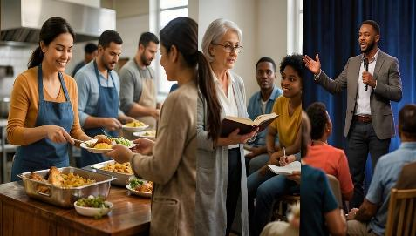
MANY GIFTS, ONE GIVER
“But there are differences of gifts, but the same Spirit” (1 Corinthians 12:4)
Why does God give different gifts to different people? (1 Cor. 12:7)
What gifts does Paul give as examples, among the many others that exist? (1 Cor. 12:8-10; Rom. 12:6-8; Eph. 4:11-12)
Word of wisdom
Word of knowledge
Faith
Health
To perform miracles
Prophecy
Discernment of spirits
Tongues
Interpretation of tongues
Romans 12:6-8
Service
Teaching
Exhortation
Generosity
Leadership
Mercy
Ephesians 4:11-12
Apostleship
Evangelism
Pastorate and Master's Degree
1 Corinthians 12:8-10
Spiritual gifts are used “for the benefit” of the church. Only God knows which people can use a particular gift to achieve that purpose.

Slide 7

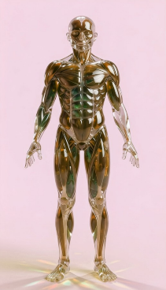
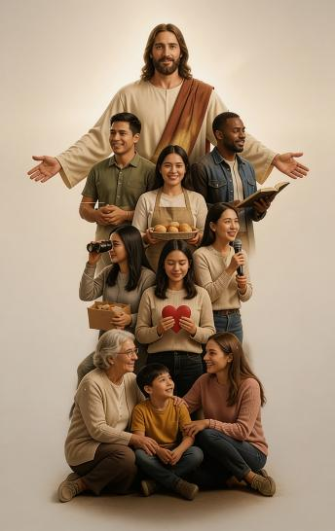

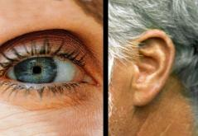
MANY MEMBERS, ONE BODY
“Just as a body, though one, has many parts, but all its many parts form one body, so it is with Christ.” (1 Corinthians 12:12)
God is one, but each member of the Godhead has its own function. Likewise, the church is one, but each component of it has its own function as part of the body of Christ on Earth (1 Cor. 12:12-13).
Paul uses the analogy of the human body as the church to highlight unity in diversity. The eye has the “gift” of sight, but the ear does not. However, the two complement each other by working together. Similarly, in the church, each person carries out their work according to the gifts they have received
(1 Corinthians 12:28-30).
This implies that everyone is needed; that no one is greater than another; that everyone should care about the well-being of others; and that everyone should work for the unity of the church (1 Cor. 12:15-27).

Slide 8


THE UNIFYING ELEMENT

Slide 9

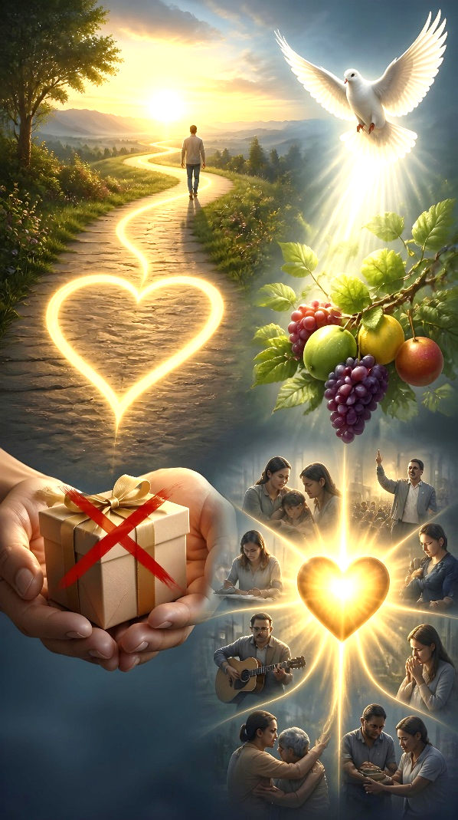

THE EXCELLENCE OF LOVE
“Now eagerly desire the greater gifts. And yet I will show you the most excellent way.” (1 Corinthians 12:31)
What love does
He is patient
He is kind
What love DOES NOT do
He is not envious
He is not boastful
He is not proud
He's not rude
It's not selfish
He doesn't get angry easily
He doesn't hold a grudge
He does not delight in evil
He rejoices in the truth
He excuses everything
He believes everything
Everything awaits
It endures all things
Love is not a gift, but “the most excellent way” (1 Corinthians 12:31). It is a fruit of the Holy Spirit in the life of the believer (Galatians 5:22). Spiritual gifts can only be used properly through love.
The gift of tongue, without love, is “a resounding gong or a clanging cymbal.” The gift of prophecy, the gift of knowledge, and the gift of faith, without love, are nothing. The gift of generosity and the gift of martyrdom, without love, are worthless (1 Cor. 13:1-3).
1 Corinthians 13:4-7 provides a solid guide for proper conduct in the practice of spiritual gifts:

Slide 10

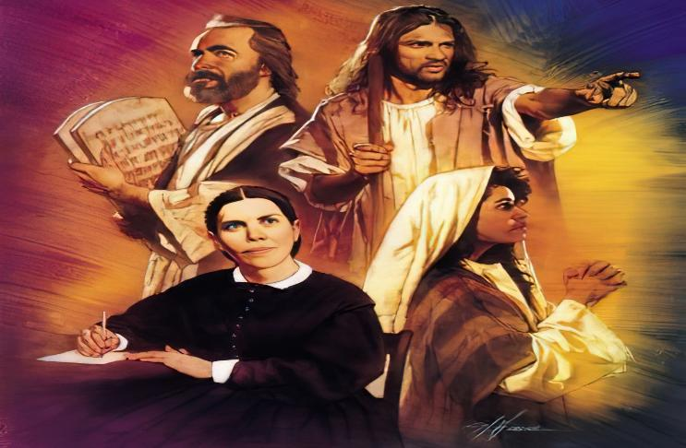
SPECIAL GIFTS

Slide 11

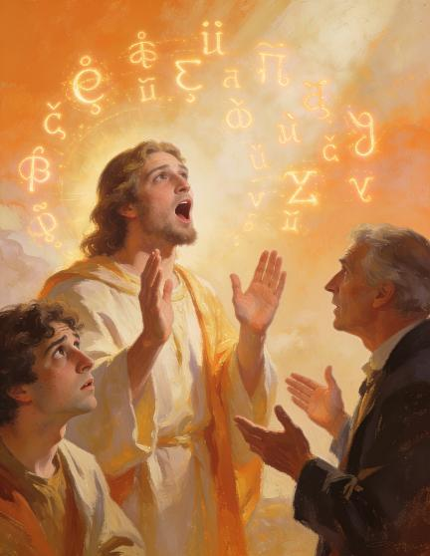
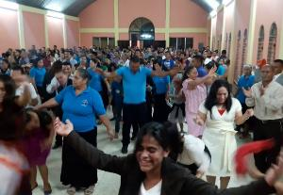
THE GIFT OF TONGUES
“For this reason the one who speaks in a tongue should pray that they may interpret what they say.” (1 Corinthians 14:13)
Paul's emphasis on the gift of tongue and its proper use implies that it was being misused by members of the Corinthian church, causing disorder and confusion in public worship (1 Cor. 14:23).
The gift of tongue is the ability to speak human or angelic languages unknown to the person (1 Cor. 13:1). When this language is unknown to the listener, it needs interpretation
(Acts 2:8; 1 Cor. 14:2, 13-14, 27-28).
Paul's desire that all should speak in tongue has been misinterpreted by those who think that we should all have that gift (1 Cor. 14:5).
In reality, this longing encompasses all the gifts (1 Cor. 14:1). Paul had already made it clear that “Now to each one the manifestation of the Spirit is given for the common good” (1 Cor. 12:7 ). Therefore, not everyone receives the same gifts.

Slide 12

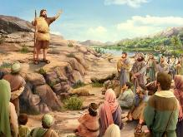
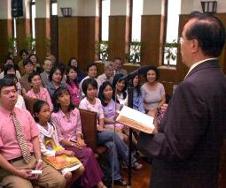
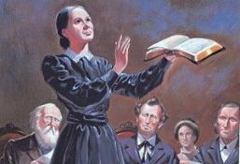
THE GIFT OF PROPHECY
“But the one who prophesies speaks to people for their strengthening, encouraging and comfort” (1 Corinthians 14:3)
We must not limit the gift of prophecy to predicting future events. The primary use of the gift of prophecy is for edification, exhortation, and consolation (1 Cor. 14:3).
The announced future events—if they are not conditional—must come to pass (Deut. 18:22; Jer. 28:8-9; Jonah 4:2)
His message must be in accordance with that of the earlier prophets
(Deut. 13:1-3; Isa. 8:20)
He must bear witness to the incarnation of Jesus
(1 John 4:1-3)
His life must be in accordance with the biblical message he preaches (Mt. 7:15-20)
Paul highlights this gift above others (1 Cor. 14:1, 4, 22-25). But he also urges that it be used correctly so as not to create confusion: “but let everything be done decently and in order”
(1 Cor. 14:40; see 1 Cor. 14:29-33).
As a characteristic gift of the remnant church, it had its special manifestation in the life and work of Ellen G. White (Rev. 12:17; 19:10). But how can we recognize a true prophet?

Slide 13

“In all the Lord’s arrangements, there is nothing more beautiful than His plan of giving to men and women a diversity of gifts. The church is His garden, adorned with a variety of trees, plants, and flowers. He does not expect the hyssop to assume the proportions of the cedar, nor the olive to reach the height of the stately palm. Many have received but a limited religious and intellectual training, but God has a work for this class to do, if they will labor in humility, trusting in Him…”
Different gifts are imparted to different ones, that the workers may feel their need of one another. God bestows these gifts, and they are employed in His service, not to glorify the possessor, not to uplift man, but to uplift the world’s Redeemer. They are to be used for the good of all mankind, by representing the truth, not testifying to a falsehood.
EGW (Ye Shall Receive Power, July 1)

