Slide 1
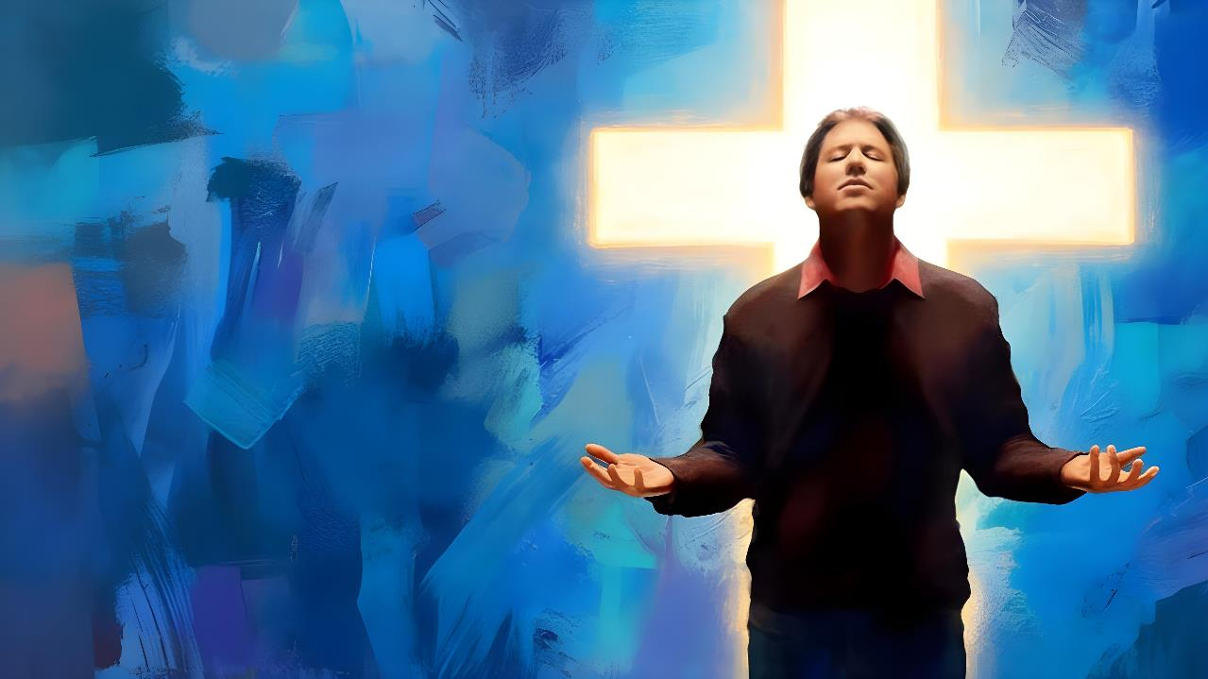
COMPLETE
IN
CHRIST
Lesson 10 for March 7, 2026

Slide 2
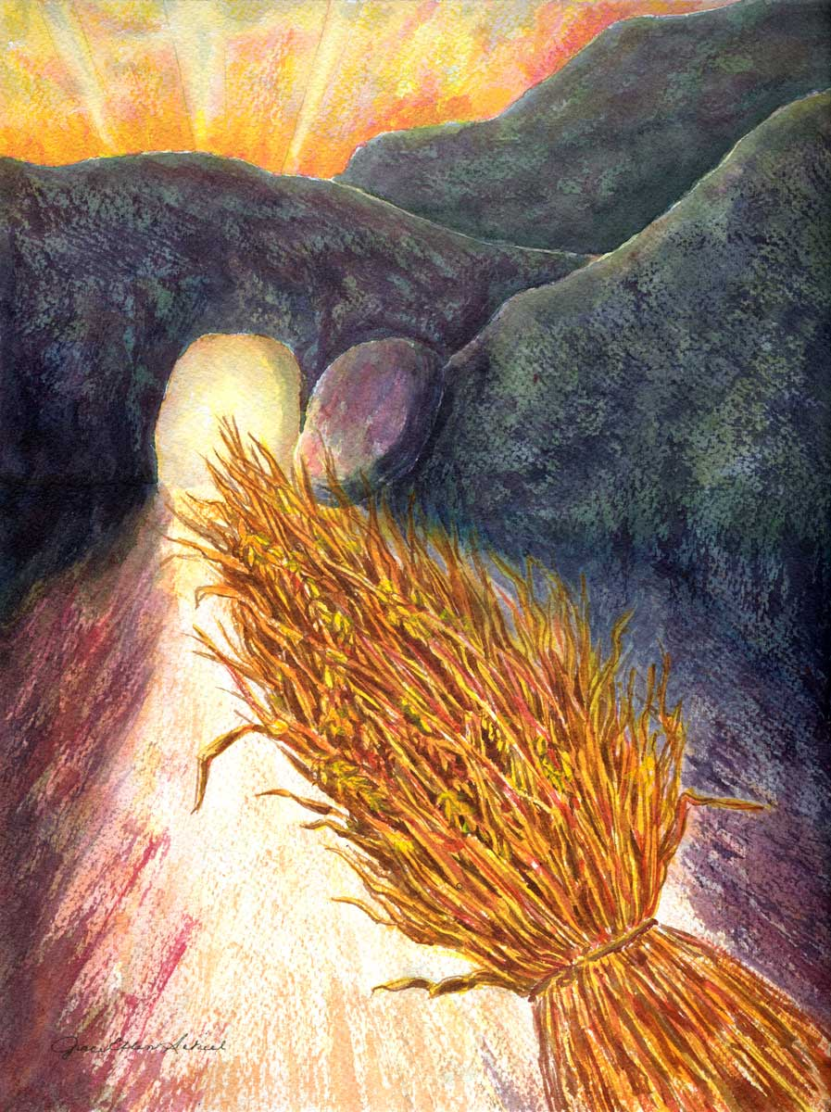
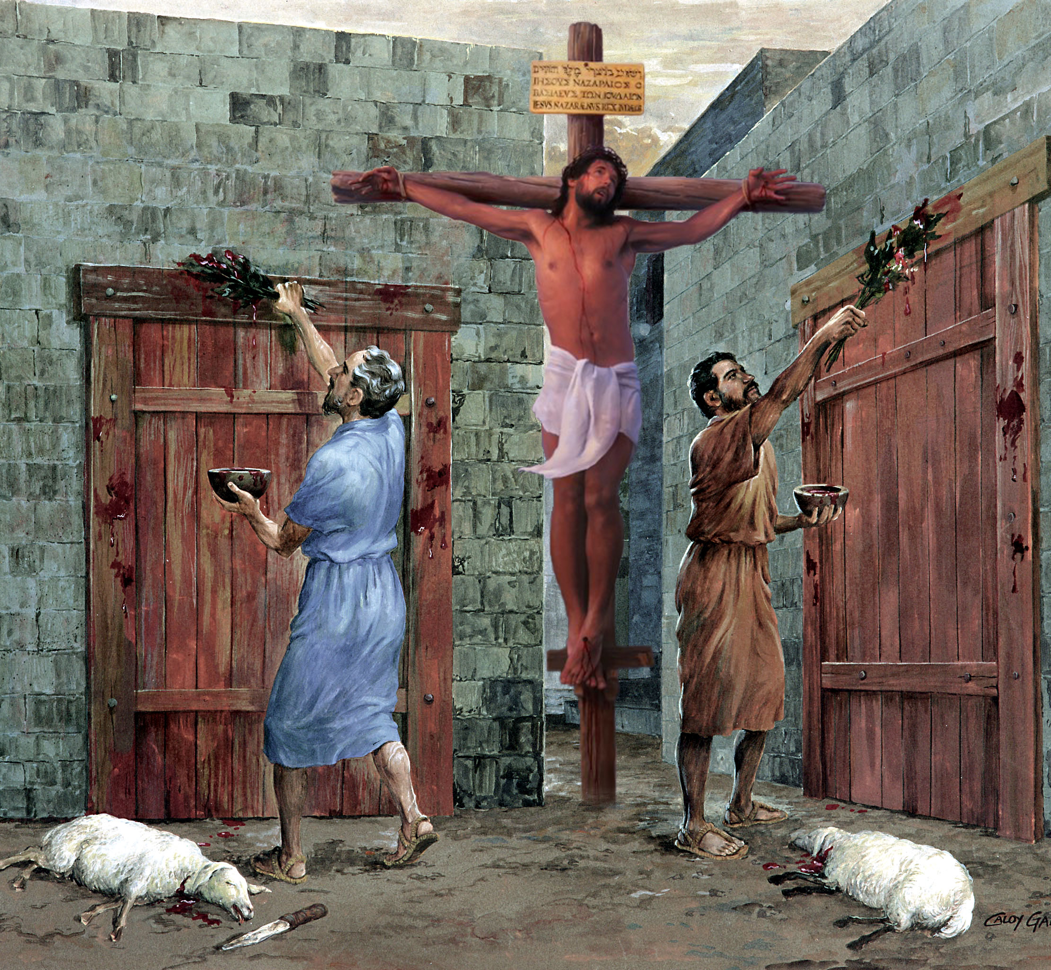
“So let no one judge you in food or in drink, or regarding a festival or a new moon or sabbaths, which are a shadow of things to come, but the substance is of Christ” Colossians 2:16, 17, NKJV

Slide 3

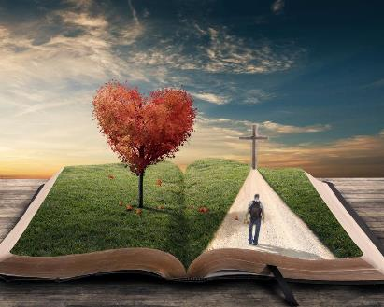



Faith in Jesus brings us great benefits. In addition to the forgiveness of our sins, we receive comfort, wisdom, and more.
Paul invites us to take root in that faith so that we may be trees that bear good fruit for the Kingdom of God.
It also warns us about how we should take root: not based on human philosophies and theories, but only on the living Word of God.
The benefits of faith:
  Consolation, praise, and order (Colossians 2:1-5)
  Rooted in Christ (Colossians 2:6-8)
  The handwriting of ordinances nailed to his cross (Colossians 2:9-15)
Problems that shake faith:
  Holyday, new moon, sabbath days (Colossians 2:16-19)
  Commandments of men (Colossians 2:20-23)

Slide 4


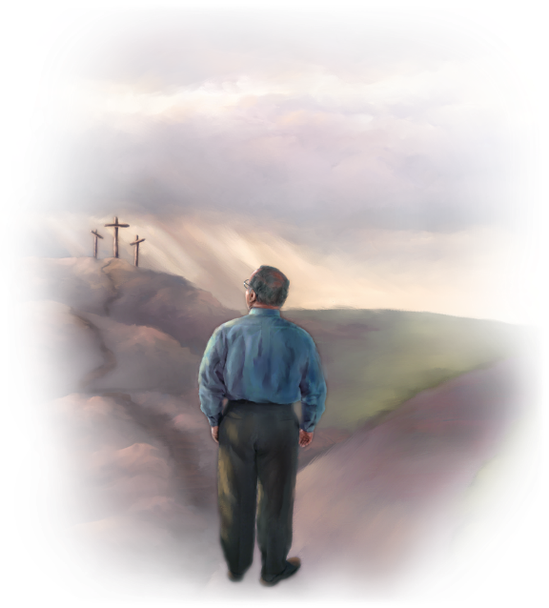
THE BENEFITS OF FAITH

Slide 5

Where is wisdom found? Where does intelligence dwell?
(Job 28:12)
In Christ are hidden all the treasures of wisdom and knowledge
(Colossians 2:3)

Slide 6

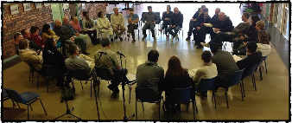
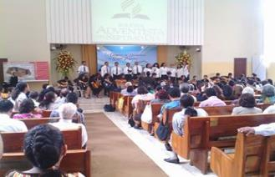
CONSOLATION, PRAISE AND ORDER
“For though I am absent in the flesh, yet I am with you in spirit, rejoicing to see your good order and the steadfastness of your faith in Christ.” (Colossians 2:5)
Although he did not personally know the church in Colossae, Paul knew that it was being threatened by false teachings (Col. 2:1, 4).
For this reason, he writes to them with three clear purposes that will help them to cope with this danger (Col. 2:2 NIV):
they may be encouraged in heart
and united in love
that they may have the full riches of complete understanding
In order that they may know the mystery of God, namely, Christ
Before identifying the false doctrines, there is a double commendation for the Colossians: they have good order; and they are firm in the faith (Col. 2:5).
The “order” Paul refers to here means order in worship and in the various activities of the church. There must be leadership and a division of responsibilities; activities must be carried out with due decorum; and so on. This will result in a better proclamation of the gospel and will protect them from certain errors.

Slide 7

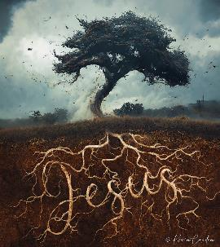
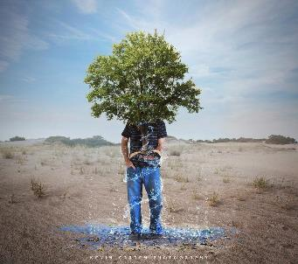
ROOTED IN CHRIST
“Rooted and built up in Him and established in the faith, as you have been taught, abounding in it with thanksgiving.” (Colossians 2:7)
We obtain salvation by accepting a Person, not by accepting doctrines (Col. 2:6). However, these are essential. Paul exhorts us to walk in Christ “as you have been taught” (Col. 2:7b).
As we walk with Jesus, we are rooted in Him. We are, metaphorically, “the planting of the Lord, that he might be glorified” (Isaiah 61:3) . We are “trees” clinging to Jesus and His teachings (Psalm 1:3).
Now, there are two types of doctrine
According to Christ and his teaching recorded in the Bible
We are strengthened in the faith and abound in thanksgiving (Col. 2:7)
According to philosophies and empty subtleties, according to the traditions of men
We are deceived, judged, and deprived of our reward
(Col. 2:8, 16, 18)

Slide 8

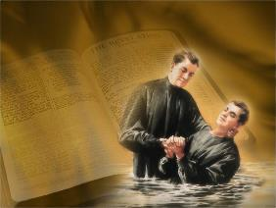

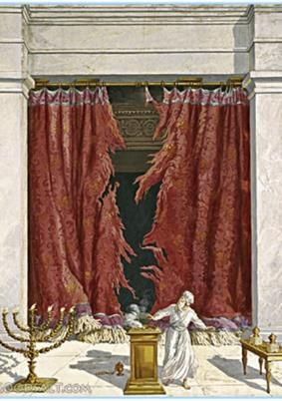
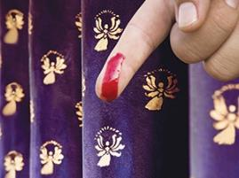
THE HANDWRITING OF ORDINANCES NAILED TO HIS CROSS
“Blotting out the handwriting of ordinances that was against us, which was contrary to us, and took it out of the way, nailing it to his cross” (Colossians 2:14)
Abraham ratified his covenant with God through circumcision (Gen. 17:11). We ratify our covenant with Jesus through baptism, which is “the circumcision of Christ” (Col. 2:11–12). This implies that physical circumcision is no longer necessary. Having clarified this point, Paul speaks of Jesus’ work on the cross. What did Jesus accomplish?
He gave us life, forgiving our sins (Col. 2:13)
He canceled the charge of our legal indebtedness, which stood against us (Col. 2:14)
He triumphed over the powers and authorities of evil (Col. 2:15)
Ephesians 2:14-15 clarifies that the “ordinances” or “requirements” that was against us was the ceremonial law, which constituted a wall of separation between Jews and Gentiles.
For this reason, we no longer need to worry about observing the ritual laws of the Old Testament, which had their fulfillment and end in Christ.

Slide 9

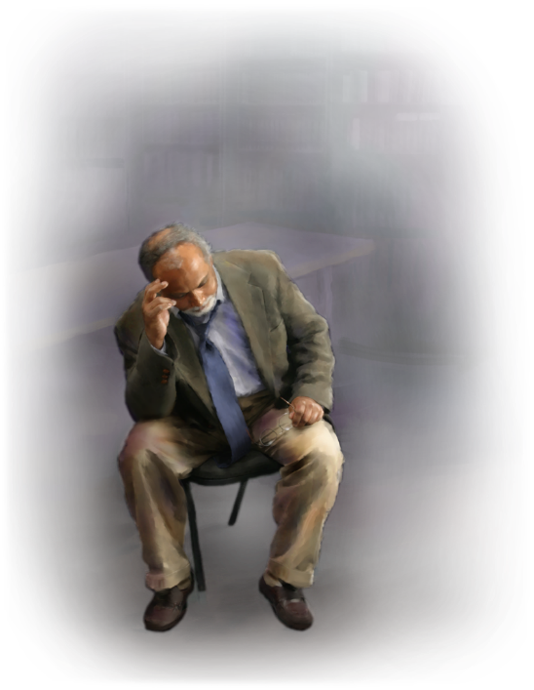
PROBLEMS THAT SHAKE FAITH

Slide 10


HOLYDAY, NEW MOON, SABBATH DAYS
“Let no man therefore judge you in meat, or in drink, or in respect of an holyday, or of the new moon, or of the sabbath days” (Colossians 2:16)
Along with circumcision, there were other points that differentiated Jews from Gentiles: religious rites and festivities.
Paul had already made the role of circumcision clear. Now, with the expression “let,” Paul indicates the implications of the annulment of the “handwriting” (the ceremonial laws): it was no longer obligatory for salvation to observe the rites and festivals, which Jesus fulfilled by dying on the cross (Mt. 27:51; Col. 2:16).
Paul appears to quote Hosea 2:11 to summarize the entire ceremonial system of the Sanctuary in one sentence. This implies that the Sabbaths mentioned here are the seven ritual Sabbaths (observed regardless of the day of the week on which they fell), and not the weekly Sabbath (included in the moral law, universal and applicable to all, Jews and Gentiles).

Slide 11


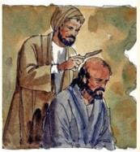
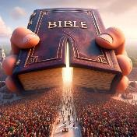
COMMANDMENTS OF MEN
“These rules, which have to do with things that are all destined to perish with use” (Colossians 2:22 NIV)
The false teachers, whom Paul refers to several times in his letter, were Jews who taught the necessity of adhering to Jewish law to obtain salvation (Acts 15:1, 5). These laws also included many rules devised by the rabbis.
Let us follow Paul's reasoning. In baptism we have died to "the rudiments of the world" and live for Christ. If we continue to worry about, for example, ceremonial impurities, we still live in the world, and we are concerned about things that disappear with use (Col. 2:20-22).
However, Paul clarifies that, for Jews accustomed to these rites, these have a certain moralizing value for themselves, although they are not useful for transforming the heart (Col. 2:23).
In summary, we must be guided by the teachings contained in the Scriptures –divinely inspired–, and not by human philosophies or reasoning.

Slide 12

“The Christian is likened to the cedar of Lebanon. I have read that this tree does more than send down a few short roots into the yielding loam. It sends strong roots deep down into the earth, and strikes down farther and still farther in search of a still stronger hold. And in the fierce blast of the tempest, it stands firm, held by its network of cables beneath.
So the Christian strikes root deep into Christ. He has faith in his Redeemer. He knows in whom he believes. He is fully persuaded that Jesus is the Son of God and the Saviour of sinners. ... .... The roots of faith strike deep down. Genuine Christians, like the cedar of Lebanon, do not grow in the soft surface soil, but are rooted in God, riveted in the clefts of the mountain rocks..”
EGW (Our High Calling, November 21)

