Slide 1
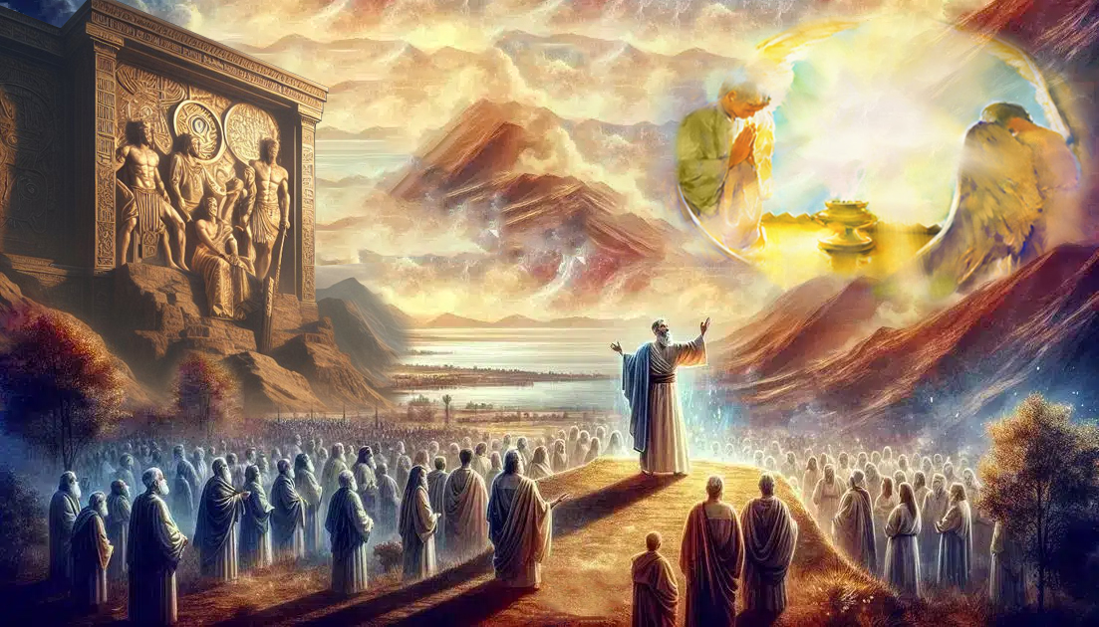
CHOOSE THIS DAY!
Lesson 13 for December 27, 2025

Slide 2
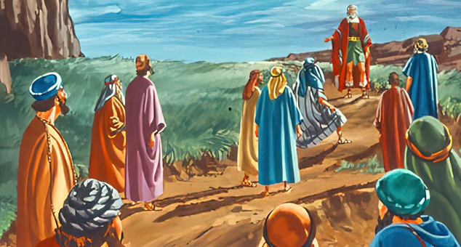
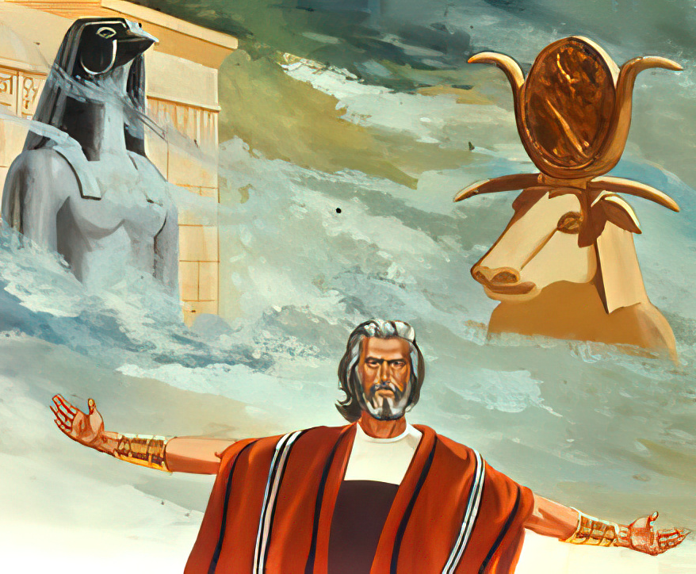
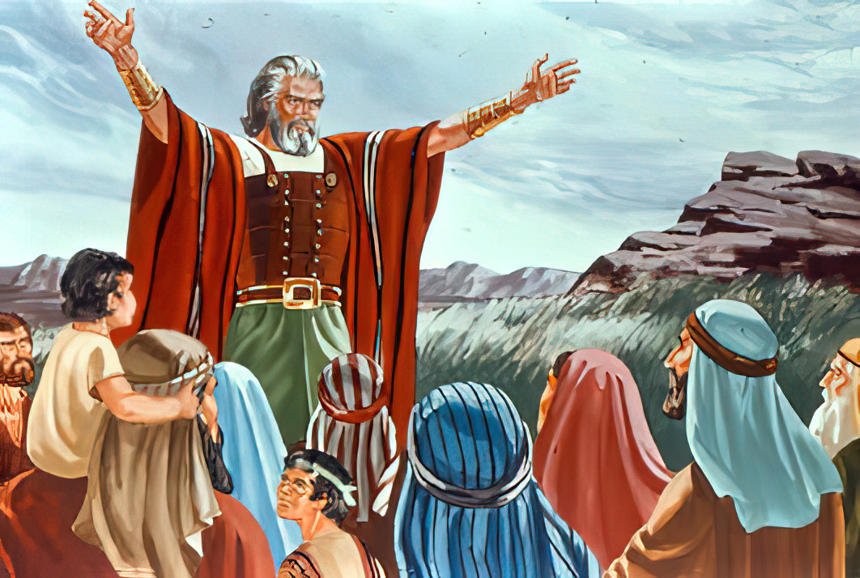
“And if it seems evil to you to serve the Lord, choose for yourselves this day whom you will serve. . . . But as for me and my house, we will serve the Lord”
(Joshua 24:15, NKJV)

Slide 3

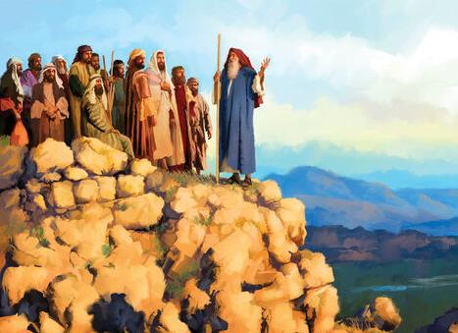
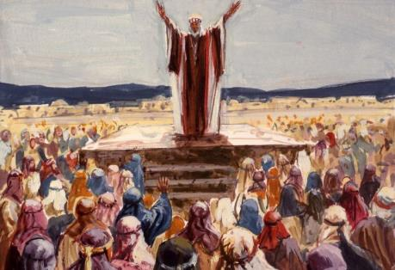
Joshua felt his end was near. He had fought the good fight. He had finished the race. He had kept the faith. He could confidently await, like Paul, his crown of righteousness (2 Tim. 4:7-8).
But, like Caleb, he still had to make sure that others would take up the torch and lead God's people on the right path.
For that reason, he gathered the people in Shechem to renew the covenant of faithfulness, and to exhort them to choose a life of service to God.
The story that God wrote (Joshua 24:1-13)
The call to integrity (Joshua 24:14-15)
The election of the people (Joshua 24:16-21)
The renewal of the covenant (Joshua 24:22-28)
The continuation of the story (Joshua 24:29-33)

Slide 4


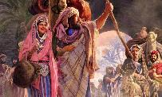
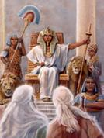
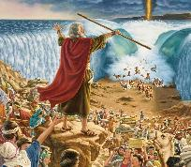
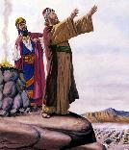
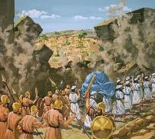
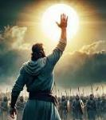
THE STORY THAT GOD WROTE
“And I have given you a land for which ye did not labour, and cities which ye built not, and ye dwell in them; of the vineyards and oliveyards which ye planted not do ye eat.” (Joshua 24:13)
The place chosen by Joshua for his final speech was a historical place: Shechem (Josh. 24:1).
1. It was the first place in Canaan where Abraham camped ( Gen. 12:6)
2. It was the first place in Canaan where Jacob camped (Gen. 33:18)
3. It was the only possession acquired by Jacob (Gen. 33:19)
4. There Jacob buried the foreign gods that his family still possessed (Gen. 35:4)
Joshua began by telling them about the “strange gods” that Terah, their ancestor, worshipped (Josh. 24:2). From there, he reminded them in the first person of everything God had done: I took; I brought; I increased; I sent; I struck; I brought out; I brought you in; I delivered them; I destroyed them; I did not listen to Balaam; I delivered you; I gave them up; I sent flies; I gave you the land (Josh. 24:3-13).
In this account, generations pass one after another without distinction. All are included. Those who listened to Joshua came “from beyond the river”; they went down to Egypt; they left with great power; they crossed the sea; they took Transjordan; they possessed Canaan. What God did with their ancestors, He is doing with them, and He will do with us today.

Slide 5

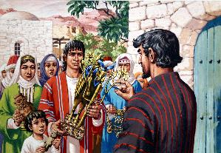
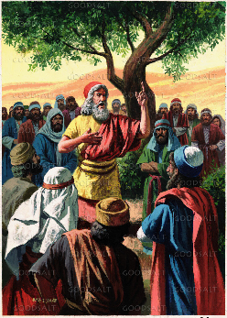
THE CALL TO INTEGRITY
“And if it seem evil unto you to serve the Lord, choose you this day whom ye will serve; whether the gods which your fathers served that were on the other side of the flood, or the gods of the Amorites, in whose land ye dwell: but as for me and my house, we will serve the Lord.” (Joshua 24:15)
Just as Jacob invited his family to bury their gods before renewing their covenant with God at Bethel, Joshua invites the people to abandon their gods before renewing their covenant with God (Josh. 24:14b).
They were to fear God and serve him “in sincerity and in truth” (Josh. 24:14a). What does this imply?
To fear God
To show profound respect for Him who is infinitely greater than I, and to accept Him as my King and Lord
To serve God in sincerity [integrity]
A service without defects (this is how the animal was defined that was only suitable for slaughter if it was “without defect” [whole])
To serve God in truth
To be faithful, trustworthy, loyal, undivided, and consistent. To reflect through my life my gratitude to God for what He has done in me.

Slide 6

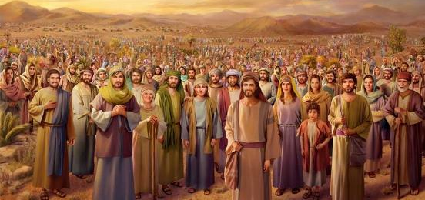
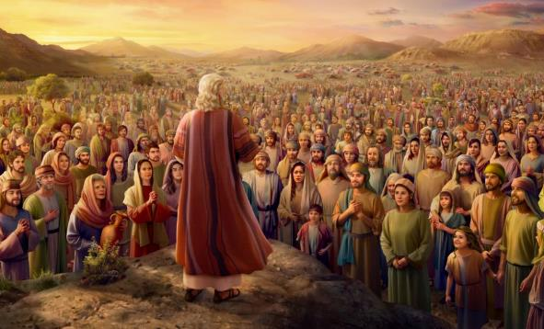
THE ELECTION OF THE PEOPLE
“And the people answered and said, God forbid that we should forsake the Lord, to serve other gods!’” (Joshua 24:16)
What was the response to Joshua's call (Josh. 24:16)? The entire people said no to their gods, and accepted that they only had one God: “our God,” the same one who had guided them—both their ancestors and themselves—up to that moment (Josh. 24:17-18).
Instead of congratulating the people on their decision, Joshua gave an unexpected response: “You are unfit to serve the Lord” (Josh. 24:19 NIV). What a disappointment!
Joshua had heard his parents make the same promise (Ex. 19:8), and had seen how they had repeatedly broken it for 40 years.
This harsh response achieved its purpose. The new generation was determined not to repeat the same mistakes (Josh. 24:21).

Slide 7


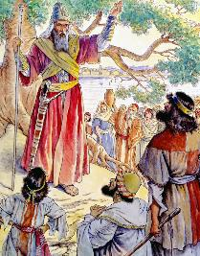
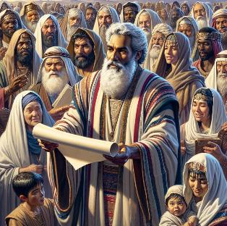
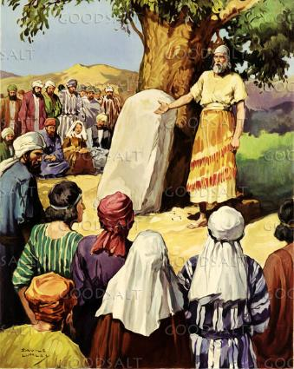
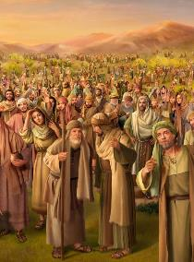
THE RENEWAL OF THE COVENANT
“So Joshua made a covenant with the people that day, and set them a statute and an ordinance in Shechem” (Joshua 24:25)
To conclude his speech, Joshua asked them to remove the gods that are “among you,” and to turn their hearts back to God (Josh. 24:23).
For the third time, the people pledged to serve God (Josh. 24:24). The covenant was ratified, and, like Moses, Joshua “gave them statutes and laws” (Josh. 24:25).
Although the covenant with God is based on a living relationship with Him and cannot be fully expressed through mere regulations, Joshua understood that it was necessary to leave clear reminders that would help them stay in the covenant.
He put the covenant in writing, and erected a memorial monument: a stone to serve as a witness to the commitment they had made (Josh. 24:26-27).

Slide 8

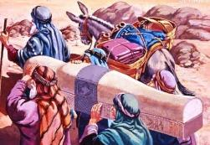
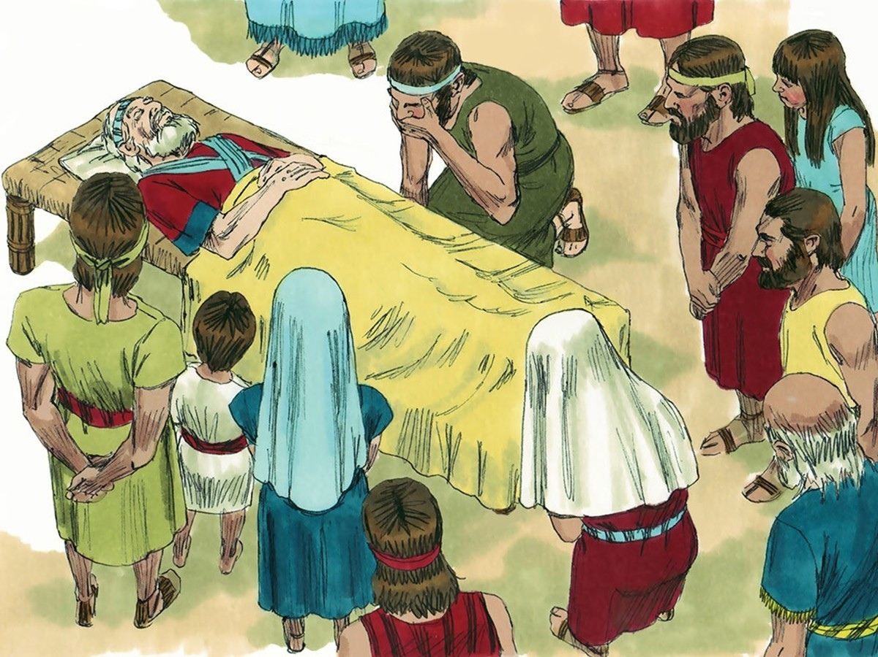
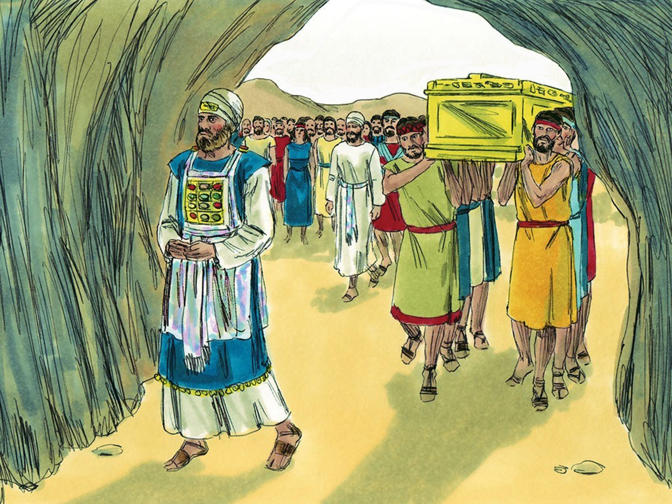
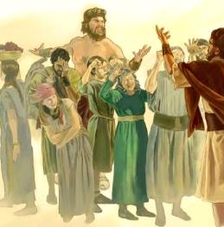

THE CONTINUATION OF THE STORY
“And Israel served the Lord all the days of Joshua, and all the days of the elders that overlived Joshua, and which had known all the works of the Lord, that he had done for Israel” (Joshua 24:31)
The book of Joshua ends with three burials. One of them, prophesied hundreds of years earlier, was the burial of Joseph in Jacob's inheritance (Gen. 50:24-26; Josh. 24:32).
The rebellious generation that had come out of Egypt was buried in the desert. But the new generation was to be buried “in their inheritance,” along with those who had remained faithful in an unfaithful generation: Joshua and Eleazar (Josh. 24:29-30, 33).
This new generation remained faithful (Josh. 24:31). But what about the next generation (Judg. 2:10-11)?
Each generation must make its own covenant with God. The faith of their parents can help them make the right decision. But the decision is theirs. Let us make our decision today: “As for me and my household, we will serve the Lord” (Josh. 24:15 NIV).

Slide 9

“Our General, who has never lost a battle, expects willing, faithful service from everyone who has enlisted under His banner. In the closing controversy now waging between the forces for good and the hosts of evil He expects all, laymen as well as ministers, to take part. All who have enlisted as His soldiers are to render faithful service as minutemen, with a keen sense of the responsibility resting upon them individually.”
EGW (Testimonies for the Church, vol. 9, p. 116)

