Slide 1
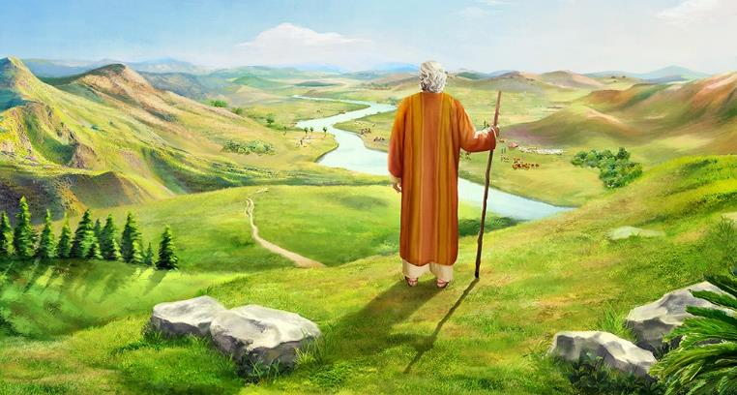

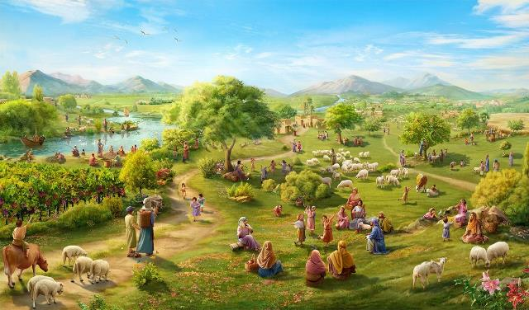
GOD IS FAITHFUL!
Lesson 12 for December 20, 2025

Slide 2

“Not one word of all the good promises that the Lord had made to the house of Israel had failed; all came to pass” (Joshua 21:45, ESV)

Slide 3

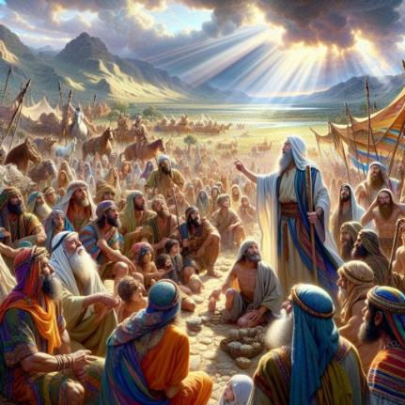
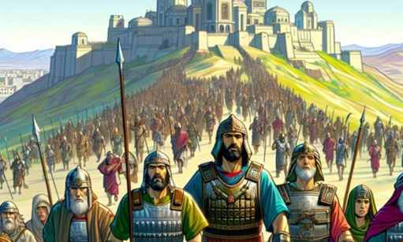
Joshua was already old, and there were still territories to conquer. He gathered the new leaders to encourage them to continue the conquest.
The ability to achieve victory was not within them, but within God. So he reminded them of the faithfulness God had already demonstrated and assured them that He would continue to be faithful.
But he also presented them with the dangers. In reality, there was only one danger, the same one we must face today: ceasing to be faithful to God; returning God's faithfulness with unfaithfulness on our part.
The faithfulness of God (Joshua 21:43-45)
What God has done and what He will do (Joshua 23:1-5)
The reward for faithfulness (Joshua 23:6-10)
What we must do (Joshua 23:11-14)
The punishment for unfaithfulness (Joshua 23:15-16)

Slide 4


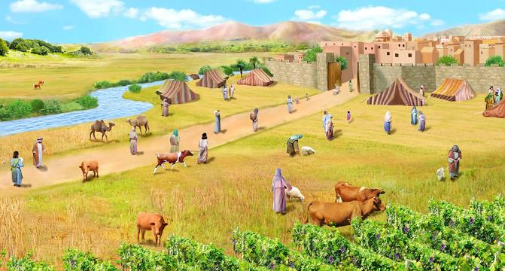
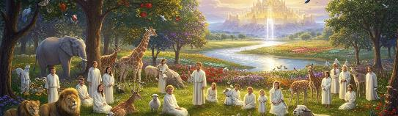
THE FAITHFULNESS OF GOD
“Not one of all the Lord’s good promises to Israel failed; every one was fulfilled.” (Joshua 21:45 NIV)
God had given Israel “all the land” (Josh. 21:43 NIV) and had delivered into their hands “all their enemies” (Josh. 21:44 NIV), so “every one was fulfilled” (Josh. 21:45 NIV).
The repeated use of the word “all” emphasizes God’s faithfulness in fulfilling his promises. His enemies had been defeated by God. They could inhabit the land because God had possessed it. They could be certain that they would finish driving out the Canaanites who still lived in the land because God had kept his promises thus far and would continue to keep them in the future.
All of this works out for our good. God remains faithful. (Deut. 7:9; Ps. 117:2; Lam. 3:22-23). He has promised to save us and give us the Earth as an inheritance, and he will fulfill this promise (Phil. 1:6; 1 Pet. 1:5; Ps. 37:29).

Slide 5

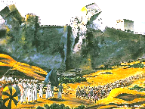
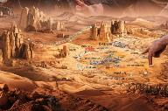
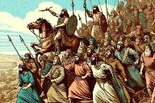
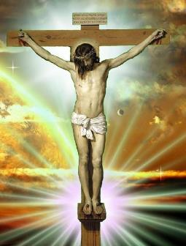
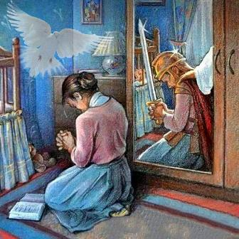
WHAT GOD HAS DONE AND WHAT HE WILL DO
“You yourselves have seen everything the Lord your God has done to all these nations for your sake; it was the Lord your God who fought for you” (Joshua 23:3 NIV)
In his speech to the elders, Joshua begins by telling them what God had already done and what He was still going to do:
He has fought against the nations
(Josh. 23:3)
He has divided the land among the tribes (Josh. 23:4)
He will drive out the nations that are left (Josh. 23:5)
All this (what had already been done and what was yet to be done) was subject to a single condition on the part of Israel: obedience (Josh. 23:6).
The history of Israel is a lesson for us today. God has already triumphed over sin and has given us the assurance of salvation through the sacrifice of Jesus (Col. 2:15).
It is up to us to continue the battle, and to trust in the Holy Spirit in order to live a triumphant life (2 Cor. 10:3-5; Eph. 6:11-18).

Slide 6

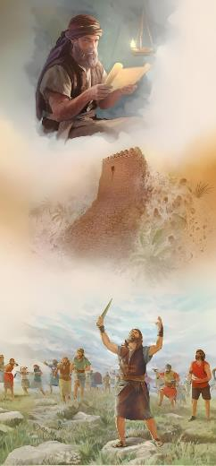
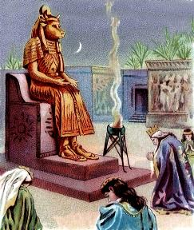

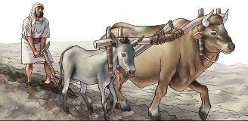
THE REWARD FOR FAITHFULNESS
“One of you routs a thousand, because the Lord your God fights for you, just as he promised.” (Joshua 23:10 NIV)
The reward for Israel's faithfulness would be complete and absolute victory over all their enemies (Josh. 23:6, 10).
In the context of the conquest of Canaan, faithfulness to God had to be manifested in three very specific ways:
Do not marry the inhabitants of the land
(Josh. 23:7a)
Do not mention the names of their gods
(Josh. 23:7b)
Not to worship their gods (Josh. 23:7c)
They had to maintain spiritual purity. If they married the inhabitants, they would begin to speak of their gods, and would end up worshipping them. Thus began Solomon's apostasy (1 Kings 11:4).
Therefore, we Christians are advised to follow the same recommendations, and not to marry unbelievers (2 Cor. 6:14-16).

Slide 7


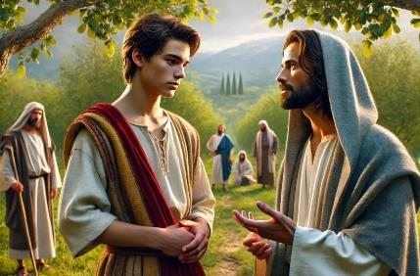
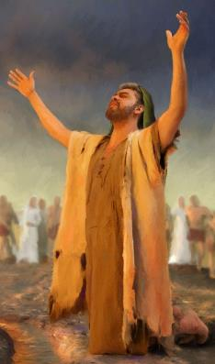
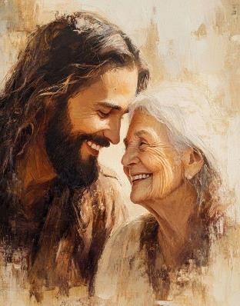
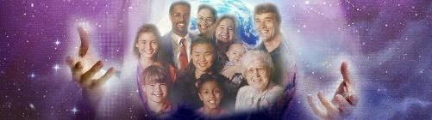
WHAT WE MUST DO
“So be very careful to love the Lord your God” (Joshua 23:11 NIV)
We can say without a doubt that the main point of Joshua's speech is found in verse 11: to love God.
Israel had to demonstrate their love by not loving other gods, which would result in serious harm to them (Josh. 23:12-13).
In addition, Joshua proposes an incentive to nurture that love: God's faithfulness (Josh. 23:14).
Today we have an even greater incentive: the example of Jesus (Jn. 13:34).
God desires to enter into an intimate and personal relationship with every person who responds to His love.
Consequently, His love for all constitutes the framework for the manifestation of our voluntary and mutual love.

Slide 8

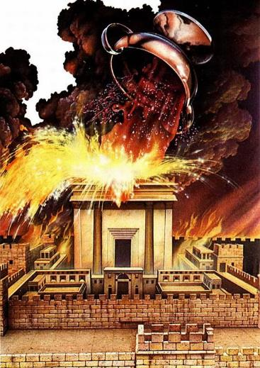
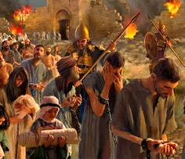
THE PUNISHMENT FOR UNFAITHFULNESS
“But just as all the good things the Lord your God has promised you have come to you, so he will bring on you all the evil things he has threatened, until the Lord your God has destroyed you from this good land he has given you.” (Joshua 23:15 NIV)
Joshua ends his speech with harsh words of warning about the consequences of disobedience: suffering the wrath of God (Josh. 23:15-16).
As well as in the Promised Land and was fully aware of the consequences of provoking Yahweh’s anger by flagrantly breaking the covenant.
The same love that led God to give his Son for us is the one that manifests itself in anger against those who stubbornly cling to sin (John 3:16; Romans 2:5).
Israel failed and suffered its punishment. We today have the opportunity to write a different story: to remain faithful and abide in His love (John 15:9).

Slide 9

“All your happiness, peace, joy, and success in this life are dependent upon genuine, trusting faith in God. This faith will prompt true obedience to the commandments of God. Your knowledge and faith in God is the strongest restraint from every evil practice, and the motive to all good.
Believe in Jesus as one who pardons your sins, one who wants you to be happy in the mansions He has gone to prepare for you. He wants you to live in His presence; to have eternal life and a crown of glory.”
EGW (Messages to Young People, p. 410)

