Slide 1
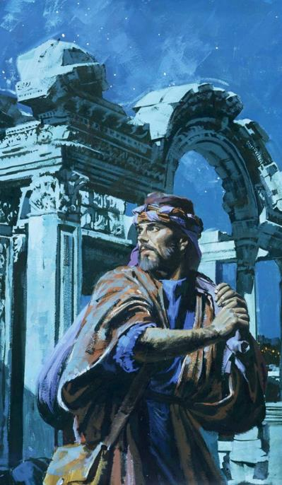
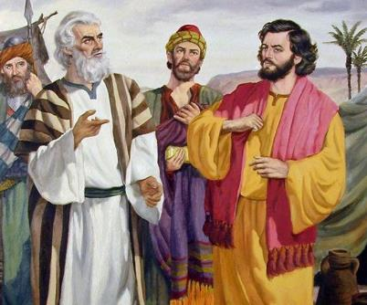
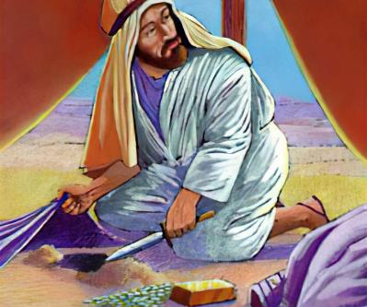
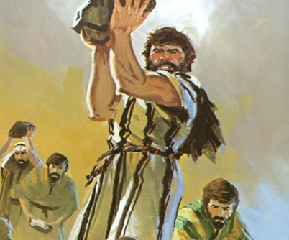
Lesson 6 for November 8, 2025
THE ENEMY WITHIN

Slide 2


“I the Lord search the heart and test the mind, to give every man according to his ways, according to the fruit of his deeds”
Jeremiah 17:10, ESV

Slide 3


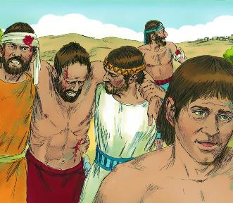
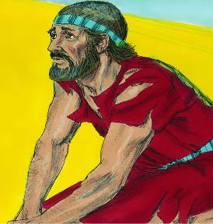





After an illogical military tactic, the walls of Jericho fell. Israel entered the city and razed it to the ground. Victory! Whose? God's, since Israel had little to do with it.
After a well-thought-out military tactic, Ai wins. Defeat! By whom? By the people of Israel, since they hadn't counted on God.
When they finally questioned God, the answer was resounding: Israel has sinned and can no longer defeat its enemies. How can it regain divine favor?
The cause of the defeat (Joshua 7:1-5, 10-13)
Dismayed and afflicted (Joshua 7:6-9)
Discovering the transgressor (Joshua 7:14-19)
Achan's sin (Joshua 7:20-26)
Victorious Again (Joshua 8:1-29)

Slide 4

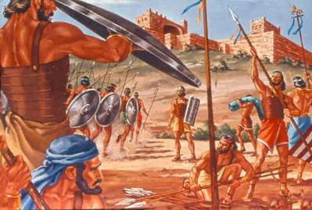
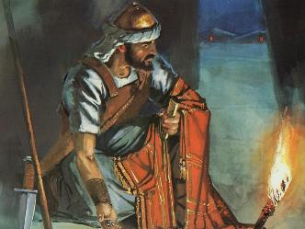
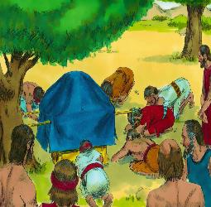
THE CAUSE OF THE DEFEAT
“Israel has sinned; they have violated my covenant, which I commanded them to keep. They have taken some of the devoted things; they have stolen, they have lied, they have put them with their own possessions” (Joshua 7:11)
After the favorable report from the spies sent to Jericho, Joshua consulted God and received from Him the strategy for taking the city.
If, after receiving the report from the spies sent to Ai, Joshua had done the same, the deaths of 36 people would have been avoided. (Joshua 7:1-5).
But what was the real reason for the defeat, or what would have been the reason for God to tell Joshua not to attack Ai (Josh. 7:11)?
God had seen that “Israel has sinned.” Nowhere in the Bible is sin described with such nuances: “they have violated… they have taken… they have stolen… they have lied… they have put them with their own possessions.”
Note the plural. The sin was committed by one man, but God held the entire people responsible. They had broken the covenant; sin had to be rooted out so it could be restored.

Slide 5

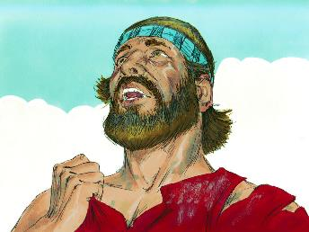
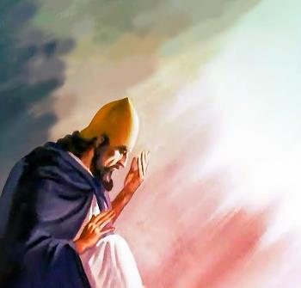
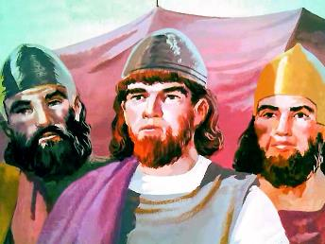
DISMAYED AND AFFLICTED
“And Joshua said, ‘Alas, Sovereign Lord, why did you ever bring this people across the Jordan to deliver us into the hands of the Amorites to destroy us? If only we had been content to stay on the other side of the Jordan!’ ” (Joshua 7:7)
Joshua and the elders were dismayed by the defeat at Ai, and they showed clear signs of mourning (Josh. 7:6).
Joshua then reacts with a tantrum similar to Israel’s repeated reaction during their 40 years of wandering: “Why did you bring us across…? If only we had been content to stay…!” (Josh. 7:7).
However, Joshua's spirit was not the same as that of the Israelites in the desert. His complaint was not motivated by disappointment, but by fear that God's name would be dishonored among the Gentiles (Josh. 7:8-9).
He clearly saw that God's character would be interpreted by unbelievers based on how His people acted. Today we continue to be God's testimony in the world. What a great responsibility!

Slide 6

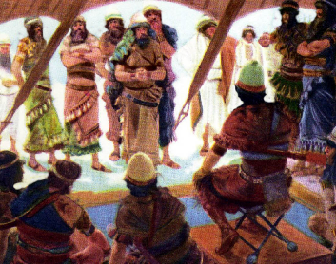
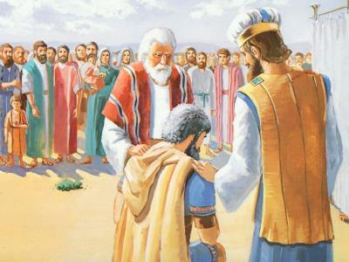
DISCOVERING THE TRANSGRESSOR
“In the morning, present yourselves tribe by tribe. The tribe the Lord chooses shall come forward clan by clan; the clan the Lord chooses shall come forward family by family; and the family the Lord chooses shall come forward man by man.” (Joshua 7:14)
To remove corporate sin (the guilt of the entire people), the sinner had to be eliminated (Josh. 7:15). Eliminated? Wouldn't he be forgiven if he repented? Of course he would! But Achan showed no sign of sincere repentance (and he had plenty of opportunities to do so).
The investigation process was announced and postponed until the next day (Josh. 7:14-15)
The tribe of Judah was taken (Josh. 7:16)
The family of Zerah was taken (Josh. 7:17a)
The leader Zabdi was taken (Josh. 7:17b)
Achan was taken (Josh. 7:18)
Achan fell silent
Achan fell silent
Achan fell silent
Achan fell silent
Achan fell silent
Reflecting divine kindness and love, Joshua asked Achan to confess his sin (Josh. 7:19).
Achan's case was lost. He confessed, but he didn't ask for forgiveness (Josh. 7:20). Yet God mourned over his hardness of heart, demonstrated in every call to repentance.

Slide 7

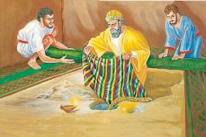

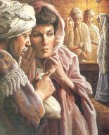
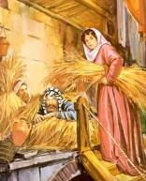
ACHAN'S SIN
“When I saw in the plunder a beautiful robe from Babylonia, two hundred shekels of silver and a bar of gold weighing fifty shekels, I coveted them and took them. They are hidden in the ground inside my tent, with the silver underneath” (Joshua 7:21 NIV)
Rahab
He hid the spies on the roof
He acted kindly toward Israel
Achan
He hid the loot in the ground
It brought trouble to Israel
He favored victory because of his faith
He caused defeat by his works
He made a covenant with Israel
He broke the covenant of Israel
He freed his life and that of his family
He died with his family
Joshua asked Achan to give glory to God and confess his sin (Josh. 7:19). It was his last chance. If, when he confessed, he had asked for forgiveness… But he didn't, and there was no forgiveness for him (Num. 15:30-31).
Like Eve, Achan “saw,” “desired,” and “took,” and his sin affected many (Gen. 3:6). Like Ananias and Sapphira, Achan took some of the accursed things dedicated to God and paid for them (Acts 5:1-2).
The decisions Achan made in Jericho were diametrically opposed to those of Rahab:

Slide 8

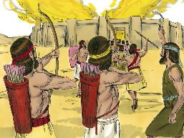
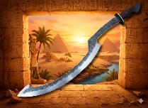
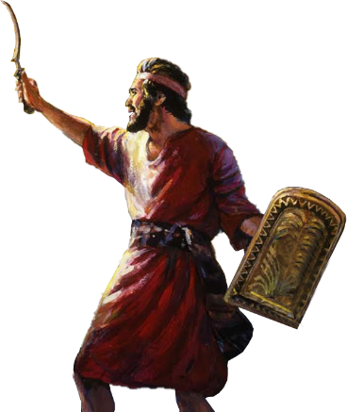
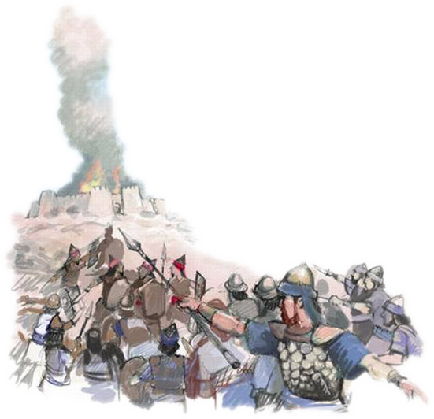
VICTORIOUS AGAIN
“Then the Lord said to Joshua, ‘Do not be afraid; do not be discouraged. Take the whole army with you, and go up and attack Ai. For I have delivered into your hands the king of Ai, his people, his city and his land.’ ” (Joshua 8:1)
As in Jericho, God provided Joshua with the strategy to gain victory over Ai (Josh. 8:1-2).
During the night, an ambush was set up behind the city. At dawn, the army approached Ai and pretended to flee before them again.
As Moses raised his staff until he had victory over the Amalekites, at God's command, Joshua raised his “weapon” (probably a sickle sword used by the Egyptians), and kept it raised until he had complete victory (Josh. 8:18-22, 26).
God was once again giving victory to his people. The Valley of Achor, where Achan and his family were executed, opened the door to victory, a “door of hope” (Hosea 2:15).
When we accept divine forgiveness by faith, God buries our sin in Achor, and opens the door to hope.

Slide 9

“The influence most to be feared by the church is not that of open opposers, infidels, and blasphemers, but of inconsistent professors of Christ. These are the ones who keep back the blessing of the God of Israel and bring weakness upon the church, a reproach that is not easily wiped away…
Christianity is not to be merely paraded on the Sabbath and displayed in the sanctuary; it is for every day in the week and for every place. Its claims must be recognized and obeyed in the workshop, at home, and in business transactions with brethren and with the world…”
EGW (Conflict and Courage, April 23)

