Slide 1
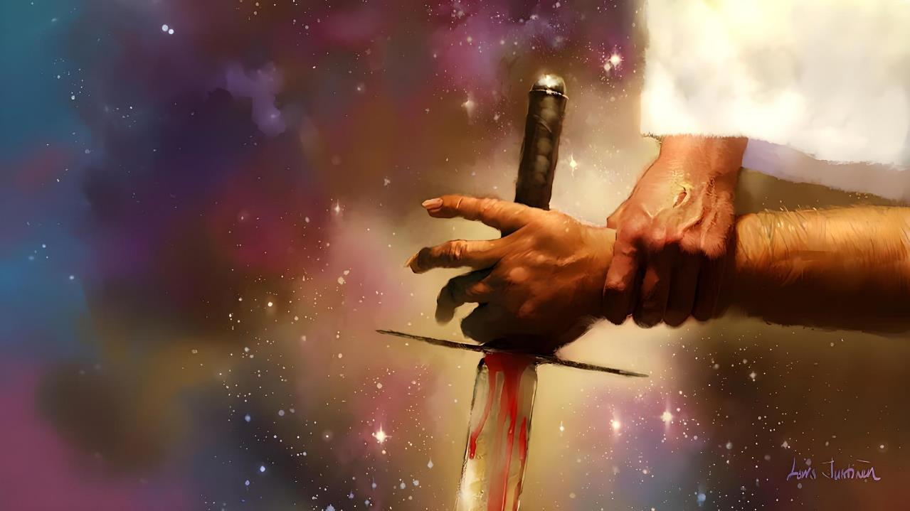
THE CONFLICT BEHIND ALL CONFLICTS
Lesson 4 for October 25, 2025

Slide 2
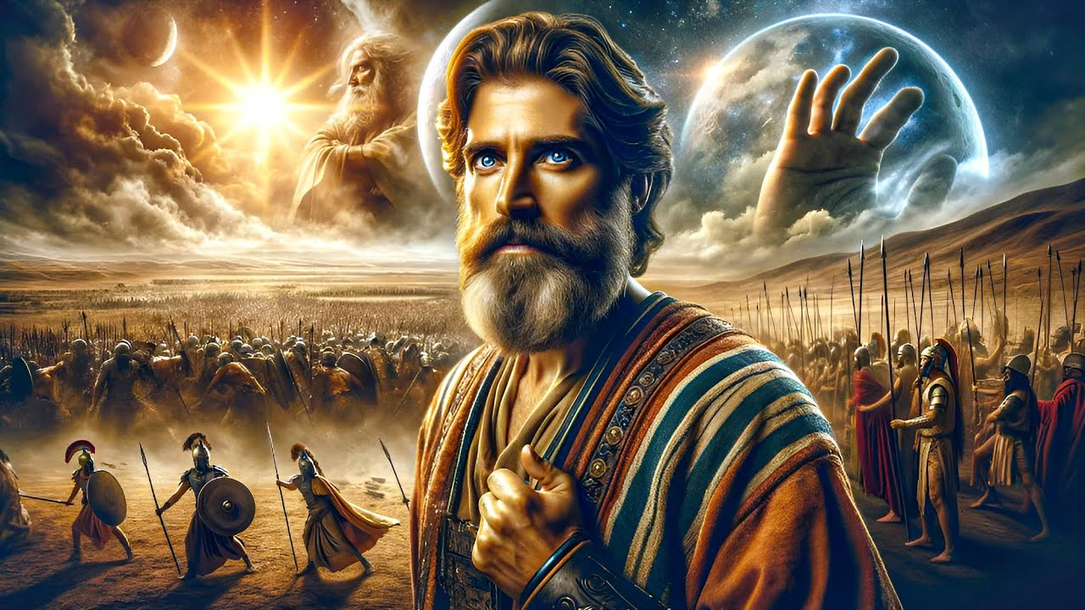
“There has been no day like it before or since, when the Lord heeded the voice of a man, for the Lord fought for Israel”
Joshua 10:14, ESV

Slide 3

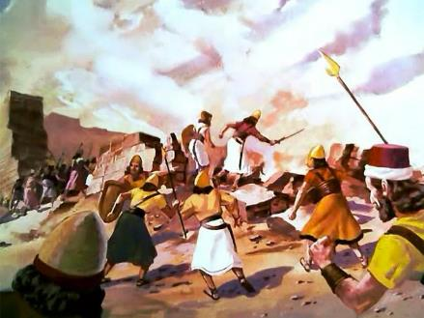
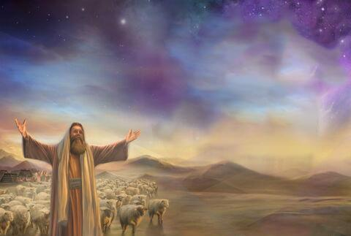
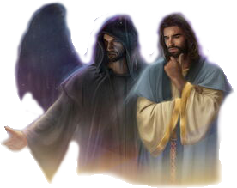
The conquest of Canaan was a war of extermination ordered by God. But if God is love, why did he order such a massacre?
To get a glimpse into the reasons for these events, we need to zoom in.
We must broaden our vision beyond the visible, until we can observe the conflict that lies behind all conflicts (including the conquest of Canaan): the great conflict between Christ and Satan, between good and evil.
The parties in conflict:
The Prince of God's army.
The prince of the army of evil.
The most powerful warrior.
The strategies of conflict:
God fighting for us.
We fighting for God.

Slide 4

THE PARTIES IN CONFLICT

Slide 5


THE PRINCE OF GOD'S ARMY
“Neither,” he replied, “but as commander of the army of the Lord I have now come.” Then Joshua fell facedown to the ground in reverence, and asked him, “What message does my Lord have for his servant?” (Joshua 5:14)
As Joshua prayed near Jericho seeking divine direction to take the city, a warrior with his sword drawn stood before him (Josh. 5:13).
When questioned by Joshua, this man denied his affiliation with any earthly army. He was the Commander of God's army (Josh. 5:14).
By demanding worship, he showed that he was God himself, in the person of Jesus—known as Michael in the book of Daniel (Josh. 5:15; Dan. 12:1).
The prayer had been answered. To Joshua's relief, God himself took command of the operation. As Israel's visible commander, Joshua was to follow only the orders of the true commander-in-chief: God.

Slide 6

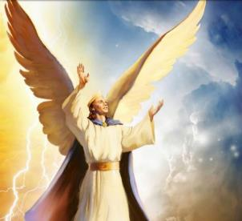
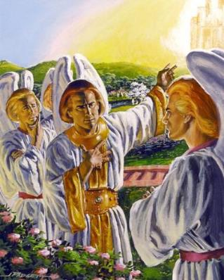
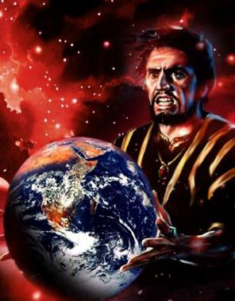
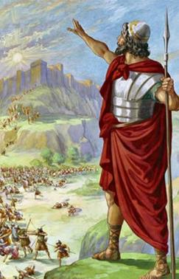
THE PRINCE OF THE ARMY OF EVIL
“How you have fallen from heaven, morning star, son of the dawn! You have been cast down to the earth, you who once laid low the nations!” (Isaiah 14:12)
We can say that he invented war. He was born a prince; a cherub of the highest rank; at the very side of God; walking on burning coals; precious; perfect… (Ezek. 28:12-15).
Endowed with free will – like all intelligent beings created by God – Lucifer decided to rebel and usurp God's throne (Is. 14:12-14).
Although his rebellion failed, the universe has been engulfed in war ever since. Having taken over the Earth, Satan and his angels have a single purpose: to thwart God's plans to save the human race.
The conquest of Canaan was an important battle in this war.

Slide 7

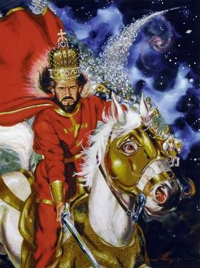
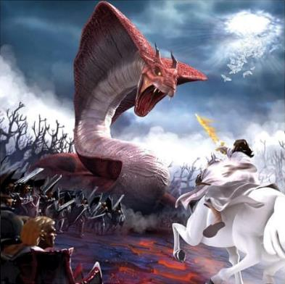
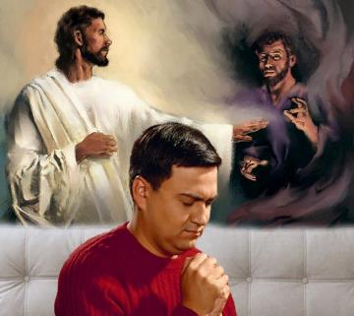
THE MOST POWERFUL WARRIOR
“The LORD is a warrior; the LORD is his name” (Exodus 15:3 NIV)
God himself is presented as a “man of war,” the most powerful warrior in battle. (Ex. 15:3; Ps. 24:8).
But God is not at war with human beings, but with the spiritual powers to which they cling. Therefore, the plagues are presented as a war against the gods of Egypt, that is, the demons (Ex. 12:12; Deut. 32:17).
God desires to eradicate evil from the Earth. Therefore, He expelled from Canaan those who had chosen to side with Satan, and granted the land to the people who had sided with Him.
Today the war continues, but not over territory. The fight is for each family, for each individual. There is no neutral ground. We are either with God or with the enemy.

Slide 8

THE STRATEGIES OF CONFLICT

Slide 9

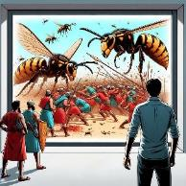
GOD FIGHTING FOR US
“The Lord will fight for you; you need only to be still” (Exodus 14:14)
He sank the Egyptian army in the Red Sea (Ex. 14:24-28)
He used hail against the Canaanites (Josh. 10:11)
He destroyed those who despised Elijah (2 Kings 1:9-10)
He sent bears against those who mocked Elisha (2 Kings 2:23-24)
He achieved peace by blinding the Syrian army (2 Kings 6:14-23)
He made the Ammonites and the Moabites fight each other (2Chr. 20:15-17, 22-24)
He killed 185,000 Assyrians in one night (2 Kings 19:35)
He sent a deadly disease to Herod (Acts 12:21-23)
God's original plan was to conquer Canaan by supernatural means, without Israel having to fight (Exod. 23:28). If it hadn't been for the people's unbelief, this would have happened.
The Bible records some examples of what God can do to deliver his people, without them having to take up any weapons against their enemies:

Slide 10

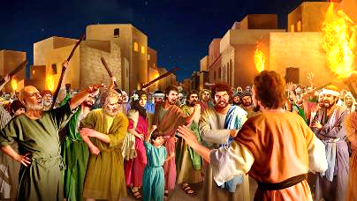
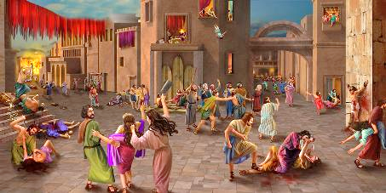

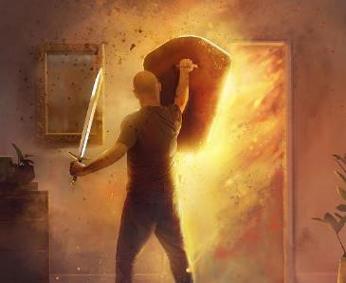
WE FIGHTING FOR GOD
“They devoted the city to the Lord and destroyed with the sword every living thing in it—men and women, young and old, cattle, sheep and donkeys” (Joshua 6:21)
As with the antediluvians, or with Sodom and Gomorrah, the Canaanites had overstepped the bounds of grace, and had enlisted themselves with Satan (Gen. 6:5; 18:20-21; 15:16).
They were all destined for the second death, eternal death. Prolonging their lives here would not change their final destiny. And God allowed Israel, on this occasion (the capture of Canaan), to take an active part in the slaughter.
Why not do it Himself, as He had planned? Because of their unbelief. Israel’s first taste of war was after declaring, “Is the LORD among us, or not?” (Exod. 17:7-9).
By taking an active part in the battle (physical for them, spiritual for us), we develop an unconditional trust in God's help.

Slide 11

“Battles are to be fought every day. A great warfare is going on over every soul, between the prince of darkness and the Prince of life.... As God’s agents you are to yield yourselves to Him, that He may plan and direct and fight the battle for you, with your cooperation. The Prince of life is at the head of His work. He is to be with you in your daily battle with self, that you may be true to principle; that passion, when warring for the mastery, may be subdued by the grace of Christ; that you come off more than conqueror through Him that hath loved us.”
EGW (Conflict and Courage, April 21)

