Slide 1

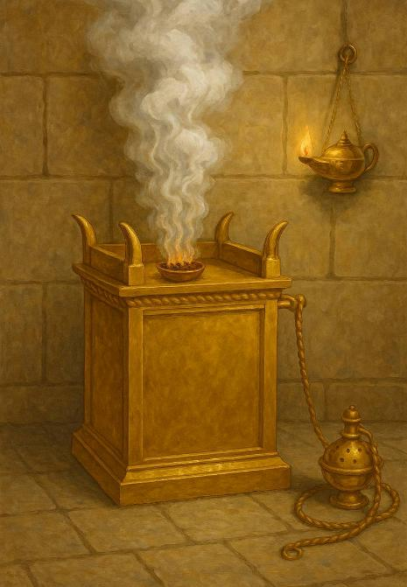
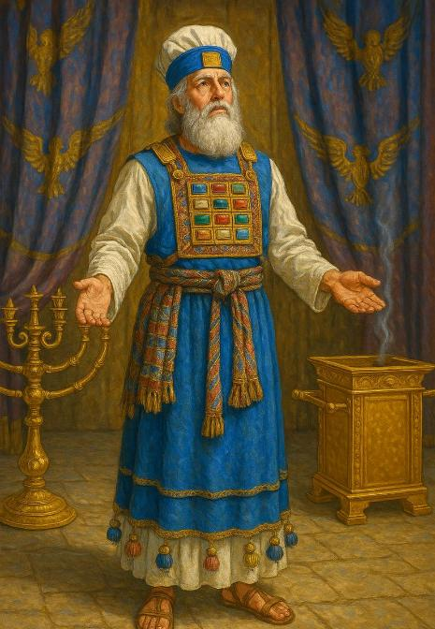
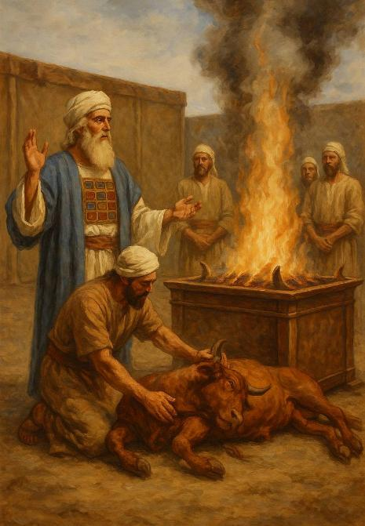
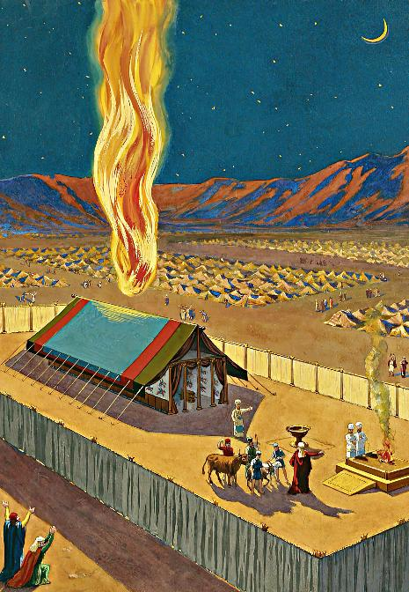
THE TABERNACLE
Lesson 13 for September 27, 2025

Slide 2
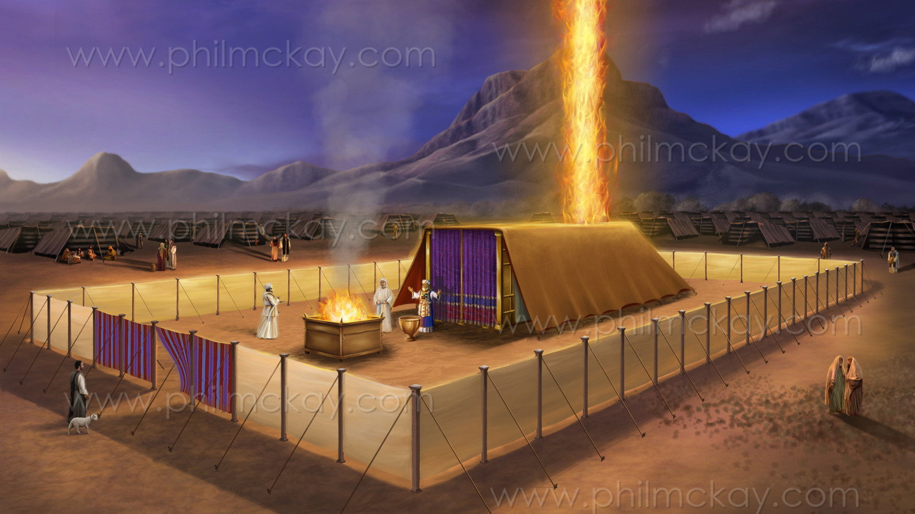
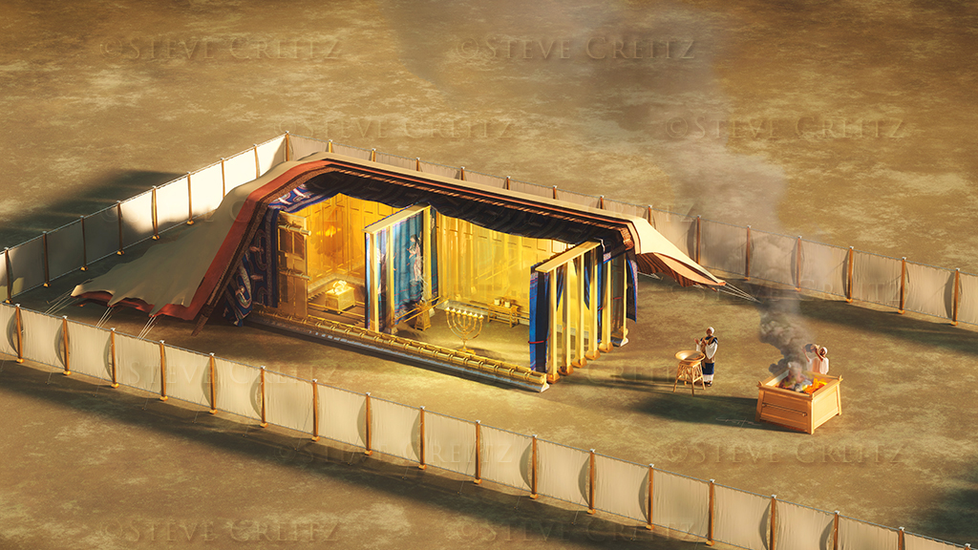
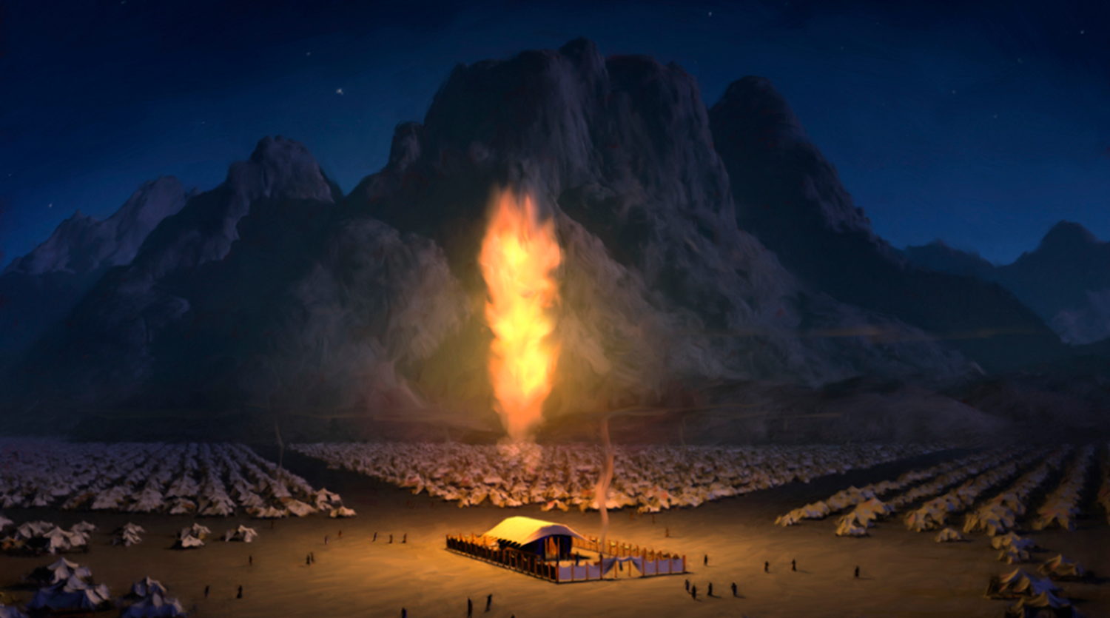
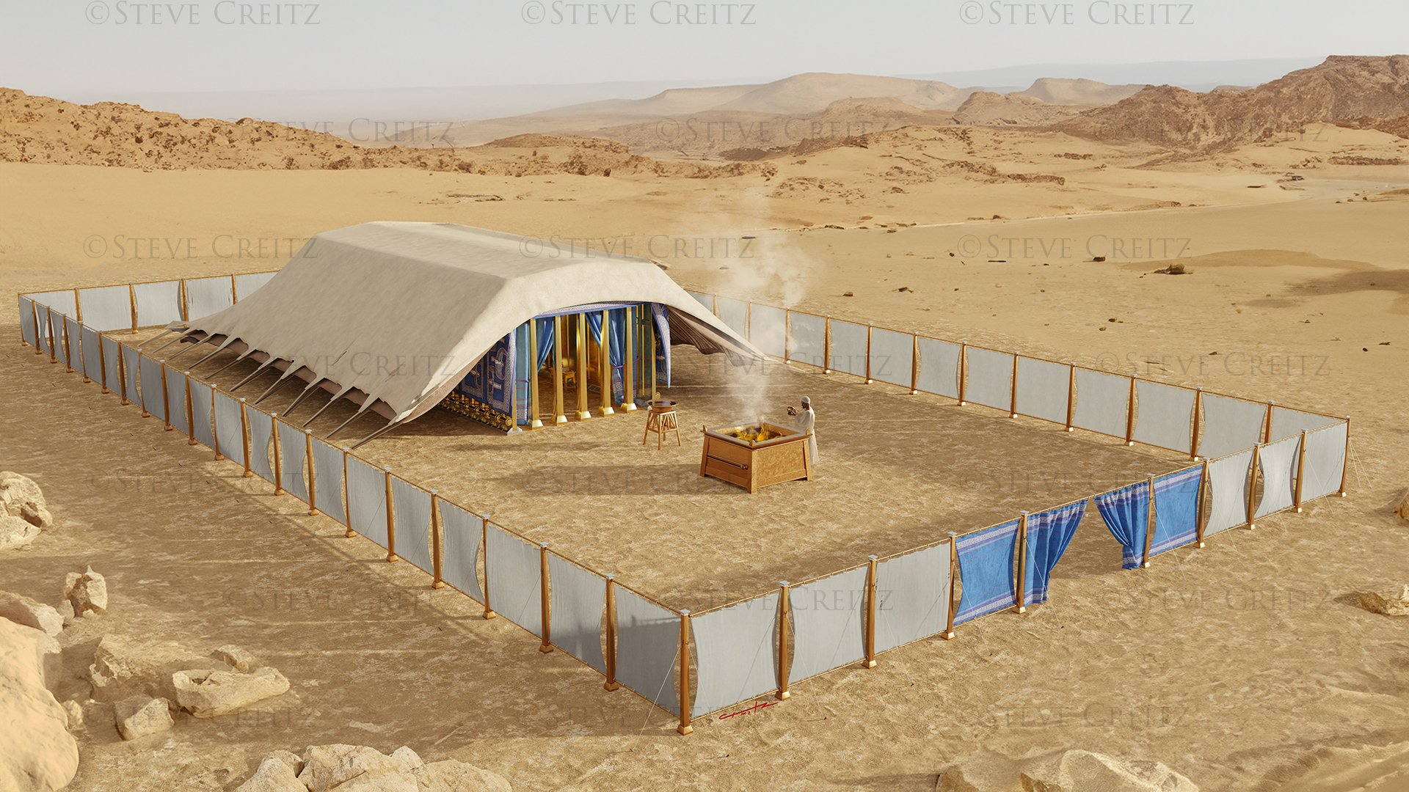
“Then the cloud covered the tabernacle of meeting, and the glory of the Lord filled the tabernacle. … For the cloud of the Lord was above the tabernacle by day, and fire was over it by night, in the sight of all the house of Israel, throughout all their journeys”
Exodus 40:34, 38, NKJV

Slide 3

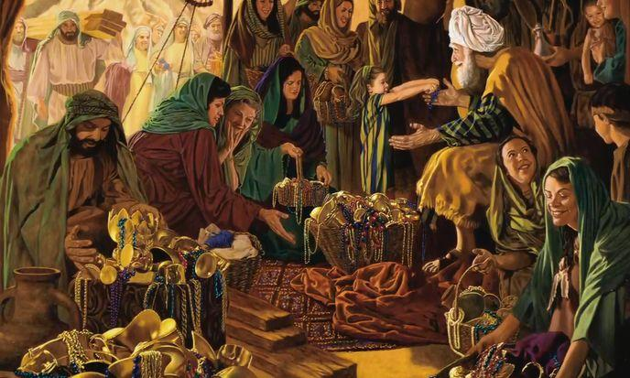

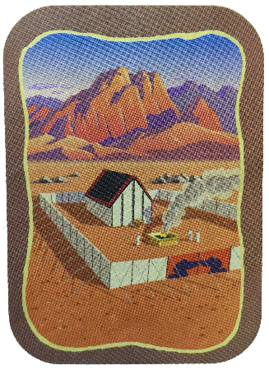
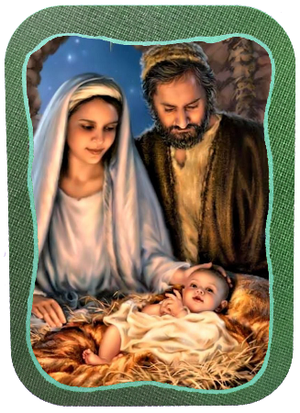
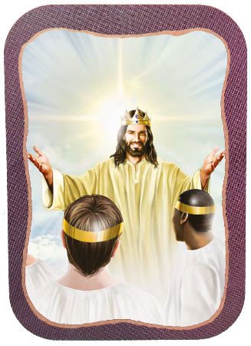







The last chapters of Exodus are devoted to the detailed description of the construction and dedication of the Tabernacle.
These were special moments, where the people participated joyfully, contributing—each as they could—to this great work for God.
The primary reason God gives for building this portable Temple is His desire to dwell among His people
(Ex. 25:8). This desire was fulfilled in the person of Jesus, and it will be fully realized when we are all with Him on the New Earth.
The preparation:
  The Sabbath (Exodus 35:1-3)
  The Freewill Offering (Exodus 35:4-36:7)
The Tabernacle:
  The Construction (Exodus 36:8-39:43)
  The Dedication (Exodus 40:1-38)
Other Tabernacles:
  Jesus and the New Jerusalem

Slide 4
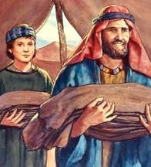
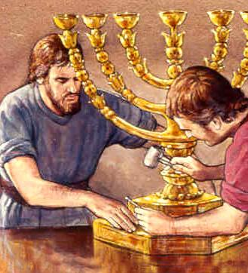
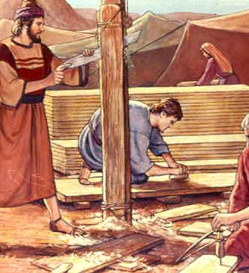
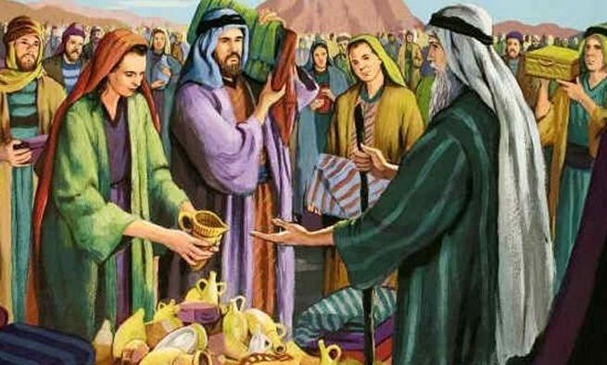
THE PREPARATION

Slide 5

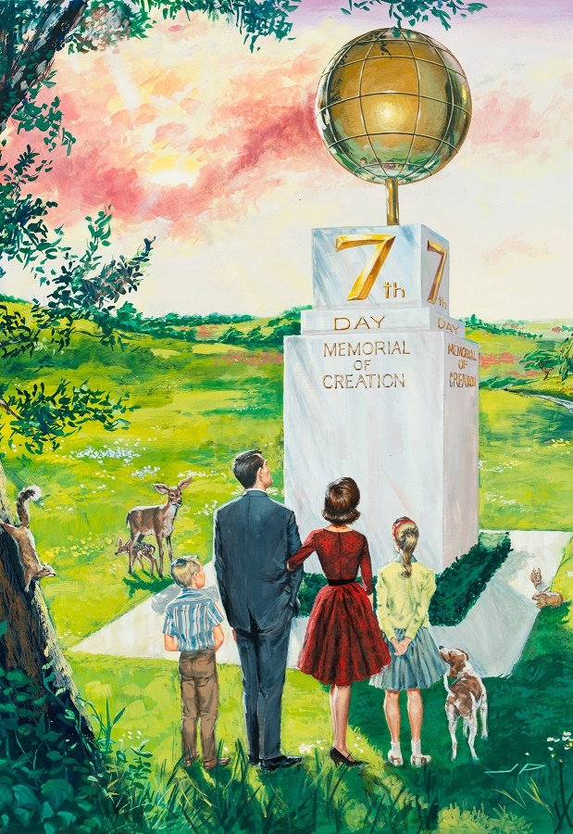
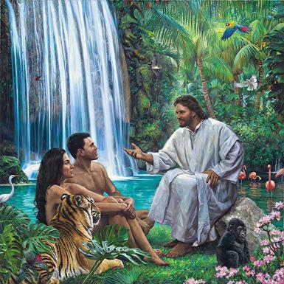
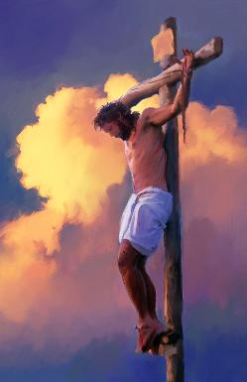
THE SABBATH
“For six days, work is to be done, but the seventh day shall be your holy day, a day of Sabbath rest to the Lord. Whoever does any work on it is to be put to death” (Exodus 35:2)
After having a glimpse of God’s glory, Moses conveyed to the people “what the Lord has commanded” (Ex. 35:1, 4). These instructions included their relationship with God in time (the Sabbath) and in space (the Tabernacle).
God set aside the Sabbath as a special time for us to enjoy His company at Creation itself (Gen. 2:1-3; Ex. 20:11), and He reminded Israel of this shortly before proclaiming the Ten Commandments (Ex. 16:22-29).
The Sabbath reminds us that God is our Creator and Redeemer
(Deut. 5:15), and takes us to the future time when we can enjoy His company for eternity (Isa. 66:22-23).

Slide 6

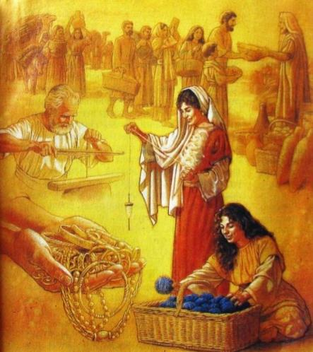
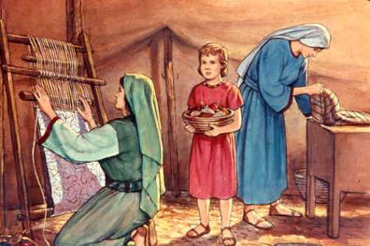
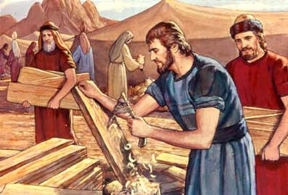
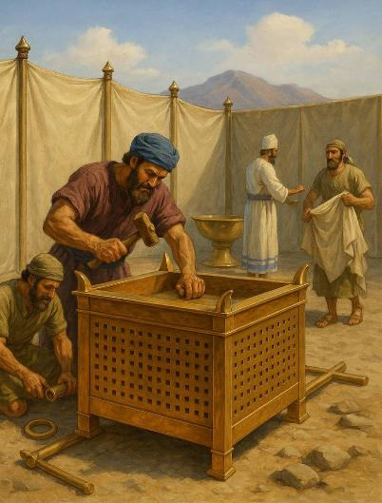
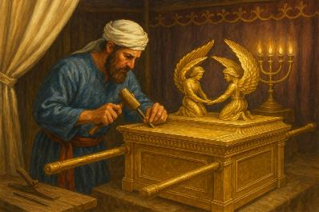
THE FREEWILL OFFERING
“From what you have, take an offering for the Lord. Everyone who is willing is to bring to the Lord an offering of gold, silver and bronze [ …] All who are skilled among you are to come and make everything the Lord has commanded” (Exodus 35:5,10)
There were two ways to contribute to the work of the Tabernacle: donating materials and performing labor.
More than a ton of gold, about 3.75 tons of silver, and about 2.5 tons of bronze were used, as well as wood and various fabrics (Ex. 38:21-31).
Where did all this come from? Much of it came from what Israel took from the Egyptians when they left (Ex. 11:2).
In addition, the work of spinners, seamstresses and tailors, carpenters, carvers, jewelers, etc. was needed.
Everyone was so willing to help that Bezaleel, Aholiab, and the other workers asked Moses to stop the people from bringing offerings (Ex. 36:3-7).
To accomplish this work, the Holy Spirit endowed all the workers involved with gifts (Ex. 35:30–36:2). Likewise, He continues to give the necessary gifts to all who collaborate in God's work.

Slide 7

“God has put men and women in possession of precious gifts. To different ones He has given different gifts. Not all have the same strength of character or the same depth of knowledge. But each one is to use his gifts in the Master’s service, however small this gift may seem to be. The faithful steward trades wisely on the goods entrusted to him.”
EGW (The Upward Look , December 31)

Slide 8
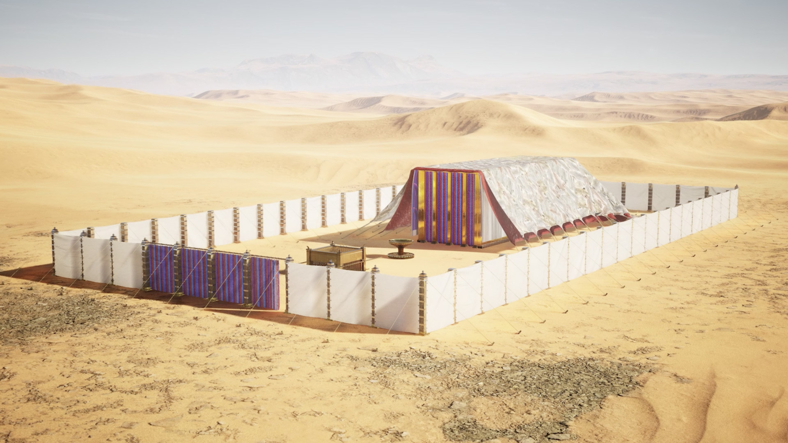
THE TABERNACLE

Slide 9

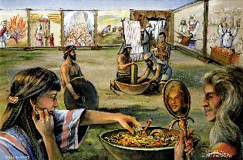
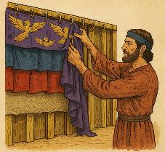
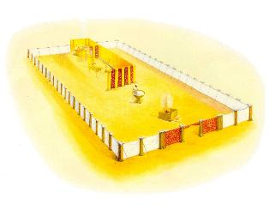
THE CONSTRUCTION
“Moses inspected the work and saw that they had done it just as the LORD had commanded. So Moses blessed them” (Exodus 39:43)
What elements were necessary for the Tabernacle of Meeting to fulfill its functions?
The Tabernacle (Holy and Most Holy Place)
The golden ark
The table of bread
The lampstand
The incense altar
The altar of burnt offering
The laver of bronze
The outer court
The ephod
The breast-pocket
The rest of the garments

Slide 10

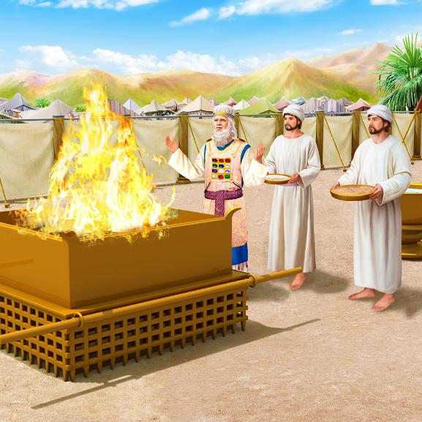
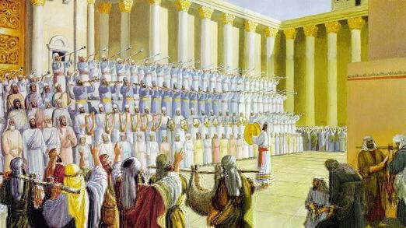
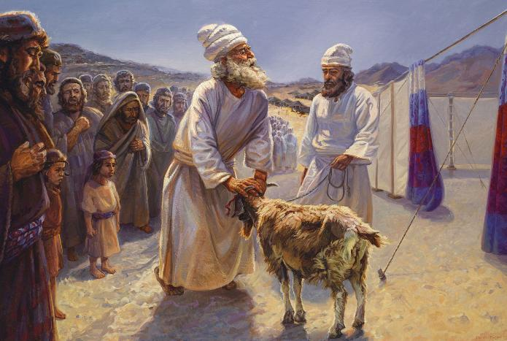
THE CONSTRUCTION
Once built, the Sanctuary (the Tabernacle and the courtyard) was home to two distinct services: the daily and the annual. Their various ceremonies, taken together, teach us that:
God hates sin
God saves the sinner
God will destroy the wicked
God assures us of a glorious future
Through the daily service, God showed the way in which He forgives, by grace, the sinner: with the death of an innocent animal, “the Lamb of God who takes away the sin of the world”. (Jn. 1:29).
With the annual service (the Day of Atonement), God showed how He will eradicate sin from the universe, showing the final solution to the problem of evil (Ps. 73:17).
The Sanctuary was also the place to worship God, praise him and express gratitude to him.

Slide 11

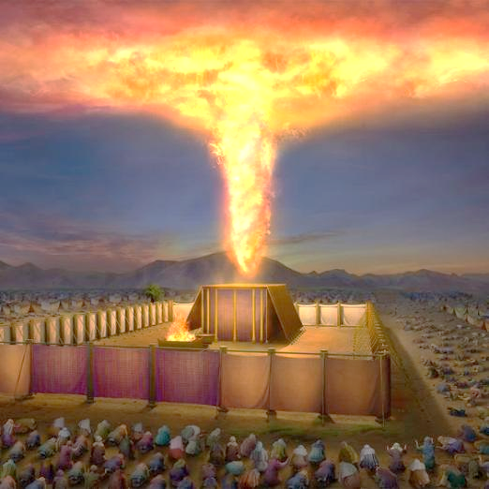
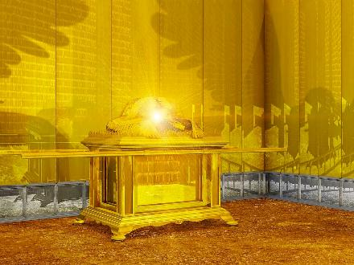
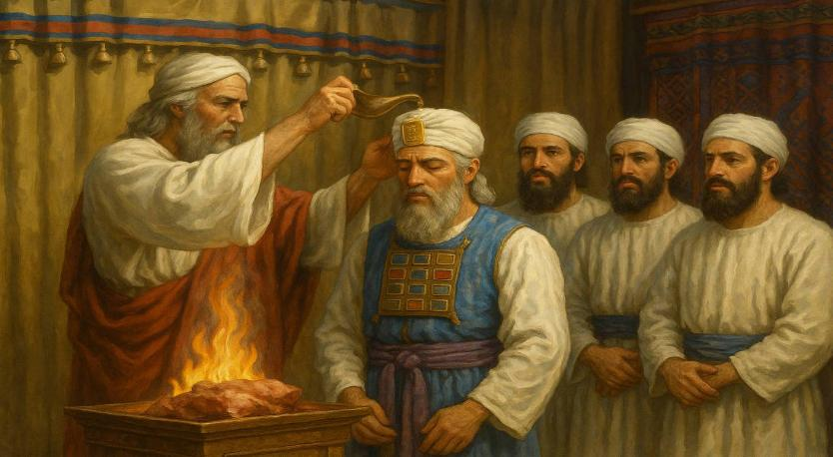
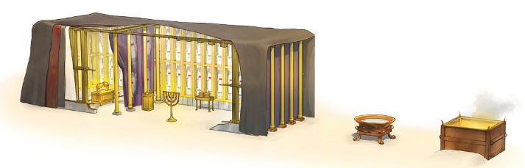
THE DEDICATION
“Then the cloud covered the tent of meeting, and the glory of the Lord filled the tabernacle” (Exodus 40:34)
The book of Exodus ends with the dedication of the Sanctuary and its priests. The protagonist of this chapter is undoubtedly God, who fills everything with his glorious presence (Ex. 40:34). This Presence continued to accompany the Tabernacle in the cloud and in the Shekinah (the manifestation of divine glory between the cherubim of the ark).
After months of work, the sanctuary was erected on the first day of the first month of the second year after their departure from Egypt (Ex. 40:2, 17). Everything was arranged in order (ark, veil, table, chandelier, golden altar, bronze altar, laver), and consecrated (Ex. 40:9).
Finally, Aaron and his sons were dressed in their priestly garments, and anointed for their mission (Ex. 40:12-15).

Slide 12

EGW (Patriarchs and Prophets, p. 349)
“No language can describe the glory of the scene presented within the sanctuary—the gold-plated walls reflecting the light from the golden candlestick, the brilliant hues of the richly embroidered curtains with their shining angels, the table, and the altar of incense, glittering with gold; beyond the second veil the sacred ark, with its mystic cherubim, and above it the holy Shekinah, the visible manifestation of Jehovah’s presence; all but a dim reflection of the glories of the temple of God in heaven, the great center of the work for man’s redemption.”

Slide 13
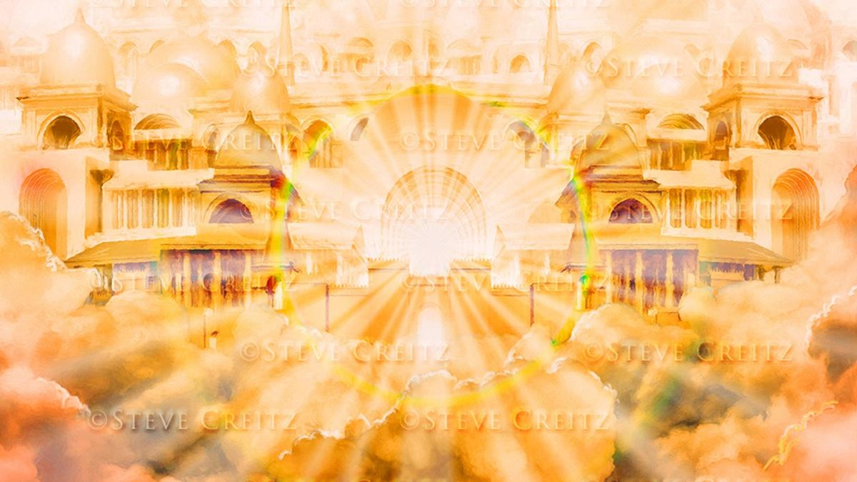
OTHER TABERNACLES

Slide 14
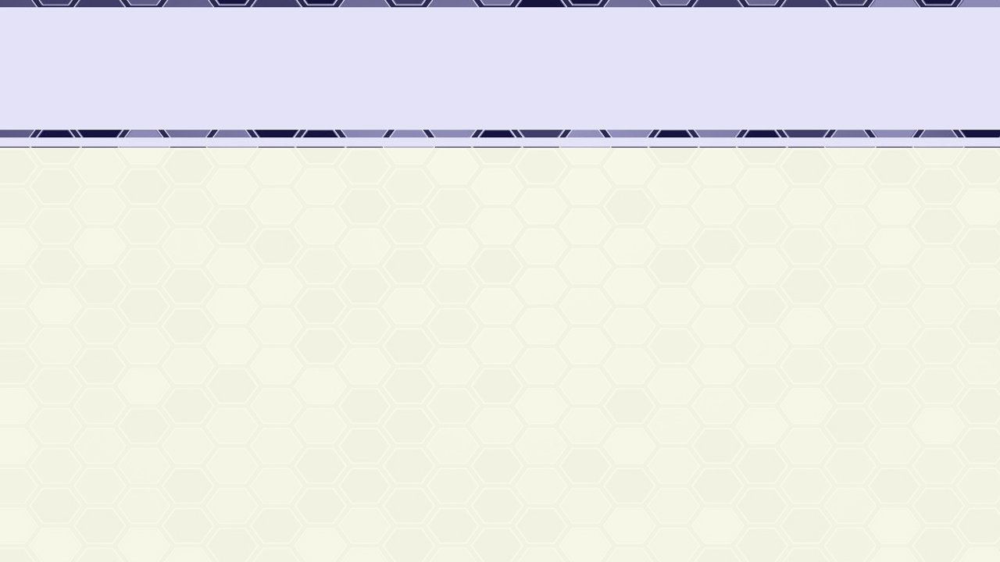
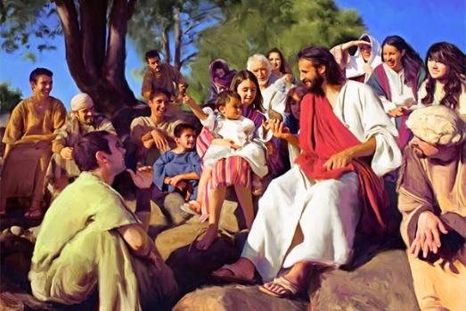
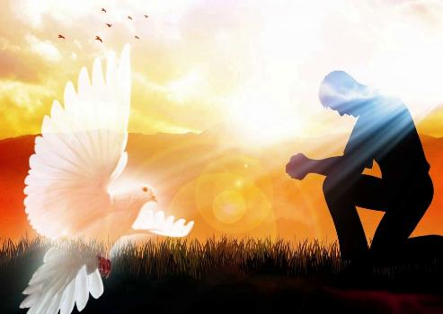
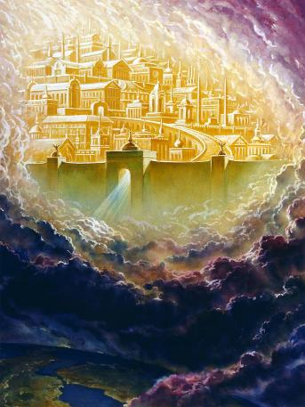
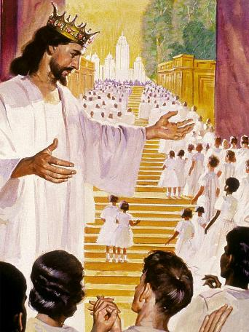
JESUS AND THE NEW JERUSALEM
“The Word became flesh and made his dwelling among us” (John 1:14a)
“And I heard a loud voice from the throne saying, “Look! God’s dwelling place is now among the people, and he will dwell with them. They will be his people, and God himself will be with them and be their God” (Revelation 21:3)
John 1:14 literally says that Jesus became flesh and “tabernacled” (was a tabernacle) among us. With his incarnation, Jesus, the eternal God, fulfilled his desire to physically dwell among us. He became Emmanuel, God with us (Mt. 1:23).
Through the Holy Spirit, God continues to dwell with us today (Mt. 18:20; 1Co. 3:16).
But the day will soon come when we will be able to stand face to face with our God, and dwell with Him, in the royal Tabernacle that He Himself has prepared for us: the New Jerusalem (Rev. 21:3).
This will occur when the Plan of Salvation is completed, and evil is completely eradicated.

Slide 15

EGW (The Desire of Ages, p. 23)
“God commanded Moses for Israel, "Let them make Me a sanctuary; that I may dwell among them" (Exodus 25:8), and He abode in the sanctuary, in the midst of His people. Through all their weary wandering in the desert, the symbol of His presence was with them. So Christ set up His tabernacle in the midst of our human encampment. He pitched His tent by the side of the tents of men, that He might dwell among us, and make us familiar with His divine character and life.”

