Slide 1
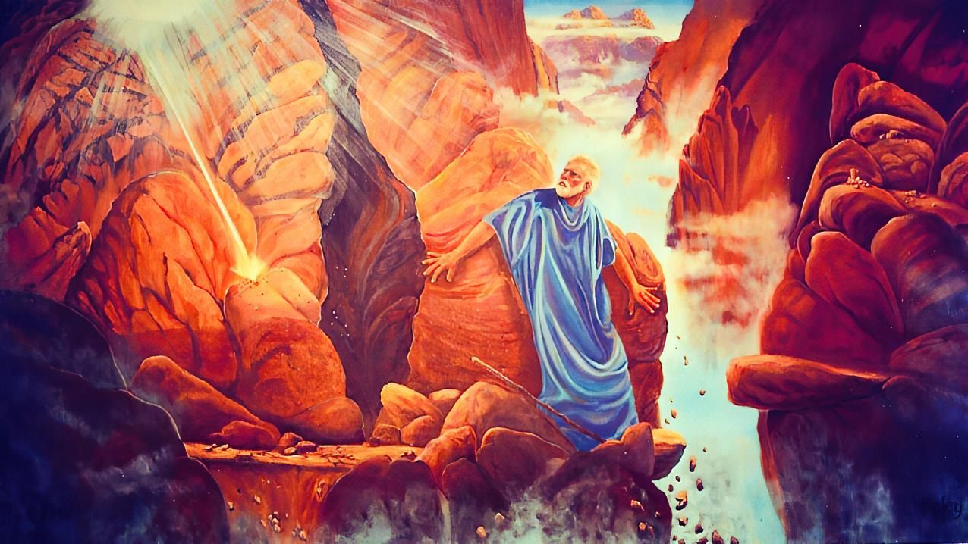
“PLEASE, SHOW ME YOUR GLORY”
Lesson 12 for September 20, 2025

Slide 2
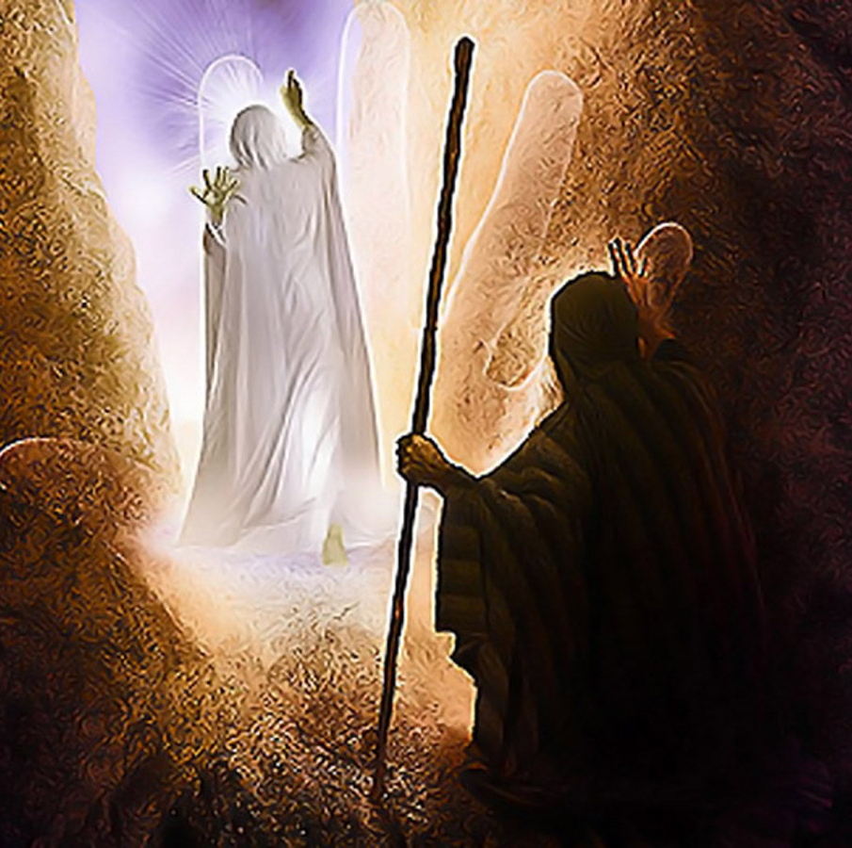
“And the Lord passed before him and proclaimed, ‘The Lord, the Lord God, merciful and gracious, longsuffering, and abounding in goodness and truth, keeping mercy for thousands, forgiving iniquity and transgression and sin, by no means clearing the guilty, visiting the iniquity of the fathers upon the children and the children’s children to the third and the fourth generation’ ”
Exodus 34:6, 7, NKJV

Slide 3

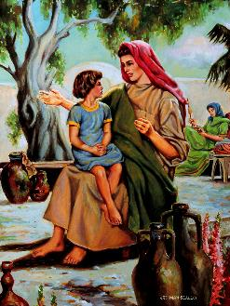
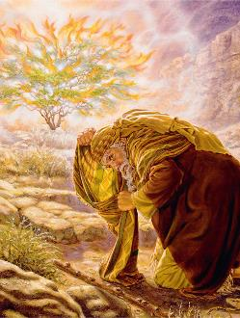

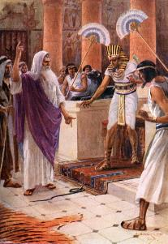
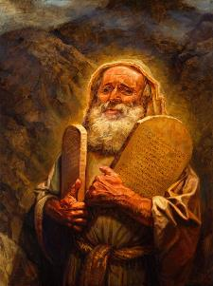

There's no doubt about it. God and Moses became close friends.
This didn't happen overnight. It was a slow process. It began in his early years, when his mother spoke to him about the wonderful God they served.
Their friendship was strengthened during the various encounters they had on Mount Sinai, and continued to grow until the day God called Moses to rest.
Chapters 33 and 34 of Exodus record a special moment in this intense relationship: Moses' request to see the glory of God.
God and Moses:
  Meeting with God (Exodus 33:7-11)
  Getting to Know God Better (Exodus 33:12-17)
The glory of God:
  The desire to know the glory of God (Exodus 33:18-23)
  The vision of the glory of God (Exodus 34:1-28)
  The result of seeing the glory of God (Exodus 34:29-35)

Slide 4

GOD
AND
MOSES

Slide 5

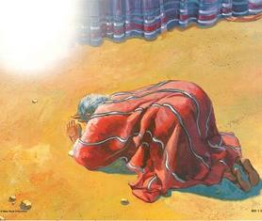
MEETING WITH GOD
The relationship between God and Moses gradually intensified
God called him from the burning bush
Moses saw how God defeated the Egyptian gods
He witnessed the parting of the Red Sea to free Israel
He watched as God led Israel to Sinai
They spent 40 full days together on the mountain
Their relationship continued to grow every day more
God inspired Moses to write Job and Genesis
“And whenever Moses entered the tabernacle, the pillar of cloud came down and stood at the door of the tabernacle, and the LORD spoke with Moses” (Exodus 33:9)
Moses met with God in the tabernacle, where he spoke with Him face to face (Ex. 33:7-11).
A clarification: the expression “face to face” did not imply that they saw each other physically, but rather that they had a fluid dialogue (although Moses never saw God’s face).
Moses became a faithful servant of God (Heb. 3:5), an inextinguishable beacon in the darkness, and an exemplary prophet.

Slide 6


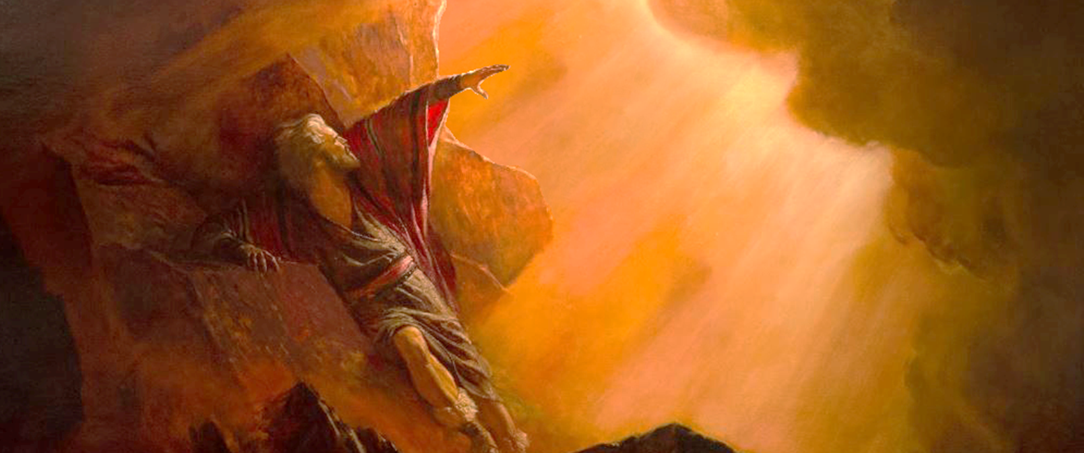
GETTING TO KNOW GOD BETTER
“If you are pleased with me, teach me your ways so I may know you and continue to find favor with you. Remember that this nation is your people.” (Exodus 33:13)
When God told Moses that He would not accompany the people to Canaan (Ex. 33:1-3), an interesting conversation ensued (Ex. 33:12-17 NIV):
God
Moses
God
Moses
Moses
God
You are my friend and you have my favor
If it is really so, teach me your way, that I may know you
My Presence will go with you, and I will give you rest
If your Presence does not go with us, do not send us up from here
If you don't come with us, how will anyone know that you are pleased with me?
Okay, I'll do what you ask, because you have my favor and I consider you my friend.
Moses had spent 40 days with God, receiving the Ten Commandments and instructions for building the sanctuary. Now he was once again before God, interceding for the people. He seemed to know God quite well, for he spoke to Him very familiarly. In what sense, then, did he need to know Him (Ex. 33:13)? In what sense do you also need to know Him?

Slide 7

THE GLORY
OF GOD

Slide 8


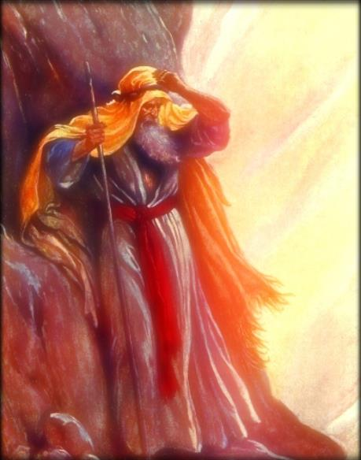
THE DESIRE TO KNOW THE GLORY OF GOD
“Then Moses said, ‘Now show me your glory.’ ” (Exodus 33:18)
Moses asked: Show me your glory (Ex. 33:18)
God answered: I will show you my goodness (Ex. 33:19)
The glory of God is his goodness, that is, his character
What God showed him was his character (Ex. 34:6-7)
Ellen G. White adds that God's glory consists in empowering his children; embracing repentant sinners; and providing everything necessary for their transformation.
Thus, our “glory” is to reflect the character of God in our lives (2 Cor. 1:12; 3:18).
When we look at the Cross, we have the greatest revelation of God's glory, his goodness, and his character.

Slide 9

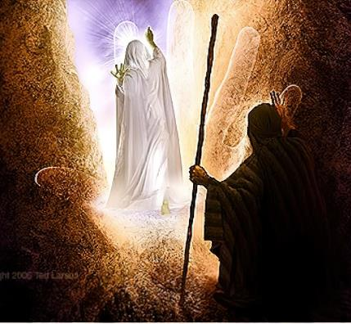
THE VISION OF THE GLORY OF GOD
“And he passed in front of Moses, proclaiming, ‘THE LORD, THE LORD, the compassionate and gracious God, slow to anger, abounding in love and faithfulness’ ” (Exodus 34:6 NIV)
God showed his glory to Moses on the seventh occasion he ascended Mount Sinai. At what times and for what purpose did Moses present himself before God?
1
2
3
4
5
6
7
To receive the bases of the covenant (Ex. 19:3-7)
To give the people's response and receive instructions on the theophany at Sinai (Ex. 19:8-14)
To receive new instructions (Ex. 19:20-25)
To receive the complementary laws (Ex. 20:21; 24:3)
To receive the Ten Commandments written by the finger of God, and the pattern of the Sanctuary (Ex. 24:12, 18; 32:15)
To intercede for the sin of the golden calf (Ex. 32:30)
So that God could show him his glory, and receive new tablets with the Ten Commandments (Ex. 34:1-5)
The vision of God's glory proved to be a self-proclamation of God's character (Exod. 34:6-7). At this glimpse of God's love, Moses worshipped (Exodus 34:8; 1 John 4:19). Eventually, God reaffirmed his covenant with Israel and forgave the calf incident.

Slide 10

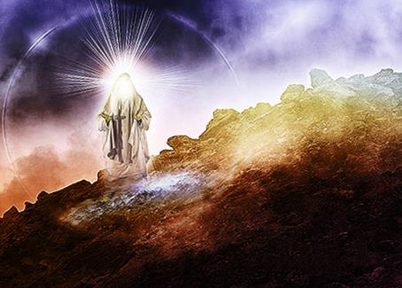
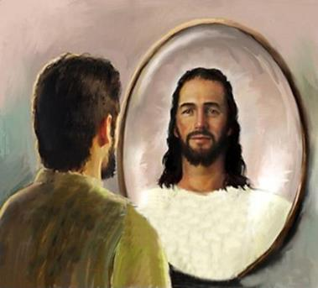
THE RESULT OF SEEING THE GLORY OF GOD
“When Moses came down from Mount Sinai with the two tablets of the covenant law in his hands, he was not aware that his face was radiant because he had spoken with the Lord.” (Exodus 34:29)
Moses had spoken with God “face to face” many times before, and until then, his face had never shone. What had changed this time? Notice, moreover, that the change persisted over the long term (Ex . 34:34-35).
Now Moses knew God much better. His friendship had reached maturity. He had contemplated God's glory, and had been transformed by that glory.
Echoing this episode, Paul invites us to imitate Moses and contemplate the glory of God to be transformed as he was
(2 Cor. 3:12-18).
Moses is a model that demonstrates what God can do for us when we allow him to transform our character and mold us into his divine image.

Slide 11

EGW (In Heavenly Places, August 22)
“Think you that God reproved Moses for his presumption? No, indeed. Moses did not make this request from idle curiosity. He had an object in view. He saw that in his own strength he could not do the work of God acceptably. He knew that if he could obtain a clear view of the glory of God, he would be enabled to go forward in his important mission, not in his own strength, but in the strength of the Lord God Almighty. His whole soul was drawn out after God; he longed to know more of Him, that he might feel the divine presence near in every emergency or perplexity. It was not selfishness that led Moses to ask for a sight of the glory of God. His only object was a desire better to honor his Maker”

