Slide 1
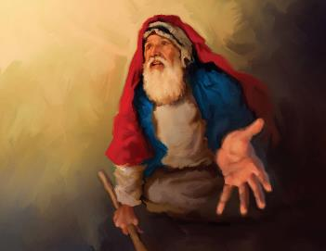
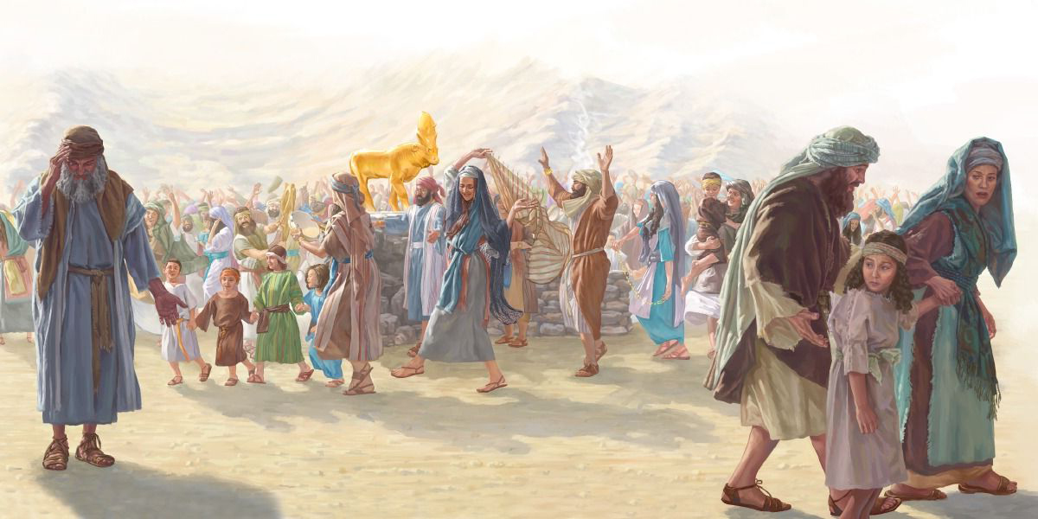
APOSTASY AND INTERCESSION
Lesson 11 for September 13, 2025

Slide 2
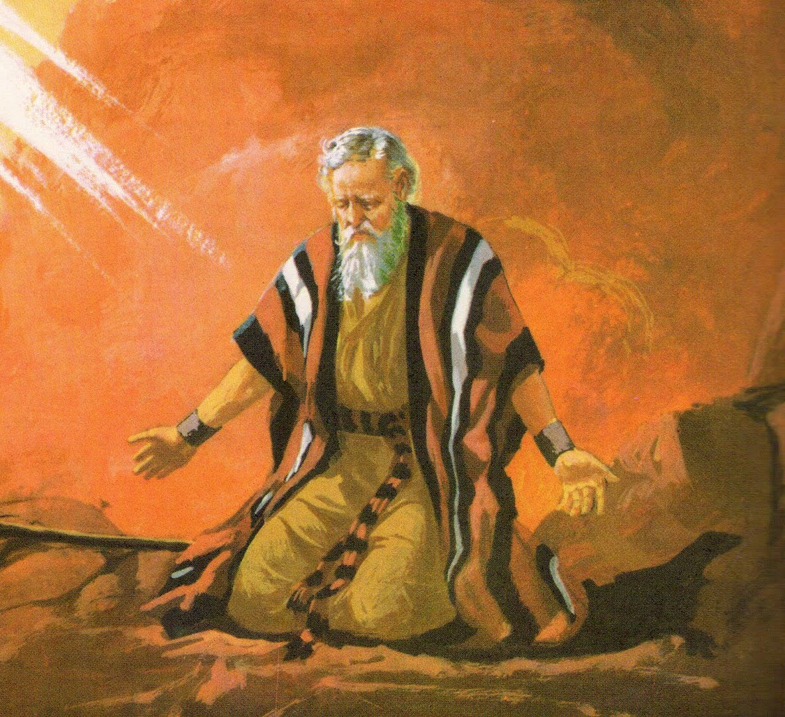
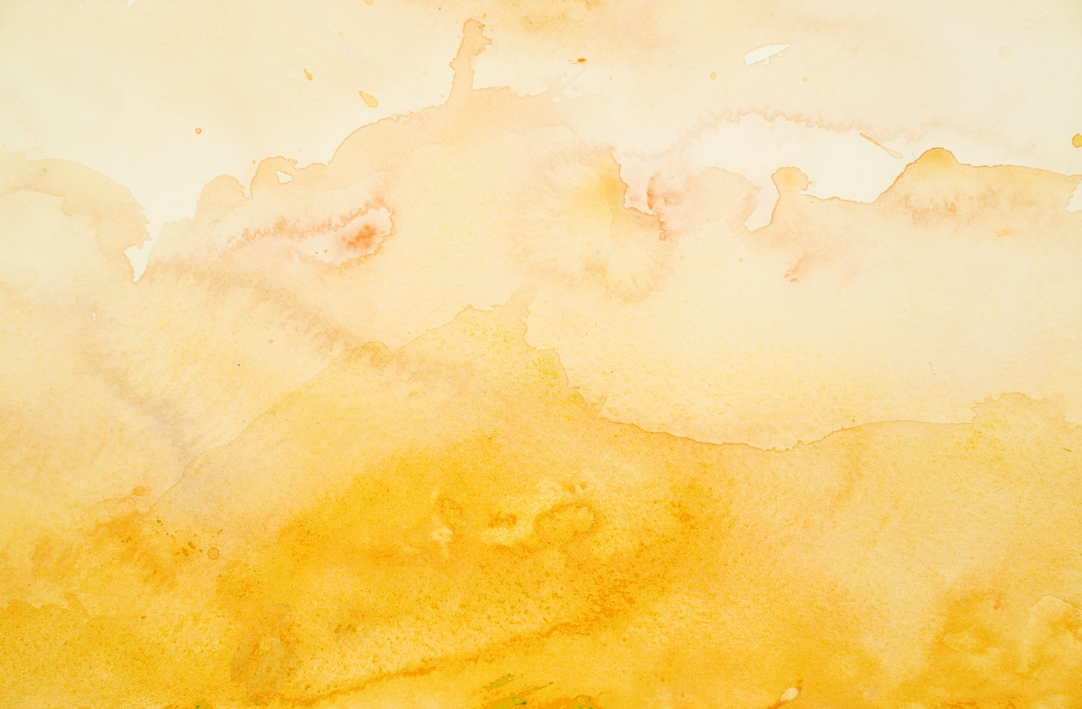
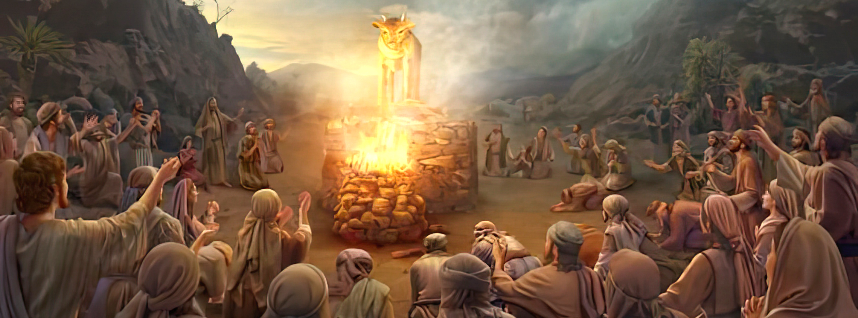
“Then Moses returned to the Lord and said, ‘Oh, these people have committed a great sin, and have made for themselves a god of gold! Yet now, if You will forgive their sin—but if not, I pray, blot me out of Your book which You have written’ ”
Exodus 32:31, 32, NKJV

Slide 3

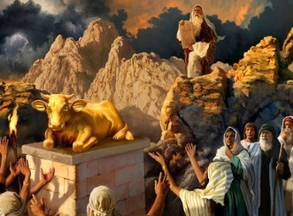
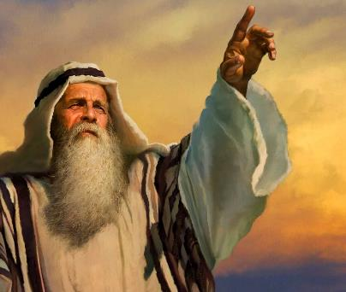


“They have been quick to turn away from what I commanded them” (Ex. 32:8 NIV).
Shortly after receiving the Ten Commandments, and being told again that they should not make idols (Ex. 20:23), Israel made a golden calf to worship.
In the face of this apostasy, God asked Moses for permission to destroy Israel and make it a new nation (Ex. 32:10). Despite the people's apostasy, Moses twice interceded before God to request the forgiveness they did not deserve.
Apostasy:
  Aaron's weakness (Exodus 32:1-5)
  The Feast of the Calf (Exodus 32:6)
  The corruption of idolatry (Exodus 32:7-8)
Intercession:
  “Turn from your fierce anger!” (Exodus 32:9-29)
  “Blot me out of the book you have written!” (Exodus 32:30-32)

Slide 4

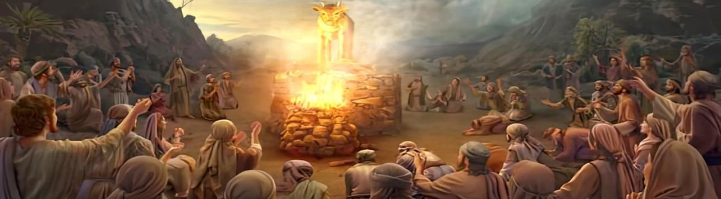
APOSTASY

Slide 5

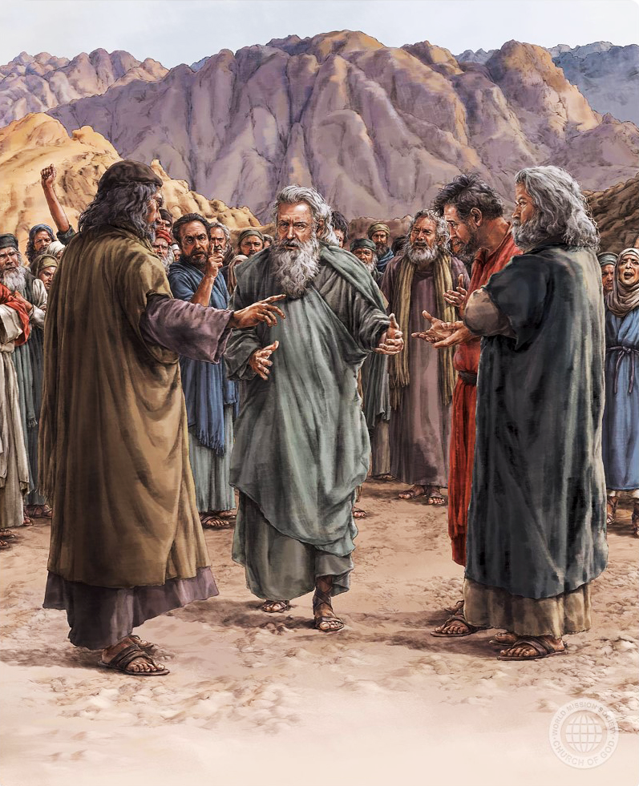
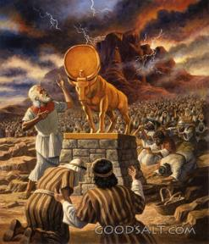
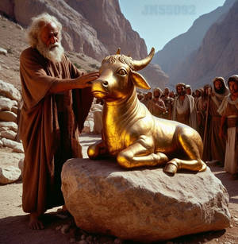
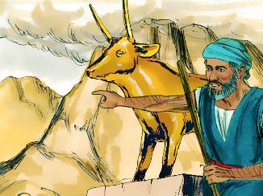
AARON'S WEAKNESS
“When Aaron saw this, he built an altar in front of the calf and announced, ‘Tomorrow there will be a festival to the Lord’ ” (Exodus 32:5)
Although the Hebrew word elohim is the plural of “god,” it is commonly used to refer to the one God: “I am Jehovah your God [elohim], who brought you out of the land of Egypt” (Ex. 20:2).
In Moses' absence, the people asked Aaron to make them a visible elohim whom they could worship.
(Ex. 32:1). They had soon forgotten the commandments they had received and their commitment to obey them (Ex. 24:7).
Aaron's initial hesitation in attempting to negotiate with the people (Ex. 32:2) led him to lead the apostasy rather than eradicate it.
Instead of reminding them of the prohibition against making idols, Aaron made them a golden calf, and declared, “This is your god [elohim] O Israel, who brought you up from the land of Egypt!” (Ex. 32:4 MEV).

Slide 6

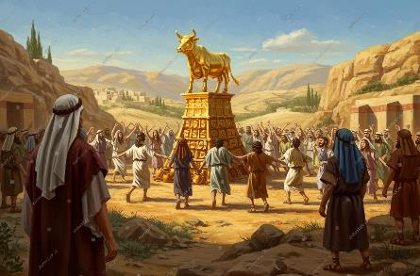
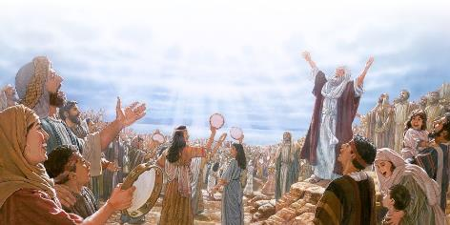
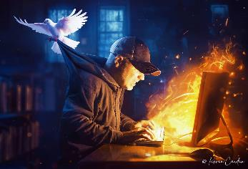
THE FEAST OF THE CALF
“So the next day the people rose early and sacrificed burnt offerings and presented fellowship offerings. Afterward they sat down to eat and drink and got up to indulge in revelry” (Exodus 32:6)
By making an idol in the shape of a calf, the Israelites reduced the Almighty God to the image of an animal, worshipping the creature instead of the Creator (Rom. 1:23).
They irrationally thought that a carved image would be capable of leading them. They may even have thought that elohim himself had become a calf! (Exod. 32:24)
In fact, they turned from worshipping God to worshipping demons (Deut. 32:17). While they were worshipping God, they grew morally, for they became like God.
By worshipping demons, they began to degrade themselves, for they resembled the demons they worshipped.
When we do not give our hearts to the Creator, but instead serve some other idol (and there are many), sooner or later it will lead us to moral degradation.

Slide 7

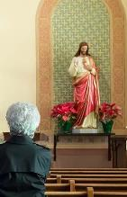
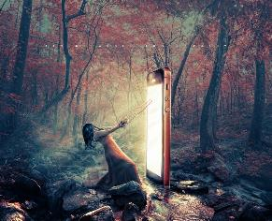

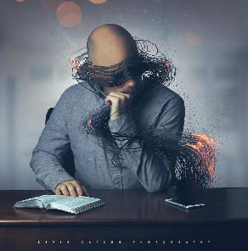
THE CORRUPTION OF IDOLATRY
“Then the Lord said to Moses, “Go down, because your people, whom you brought up out of Egypt, have become corrupt.’” (Exodus 32:7)
To bow down before an image (even if it represents God Himself, Christ, or His saints) is to disobey God's Law (Ex. 20:3-6) and, therefore, to enter into sin and corruption.
What is 21st-century idolatry? Idolatry is worshipping something that replaces God. An idol is anything that captures our imagination, affection, time, and mind more than God, and that enslaves our thinking.
What idols do we worship? You can make your own list. Some suggestions: pride, money, power, sex, food, work, social media…
What does worshiping these idols entail? Our personality, way of thinking, emotions, and even our social life are transformed. We exchange authentic relationships with God for hollow and meaningless interactions that cannot save us.

Slide 8

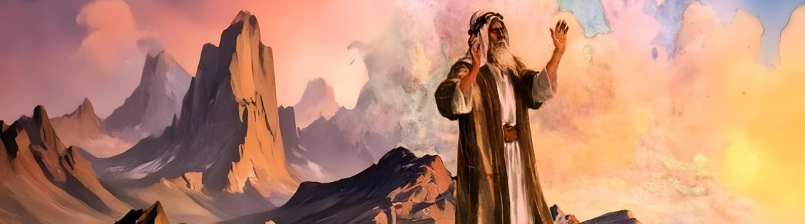
INTERCESSION

Slide 9

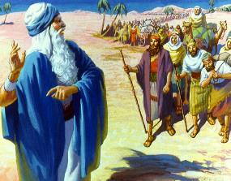
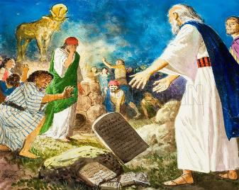
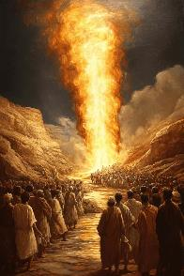
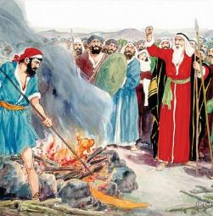
“TURN FROM YOUR FIERCE ANGER!”
“Why should the Egyptians say, ‘It was with evil intent that he brought them out, to kill them in the mountains and to wipe them off the face of the earth’? Turn from your fierce anger; relent and do not bring disaster on your people!’ ” (Exodus 32:12 NIV)
God told Moses that “Because YOUR people, whom YOU brought up out of Egypt, have become corrupt.” (Ex. 32:7).
Moses reacted appropriately: “They are not my people, but yours; it was not I who brought them out, but you” (Ex. 32:11). God was asking him to let him destroy Israel (Exod. 32:10), but Moses refused to grant such permission.
God’s wrath was just, but Moses knew that “mercy triumphs over judgment” (James 2:13). After interceding for Israel, and confident that God had appeased his anger, he (angry) descended from the mountain (Ex. 32:12-15). Seeing the apostasy, he broke the symbol of the covenant: the stone tablets (Ex. 32:19).
After listening to his brother's weak excuses, Moses acted decisively to stop the rampage (Ex. 32:20-28).

Slide 10

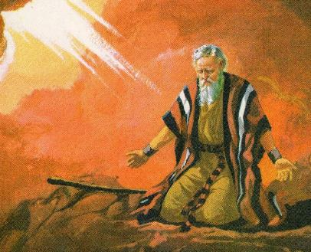
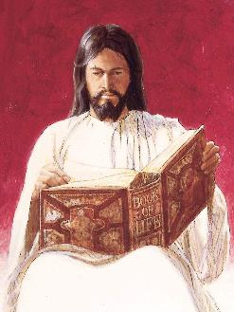
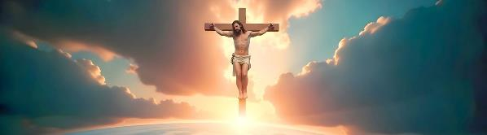
“BLOT ME OUT OF THE BOOK YOU HAVE WRITTEN!”
“But now, please forgive their sin—but if not, then blot me out of the book you have written!” (Exodus 32:32 NIV)
With his first intercession, Moses prevented the destruction of the people. But it was clear that God could no longer bless them after this sin. Therefore, he decided to make a second intercession (Ex. 32:30).
Moses was willing to lose his own salvation if the people were not forgiven (Ex. 32:31-32). However, this was not a normal forgiveness Moses was asking for, for he did not use the usual Hebrew word for "forgive." He asked that God "bear" the people's sin.
This implied that God would take sin upon himself and bear it, paying its price: death (Isa. 53:6;
Rom. 6:23). This is precisely what Jesus did on the cross. He took our sins upon himself so that he could die the death we deserved (1 Pet. 2:24).

Slide 11

EGW (Patriarchs and Prophets, p. 315)
“During this period of waiting, there was time for them to meditate upon the law of God which they had heard, and to prepare their hearts to receive the further revelations that He might make to them. They had none too much time for this work; and had they been thus seeking a clearer understanding of God’s requirements, and humbling their hearts before Him, they would have been shielded from temptation. But they did not do this, and they soon became careless, inattentive, and lawless. […]
Feeling their helplessness in the absence of their leader, they returned to their old superstitions. […] The people desired some image to represent God, and to go before them in the place of Moses.”

