Slide 1
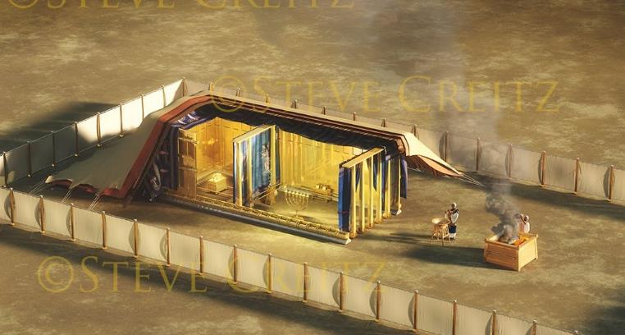
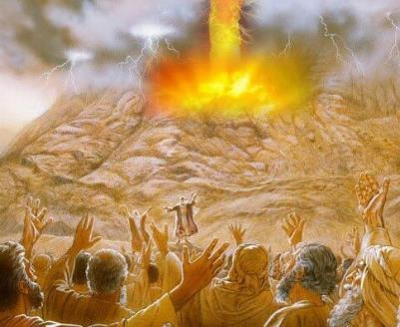
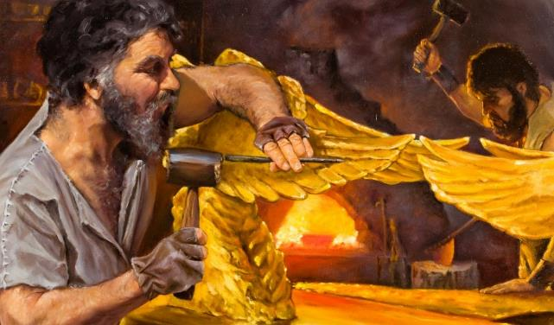
Lesson 10 for September 6, 2025
THE COVENANT AND THE BLUEPRINT

Slide 2
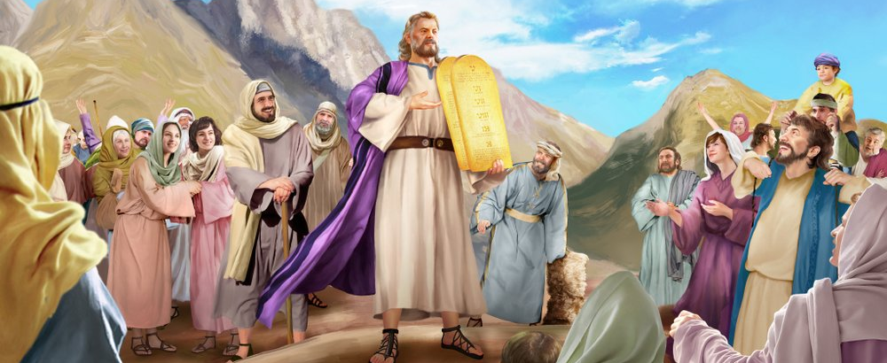
“So Moses came and told the people all the words of the Lord and all the judgments. And all the people answered with one voice and said, ‘All the words which the Lord has said we will do’ ”
Exodus 24:3, NKJV

Slide 3

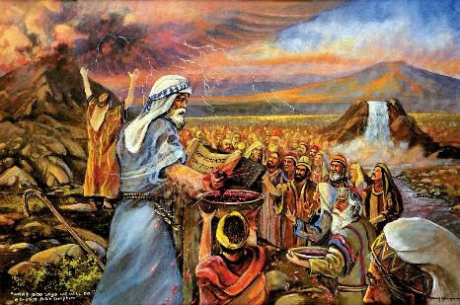
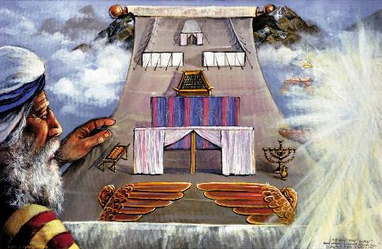


After loudly proclaiming the Ten Commandments and giving Moses a basic set of laws, God wanted to make a covenant with Israel.
The covenant was simple: I will be your God, I will protect you and bless you; you, obey my laws.
After writing the covenant on a scroll, both parties had to ratify it. The people ratified it, saying they would keep it. How did God ratify it? With blood; with a feast; and with a model to help them understand the covenant.
The covenant:
  The blood of the covenant (Exodus 24:1-6, 8)
  The fulfillment of the covenant (Exodus 24:7)
  The Covenant Meal (Exodus 24:9-18)
The model:
  The purpose of the model (Exodus 25:1-9)
  The Preparation of the Model (Exodus 31:1-18)

Slide 4
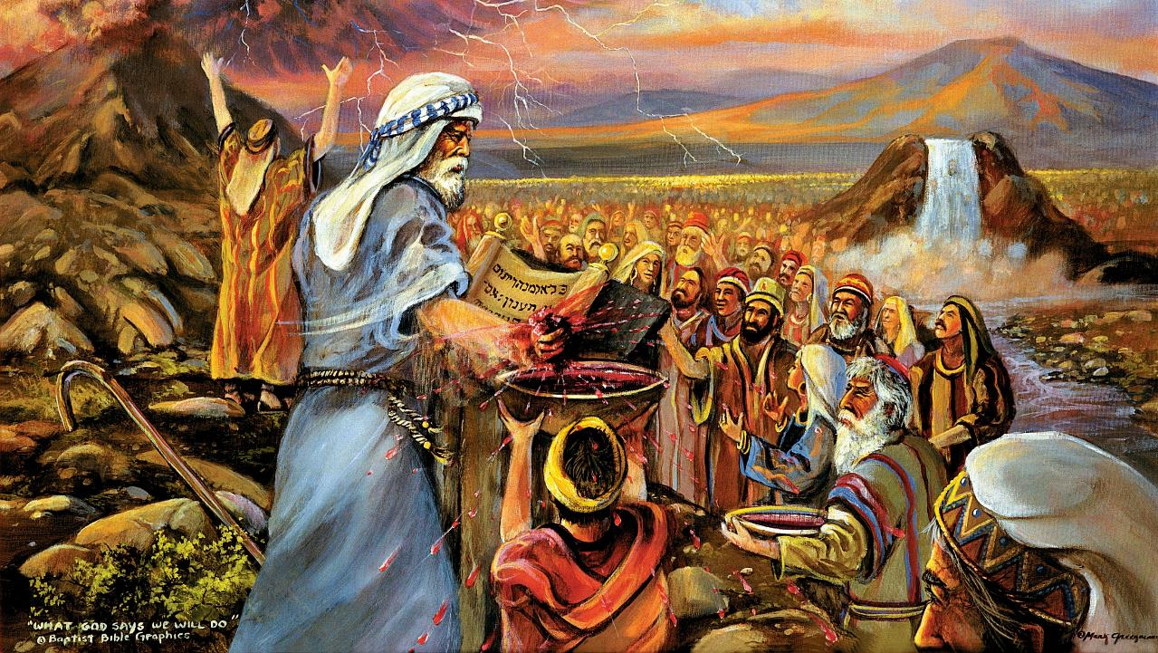
THE COVENANT

Slide 5

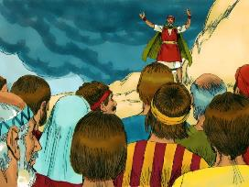
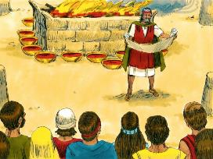
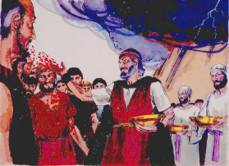
THE BLOOD OF THE COVENANT
Moses then took the blood, sprinkled it on the people and said, ‘This is the blood of the covenant that the Lord has made with you in accordance with all these words.’ ” (Exodus 24:8)
How was the covenant made?
The covenant was read (Ex. 24:3a)
The people responded affirmatively (Ex. 24:3b)
It was recorded in writing (Ex. 24:4a)
An altar was built (Ex . 24:4b)
12 pillars were erected (Ex. 24:4c)
Burnt offerings were offered (Ex. 24:5)
Half of the blood was sprinkled on the altar (Ex. 24:6)
The covenant was read again (Ex. 24:7a)
The people responded affirmatively again (Ex. 24:7b)
The other half of the blood was sprinkled on the people (Ex. 24:8a)
Moses declared it to be “the blood of the covenant” (Ex. 24:8b; Mt. 26:28)
A meal was held to ratify the covenant (Ex. 24:9-11)
God recognized Israel as a people (12 columns); He especially valued the young; and He committed himself to each person individually (sprinkling His blood on them).
God desires a relationship with us, individually and as a community of believers.

Slide 6

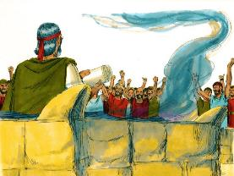
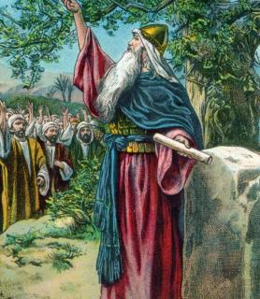
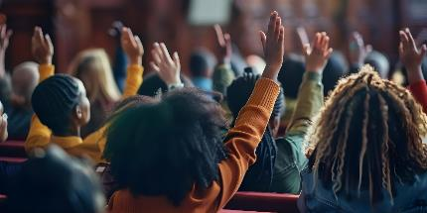

THE FULFILLMENT OF THE COVENANT
“Then he took the Book of the Covenant and read it to the people. They responded, ‘We will do everything the Lord has said; we will obey.’ ” (Exodus 24:7)
In complete sincerity, the people committed themselves to keeping the covenant. This commitment was short-lived (Ex . 32:8).
The next generation also committed to keeping the covenant (Josh. 24:18b). But Joshua clearly warned them: “You will not be able to serve the Lord” (Josh. 24:19 NIV).
What prevents us from obeying God, despite our good intentions?
By nature, we are disobedient
(Rom. 7:18), and we can do nothing to change our tendency (Rom. 7:24).
But if we allow Him, God can change our nature (Ezek. 36:26-27). He cleanses, takes away, gives, and sets so that we can obey Him. Only He makes us strong (2 Cor. 12:10).

Slide 7

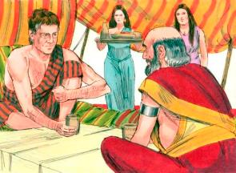
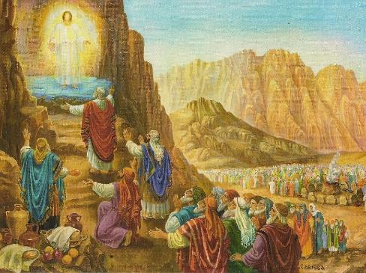
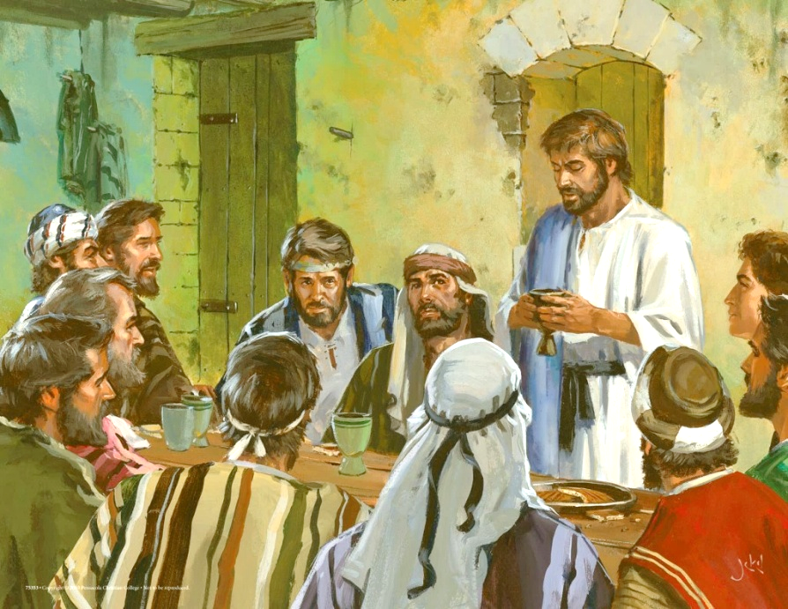
THE COVENANT MEAL
“Then Moses and Aaron, Nadab and Abihu , and seventy of the elders of Israel went up; […] and they saw God, and they ate and drank” (Exodus 24:9, 11b)
As we see in the example of Jacob and Laban, in the ancient East the ratification of a covenant included a meal shared by both parties (Gen. 31:44-54).
At Sinai, God offered a “covenant meal” to 74 people: Moses, Aaron, Nadab, Abihu, and 70 elders, representing all the people (Ex. 24:9-11).
When Jesus instituted the new covenant, he also did so by sharing his meal with the 12 apostles (Mt. 26:26-28).
Every time we partake of the Lord's Supper, we renew our covenant with God. By partaking of the bread and wine, we celebrate the forgiveness and salvation we have in Jesus (1 Cor. 11:26).
Despite their ultimate rejection of salvation, neither Nadab, nor Abihu, nor Judas were excluded from this “covenant meal.”

Slide 8
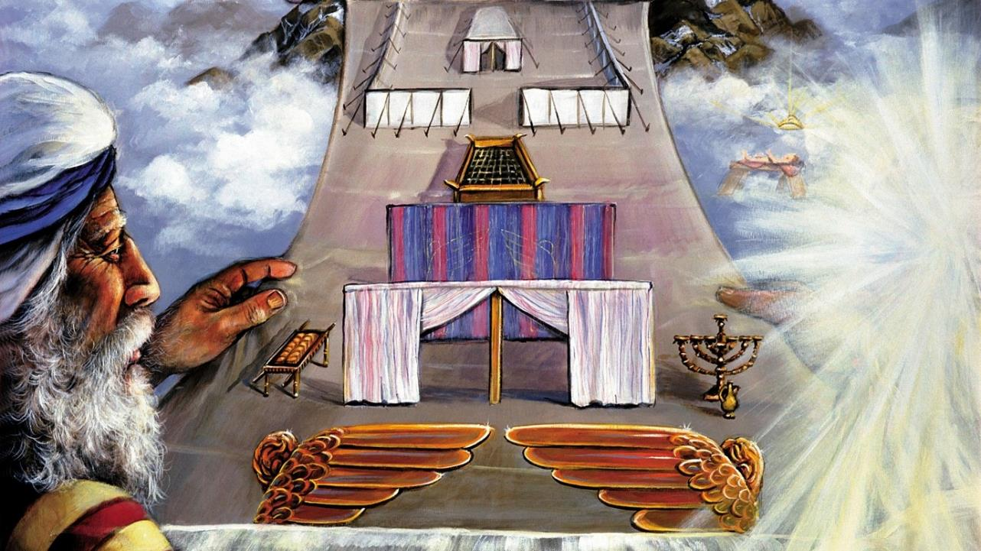
THE MODEL

Slide 9

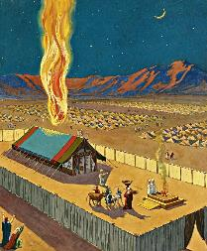
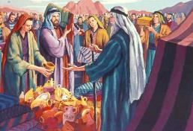
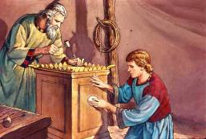
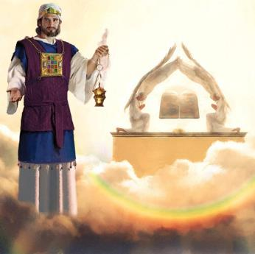
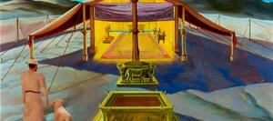
THE PURPOSE OF THE MODEL
“Then have them make a sanctuary for me, and I will dwell among them” (Exodus 25:8)
As a guarantee that he would fulfill his part of the covenant, God decided to go and live among the people.
But God's physical presence would mean immediate death for all of them (Ex. 33:20). Therefore, he commanded them to build a sanctuary where he could manifest his presence. This presence was manifested in symbols, since God does not physically dwell in any earthly temple (Acts 17:24 ).
Moses was shown the model and given specific instructions for its construction. The people were asked to contribute the necessary materials
(Ex. 25:2-7).
Both the sanctuary and the temple that Solomon built were a model of the sanctuary built in Heaven (Heb. 8:1-2; 1Ki. 8:27, 30).
When an Israelite entered the sanctuary, he entered—symbolically—into the very presence of God… until the veil was torn when Jesus died.

Slide 10

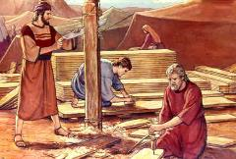
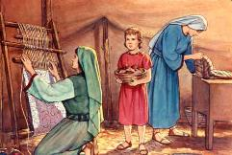
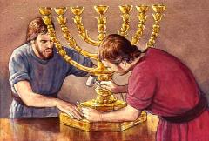
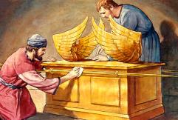
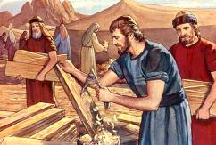
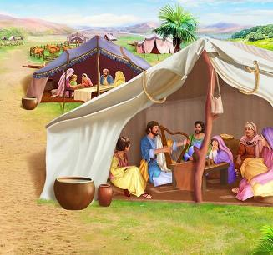
THE PREPARATION OF THE MODEL
“See, I have chosen Bezalel son of Uri, the son of Hur, of the tribe of Judah, 3 and I have filled him with the Spirit of God, with wisdom, with understanding, with knowledge and with all kinds of skills” (Exodus 31:2-3)
Although God gave Moses very detailed instructions regarding the construction, He didn't tell him every detail. What should the bronze laver, the cherubim, the priests' mitres, etc. look like? This gave the Holy Spirit the opportunity to work with the builders' gifts.
For these details, the Holy Spirit endowed with special gifts:
Bezaleel, who directed the entire project (Ex. 31:2)
Aholiab, who was his chief assistant (Ex. 31:6a)
Other people who helped in the work (Ex. 31:6b)
In the midst of the instructions for building the sanctuary, there is special mention of the Sabbath (Ex. 31:12-17). What does the Sabbath have to do with all of this?
Holiness is the key. To approach the Holy God, we must be holy like Him. The Sabbath is that sign of that holiness (Ex. 31:13; Ezek. 20:12, 20).
Notes:
Exodus 31:2
See, I have called by name Bezalel the son of Uri, the son of Hur, of the tribe of Judah;
Exodus 31:6a
And behold, I have set with him Aholiab the son of Ahisamach , of the tribe of Dan;
Exodus 31:6b
and I have put wisdom in the minds of every wise-hearted person, so that they may do all that I have commanded you;
Exodus 31:12-17 And the LORD spake unto Moses, saying, (13) Thou shalt speak unto the children of Israel, saying, Ye shall surely keep my sabbaths: for it is a sign between me and you throughout your generations, that ye may know that I am the LORD that sanctifies you. (14) Therefore ye shall keep the sabbath day, for it is holy unto you: whoso profaneth it shall surely be put to death: for whosoever doeth any work in it, that soul shall be cut off from among his people. (15) Six days shall work be done: but the seventh day is a sabbath of rest holy to the LORD: whosoever doeth any work on the sabbath day shall surely be put to death. (16) Therefore shall the children of Israel keep the sabbath, to observe the sabbath throughout their generations for a perpetual covenant. (17) It is a sign between me and the children of Israel for ever: for in six days the LORD made heaven and earth, and on the seventh day he rested, and was refreshed.

Slide 11

“In the building of the sanctuary as a dwelling place for God, Moses was directed to make all things according to the pattern of things in the heavens. God called him into the mount, and revealed to him the heavenly things, and in their similitude the tabernacle, with all that pertained to it, was fashioned.
So to Israel, whom He desired to make His dwelling place, He revealed His glorious ideal of character. […] But this ideal they were, in themselves, powerless to attain. The revelation at Sinai could only impress them with their need and helplessness.”
EGW (Education, p. 35-36)

