Slide 1

LIVING THE LAW
Lesson 9 for August 30, 2025

Slide 2
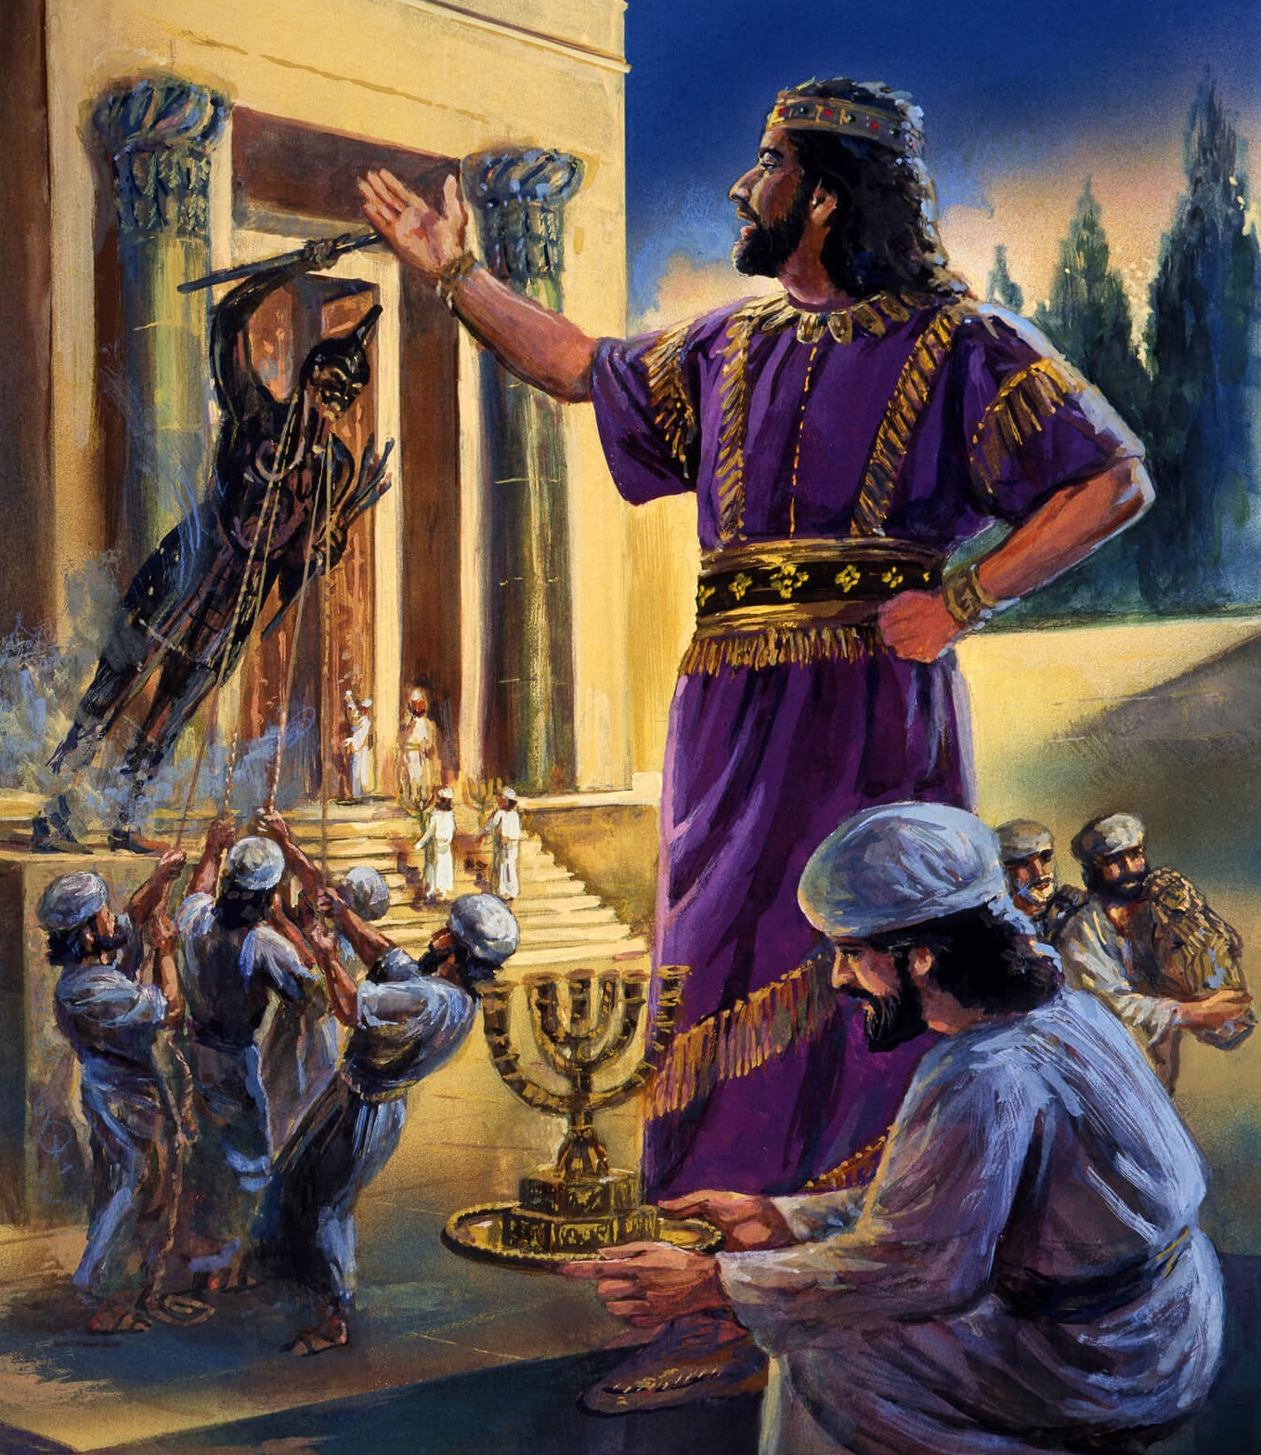
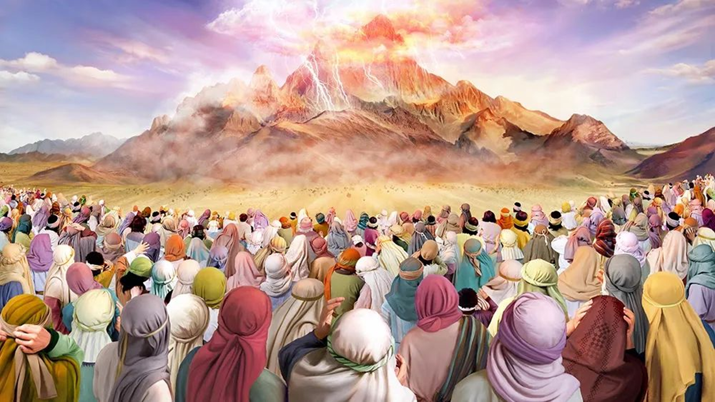
“Then the Lord said to Moses, ‘Thus you shall say to the children of Israel: “You have seen that I have talked with you from heaven. You shall not make anything to be with Me—gods of silver or gods of gold you shall not make for yourselves” ’ ” Exodus 20:22, 23, NKJV

Slide 3

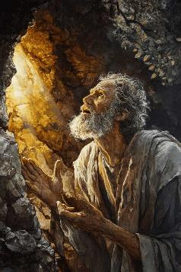
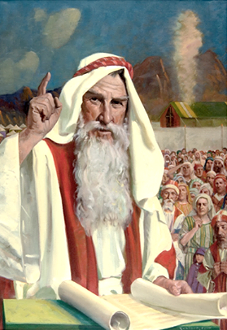



After proclaiming the Decalogue, the people asked Moses to be the intermediary between God and them (Exodus 20:19). From that moment on, God gave the laws to Moses, and he transmitted them to the people.
These laws, called the “covenant code,” were intended to regulate the lives of the people of Israel and, therefore, ours as well (with the necessary adaptations to our current reality).
They are, in short, the practical application of the Ten Commandments to specific cases of everyday life.
How to live the law:
  How to Manage Violence (Exodus 21:1-32)
  How to Live in Society (Exodus 21:33-23:19)
  How to Gain Victory (Exodus 23:20-33)
How to understand the law:
  The law of retaliation.
  Reward and punishment.

Slide 4

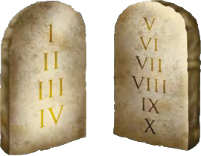

HOW TO LIVE THE LAW

Slide 5

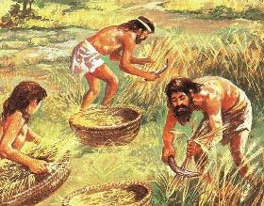
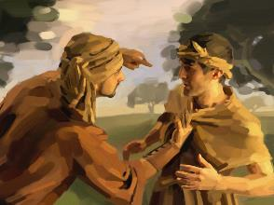
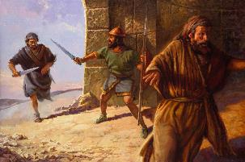
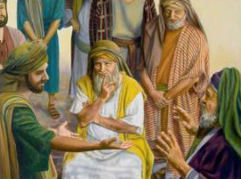
HOW TO MANAGE VIOLENCE
“Anyone who strikes a person with a fatal blow is to be put to death” (Exodus 21:12)
The covenant code begins by regulating three vital aspects of Hebrew society:
Slavery (Ex. 21:2-11)
  Men were released after the seventh year.
  Women, if they did not marry, were also free.
  A man could remain a slave if he so chose.
The death penalty (Ex. 21:12-17)
  For the intentional murderer
  For he who hurts or curses his parents
  For the kidnapper
Injuries (Ex. 21:18-32)
  Obligation of financial compensation
  If an abortion occurs, the judge and the woman (with her husband) impose the fine.
All these laws attempt to curb abuse and violence between people.

Slide 6

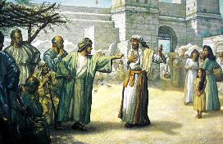
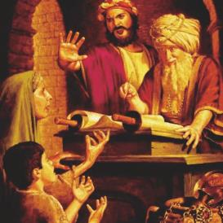
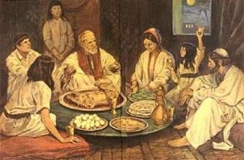
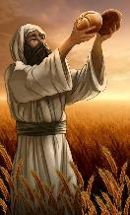
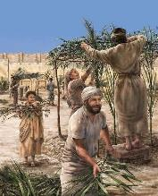
HOW TO LIVE IN SOCIETY
“If a man seduces a virgin who is not pledged to be married and sleeps with her, he must pay the bride-price, and she shall be his wife” (Exodus 22:16 NIV)
God wasn't content to simply leave us with “basic” laws and let us apply them as we see fit. He took care to provide concrete examples so we could apply them correctly.
These examples include animal-on-animal attacks (Ex. 21:35-36 ); lending and renting (Ex. 22:14-15 ); premarital relations (Ex. 22:16 ), etc.
Special emphasis is placed on protecting the weak and marginalized, but without granting them unjust benefits—that is, without perverting justice to benefit or harm them (Ex. 22:21-23; 23:2-3, 6).
Being a covenant between God and his people, these laws also included the way in which we should relate to Him. In addition to the Sabbath rests, there was the obligation to observe the feasts that remind us of our liberation from sin, divine protection, and the glorious future that awaits us.

Slide 7

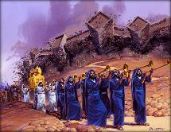
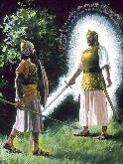
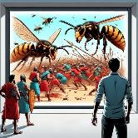
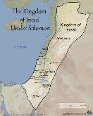
HOW TO GET VICTORY
God tells Israel what to do
Hear his voice, so that God may be the enemy of his enemies
(23:21-22)
Serve only God, so that He may remove all sickness (23:24-26)
Not to make any alliance with the Canaanites, so as not to worship their gods (23:32-33)
God tells Israel what He is going to do
He will send His Angel to guard them and bring them in [protection] (23:20)
The Angel will go before them and bring them to Canaan [direction] (23:23)
He will send terror to the inhabitants (23:27)
He will send the wasp to drive them out (23:28)
He will drive them out gradually (23:29-30)
He will hand them over to Israel until they dominate from the Mediterranean to the Euphrates (23:31)
“See, I am sending an angel ahead of you to guard you along the way and to bring you to the place I have prepared” (Exodus 23:20)
Why didn’t God give Abraham the land of the Canaanites? “For the iniquity of the Amorites is not yet full” (Gen. 15:16).
After four centuries of grace, the Canaanites had not changed their ways. It was time to hand the land over to Israel… peacefully! (Ex. 13:17)
If God had brought them out of Egypt without them having to fight, had parted the sea in two, miraculously fed them, and guided them with His Angel… wouldn't He be able to give them Canaan without them having to fight for it?

Slide 8

“Through the ages God's law has been preserved as the highest standard of morality. Not all the inventions of science or the imaginations of fruitful minds have been able to discover one essential duty not covered by this code.
God's law is the security of life and property and peace and happiness. It was given to secure our present and eternal good.”
EGW (The Upward Look. October 7)

Slide 9

HOW TO UNDERSTAND THE LAW

Slide 10

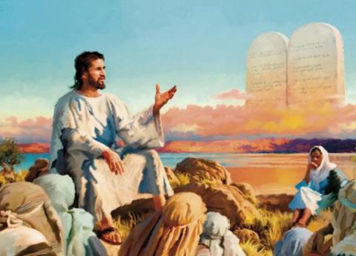


THE LAW OF RETALIATION
“eye for eye, tooth for tooth, hand for hand, foot for foot,” (Exodus 21:24)
When Jesus delivered the Sermon on the Mount, he abolished the law of retaliation (Mt. 5:38-42) … or didn't he?
The phrase “you have heard that it was said… but I say to you” did not abolish any law (Jesus used the same phrase for “you shall not kill” or “you shall not commit adultery,” but he never intended to abolish them). In fact, Jesus always expanded the Law, improved it, and gave it its true meaning.
It was never the true intention of the law of retaliation that a person should lose his eye or his hand for having harmed another.
This law was formulated with the intention of preventing revenge, putting an end to blood feuds, and retaliation without prior investigation. Damages had to be assessed by judges, and then appropriate monetary compensation was established and paid. This practice arose to prevent people from taking justice into their own hands. Justice needed to be done, but in harmony with God's Law.

Slide 11




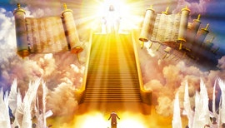
REWARD AND PUNISHMENT
“However, if it is not done intentionally, but God lets it happen, they are to flee to a place I will designate” (Exodus 21:13 NIV)
The desire for revenge is deeply rooted in us. And it's always disproportionate to the wrong we've received: “If he did this to me, I'll do more to him.”
Jesus invites us to do the opposite of what we desire: to repay evil with good (Mt. 5:44). So where is justice? Who will pay the offender what he deserves?
God doesn't tell us that the aggressor won't be punished, nor that any act will be avenged. But He does tell us clearly that He will be the avenger (Rom. 12:19-21).
Although personal revenge is tolerated in the covenant code, it was curbed by creating a judicial system to prevent abuse (Ex. 21:12-13, 22; 22:8-9).
No one can simultaneously assume the role of judge, jury, and executioner. If punishment must be imposed, it must be done through a fair judicial process. And Christ will be the supreme and final Judge.

Slide 12

“As Creator of all, God is governor over all, and He is bound to enforce His law throughout the universe. To require less from His creatures than obedience to His law would be to abandon them to ruin. To fail to punish transgression of His law would be to place the universe in confusion. The moral law is God's barrier between the human agent and sin. Thus infinite wisdom has placed before men the distinction between right and wrong, between sin and holiness.”
EGW ( The Signs of the Times , June 5, 1901)

