Slide 1

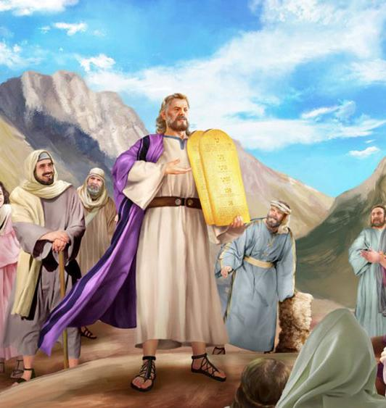
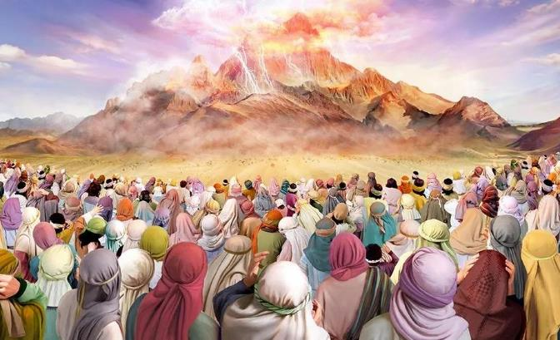
COVENANT AT SINAI
Lesson 8 for August 23, 2025

Slide 2
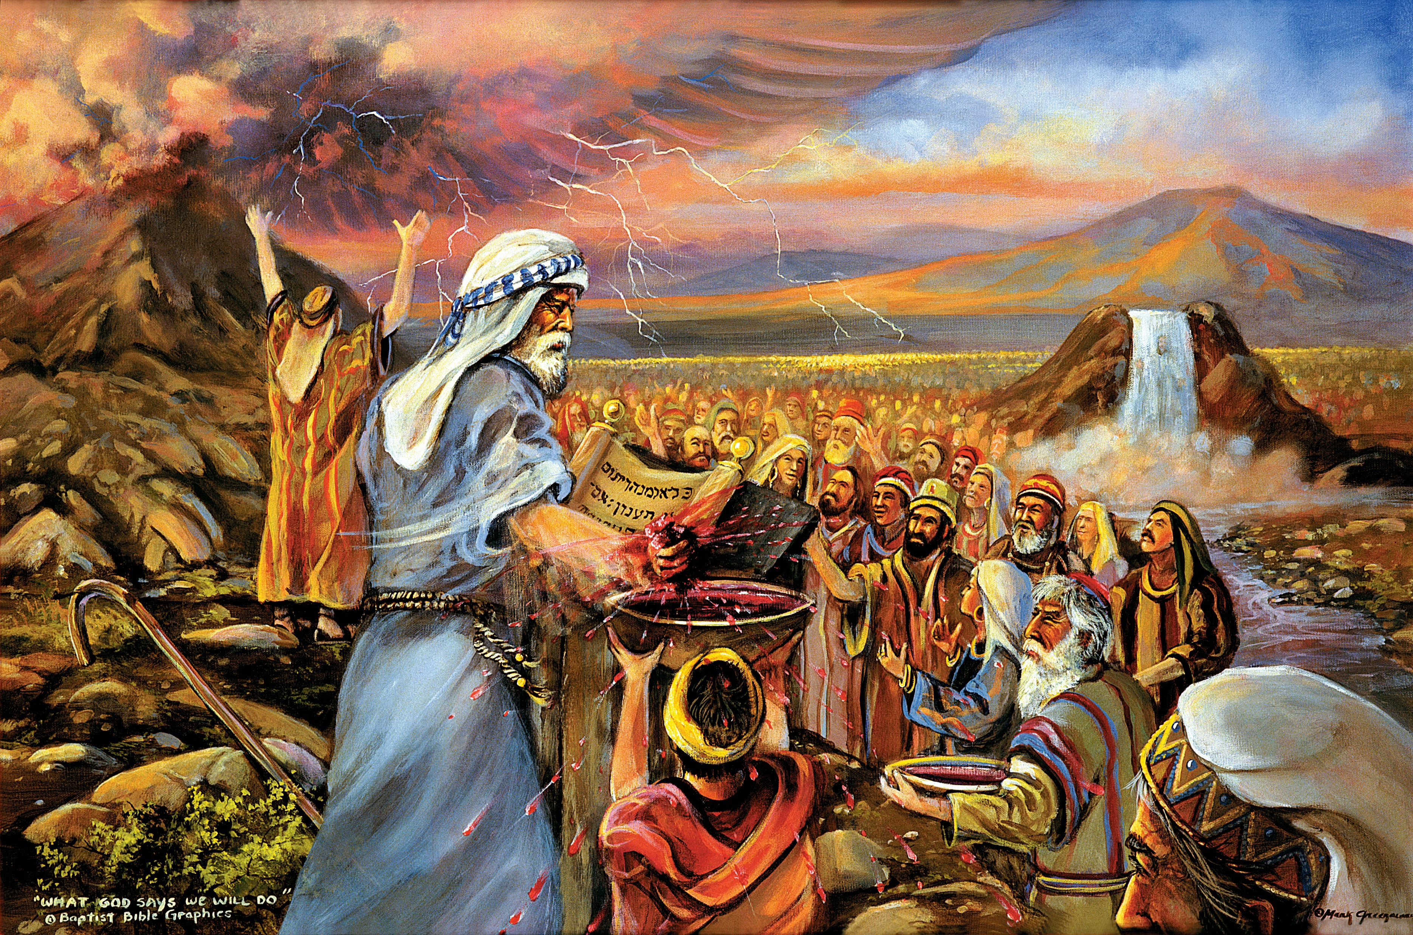
“You have seen what I did to the Egyptians, and how I bore you on eagles’ wings and brought you to Myself. Now therefore, if you will indeed obey My voice and keep My covenant, then you shall be a special treasure to Me above all people; for all the earth is Mine. And you shall be to Me a kingdom of priests and a holy nation” Exodus 19:4–6, NKJV

Slide 3

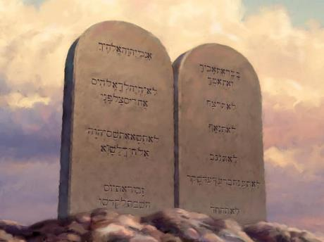
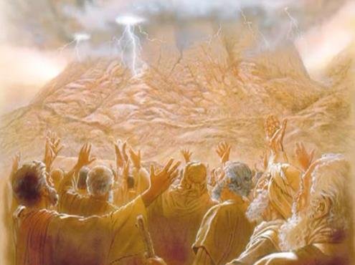








The crossing of the Red Sea was a milestone for Israel. The second milestone was the proclamation of the Law through the mouth of God himself.
At that moment, Israel was born as a holy nation. It received the rules that would govern its existence.
But they were more than just religious, civil, or health laws. The Ten Commandments, the foundation of all these laws, are a reflection of God's very character and, therefore, do not apply only to Israel, but to every one of God's children.
The delivery of the Law:
  The receivers of the Law (Exodus 19:1-8)
  The Law Giver (Exodus 19:9-25)
  The Ten Commandments (Exodus 20:1-17)
The meaning of the Law:
  The function of the Law.
  The Law as a promise.
  The Law as an end.

Slide 4

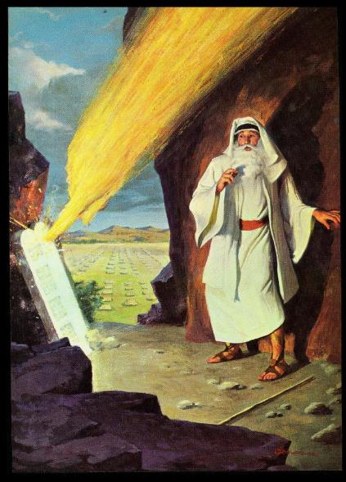
THE DELIVERY OF THE LAW

Slide 5

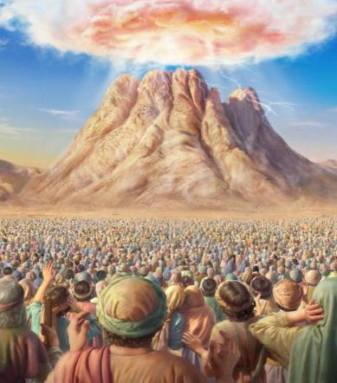
THE RECEIVERS OF THE LAW
“You yourselves have seen what I did to Egypt, and how I carried you on eagles’ wings and brought you to myself.” (Exodus 19:4)
Why had God brought Israel out of Egypt?
To serve him (Ex. 5:1; 7:16; 8:1, 20; 9:1, 13; 10:3). In doing so, they would receive great benefits (among them the land of Canaan).
In the third month after their departure from Egypt, they camped near Mount Sinai. There the foundation for the creation of the nation of Israel was laid. God proposed a covenant with them, and they accepted (Exod. 19:1-8).
By accepting the covenant, what would Israel become (Ex. 19:5-6)?
HOLY PEOPLE
They would dedicate themselves to God, and reveal His character.
KINGDOM OF PRIESTS
They would connect other people with God, and teach them his laws.
A SPECIAL TREASURE FROM GOD
God would make Israel a channel to enlighten the world with knowledge about Him

Slide 6

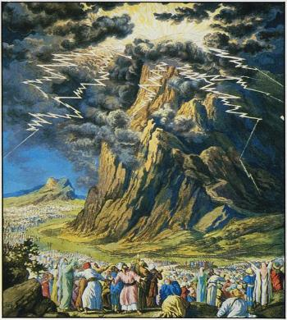
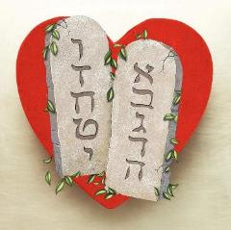
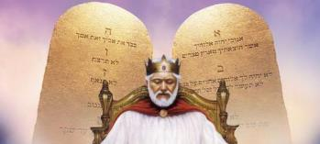
THE LAW GIVER
“Mount Sinai was covered with smoke, because the Lord descended on it in fire. The smoke billowed up from it like smoke from a furnace, and the whole mountain trembled violently” (Exodus 19:18)
The presentation of God's Law at Sinai was something superb and terrifying (Heb. 12:18-21). No one is prepared for something like that. Therefore, the people needed to purify themselves in advance and maintain the appropriate distance so as not to be consumed by divine glory (Ex. 19:10-12).
Why was such a staging necessary?
The words God was about to address to them were a manifestation of His own character. To obey them is life; to disobey them is death. Israel needed to be fully aware of the seriousness and significance of “the words of the covenant, the Ten Commandments” (Ex. 34:28).
Two versions of this Law have been recorded: one at the beginning of the Exodus, and another as part of Moses' final speeches before entering Canaan.
Although it may seem frightening in its presentation, the Law reflects the best of God's character: love (Rom. 13:10).

Slide 7
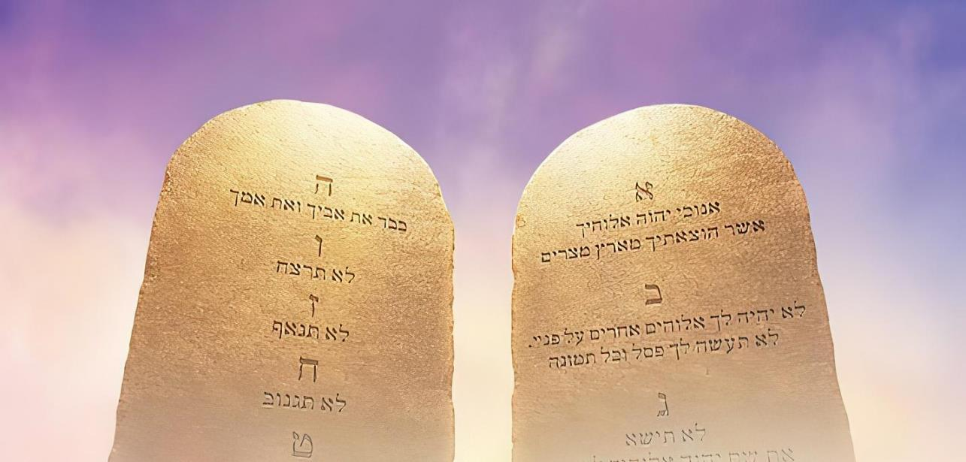

THE TEN COMMANDMENTS
“I am the Lord your God, who brought you out of Egypt, out of the land of slavery” (Exodus 20:2)
God introduces the Law by making its primary function clear: “I have redeemed you from sin, therefore, this is what you must do from now on” (Ex. 20:2). Observing the Law is, for us, the response to Redemption. It is a response of love to the love received.
“love is the fulfillment of the law” (Rom. 13:10)
Love God (Dt. 6:5; Ex. 20:3-11)
Love your neighbor (Lev. 19:18; Ex. 20:12-17)
Respect ourselves so that no selfish desire stains our character.
Honor His day of rest and worship, the Sabbath
Honor and venerate God by giving him first place in our lives.
Honor God without replacing him with any idol
Revere God's name, reputation, and character
Respect parents
Respect life
Respect marriage
Respect people's property
Respect the reputation of others

Slide 8

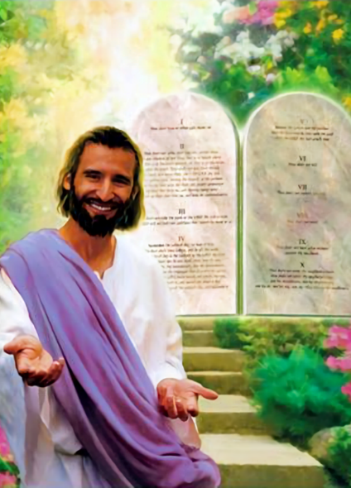

THE MEANING OF THE LAW

Slide 9


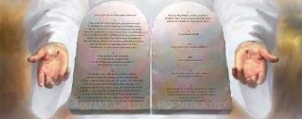
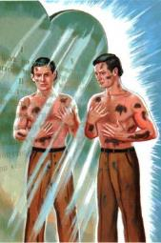
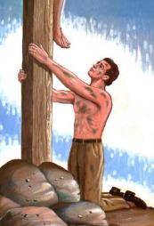
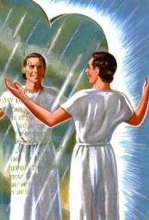
THE FUNCTION OF THE LAW
“So the law was our guardian until Christ came that we might be justified by faith” (Galatians 3:24 NIV)
What are some of the functions of the Law?
Salvation is not among its functions (Gal. 2:16). The Law is like a mirror in which our sins are reflected (James 1 :23-25).
It keeps us away from evil (Ps. 119:104)
It gives us wisdom (Dt. 4:6)
It gives us freedom (James 2:12)
It gives us peace (Ps. 119:165)
He gives us prosperity (Josh. 1:8)
He points out our sin (Rom. 7:7)
Leads us to Christ
(Gal. 3:24)
Breaking the mirror doesn't remove the stains; ignoring it doesn't either. But without the “mirror” [the law] we wouldn't know we were stained [with sin], and that we needed the “handkerchief” [Christ] to cleanse us.
The Bible is clear: the Law is good (Rom. 7:12); meditating on it is a delight (Ps. 1:2). “Oh, how I love your law! I meditate on it all day long” (Ps. 119:97).

Slide 10


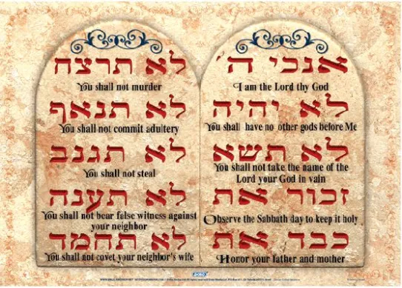

THE LAW AS A PROMISE
“And he declared to you his covenant which he commanded you to do, THE TEN WORDS, and wrote them on two tablets of stone” (Deuteronomy 4:13, original Hebrew )
In Hebrew, the three times the Ten Commandments are mentioned, they are called “the ten words” (Ex. 34:28; Deut. 4:13; Deut. 10:4).
Let's think about this. What do we mean when we say to someone, “I give you my word”?
In reality, we're not giving you anything; we're making you a promise. We're reassuring you that we're going to do something concrete.
Thus, the Hebrew root “dabar” can be translated as “word” or “promise.”
Example: “There has not failed one word [dabar] of all His good promise [dabar], which He promised through His servant Moses” (1 Kings 8:56).
The Ten Commandments are ten promises God makes to us, intended to guide us on the right path.

Slide 11

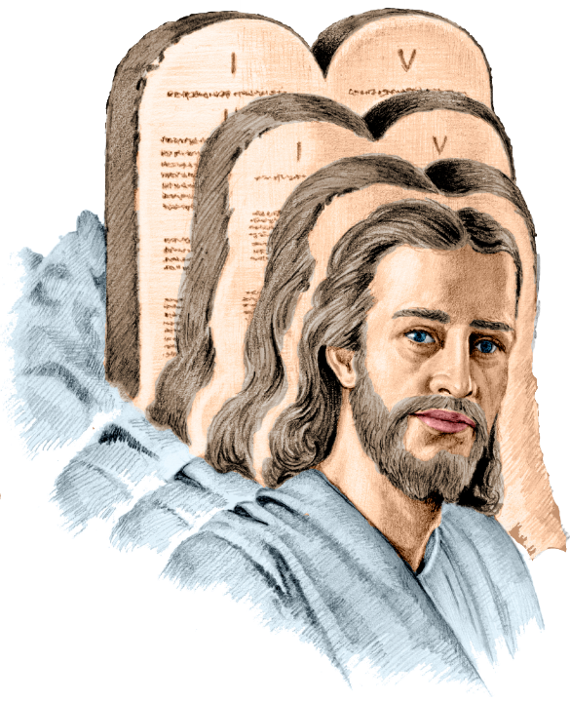
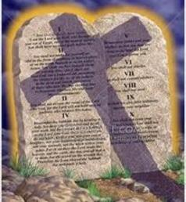
THE LAW AS AN END
“For Christ is the end of the law for righteousness to everyone who believes” (Romans 10:4)
The word “end” applied to the law by Paul in Romans 10:4 is “telos.” What is the meaning of this word?
The primary meaning is: the point indicated as a limit or purpose. By implication (secondary meanings): the conclusion, the termination, the result, the purpose. Its specific meaning must be determined by the sentence in which it is used.
If we translate this as “Christ is the termination of the law,” there is no longer any law since Jesus’ death. Therefore, there is no sin. Paul would be contradicting himself (Rom. 7:7).
If we translate “Christ is the point to which the law points,” Paul is consistent, because the law is still in force, and leads us to Christ (Rom. 3:31; Gal. 3:24).

Slide 12

EGW (Patriarchs and Prophets, p. 305)
“The law was not spoken at this time exclusively for the benefit of the Hebrews. God honored them by making them the guardians and keepers of His law, but it was to be held as a sacred trust for the whole world. The precepts of the Decalogue are adapted to all mankind, and they were given for the instruction and government of all. Ten precepts, brief, comprehensive, and authoritative, cover the duty of man to God and to his fellow man; and all based upon the great fundamental principle of love.”

