Slide 1
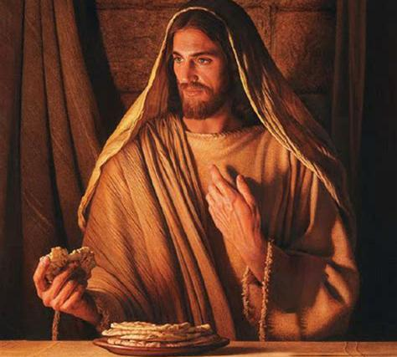
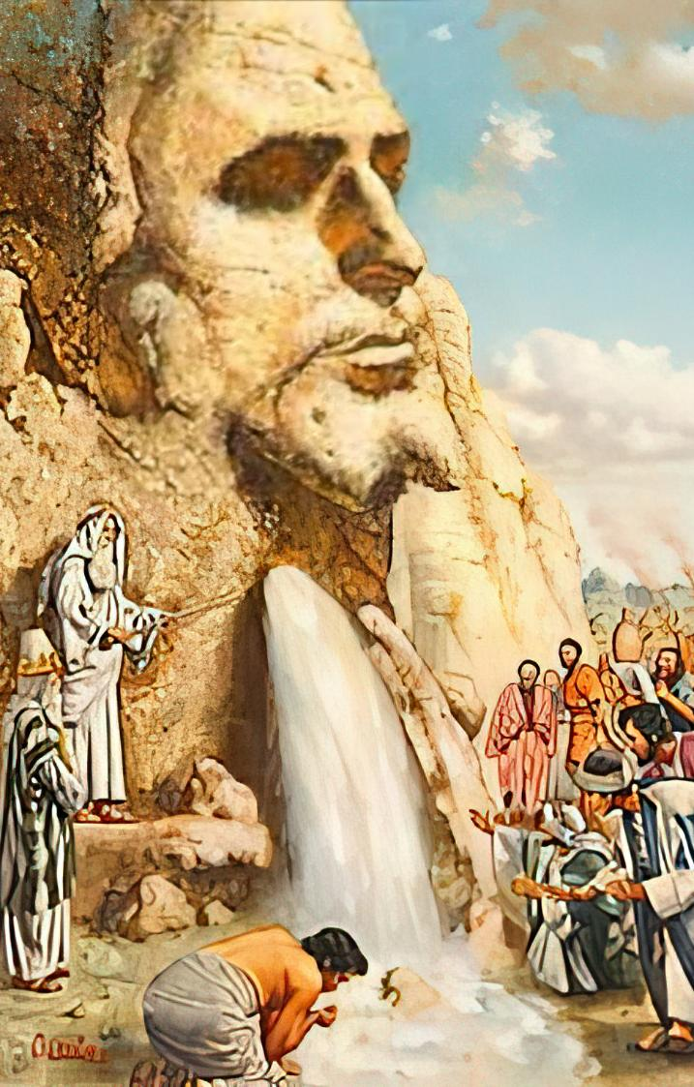
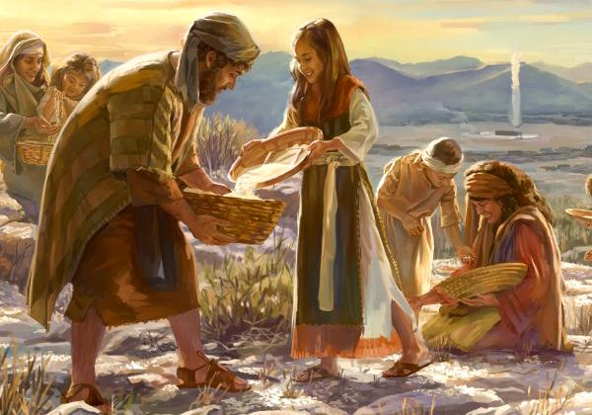
THE BREAD
AND WATER OF LIFE
Lesson 7 for August 16, 2025

Slide 2
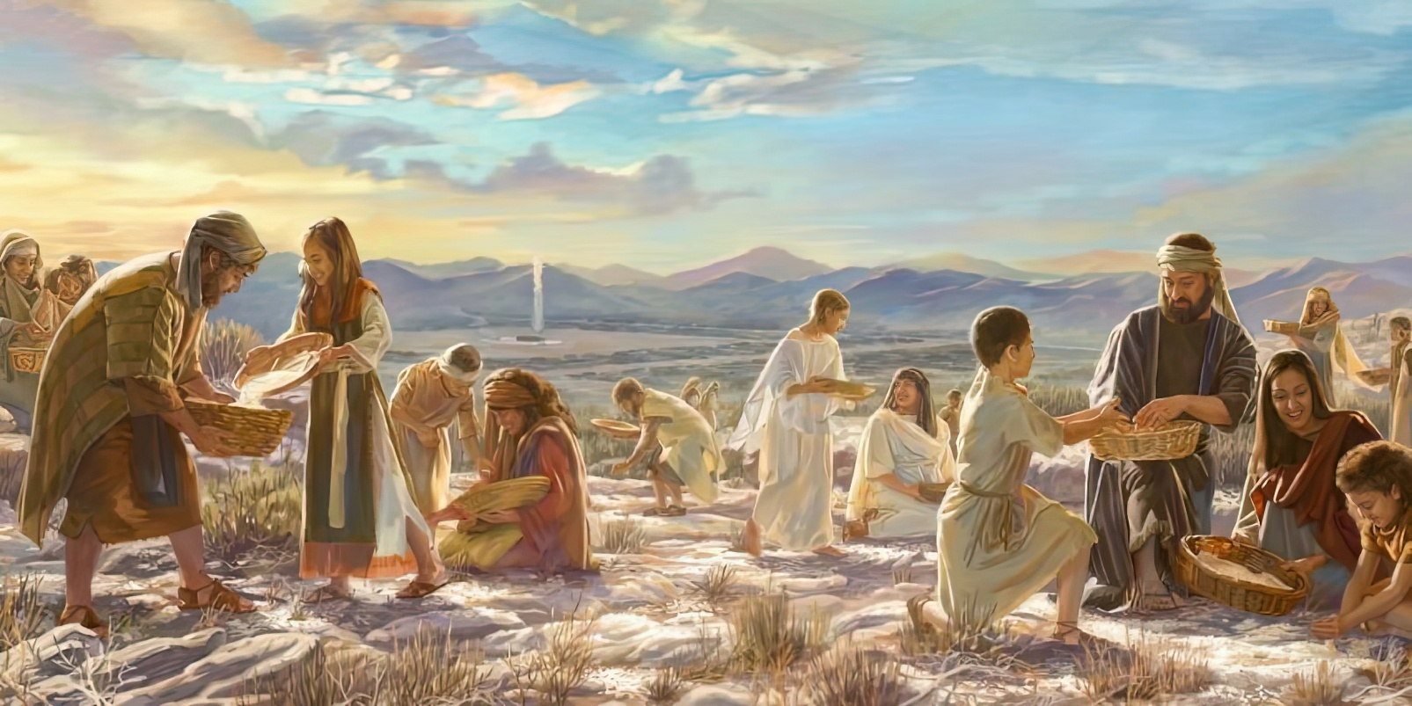

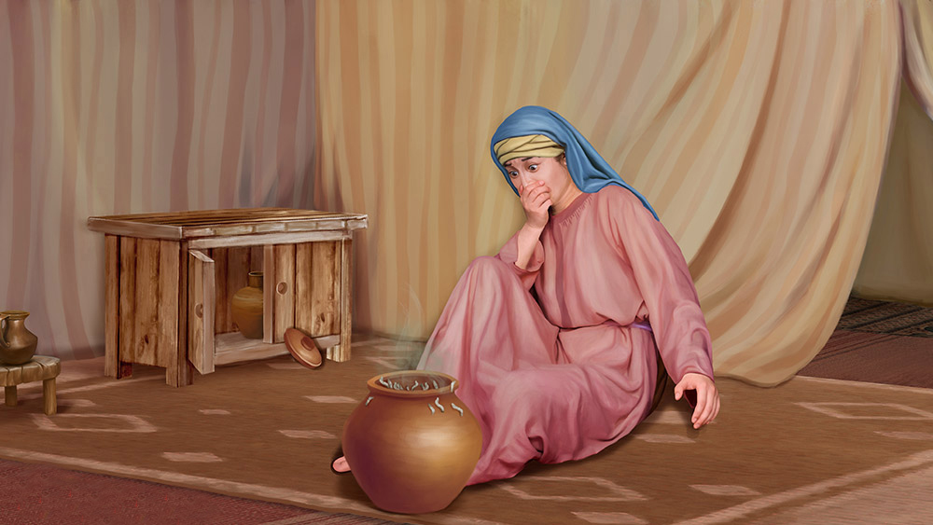
“And the Lord said to Moses, ‘How long do you refuse to keep My commandments and My laws? See! For the Lord has given you the Sabbath; therefore He gives you on the sixth day bread for two days. Let every man remain in his place; let no man go out of his place on the seventh day.’ So the people rested on the seventh day”
Exodus 16:28–30, NKJV

Slide 3

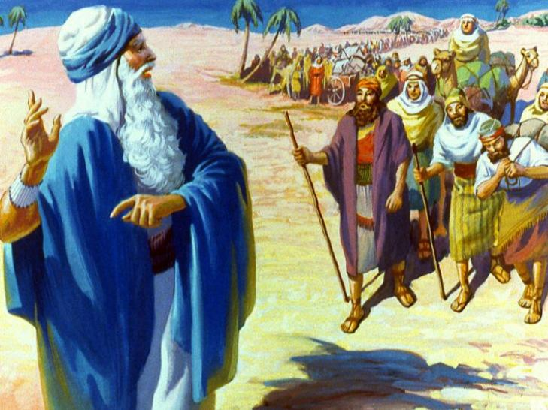
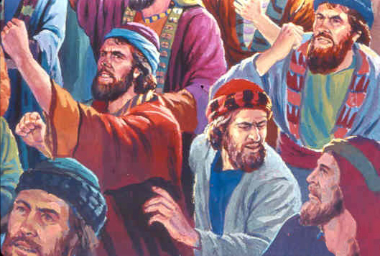
They had finally crossed the border of Egypt. They were finally on the road to Canaan, the land flowing with milk and honey.
For three days, everything seemed perfect. But the supplies they had were running out. How could they feed two million people in the desert?
At the first signs of trouble, the people began to complain. They would have preferred to have died in Egypt! Clearly, their faith needed to grow and strengthen. So God provided them with water and bread; protected them from their enemies; and helped them organize.
Clean water (Exodus 15:22-27)
The bread from heaven (Exodus 16:1-36)
The Rock of Horeb (Exodus 17:1-7)
The raised hands (Exodus 17:8-16)
Good advice (Exodus 18:1-27)
The bread and water of life: Jesus

Slide 4

“The varied experience of the Hebrews was a school of preparation for their promised home in Canaan. God would have His people in these days review with a humble heart and teachable spirit the trials through which ancient Israel passed, that they may be instructed in their preparation for the heavenly Canaan.”
EGW (Patriarchs and Prophets, p. 293)

Slide 5


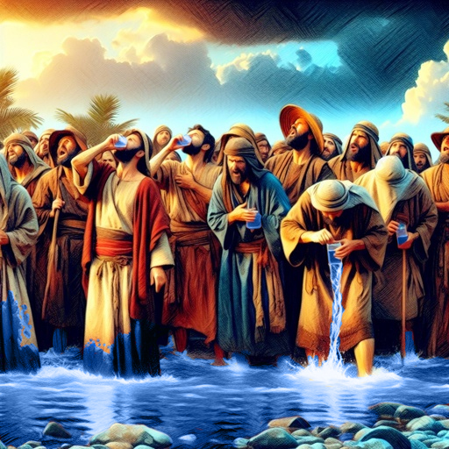
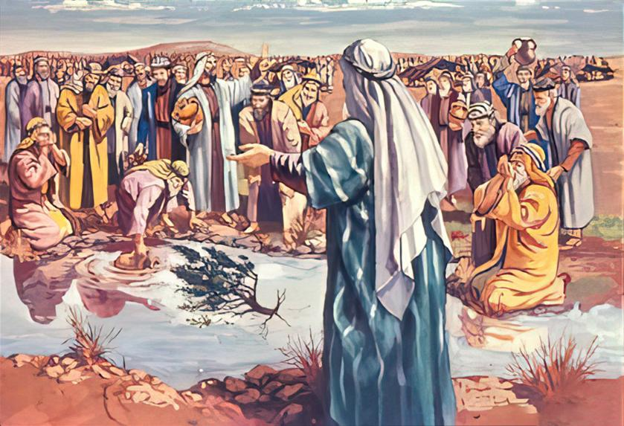
SANITIZED WATER
“When they came to Marah, they could not drink its water because it was bitter. (That is why the place is called Marah.)” (Exodus 15:23)
If God is with us, how can anything bad happen to us? This seemed to be the philosophy of the people of Israel after crossing the Red Sea.
Finding the water unsafe to drink, they complained, “What shall we drink?” (Ex. 15:24). God could have cleansed the water before they arrived, but He waited for the right moment.
He also asked Moses to help perform the miracle, asking him to throw a tree to clear the waters (Ex. 15:25).
God wants us to be aware of His presence, to await His commands, and to cooperate with Him.
If Israel fulfilled God's requirements, obeying the laws God gave them, they could be sure that they would be protected from evil (Ex. 15:26).

Slide 6


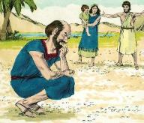
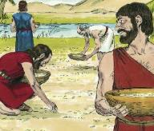
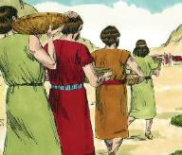
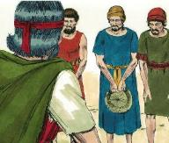
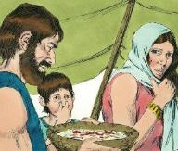
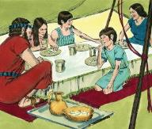
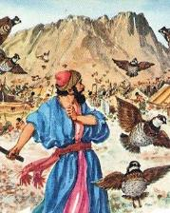
THE BREAD FROM HEAVEN
“When the Israelites saw it, they said to each other, “What is it?” For they did not know what it was. Moses said to them, “It is the bread the Lord has given you to eat” (Exodus 16:15)
The desire to eat meat caused Israel to grumble against Moses and Aaron (Ex. 16:2-3). But their grumbling was really against God Himself (Ex. 16:8). What was their problem?
This bread from heaven was truly miraculous:
They forgot the past
They focused on the difficulties of the present
They lost sight of the promised future
When the sun rose it melted
(Ex . 16:21)
The same amount fell for five days (Ex. 16:16)
On the sixth day it fell twice as much
(Ex. 16:22)
After giving them quail to eat, God provided them with enough bread to feed them every day… for 40 years! (Ex. 16:35)
On Saturday nothing fell
(Ex. 16:26)
From one day to the next it was filled with worms (Ex. 16:20)
From Friday to Saturday it was not spoiled (Ex. 16:23-24)

Slide 7


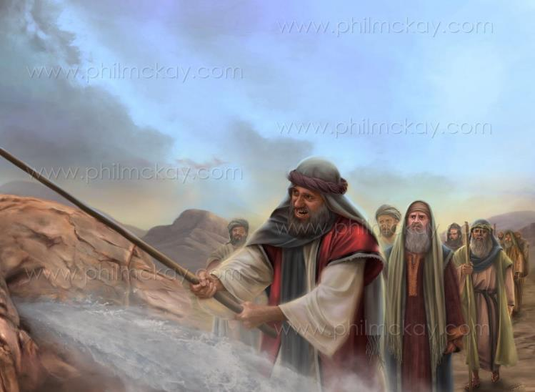
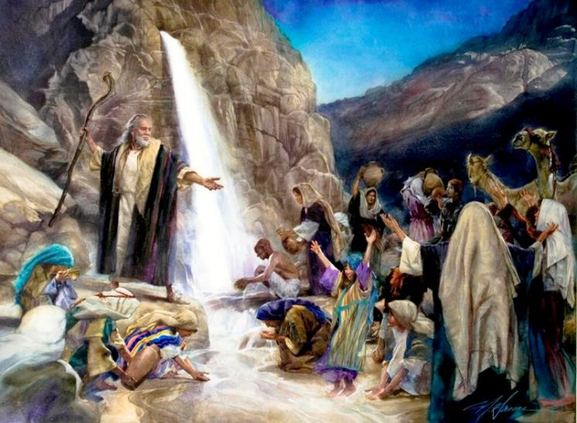
THE ROCK OF HOREB
“I will stand there before you by the rock at Horeb. Strike the rock, and water will come out of it for the people to drink.” So Moses did this in the sight of the elders of Israel” (Exodus 17:6)
“Is the LORD among us or not?” (Exod. 17:7 NIV). Didn’t God send them bread from heaven every day? Couldn’t they see it in the cloud?
The unbelief displayed by Israel is astonishing. But Paul warns us not to fall into the same example of unbelief (Heb. 3:12).
Despite their unbelief, Jesus himself split the rock and continued to provide them with water throughout their journey. He is “the spiritual rock that followed them” (1 Cor. 10:4).
For them, as for us, Christ is the Source of life and the Giver of eternal life.

Slide 8

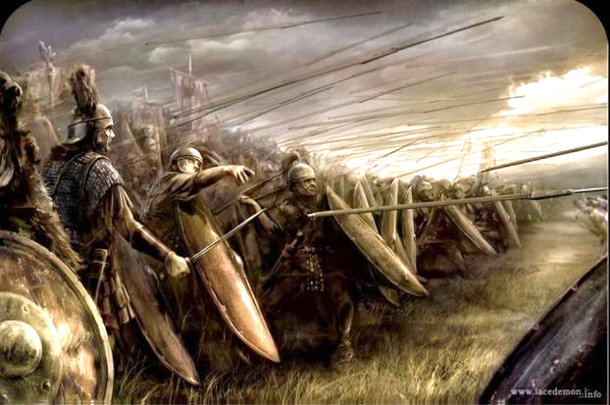
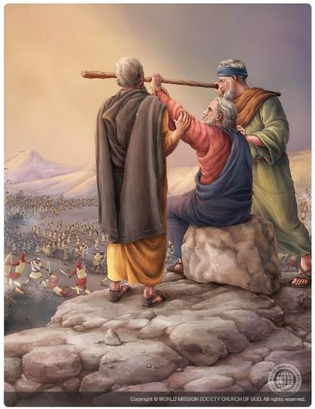
THE RAISED HANDS
“The Amalekites came and attacked the Israelites at Rephidim” (Exodus 17:8)
As they advanced through the desert, the Amalekites attacked Israel, and Moses asked Joshua to defend them while he, Aaron, and Hur went up the mountain with “the rod of God” (Ex. 17:8-10).
Why did the Amalekites attack?
They had heard what God had done in Egypt. But, unlike the other Canaanites, they were not afraid. They mocked God and defied Him by attacking His people, just to prove they were stronger than Him (Ex. 17:16).
As long as Moses raised God's rod, Israel won. But when his arms grew weary, Israel was defeated (Exod. 17:11).
It was time for the burden of action to be shared by other leaders. Aaron and Hur supported Moses and helped him make God's work successful, thus defeating the enemy (Ex. 17:12).

Slide 9


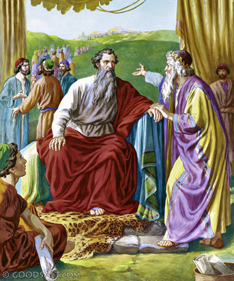
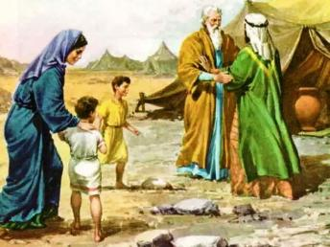
GOOD ADVICE
“But select capable men from all the people—men who fear God, trustworthy men who hate dishonest gain—and appoint them as officials over thousands, hundreds, fifties and tens.” (Exodus 18:21)
Seeing the sign that God had announced to Moses, Jethro, with Zipporah and his sons, went to see him at Horeb (Ex. 3:12; 18:1-5).
Jethro, although not an Israelite, did worship God. Therefore, after receiving Moses' report of what had happened in Egypt, he praised God and offered sacrifices to him (Exod. 18:8-12).
The next day, after watching Moses judge the entire people alone, he gave him some wise advice: share out the responsibilities
(Ex. 18:17-23).
Moses humbly acknowledged God's words in this advice. Therefore, he heeded his father-in-law's advice and chose people capable of carrying the responsibilities.
Its characteristics (Ex. 18:21):
Respect God
Be trustworthy
Hate bribery

Slide 10


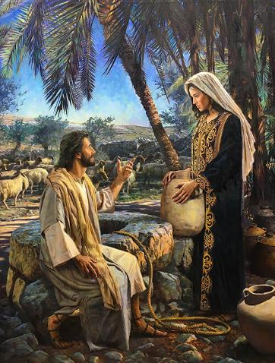
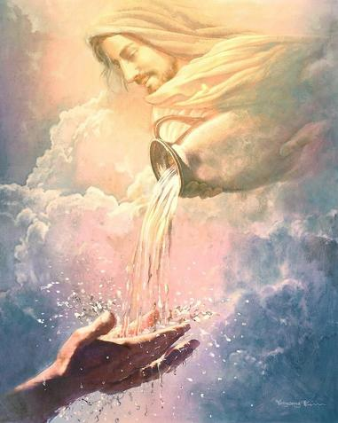
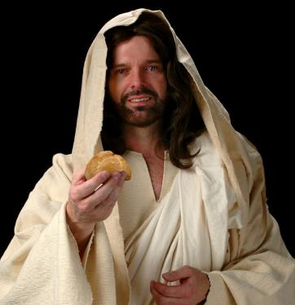
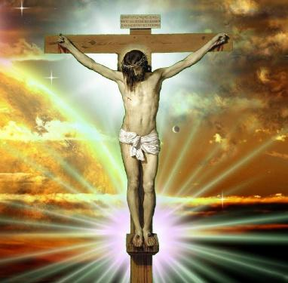
THE BREAD AND WATER OF LIFE: JESUS
“I am the living bread that came down from heaven. Whoever eats this bread will live forever. This bread is my flesh, which I will give for the life of the world” (John 6:51)
Paul tells us that the Exodus stories were written for our instruction, that is, they have a spiritual application for our lives (1 Cor. 10:1-11).
These stories warn us against covetousness; idolatry; fornication; tempting God; and gossip.
Furthermore, Jesus applied especially to himself the stories of the water from the rock and the bread from heaven.
He is the one who provides the water of life, symbolizing the Holy Spirit (Jn. 4:14; 7:37-39). He is the only one who can satisfy our inner thirst for peace, joy, and happiness.
Jesus said He is the true bread that came down from heaven. That bread is His own flesh (John 6:51). It is His body, broken on the cross to bring salvation to all who will “eat” it—that is, accept Him as Savior and have a daily relationship with Him. Only Christ can satisfy our spiritual thirst and hunger.

Slide 11

“The world's Redeemer knows the necessities of every soul. When we are oppressed and languid, he knows it, and he it is that supplies the spiritual refreshment. Ask ye of him; watch unto prayer, and it will come. Jesus is the bread of life, to be eaten every day; he is the water of life to the parched and fainting soul, and all may partake of his grace.
Earth's cisterns will often be emptied, its pools become dry; but in Christ there is a living spring from which we may continually draw. However much we draw and give to others, an abundance will remain. There is no danger of exhausting the supply; for Christ is the inexhaustible well-spring of truth”
EGW (The Signs of the Times, April 22, 1897)

