Slide 1
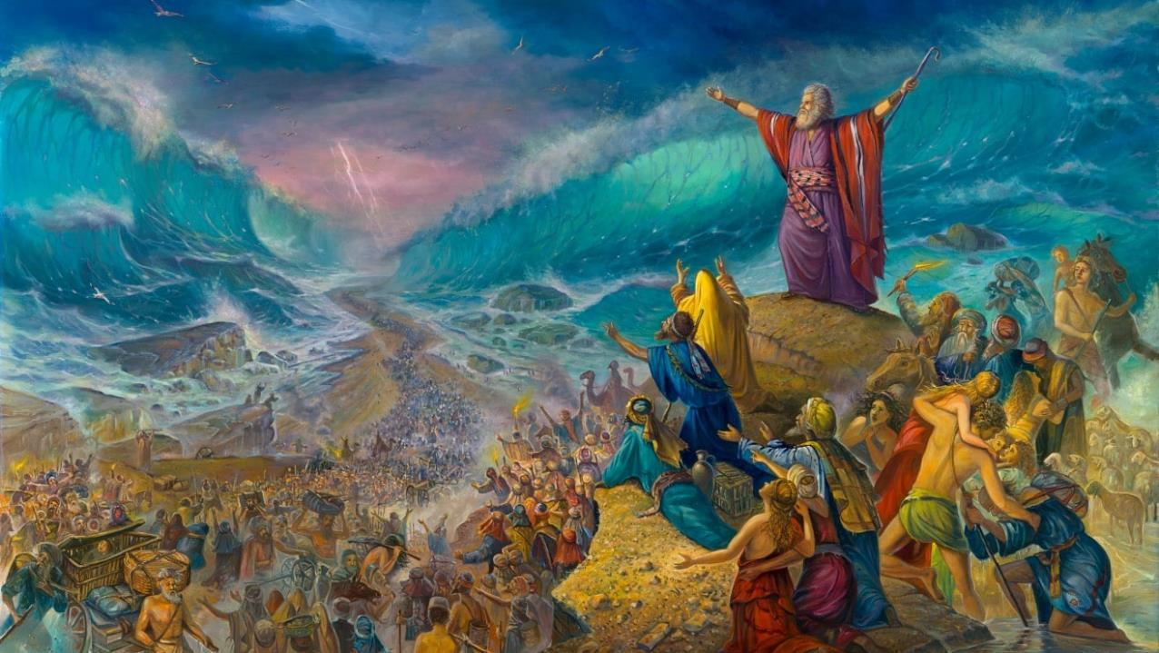
THROUGH THE RED SEA
Lesson 6 for August 9, 2025

Slide 2
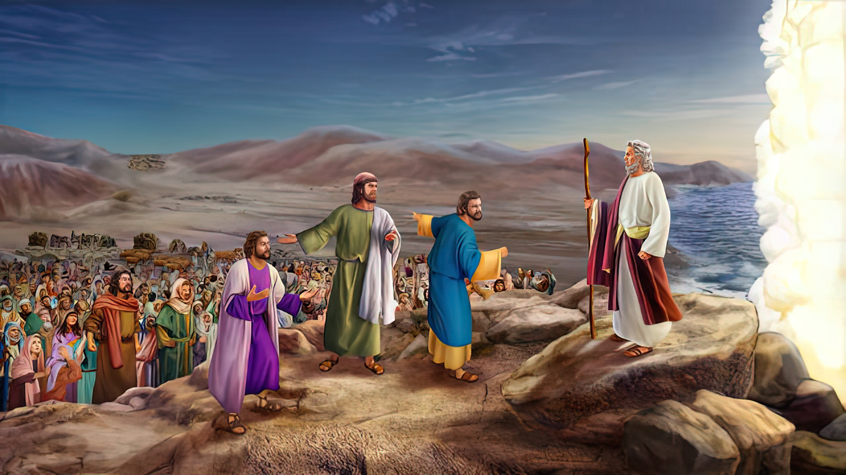
“And Moses said to the people, ‘Do not be afraid. Stand still, and see the salvation of the Lord, which He will accomplish for you today. For the Egyptians whom you see today, you shall see again no more forever. The Lord will fight for you, and you shall hold your peace’ ” Exodus 14:13, 14, NKJV

Slide 3

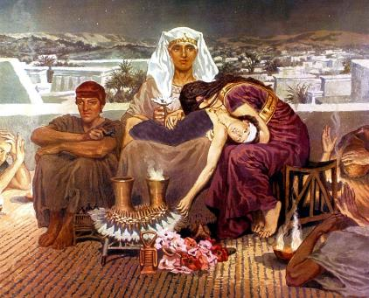
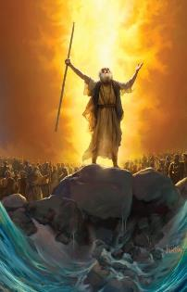
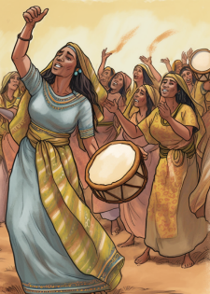



God had warned from the beginning that the exodus from Egypt would involve the death—or at least the threat of death—of Pharaoh's firstborn (Exodus 4:22-23).
To avoid the death of the firstborn and to be able to lead them out of Egypt, God had asked them for an act of faith: the Passover rite. Now, as He was leading them to a dead end, it was time to take the second step of faith: to move forward.
After crossing the Red Sea, finally freed from slavery in Egypt, Israel burst into a song of praise for their Liberator.
The Exodus from Egypt:
  Please leave! (Exodus 12:31-36)
  The Consecration of the Firstborn (Exodus 13:1-16)
The crossing of the Red Sea:
  Trapped in the Desert (Exodus 13:17-14:12)
  A path in the sea (Exodus 14:13-31)
The celebration:
  The Song of Moses (Exodus 15:1-21)

Slide 4
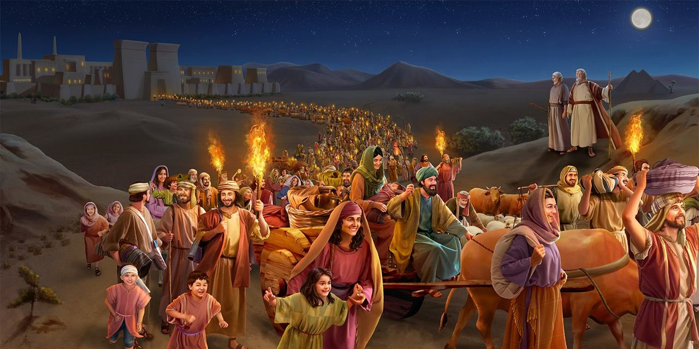
THE EXODUS FROM EGYPT

Slide 5


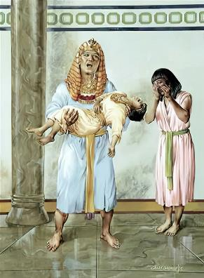
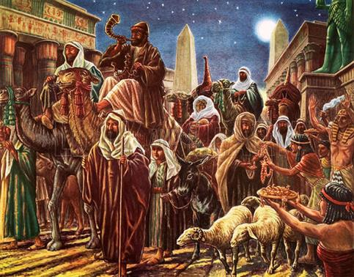
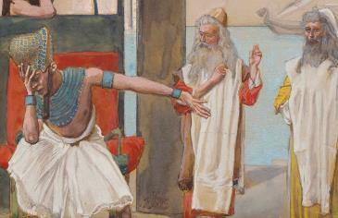
PLEASE LEAVE!
“The Egyptians urged the people to hurry and leave the country. “For otherwise,” they said, “we will all die!” (Exodus 12:33)
All of Egypt was desolate, “for there was not a house where there was not someone dead” (Ex. 12:30). Pharaoh’s permission for Israel to leave came too late.
With the phrase “And also bless me” (Ex. 12:32), Pharaoh expressed the feelings of all his people: please let nothing else happen to us!
It was not an expression of sincere regret for his wrongdoing, but rather a desire for the devastation to stop.
When Israel demanded payment for their years of service, the Egyptians “gave them what they asked for” (Exod. 12:36). In this way, God ensured that His firstborn would leave Egypt safely—and with his hands full.

Slide 6

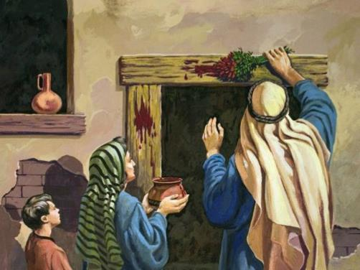
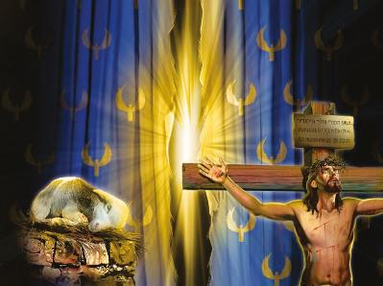
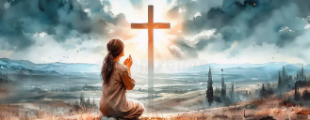
THE CONSECRATION OF THE FIRSTBORN
“Consecrate to me every firstborn male. The first offspring of every womb among the Israelites belongs to me, whether human or animal.” (Exodus 13:2)
How were the firstborn consecrated?
They were consecrated by death. Every firstborn son had to die. But provision had been made to replace the firstborn, so that another being would die in his place.
Note the relationship: Israel is God's firstborn (Ex. 4:22); the Church today is spiritual Israel (Gal. 6:16); therefore, we must all die to be consecrated to God; but there is a Being who has died in our place.
Jesus, “the Lamb of God” (Jn. 1:29), died so that whoever applies His blood at the door of their heart will not die but have ETERNAL LIFE.
God has already done his part. It is our responsibility to allow ourselves to be covered with his redeeming blood.

Slide 7
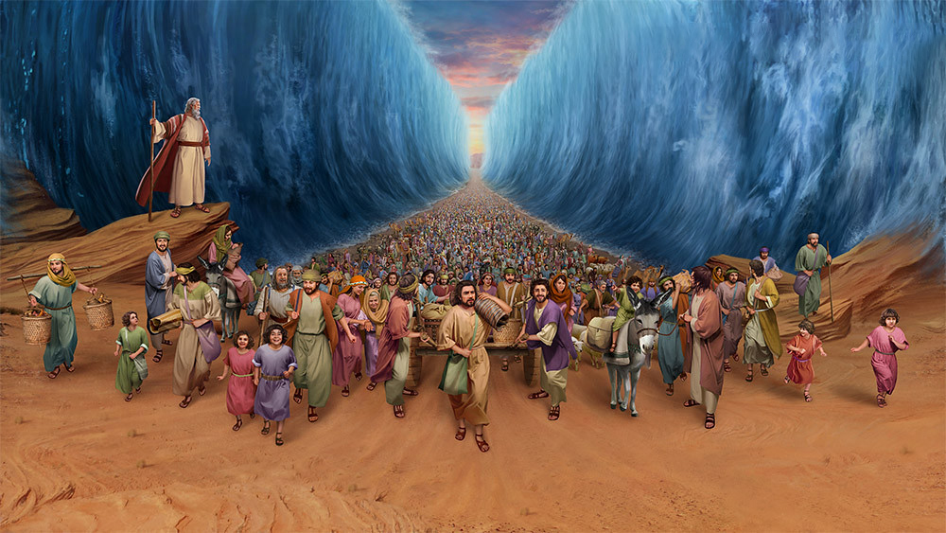
THE CROSSING OF THE RED SEA

Slide 8


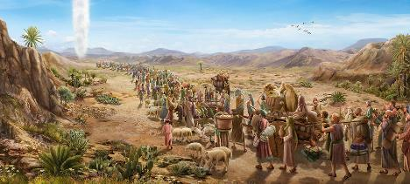
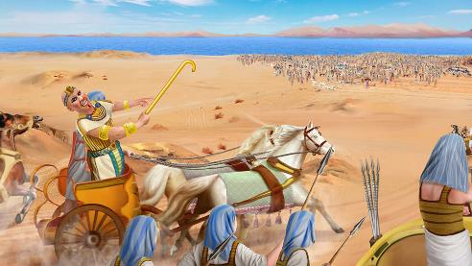
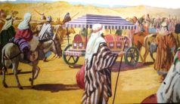
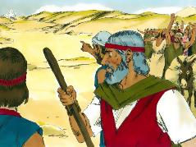
TRAPPED IN THE DESERT
“Pharaoh will think, ‘The Israelites are wandering around the land in confusion, hemmed in by the desert.” (Exodus 14:3)
With Pharaoh’s permission, Israel went out “ready for battle” (Exod. 13:18 NIV). But God did not want them to face war, so He led them around (Exod. 13:17).
Meanwhile, Pharaoh regretted having repented and went after Israel (Exod. 14:5). Israel was now trapped in the wilderness, with no escape possible (Exod. 14:2-3, 9).
As an act of faith, they had taken Joseph's sarcophagus with them (Ex. 13:19). Furthermore, God was guiding them miraculously (Ex. 13:21).
However, at the sight of Pharaoh's army, their faith collapsed completely. (Ex. 14:10-12). How quickly they forgot the miracles they had experienced! Could this happen to us too?
“Remember the wonders he has done” (1 Chr. 16:12)

Slide 9

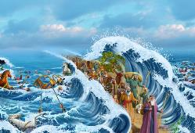
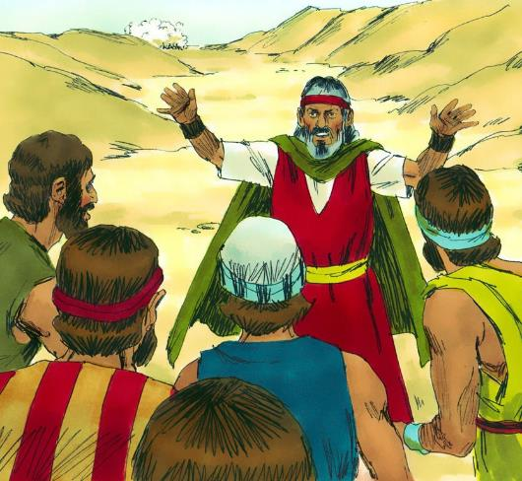
A PATH IN THE SEA
“Moses answered the people, “Do not be afraid. Stand firm and you will see the deliverance the Lord will bring you today. The Egyptians you see today you will never see again. The Lord will fight for you; you need only to be still.” (Exodus 14:13-14)
In the face of the people's lack of faith, Moses encouraged them to trust in God (Ex. 14:13-14):
“Do not be afraid”
The first step to achieving victory is to trust in God
“Stand firm”
We must remain patiently at our post, without murmuring.
“See salvation”
If we let God guide us, victory is assured.
“Jehovah will fight for you”
God fights for us against Satan and sin. Calvary is the greatest proof of this.

Slide 10

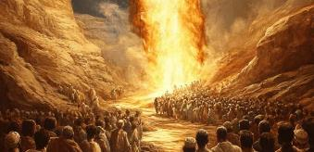
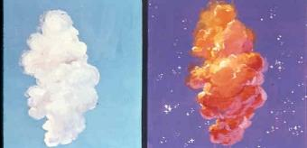
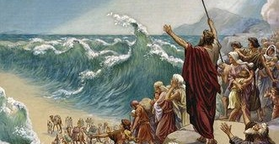
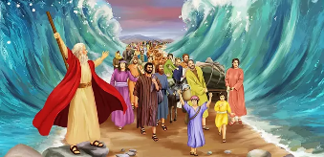
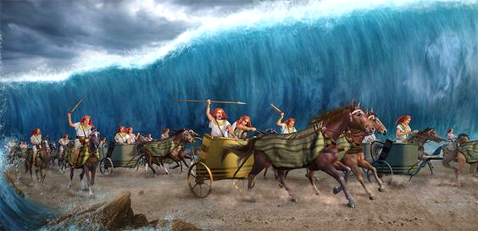
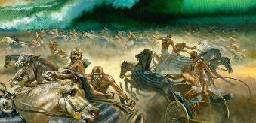
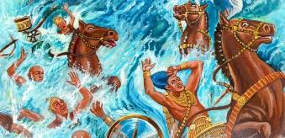
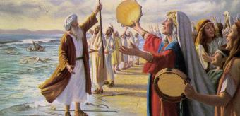
A PATH IN THE SEA
God gave the people only one command: “go forward” (Exodus 14:15). From this moment on, the unexpected began (Exodus 14:19-31):
The angel of God and the pillar of cloud stood between the camp of Israel and the camp of the Egyptians
During the night, the pillar was darkness for the Egyptians, and light for the Israelites
Moses raised his staff and the sea parted so that Israel could pass through on dry land.
Israel entered the sea, having the waters as walls on their right and left
The Egyptians also entered the sea
At dawn, God upset the Egyptians
As they tried to retreat, the sea returned to its course, destroying the entire army.
From the seashore, Israel beheld the victory, and they believed in God and in Moses

Slide 11
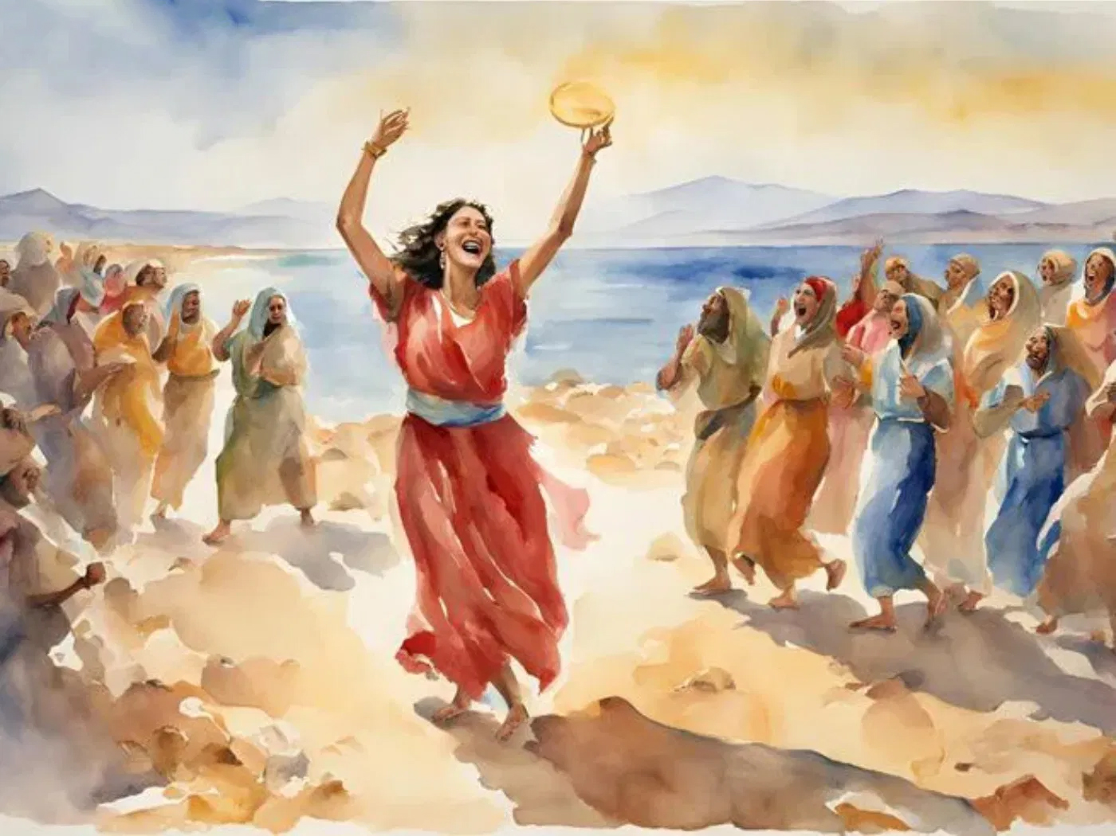
THE CELEBRATION

Slide 12


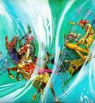
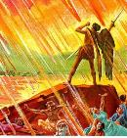
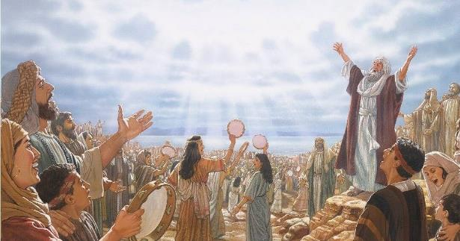
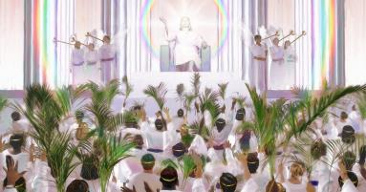
THE SONG OF MOSES
“And sang the song of God’s servant Moses and of the Lamb: “Great and marvelous are your deeds. Lord God Almighty. Just and true are your ways, King of the nations” (Revelation 15:3)
Seeing what had happened, Moses leads Israel in a song of praise, while Miriam responds with a choir, along with the women (Ex. 15:1, 20-21).
In this song, no mention is made of what Israel has done. Not only does it praise God for destroying the enemy (Ex. 15:6), but it is also admired for its works (Ex. 15:11). The reaction of those who hear what has happened is announced (Ex. 15:14).
Furthermore, what God is yet to do is announced: “You shall bring them and plant them in the mountain of Your inheritance” (Ex. 15:17).
When God's judgments have been manifested, and evil and oppression have been eradicated, the redeemed of the nations will praise Him for those righteous judgments, singing the song of Moses and of the Lamb (Rev. 15:3).

Slide 13

“In freeing our souls from the bondage of sin, God has wrought for us a deliverance greater than that of the Hebrews at the Red Sea. Like the Hebrew host, we should praise the Lord with heart and soul and voice for His “wonderful works to the children of men.” Those who dwell upon God's great mercies, and are not unmindful of His lesser gifts, will put on the girdle of gladness and make melody in their hearts to the Lord. The daily blessings that we receive from the hand of God, and above all else the death of Jesus to bring happiness and heaven within our reach, should be a theme for constant gratitude.”
EGW (Conflict and Courage, March 28)

