Slide 1
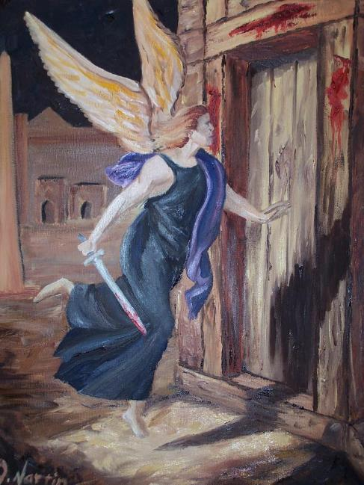
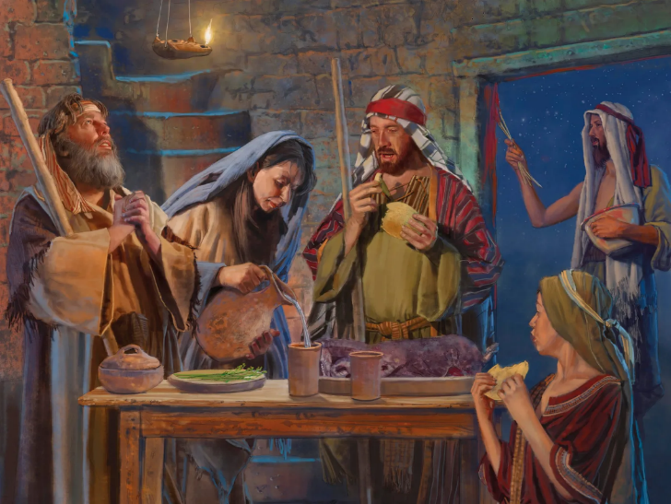
PASSOVER
Lesson 5 for August 2, 2025

Slide 2
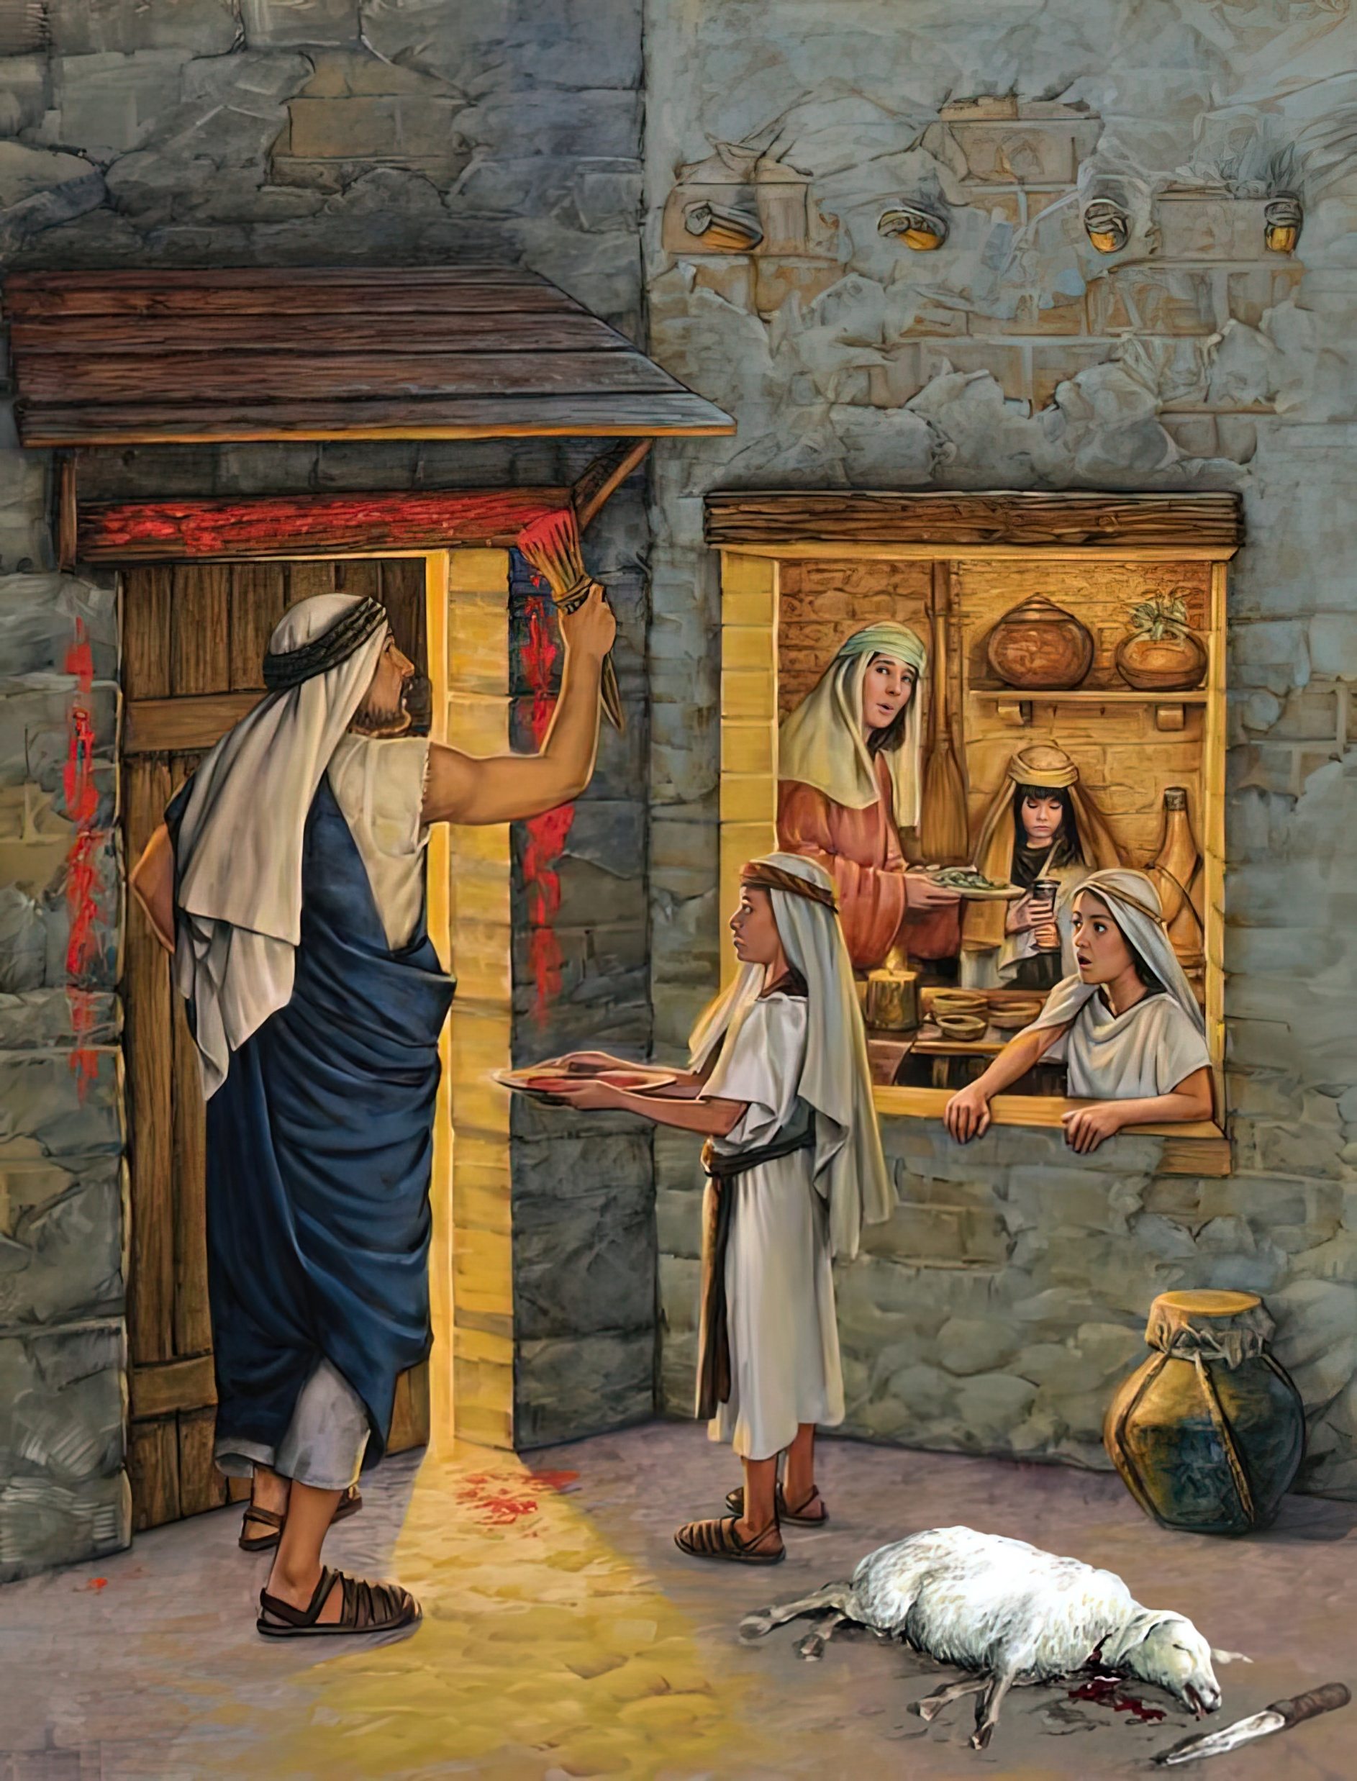
“ ‘And it shall be, when your children say to you, “What do you mean by this service?” that you shall say, “It is the Passover sacrifice of the Lord, who passed over the houses of the children of Israel in Egypt when He struck the Egyptians and delivered
our households” ’ ”
Exodus 12:26, 27, NKJV

Slide 3
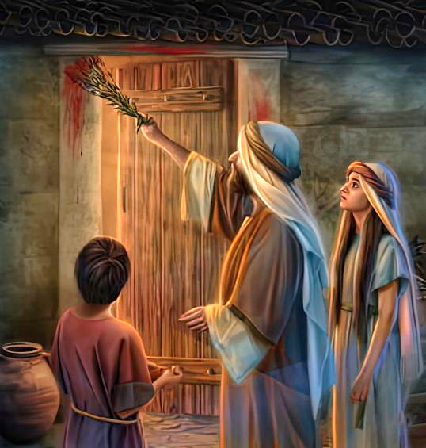
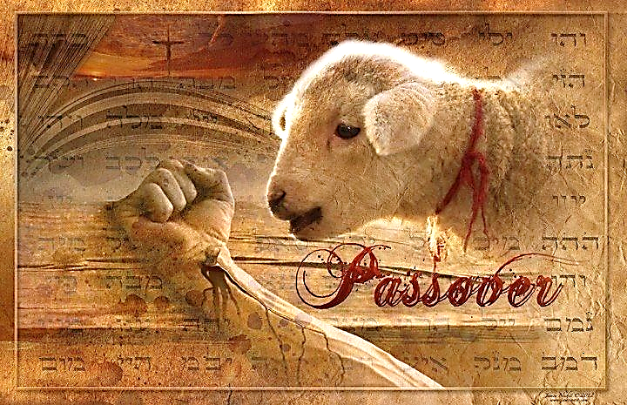
The tenth plague struck every family in Egypt that refused to follow God's instructions. It didn't come suddenly, but was announced many days in advance.
It was, in fact, a test of faith. No one needed to die that night. Everyone had the opportunity to save the life of their firstborn.
Only the Lamb was condemned. Only he was to die. Only his blood would make the Destroyer pass by. Why? Because ONLY CHRIST SAVES. And this was to be remembered from generation to generation… until He comes.
The Warning (Exodus 11)
The Preparation (Exodus 12:1-16)
The Blood and the Yeast (Exodus 12:17-23)
Remember and Teach (Exodus 12:24-28)
The Tenth Plague (Exodus 12:29-30)

Slide 4
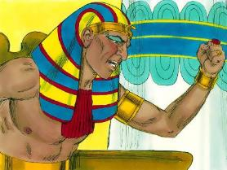
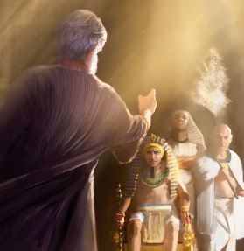
THE WARNING
“And the Lord said to Moses, “I will bring one more plague on Pharaoh and on Egypt. Afterward he will let you go from here. When he lets you go, he will surely drive you out of here altogether.’” (Exodus 11:1 NKJV )
After three days of darkness, Pharaoh became angry with Moses and forbade him to return to the palace (Ex. 10:28).
The time of divine judgment has come (Ex. 12:12):
For the proud, arrogant and exploitative: punishment, and the obligation to return what was extorted (Ex. 11:4-5, 2)
For the obedient to God's commands: to pass over punishment, and to be freed ( Ex . 11:7-8)
But Moses could not obey this order, for the life of Pharaoh's firstborn was at stake. In his role as Pharaoh's "god“ (Exod. 7:1), he had to warn him of what he was about to do (Amos 3:7).
Now it was Moses who left Pharaoh's presence in anger. Angry at his stubbornness and the consequences of his decision. Despite their respect for Moses, many Egyptians refused to heed the warning (Ex. 11:3).

Slide 5
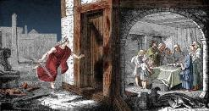
THE PREPARATION
“Speak to all the congregation of Israel, saying: ‘On the tenth of this month every man shall take for himself a lamb, according to the house of his father, a lamb for a household” (Exodus 12:3)
God explained in detail what they had to do so that the Destroyer would “pass over” (Pesach, Passover), and the firstborn would not die:
On the 10th they were to set aside a lamb without defect for each family, or for several families (Ex. 12:3-5).
On the 14th, at dusk, they were to sacrifice it (Ex. 12:6)
They were to anoint the doorposts and lintel with the blood (Ex. 12:7)
They were to eat the meat completely roasted, with unleavened bread and bitter herbs (Ex. 12:8-10)
While they were eating it hastily, they were to be dressed and ready to go (Ex. 12:11)
When they left Egypt, they were to continue eating unleavened bread for seven days (Ex. 12:15)
God prepared His people to understand His grace, and to worship Him (Ex. 12:27b).

Slide 6
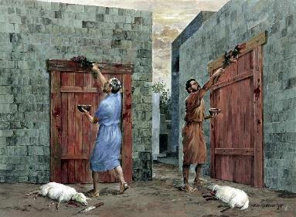
THE BLOOD AND THE YEAST
“Then Moses called for all the elders of Israel and said to them, “Pick out and take lambs for yourselves according to your families, and kill the Passover lamb” (Exodus 12:21)
On the 14th, two elements played a crucial role in the ceremony: blood and yeast.
They were to remove yeast from their homes and bake bread without it (unleavened bread). Since the departure was imminent, they would not have yeast during its initial stages (Ex. 12:17–20). This yeast is a symbol of sin, and unleavened bread symbolizes new life in Christ Jesus (1 Cor. 5:6–8; 2 Cor. 5:17).
Blood was the salvific element. It represented Jesus' blood—which He shed on the cross—so that, at the Judgment, God would "pass over" our condemnation. (1 John 1:7 ; 2:1-2).
The hyssop with which the blood was to be sprinkled (Ex. 12:22) is a symbol of the purification of sin (Ps. 51:7).

Slide 7
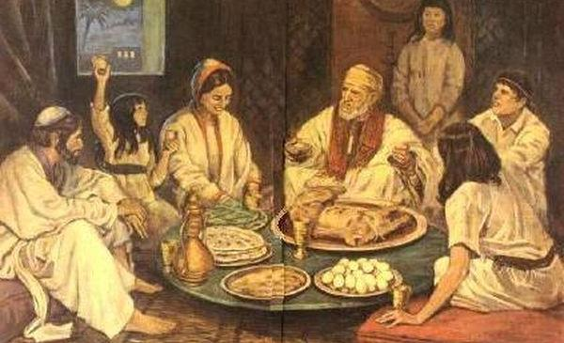
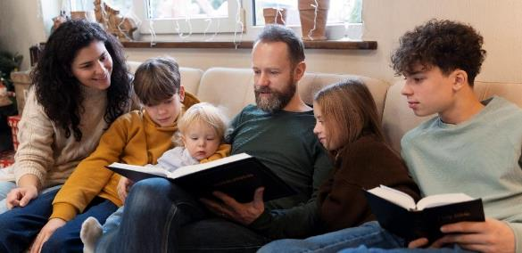
REMEMBER AND TEACH
“And you shall observe this thing as an ordinance for you and your sons forever” (Exodus 12:24)
Even before bringing them out of Egypt, God taught the Hebrew families to preserve their history by telling it to their children each year (Exod. 12:24-27).
From then on, Passover would be a family celebration. An opportunity for parents to pass on the knowledge of God to their children.
The story of liberation had to be explained in detail, and in the first person (Dt . 26:5-9).
This contains a very special lesson for us. We must pass on our faith to our children. We must tell them about what God has done, not only in history, but also in our own lives. We must bow down to them and worship (Ex. 12:27).

Slide 8
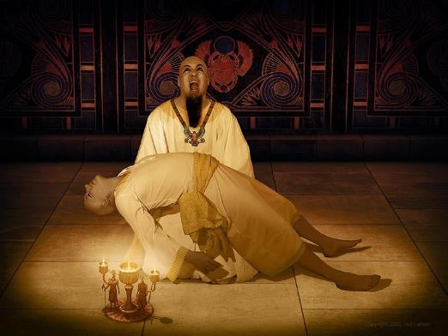
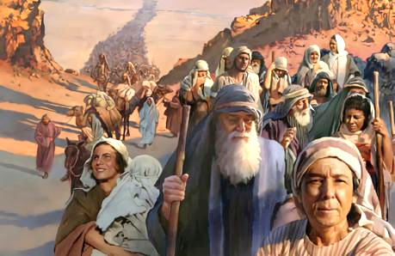
THE TENTH PLAGUE
“And it came to pass at midnight that the Lord struck all the firstborn in the land of Egypt, from the firstborn of Pharaoh who sat on his throne to the firstborn of the captive who was in the dungeon, and all the firstborn of livestock” (Exodus 12:29)
Pharaoh had ordered the killing of all Hebrew boys without exception (Ex. 1:22). God determined the conditional death of only the firstborn (Ex. 12:29). In every house where the blood of the lamb was not anointed, at least one person died (Ex. 12:30).
The judgments of God had fallen in full force upon the Egyptian gods, of whom Pharaoh was the representative (Ex. 12:12).
No Egyptian god raised his hand to help, nor could Pharaoh do anything to prevent the disaster.
As with Pharaoh, our sin can negatively affect others. But, as with Moses, our faithfulness and steadfastness can save many.

Slide 9
“They were required to separate themselves and their children from the Egyptians, and gather them into their own houses, for if any of the Israelites were found in the houses of the Egyptians, they would fall by the hand of the destroying angel. They were also directed to keep the feast of the passover for an ordinance, that when their children should inquire what such service meant, they should relate to them their wonderful preservation in Egypt. That when the destroying angel went forth in the night to slay the first-born of man, and the first-born of beast, he passed over their houses, and not one of the Hebrews was slain that had the token of blood upon their door-posts. […] They [some Egyptians] entreated to be permitted to come to the houses of the Israelites with their families, upon that fearful night when the angel of God should slay the first-born of the Egyptians. They were convinced that their gods whom they had worshiped were without knowledge, and had no power to save or to destroy. The Israelites welcomed the believing Egyptians to their houses”
EGW ( Spiritual Gifts, vol. 3, p. 223)

