Slide 1
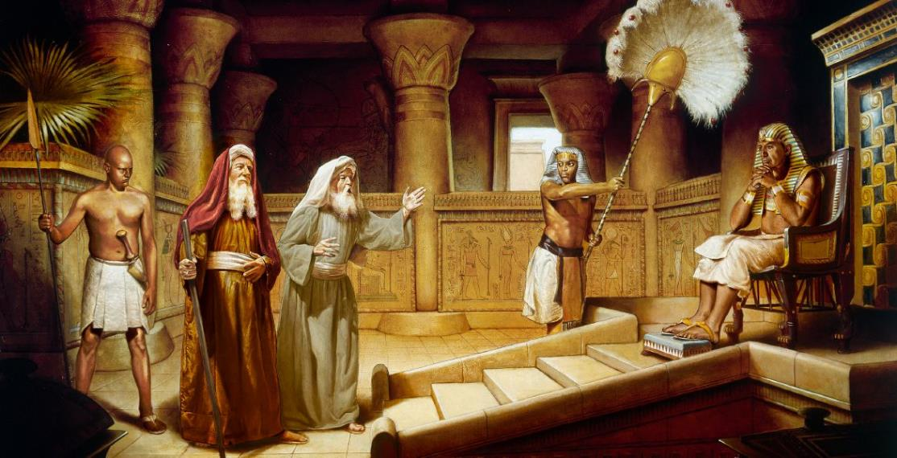
ROUGH START
Lesson 3 for July 19, 2025

Slide 2
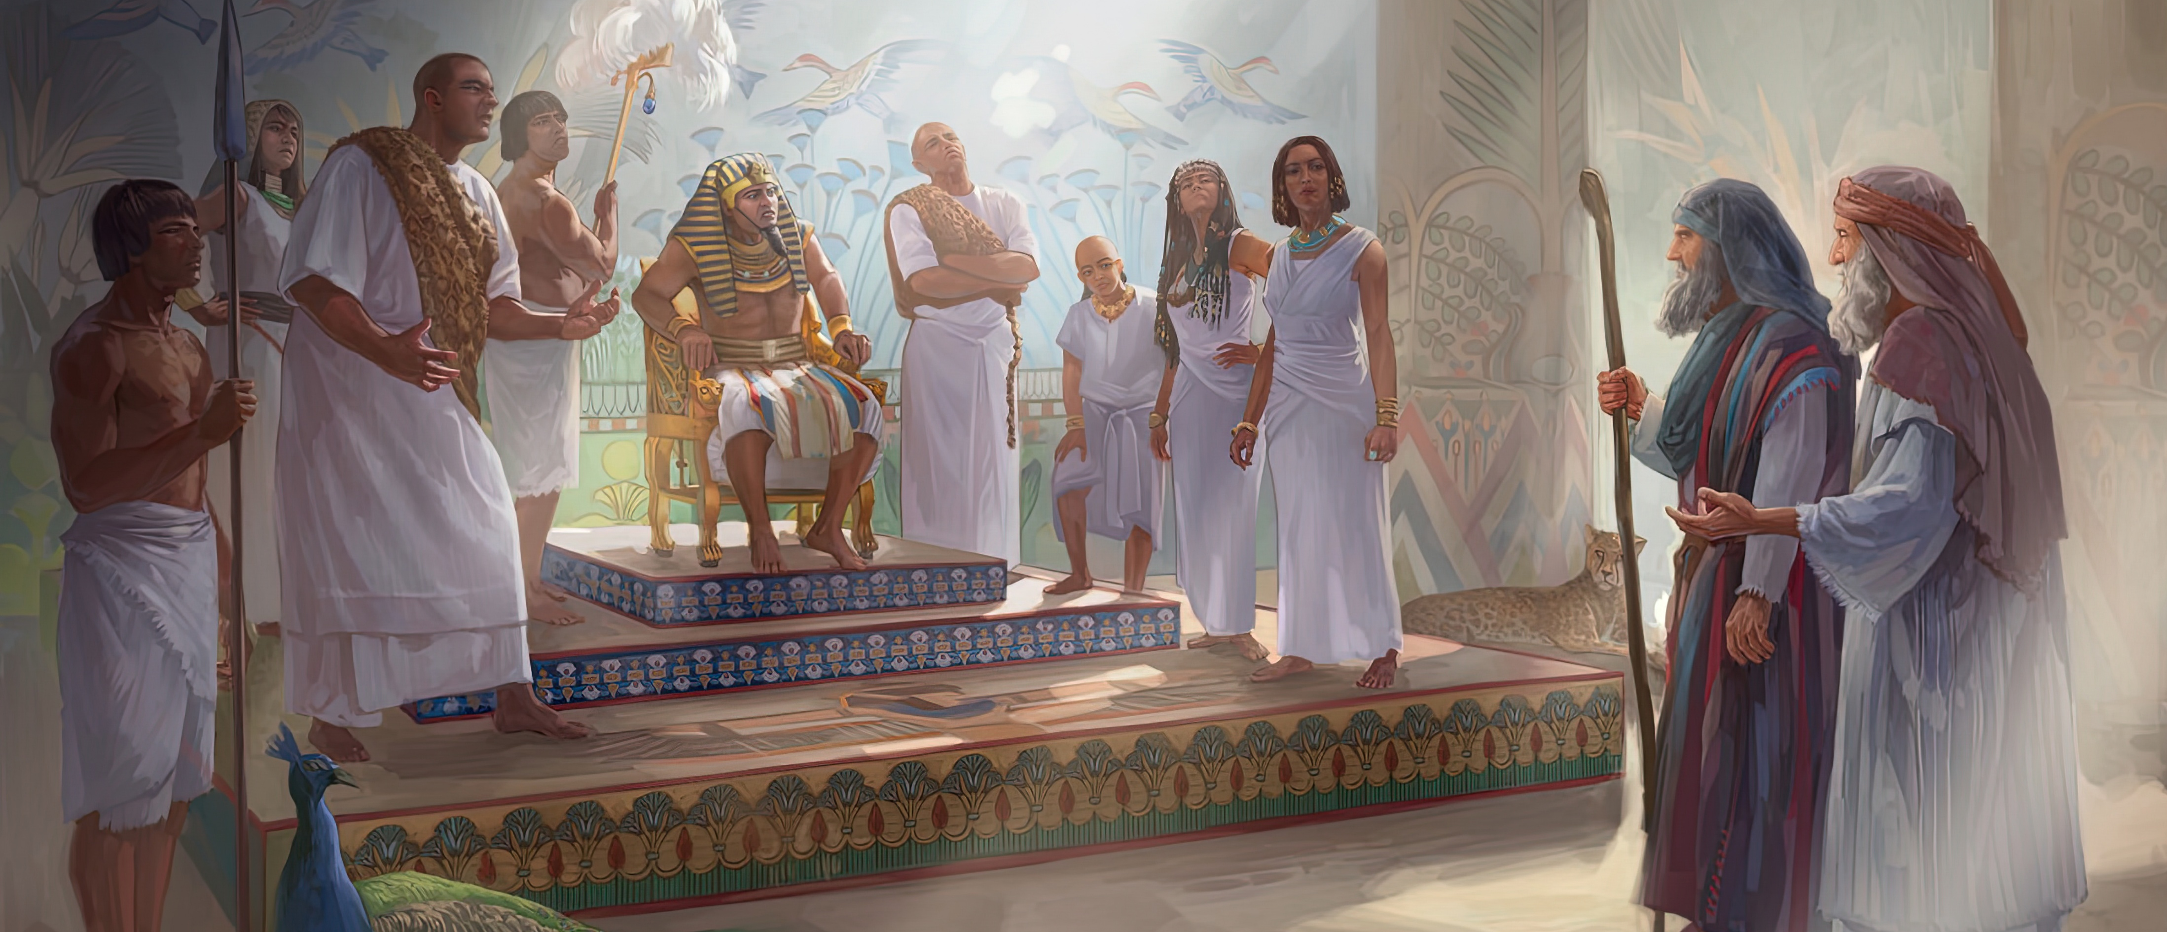
“Afterward Moses and Aaron went in and told Pharaoh, ‘Thus says the Lord God of Israel: “Let My people go, that they may hold a feast to Me in the wilderness.” ’ And Pharaoh said, ‘Who is the Lord, that I should obey His voice to let Israel go? I do not know the Lord, nor will I let Israel go’ ” Exodus 5:1, 2, NKJV

Slide 3
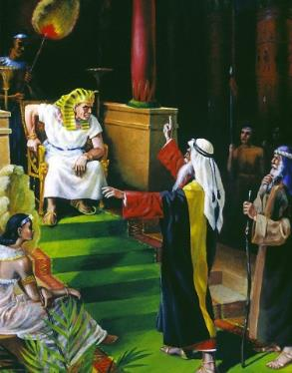
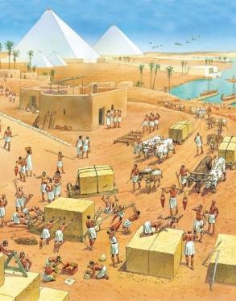
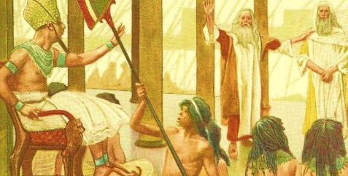
As Moses sensed, it would not be easy for Pharaoh to allow Israel to leave Egypt.
Nor did it seem logical to simply let such a large number of useful people go free, doing jobs that the Egyptians did not want to do.
So, the people's hopes were in miracles that would force Pharaoh to respond affirmatively to their request.
The request was made; it was rejected; there were reprisals; Moses did nothing miraculous; … disappointing.
The request: “Let my people go.”
Pharaoh's response (Exodus 5:1-2)
The people's response (Exodus 5:3-21)
God’s response (Exodus 5:22-6:8)
Moses' response (Exodus 6:9-13)
The role of Moses and Aaron (Exodus 6:28-7:7)

Slide 4
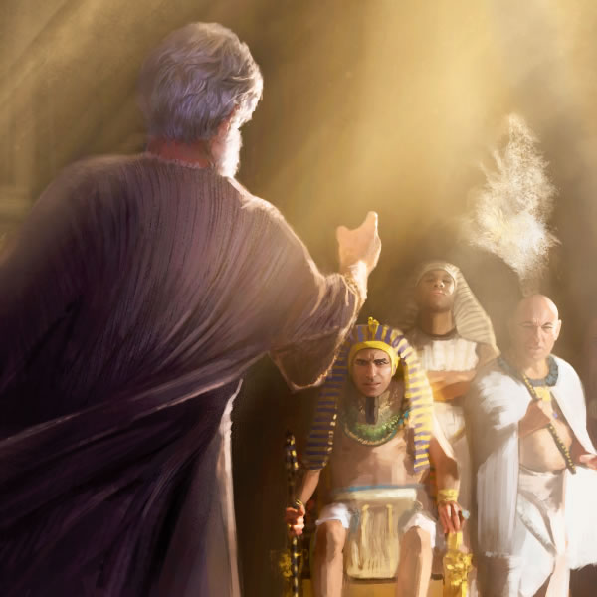
THE REQUEST:
“LET MY PEOPLE GO”

Slide 5
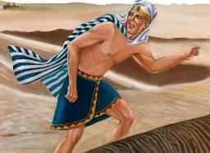
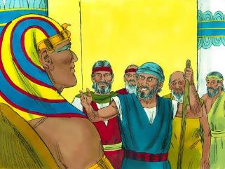
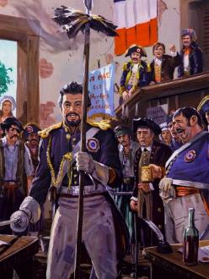
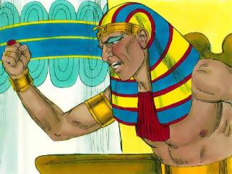
PHARAOH'S RESPONSE
“And Pharaoh said, Who is the Lord, that I should obey his voice and let Israel go? I do not know the Lord, neither will I let Israel go.” (Exodus 5:2)
Thutmose III was a child when he was placed on the throne under the regency of Hatshepsut to prevent Moses from being proclaimed pharaoh. Moses fled Egypt when Thutmose was still a teenager.
Forty years later, Moses found himself back in court. Had he come to claim his right to the throne? Not at all. The request was simple: “Let my people go” (Ex . 5:1).
Thutmose's response is a challenge, not to Moses, but to God himself. In short, he was challenging God's very existence (Exod . 5:2).
His attitude is used in Revelation as a symbol to represent the French nation during the 18th-century revolution (Rev. 11:8). Like Pharaoh, the French Republic declared religion abolished and declared itself an atheistic nation.

Slide 6
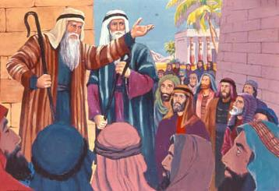
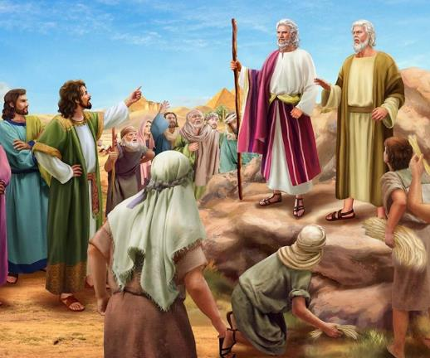
THE PEOPLE'S RESPONSE
“They said to them, ‘The Lord look upon you and judge, for you have made us abominable in the sight of Pharaoh and his servants, by putting a sword in their hand to kill us.’” (Exodus 5:21)
When Moses performed the signs God had given him before the people, they believed and worshipped (Ex. 4:29-31). We can imagine how eagerly they waited for Pharaoh's response to their request.
The response was truly unexpected. Pharaoh not only refused, but forced them to do the work without giving them the necessary materials, but demanding the same results (Ex. 5:6-8). What was the excuse for imposing such an irrational order?
Moses and Aaron—according to Thutmose—made them “rest [ shabbat ] from their labors” (Ex. 5:5). If they had time to talk about religion and freedom, they would also have time to look for straw (Ex. 5:9, 17).
When they were mistreated, the taskmasters complained to Pharaoh, but they were ignored. They then turned against Moses and Aaron, accusing them of making their situation worse (Ex. 5:20-21).

Slide 7
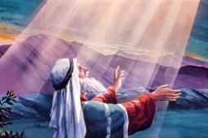
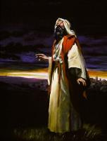
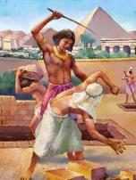
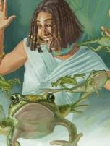
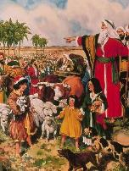
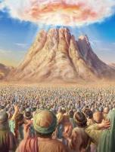
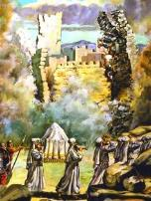
GOD’S RESPONSE
“The Lord said to Moses, ‘Now you will see what I will do to Pharaoh; for with a mighty hand he will let them go, and with a mighty hand he will drive them out of his land.’” (Exodus 6:1)
Pharaoh gets angry with Moses. The people get angry with Moses. Moses… isn’t angry, but he is dismayed, and he turns to God with his doubts: “Why are you afflicting this people? Why did you send me?” (Ex. 5:22).
Let us examine God's response (Ex. 6:1-8):
What I have done
I appeared to the prophets
What I will do
I will remove the oppression of the Egyptians from them
I will free them from slavery
I established my covenant with them
I promised to give them the land of Canaan
I have heard the moan of the people
I have remembered my promise
I will deploy my power
I'm going to make them my people
I will be their God
I will give them the land of Canaan

Slide 8
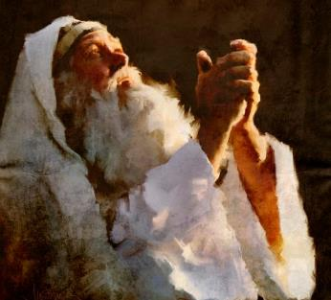
MOSES' RESPONSE
“And Moses said before the Lord, Behold, the children of Israel will not hearken unto me: how then shall Pharaoh hearken unto me, seeing I am slow of lips?” (Exodus 6:12)
After God's encouraging words, Moses spoke to the people again, but they did not listen (Ex. 6:9). God then asked him to speak to Pharaoh again to ask for Israel's freedom (Ex. 6:10-11).
Moses refused, and again brandished his excuses: If my people will not listen to me, how will Pharaoh hear me, when I speak so evilly as I do? (Ex. 6:12).
Moses was down, depressed, and disappointed. But, like other great figures who felt the same way he did—such as Asaph and Job—he did not give in to despair. His trust in God was stronger than his current feelings.
When we experience discouragement, let us make Asaph’s words our own: “But I am always with you, for you hold my right hand. You guide me with your counsel, and later you will welcome me to glory. Whom do I have in heaven but you? If I am with you, I desire nothing on earth. My body and my spirit may fail, but God strengthens my heart; he is my eternal heritage” (Ps. 73:23-26 NIV ).

Slide 9
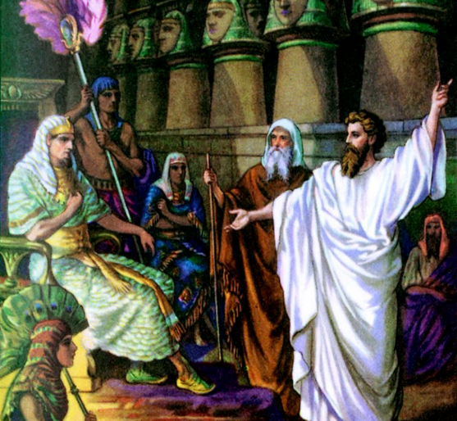
THE ROLE
OF MOSES
AND AARON

Slide 10
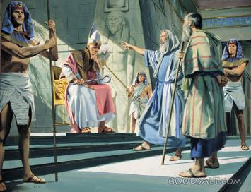
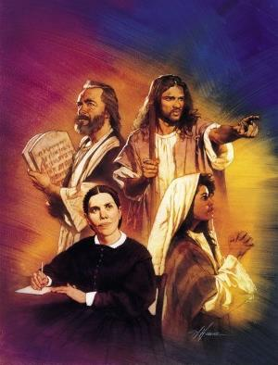
“The Lord said to Moses, ‘See, I have made you God to Pharaoh, and Aaron your brother shall be your prophet.’” (Exodus 7:1)
It seems that “I don’t know how to speak” was Moses’ favorite excuse. He even angered God with this one! But God has a solution for everything: Aaron, his talkative brother, would be Moses’ “mouth.” Moses spoke to his brother, and he spoke to the others (Ex. 4:10-16).
After the initial failures in Egypt, God had to remind Moses again of Aaron's role as his helper and spokesman (Ex. 7:1-2).
On this occasion, he made a comparison with the role of prophets. They receive a message from God and transmit it to us. In this sense, Moses plays the role of God, and Aaron that of the prophet.
As would later happen with many of the prophets, God warned that his message would not be heard, and that he would have to act with great power (Ex. 7:3).
Like later prophets, Moses was to speak to the people and Pharaoh, "whether they listen or turn away, for they are very rebellious" (Ezek. 2:7). This is also true of us, for we are the audible voice of God on this earth.

Slide 11
“The Hebrews had hoped to obtain their freedom without any special trial of their faith, without real hardship or suffering. But they were not yet ready for deliverance. They had little faith in God and were unwilling to patiently endure their afflictions until He saw fit to act on their behalf. Many were content to remain in servitude rather than face the difficulties that would attend a removal to a strange land; and the habits of some had become so like those of the Egyptians that they preferred to live in Egypt. Therefore, the Lord did not deliver them by the first manifestation of His power before Pharaoh. He orchestrated events so that the tyrannical spirit of the Egyptian king might be more fully developed and that He might reveal Himself to His people. When they saw His justice, His power, and His love, they would choose to leave Egypt and give themselves to His service.”
EGW (Patriarchs and Prophets, p. 236)

