Slide 1
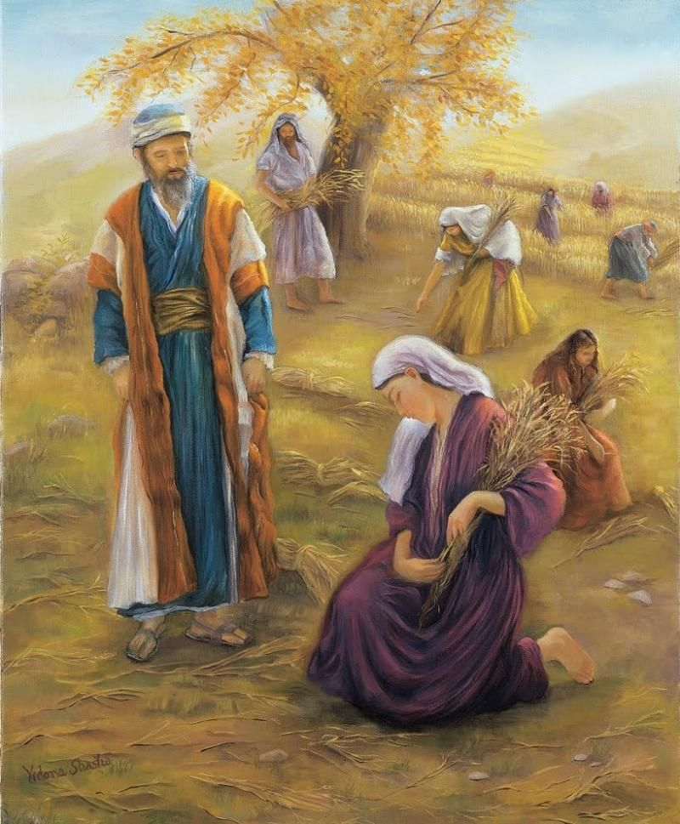
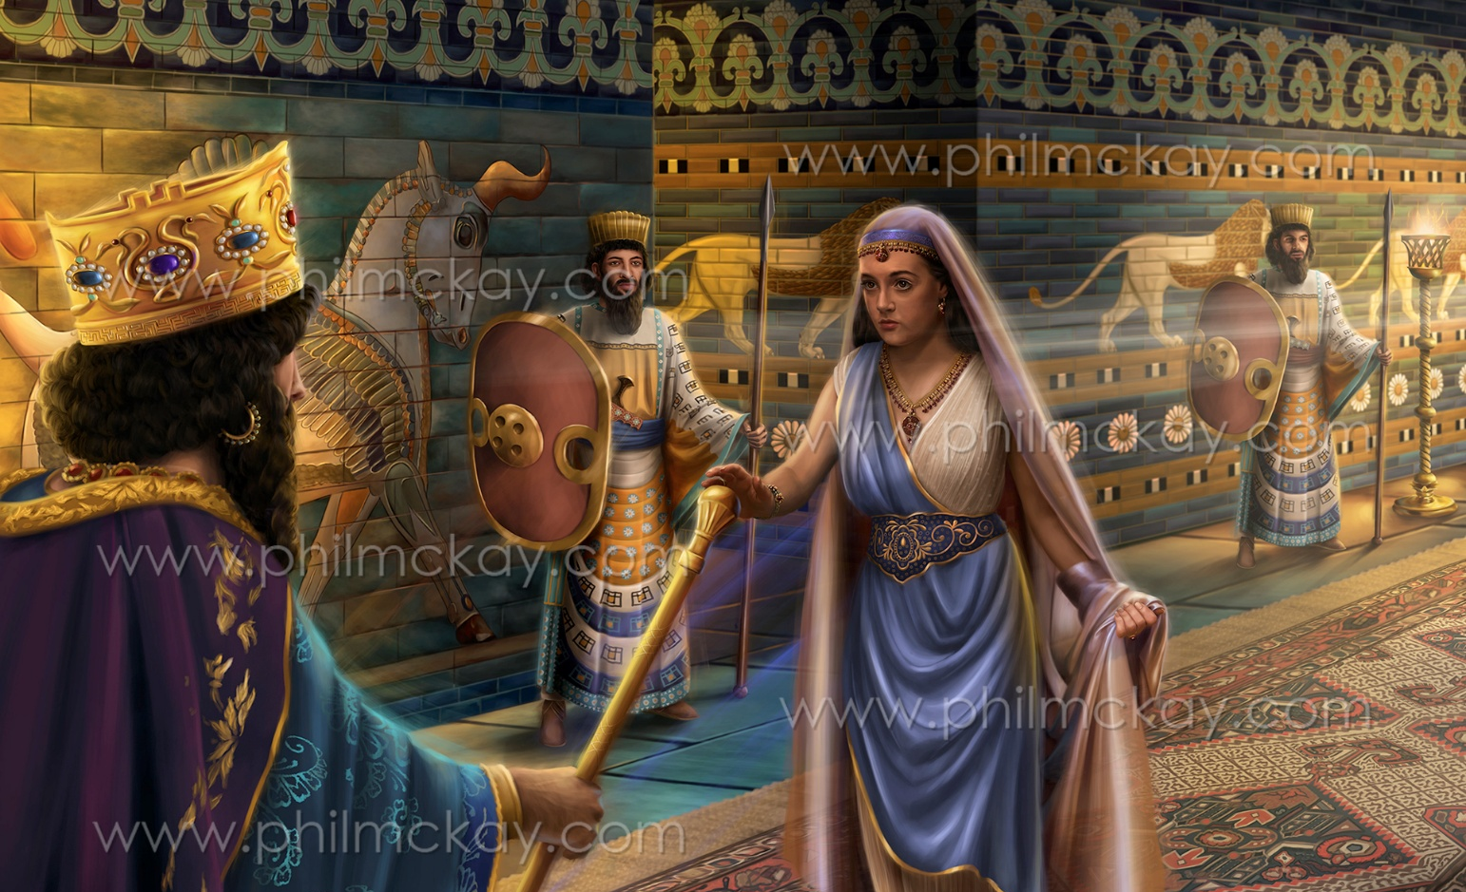
RUTH
AND
ESTHER
Lesson 11 for June 14, 2025

Slide 2
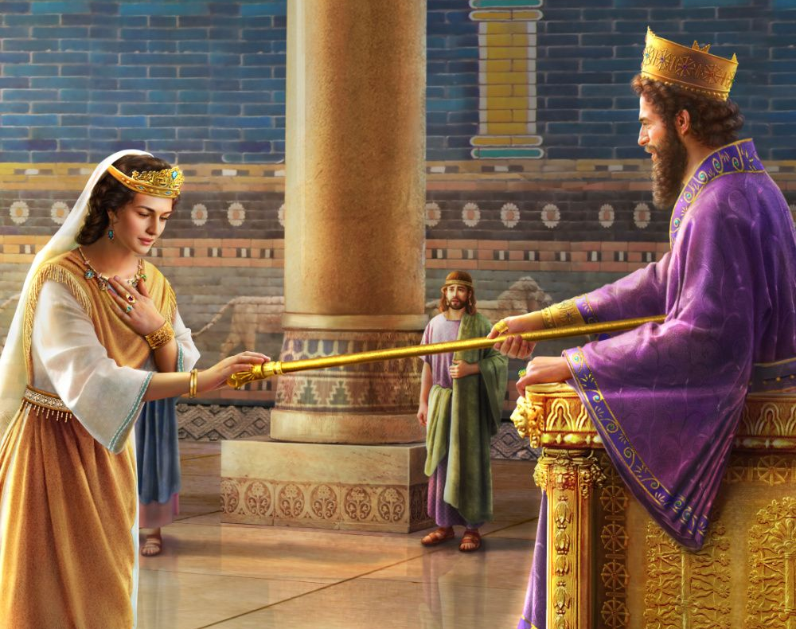
“So it was, when the king saw Queen Esther standing in the court, that she found favor in his sight, and the king held out to Esther the golden scepter that was in his hand. Then Esther went near and touched the top of the scepter”
Esther 5:2, NKJV

Slide 3
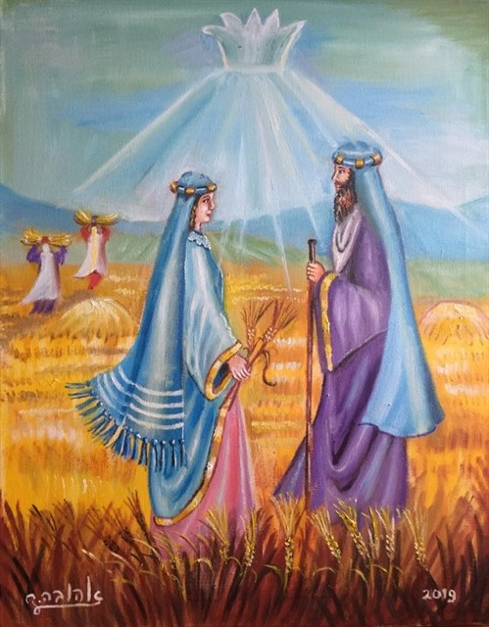
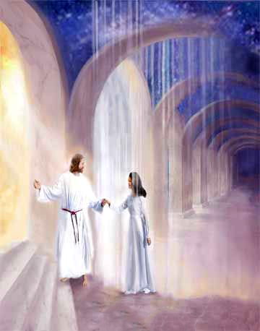
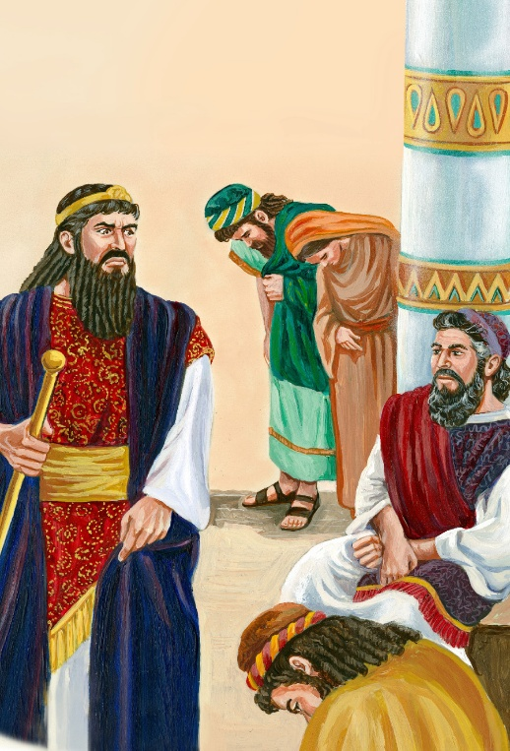
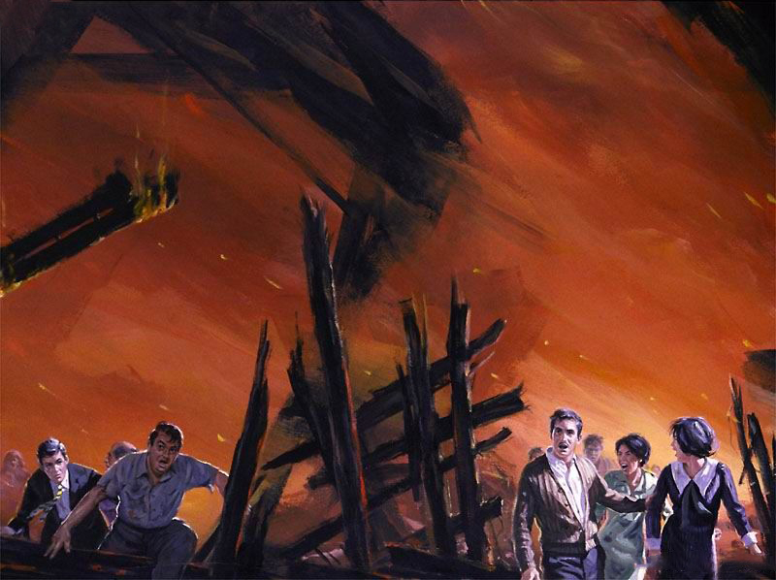
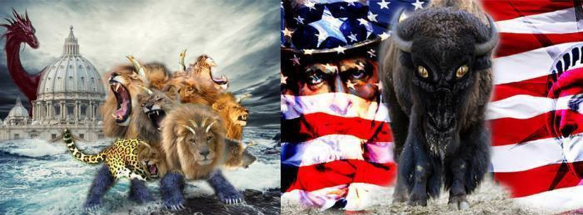
Ruth and Esther are the only two books in the Bible whose main protagonist is a woman. Two books with two impressive stories from which we can learn important lessons.
But, in addition to their historical and moral significance, Ruth and Esther have a symbolic value. As women, they represent God's faithful church. They teach us about the plan of redemption and the final episode in the conflict between Christ and Satan.
Ruth and the Plan of Redemption:
What was lost
The Redeemer
The Redemption
Esther and the End Time:
The conflict
The decisive hour

Slide 4
RUTH AND THE PLAN OF REDEMPTION

Slide 5
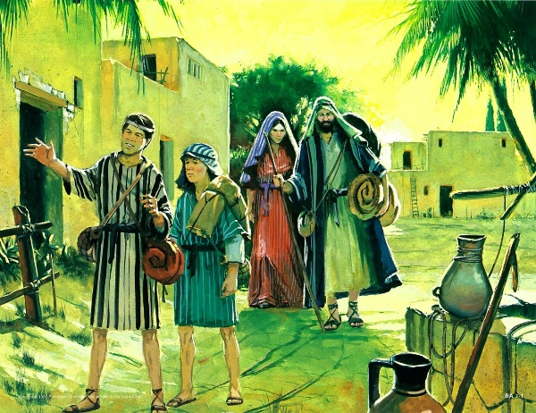
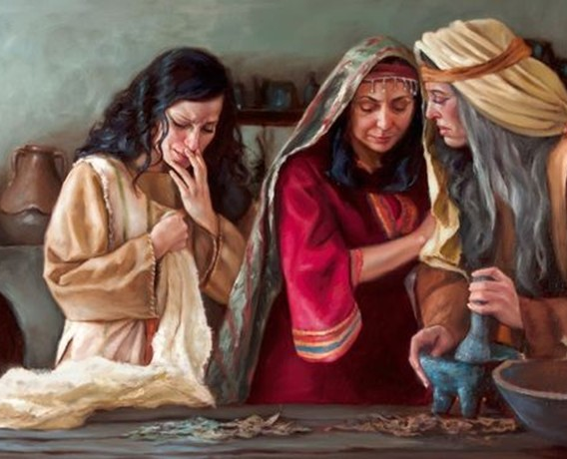
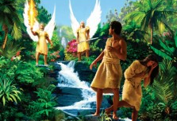
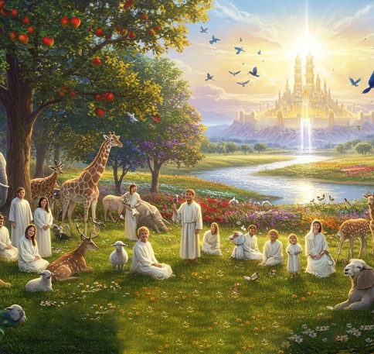
WHAT WAS LOST
“In the days when the judges ruled, there was a famine in the land. So a man from Bethlehem in Judah, together with his wife and two sons, went to live for a while in the country of Moab” (Ruth 1:1 NVI)
The story of Ruth can be understood as a parable that explains the plan of Redemption.
Elimelech and his family have to leave their home because in Bethlehem (whose name means “House of Bread”), there is no bread (Ruth 1:1), to reach a place where they found death (Ruth 1:3-5).
Sin turned the land God had given humanity into a place of death. In Eden, where God placed Adam and Eve, there was an abundance of all kinds of food (Gen. 1:29). But because of sin, they had to leave the garden and struggle to obtain their food (Gen. 3:17-18).
Even today, on a planet that produces enough food for everyone, some people still die of hunger. But the day will come when all this will end.

Slide 6
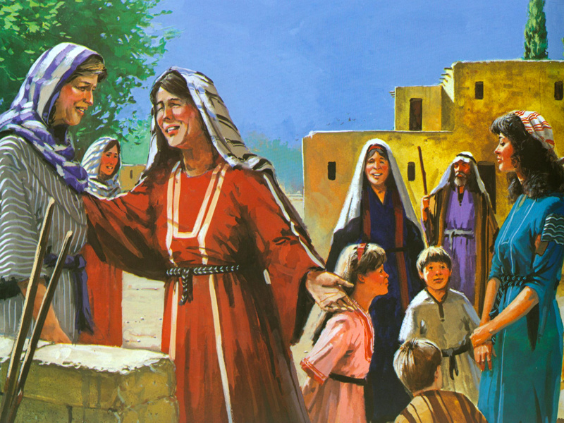
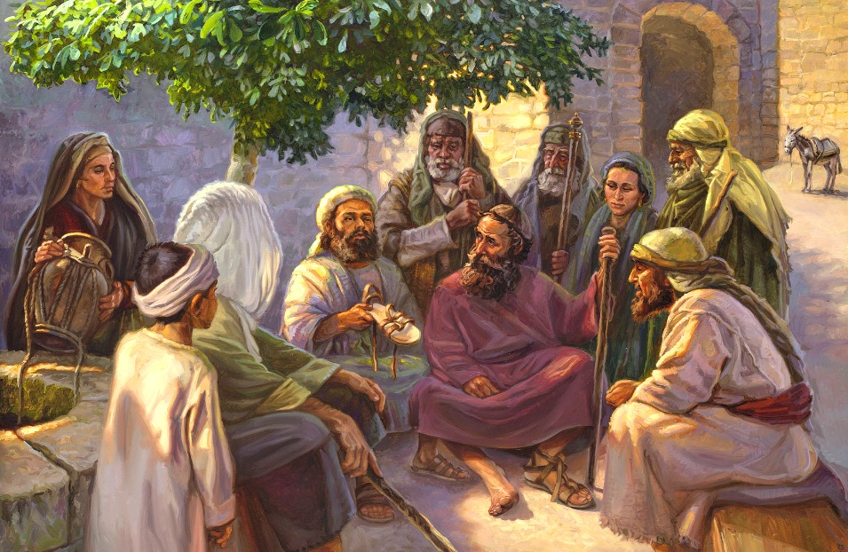
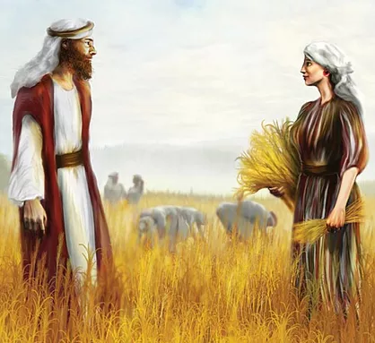
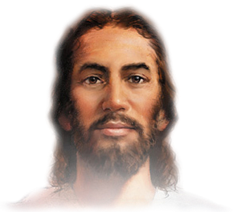
THE REDEEMER
“ ’May I continue to find favor in your eyes, my lord,’ she said. ‘You have put me at ease by speaking kindly to your servant—though I do not have the standing of one of your servants’ ” (Ruth 2:13 NVI)
When Naomi and Ruth returned to Bethlehem, Naomi asked to be called “Marah,” meaning bitterness (Ruth 1:19-20). Sin has turned our lives into bitterness, with only a few glimpses of joy. But, as Naomi later discovered, God has not forgotten us, and he waits to fill us with joy.
In order to survive, Naomi had to part with some of her property (Ruth 4:3). In Israel, there was a way to help in these situations. A relative could buy or take over the property and perpetuate the family name by marrying one of the widows. This act was called “redemption” (Ruth 4:4).
God arranged for Ruth to meet her redeemer, Boaz. In the way he treated Ruth, we can see a clear example of how Jesus treats us (Ruth 2:13-16).

Slide 7
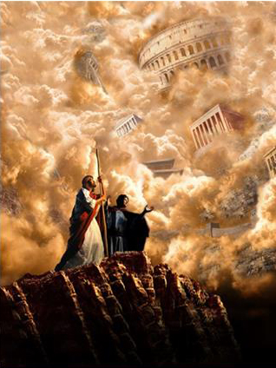
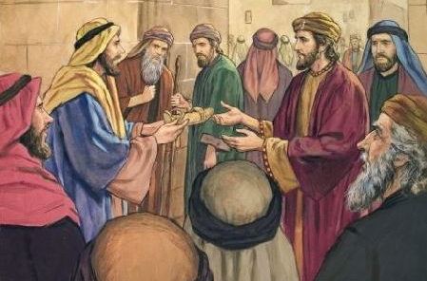
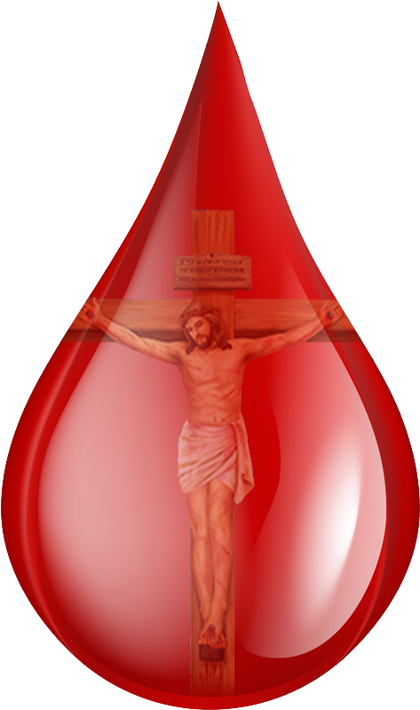
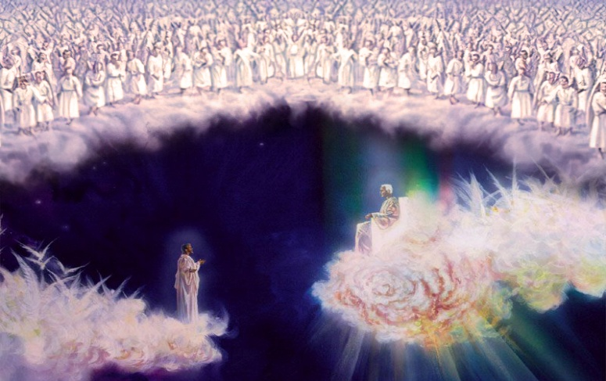
THE REDEMPTION
“At this, the guardian-redeemer said, ‘Then I cannot redeem it because I might endanger my own estate. You redeem it yourself. I cannot do it.’ ” (Ruth 4:6 NVI)
Boaz encountered an obstacle when it came to redemption. There was another suitor (Ruth 3:11-13). This “next of kinsman” symbolizes Satan, who believes he has a right over us and our planet (Luke 4:5-6; Jude 1:9; Luke 22:31).
Finally, at the city gate, after taking legal action before the elders, Boaz obtains redemption (Ruth 4:3-10).
Likewise, God gathers the “elders” representing the unfallen worlds, along with the angels, and conducts a careful investigation where it is decided that Jesus can redeem us (we call this the Judgment before the Second Coming).
On what basis can redemption be achieved? On the basis of the blood of Jesus, which He shed to free us from the power of evil and thwart the plans of the evil one.

Slide 8
“Of Christ's relation to His people, there is a beautiful illustration in the laws given to Israel. When through poverty a Hebrew had been forced to part with his patrimony, and to sell himself as a bondservant, the duty of redeeming him and his inheritance fell to the one who was nearest of kin. See Leviticus 25:25, 47-49; Ruth 2:20. So the work of redeeming us and our inheritance, lost through sin, fell upon Him who is “near of kin” unto us. It was to redeem us that He became our kinsman. Closer than father, mother, brother, friend, or lover is the Lord our Saviour. “Fear not,” He says, “for I have redeemed thee, I have called thee by thy name; thou art Mine.” “Since thou wast precious in My sight, thou hast been honorable, and I have loved thee: therefore will I give men for thee, and people for thy life.” Isaiah 43:1, 4”
EGW (The Desire of Ages, p.327)

Slide 9
ESTHER AND THE END TIME

Slide 10
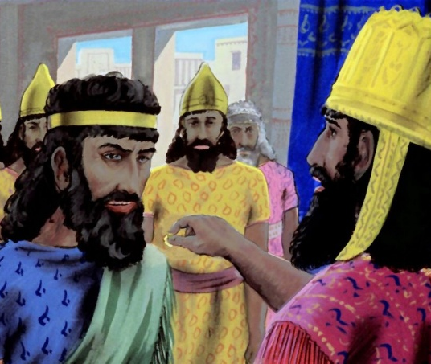
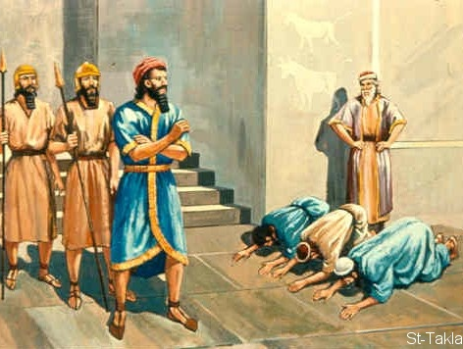
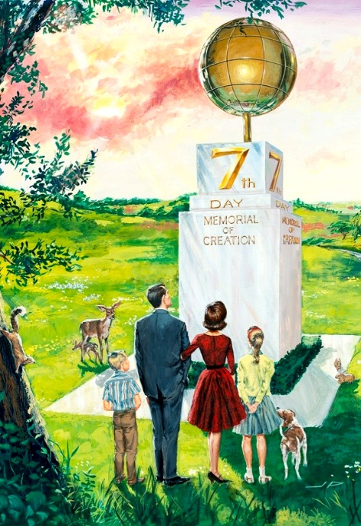
THE CONFLICT
“And the letters were sent by posts into all the king's provinces, to destroy, to kill, and to cause to perish, all Jews, both young and old, little children and women, in one day, even upon the thirteenth day of the twelfth month, which is the month Adar, and to take the spoil of them for a prey” (Esther 3:13)
Let's think of the book of Esther as a symbol of the end time:
Satan –represented by Haman– decrees the death of anyone who does not bow down before him
The remnant Church – represented by Esther – acts at the right time
Finally, the Church is delivered, and Satan and his followers are destroyed.
Haman is given authority over the kingdom of Persia, and everyone worships him, except for the Jew Mordecai. Upon learning of this, he decides to kill all the Jews (Esther 3:1-6).
At the end of time, Satan will demand worship through various political and religious powers. Those who refuse will die (Rev. 13:14-15).
A small group, despite the death decree, will decide to continue worshipping the Creator on the day He has appointed, and not on the day Satan wants it done (Ex. 20:8-11; Rev. 14:7).

Slide 11
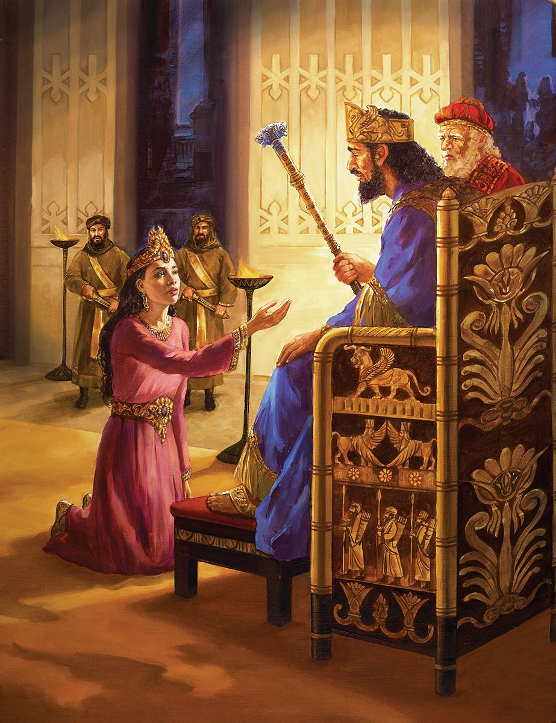
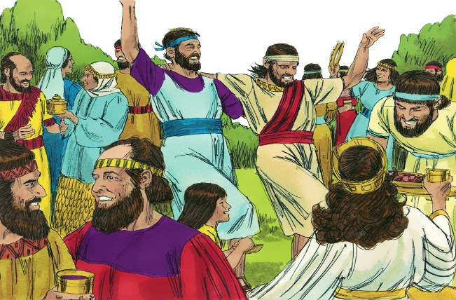
THE DECISIVE HOUR
“For if thou altogether holdest thy peace at this time, then shall there enlargement and deliverance arise to the Jews from another place; but thou and thy father's house shall be destroyed: and who knoweth whether thou art come to the kingdom for such a time as this?” (Esther 4:14)
Esther was the woman God had placed in the right place at the right time. Despite her initial fears, she decided to fulfill her mission, even at the risk of her own life (Esther 4:7-16).
When the persecution of the church ended (1798), Satan focused his attack on a faithful church that was emerging (Rev. 12:17; see Rev. 10).
This remnant church—the Adventist Church—though imperfect, is called to fulfill God's mission at a decisive moment; to remain faithful to God's commandments when the whole world tramples them underfoot (Rev. 12:17b; 13:15).
Finally, the Jews were freed and celebrated a great feast: Purim (Esther 9:20-22). Our “Purim” will be a continual feast, lasting not just two days, but an eternity (Revelation 7:13-17).

Slide 12
“History repeats itself. The same masterful mind that plotted against the faithful in ages past is now at work to gain control of the fallen churches, that through them he may condemn and put to death all who will not worship the idol Sabbath. We have not to battle with mortals, as it may appear. We war not against flesh and blood, but against principalities, against powers, against the rulers of the darkness of this world, against wicked spirits in high places. But if the people of God will put their trust in Him and by faith rely upon His power, the devices of Satan will be defeated in our time as signally as in the days of Mordecai.”
EGW (Christ Triumphant, December 25)

