Slide 1
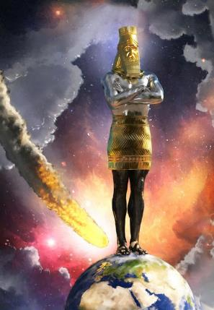
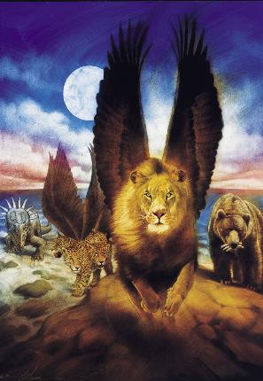
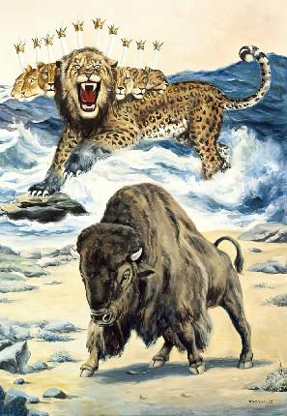
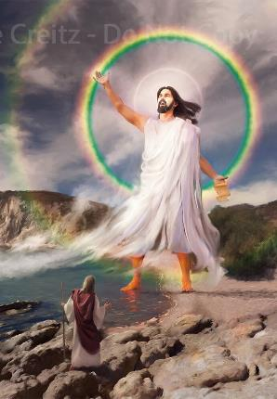
THE NATIONS: PART 2
Lesson 5 for May 3, 2025

Slide 2
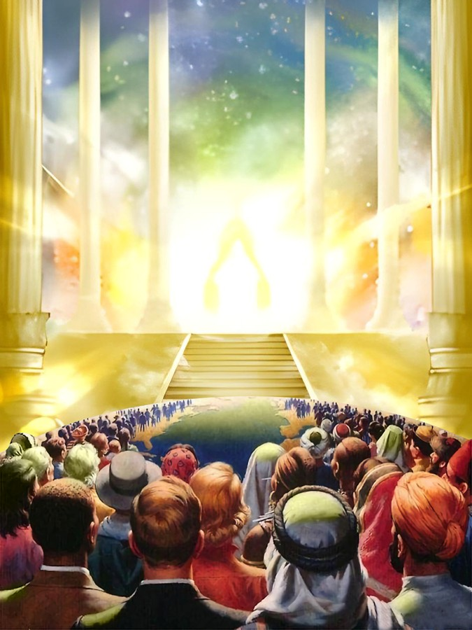
“Be still, and know that I am God; I will be exalted among the nations, I will be exalted in the earth!”
Psalm 46:10, NKJV

Slide 3

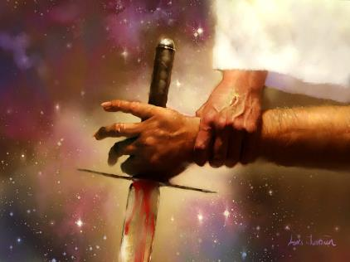
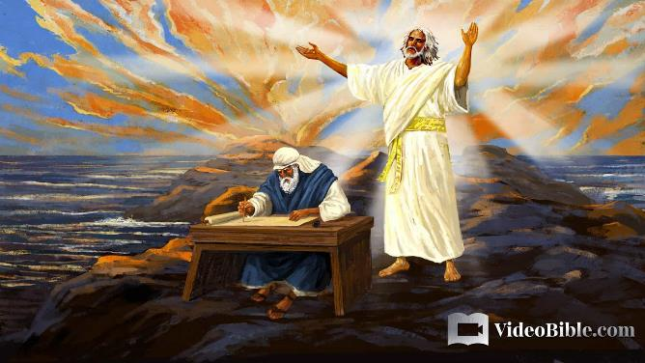



God wants us to know the development of the history of the open conflict between good and evil, between Christ and Satan.
For this reason, he showed the prophets the different stages of the conflict, especially those related to the role of nations.
The main source of this knowledge is found in the Book of Daniel, with John—in the Book of Revelation—being the one who received the most information about the final stage of the conflict.
The knowledge of good and evil
Knowledge of history:
  Precious metals
  Fantastic Beasts
The knowledge of the end time:
  The land and the sea
  The remnant people

Slide 4

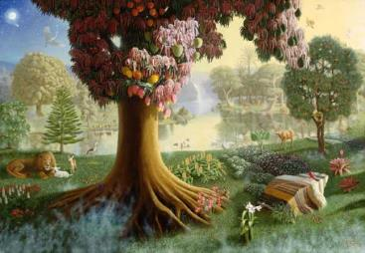
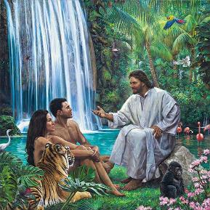
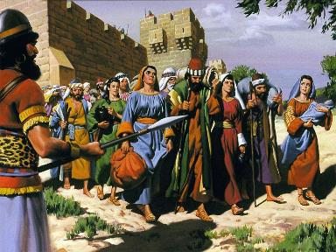
THE KNOWLEDGE OF GOOD AND EVIL
“For God knows that when you eat from it your eyes will be opened, and you will be like God, knowing good and evil.” (Genesis 3:5)
Eve was tempted to become equal with God, acquiring the knowledge of good and evil. And, apparently, she succeeded (Gen. 3:5, 22).
This knowledge had been clearly restricted to them by God (Gen. 2:16-17). Why did God withhold the knowledge of good and evil from the first couple?
If you read Genesis 3, you'll see that this knowledge brought them nothing good. Perhaps the problem wasn't the knowledge itself, but the way it was acquired. God wanted to teach the couple gradually, as children are taught in school. But they learned evil through experience.
This mistake was repeated by Israel when they asked for a king. Eventually, God allowed them to be subjected to other nations so they would know what it means to serve Him and what it means to serve the nations (2 Chron. 12:8).

Slide 5
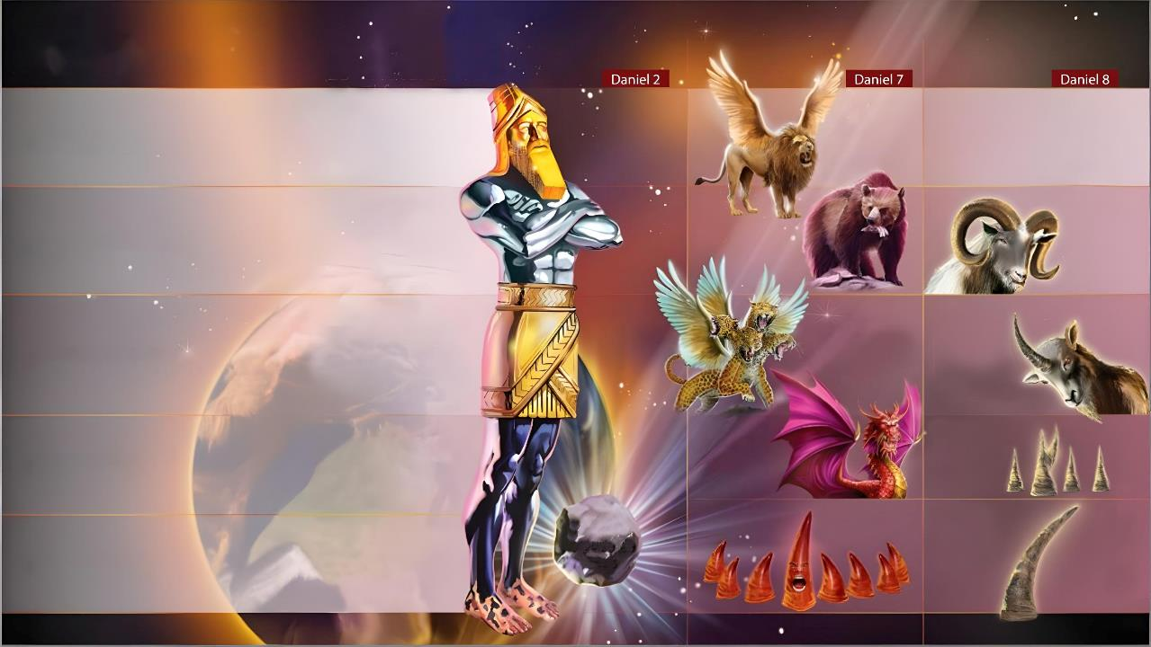
KNOWLEDGE OF HISTORY

Slide 6

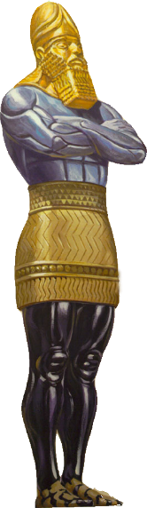
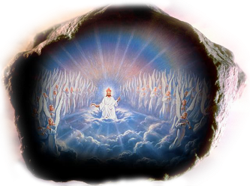

PRECIOUS METALS
“This image’s head was of fine gold, its chest and arms of silver, its belly and thighs of bronze, its legs of iron, its feet partly of iron and partly of clay” (Daniel 2:32-33)
King Nebuchadnezzar was shown the history of the nations through a terrible-looking statue (Dan . 2:31-45).
Babylon
(605 BC-539 BC)
The progressive devaluation of metals announced a progressive decline of humanity.
Medo-Persia
(539 BC-331 BC)
The Industrial Revolution, along with the theories of men like Darwin and Marx, have led us to believe that humanity can improve until it achieves a perfect society without God. What happened to the peace and security hoped for at the beginning of the 20th century?
Greece [Macedonia]
(331 BC-168 BC)
Rome
(168 BC - 476 AD)
The prophecy already warned us, and current events prove it: humanity is rapidly degenerating, especially morally. If it was right up to this point, we can trust that what is yet to happen will be fulfilled.
The eternal kingdom
Rome divided (476 AD-???)

Slide 7

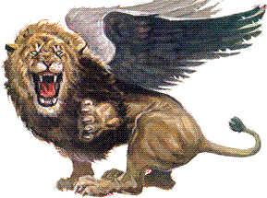

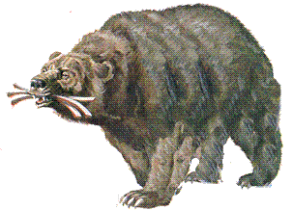
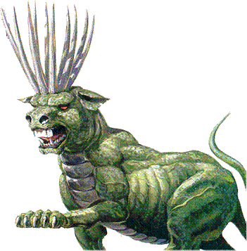
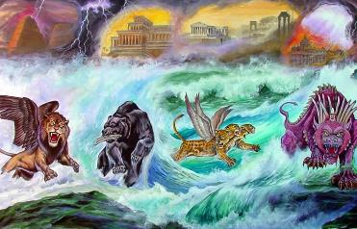

FANTASTIC BEASTS
“Daniel said: “In my vision at night I looked, and there before me were the four winds of heaven churning up the great sea. 3 Four great beasts, each different from the others, came up out of the sea.’” (Daniel 7:2-3)
Why repeat the succession of world empires again in another vision (Dan. 7:2-3, 16-18)?
Babylon
(605 BC-539 BC)
First, to make clear the certainty of its fulfillment (Gen. 41:32). Second, to show the relationship of God's people to the history of the nations, for this vision was given to a Hebrew prophet, not to a pagan king, as recorded in Daniel 2.
Medo-Persia
(539 BC-331 BC)
These nations would not arise peacefully, but as a result of wars (see Is. 17:12).
Greece [Macedonia]
(331 BC-168 BC)
Israel is not involved in the conflict; it is merely a victim; a territory that would pass from empire to empire; without autonomy.
Pagan Rome
(168 BC-476 AD)
How far from the ideal that God had thought for them! (Jer. 29:11).
Papal Rome
(476 AD-???)

Slide 8

“In the history of nations the student of God's word may behold the literal fulfillment of divine prophecy. Babylon, shattered and broken at last, passed away because in prosperity its rulers had regarded themselves as independent of God, and had ascribed the glory of their kingdom to human achievement. The Medo-Persian realm was visited by the wrath of Heaven because in it God's law had been trampled underfoot. The fear of the Lord had found no place in the hearts of the vast majority of the people. Wickedness, blasphemy, and corruption prevailed. The kingdoms that followed were even more base and corrupt; and these sank lower and still lower in the scale of moral worth.
EGW (Prophets and Kings, pg. 501-502)

Slide 9

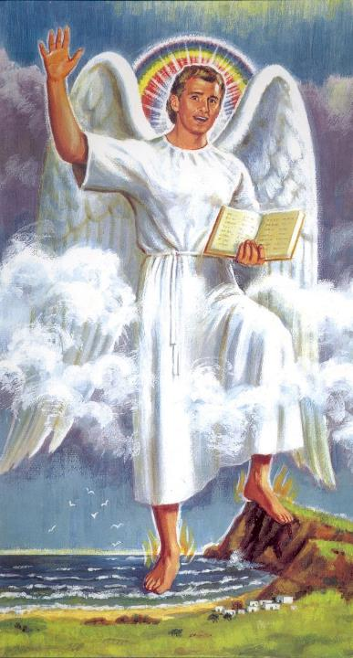
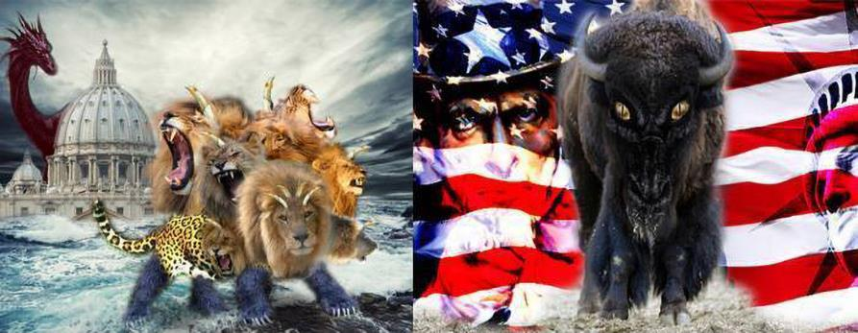
THE KNOWLEDGE OF THE END TIME

Slide 10

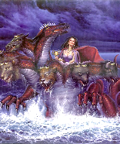
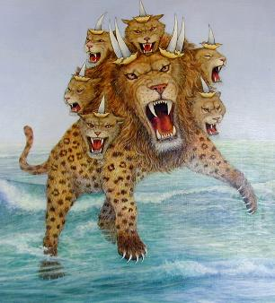
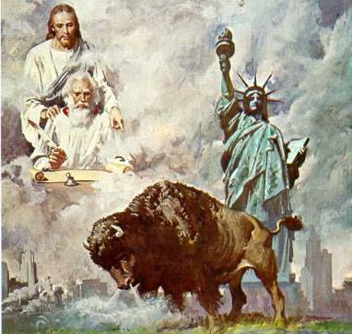
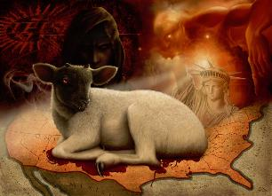
THE EARTH AND THE SEA
“[…] I saw a beast rising out of the sea […] I saw another beast rising out of the earth […]” (Revelation 13:1, 11)
As we saw, the sea represents wars and disorder. Revelation 17:15 expands on this concept by saying that the waters represent nations, multitudes who are not guided by God but are under the authority of the evil one.
From the sea comes the beast that fights against God's people at the end of time (Rev. 13:1, 17).
The earth, on the other hand, is depopwulated. It is a territory where the faithful church is taken when unconverted multitudes seek to destroy it (Rev. 12:15-16); a land of freedom (the United States).
From the earth arises the lamb-like beast (initially faithful to God), but speaking like the Dragon, who will persecute the faithful church during the final conflict on Earth. (Rev. 13:11-15).

Slide 11
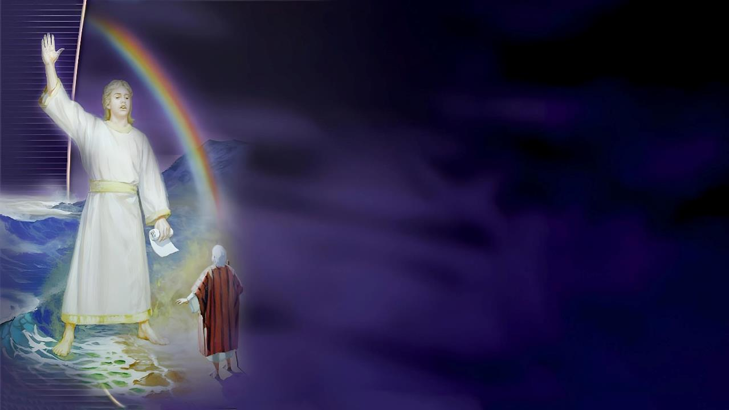
THE REMNANT PEOPLE
“Then I was told, “You must prophesy again about many peoples, nations, languages and kings” (Revelation 10:11)
Revelation 13 shows us the powers that will attack God's people from land and sea. Revelation 10 shows us God's people preaching the last message on both land and sea.
Rev. 10:1
A strong angel
Christ himself
Rev. 10:2
Bring a message to preach on land and sea
The message of the book of Daniel
Rev. 10:3-4
The interpretation is “sealed”
It was not yet time to know Daniel's interpretation
Rev. 10:5-7
An oath is interposed, like that of Daniel 12:7
The message is for the end time
Rev. 10:8-10
The message would be sweet, but with bitter results.
The preaching of the Second Coming resulted in a great disappointment
Rev. 10:11
It is necessary to prophesy again
The Adventist Church, emerging from the great disappointment, must preach the last message to the world

Slide 12

“The message of Revelation 14, proclaiming that the hour of God's judgment is come, is given in the time of the end. The angel of Revelation 10 is represented as having one foot on the sea and one foot on the land, showing that the message will be carried to distant lands, the ocean will be crossed, and the islands of the sea will hear the proclamation of the last message of warning to our world. […]
Not one cloud has fallen upon the church that God has not prepared for; not one opposing force has risen to counterwork the work of God that He has not foreseen. All has taken place as He has predicted through His prophets. He has not left His church forsaken in darkness, but has traced in prophetic declarations what would occur, and through His providence, acting in its appointed place in the world's history, He has brought about that which His Holy Spirit inspired the prophets to foretell. All His purposes will be fulfilled and established”.
EGW (Christ Triumphant, November 29)

