Slide 1
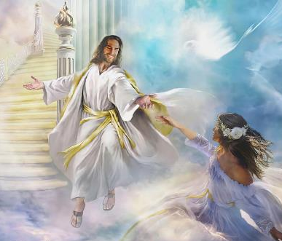
Lesson 3 for April 19, 2025
IMAGES FROM MARRIAGE

Slide 2
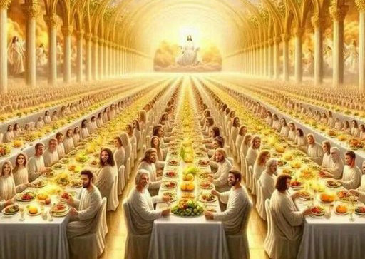
“Then he said to me, ‘Write: “Blessed are those who are called to the marriage supper of the Lamb!” ’ And he said to me, ‘These are the true sayings of God’ ”
Revelation 19:9, NKJV

Slide 3
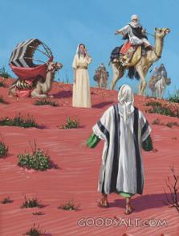
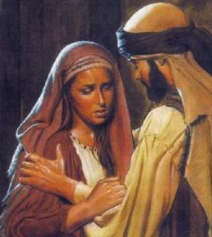
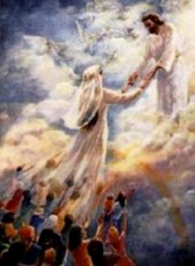
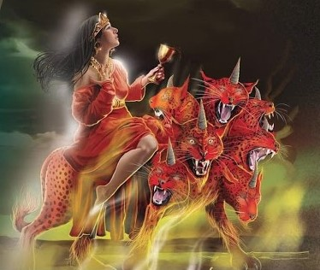
Repeatedly, in both the Old and New Testaments, God's people are compared to a wife or bride.
Sometimes we see this union symbolized in marriages whose wives were faithful (like Rebekah) or unfaithful (like Gomer.)
Other times, symbols of faithful wives (the Lamb's bride,) or promiscuous women (Babylon the Great) are used directly.
The symbolism of marriage.
Unfaithful wives:
The abandoned young woman.
Hosea's wife.
Babylon the Great.
Faithful wives:
Rebekah.
The Bride of the Lamb.

Slide 4
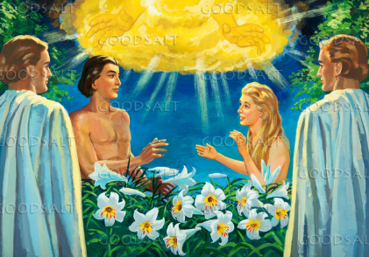
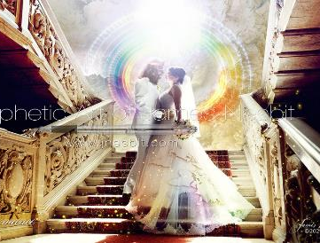
THE SYMBOLISM OF MARRIAGE
“Therefore shall a man leave his father and his mother, and shall cleave unto his wife: and they shall be one flesh” (Genesis 2:24)
When God created humanity, he gave us two gifts: The Sabbath (Gen. 2:2-3) and marriage (Gen. 2:24.) Both have to do with relationship: relationship with God, and between a man and a woman.
In its perfection, marriage reflected the perfect relationship between the members of the Godhead. After sin, it symbolizes the union between a perfect Husband—Jesus—and his imperfect Wife—the Church (Eph. 5:31-32.)
Forgive your spouse, however undeserving
as Christ forgives us, however undeserving
Accept your spouse, faults and all
as Christ accepts us, faults and all
Throughout the Bible, we see how husbands strive to perfect their wives and earn their love. From this example of marriage, we can also learn how to act in our own marriages (between two imperfect people):
Put your spouse before yourself
as Christ put us before Himself

Slide 5
UNFAITHFUL WIVES

Slide 6
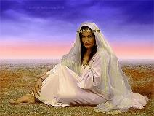
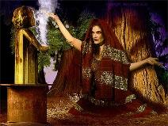
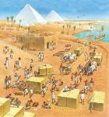
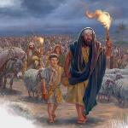
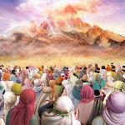
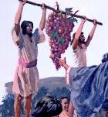
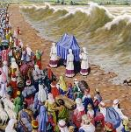
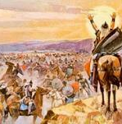
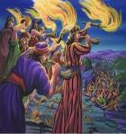
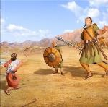
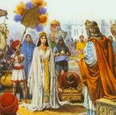
THE ABANDONED YOUNG WOMAN
“Now when I passed by thee, and looked upon thee, behold, thy time was the time of love; and I spread my skirt over thee, and covered thy nakedness: yea, I sware unto thee, and entered into a covenant with thee, saith the Lord God, and thou becamest mine” (Ezekiel 16:8)
In a vision, Ezekiel was shown how God found an abandoned baby girl (Israel); gave her life; helped her grow; made a marriage covenant with her; and she became a queen admired by all (Ezek. 16:1-14.)
This sums up the love story between God and the people of Israel from their departure from Egypt to the prosperous reign of David and Solomon, when Israel was admired by all nations (1 Kings 10:1.)
But Israel forgot that her beauty was a gift from God, a reflection of divine beauty (Ezek. 16:14,) and she turned away from her Husband, prostituting herself after other gods (Ezek. 16:15-17.)
We were created to reflect God's goodness and glory. When we assume our goodness is a product of ourselves, problems begin.

Slide 7
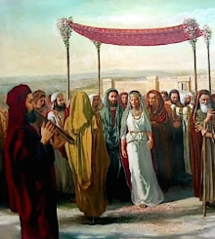
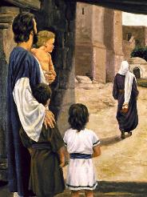
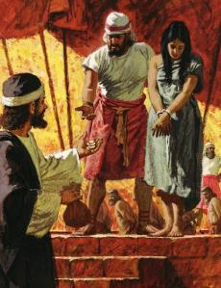
HOSEA'S WIFE
“The beginning of the word of the Lord by Hosea. The Lord said to Hosea, Go, take for yourself a wife of whoredom and children of whoredom, for the land commits whoredom, departing from the Lord.” (Hosea 1:2)
From the outset, God makes it clear that the command given to Hosea to marry Gomer (who had prostituted herself and abandoned her husband) was a symbol of the relationship between God and Israel (Hos. 1:2.)
Hosea used various methods to win back his wife's love (Hos. 2:6-7, 14-15.) Since none of these methods succeeded, he had to pay her ransom (Hos. 3:2-3.)
Of course, our rescue cost God much more than “fifteen pieces of silver, and for an homer of barley, and an half homer of barley.”
Unfortunately, the Church followed the same misguided path as Israel. But God's love remains unchanged (Hos. 11:4.) He continues to implore us to abandon "prostitution" and return to Him (Hos. 14:1-2; Rev. 18:2-4.)

Slide 8
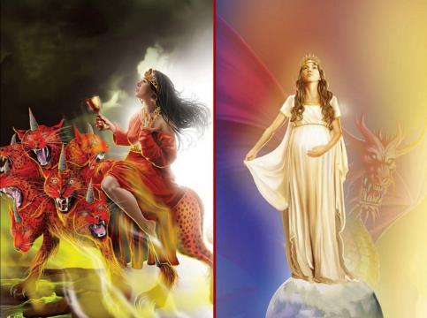
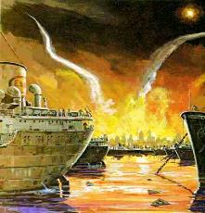
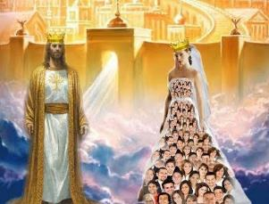
BABYLON THE GREAT
“And upon her forehead was a name written, Mystery: BABYLON THE GREAT, THE MOTHER OF HARLOTS AND ABOMINATIONS OF THE EARTH” (Revelation 17:5)
Who or what is Babylon?
A pure woman represents God's faithful people (Rev. 12:1; Eph. 5:25-27.) Babylon, the mother of harlots, represents God's people who turn away from Him and rely on the kings of the earth (Rev. 17:1-5.)
This unfaithfulness on the part of His people causes God deep sorrow. For centuries, He has tried to restore His Church to purity, but few have responded. Finally, He will make one last appeal (Rev. 18:4.)
After an infidelity, reconciliation can occur. However, unfortunately, sometimes a point of no return is reached, when reconciliation is impossible.
The time will come for Babylon and those who remain in her to be judged and punished (Rev. 19:1-5.) But the faithful, the Lamb's bride, will live forever with Jesus (Rev. 19:6-8.)

Slide 9
FAITHFUL WIVES

Slide 10
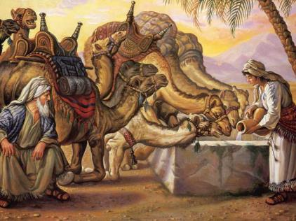
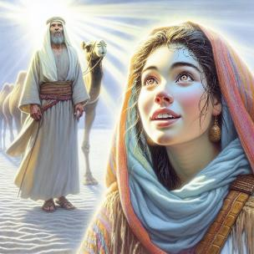
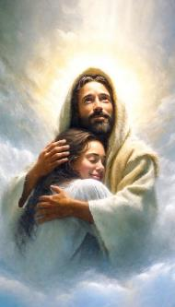
REBEKAH
“And they called Rebekah, and said unto her, Wilt thou go with this man? And she said, I will go” (Genesis 24:58)
According to the custom of his time, Abraham set out to find a wife for his son, Isaac. But he did not want to marry his son to any of the women of Canaan, but to one of his relatives, thousands of miles away (Gen. 24:2-3.)
The reason for this? Although imperfectly, his relatives worshipped the true God, while the Canaanites rejected him. If Isaac married a Canaanite woman, his religious life would decline due to his wife's negative influence.
Such has been the history of the Church when she has contracted "marriages" with the nations of this world. Gradually, she has distanced herself from the true faith.
Another special aspect of this story is the fact that Rebekah is asked if she wants to get married, since, according to custom, she had no other choice (Gen. 24:50-51, 57-59.)
Being part of God's faithful bride is a voluntary act. Let us accept Jesus' love with a clear "I will go."

Slide 11
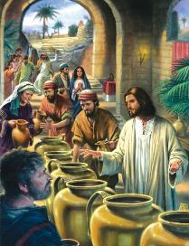
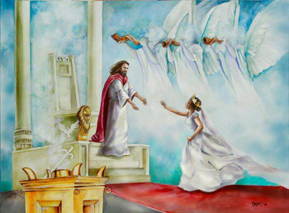
THE BRIDE OF THE LAMB
“Let us be glad and rejoice, and give honour to him: for the marriage of the Lamb is come, and his wife hath made herself ready” (Revelation 19:7)
Jesus' first miracle was performed at a wedding (John 2:1-11.) From our perspective, this act has a certain symbolism that helps us understand the Plan of Salvation.
What can we learn from these parables?
The 10 virgins (Mt. 25:1-13)
Have the Holy Spirit
Accept your calling
The Unworthy Guests (Mt. 22:1-14)
Everyone is called to the wedding
We must clothe ourselves in Christ
Perhaps the most important is that, for the bride (us) to be ready, she needs the wine that Jesus provides, that is, his purifying blood (Jn. 2:6; Rev. 7:14.)
Jesus also used parables related to the wedding to illustrate certain aspects of the preparation we must make for His imminent coming. In all of them, the bride is never mentioned, but rather the guests. Could the guests be the bride herself?

Slide 12
“Christ has been a daily companion and familiar friend. They have lived in close contact, in constant communion with God. Upon them the glory of the Lord has risen. In them the light of the knowledge of the glory of God in the face of Jesus Christ has been reflected. Now they rejoice in the undimmed rays of the brightness and glory of the King in His majesty. They are prepared for the communion of heaven; for they have heaven in their hearts.”
EGW (Reflecting Jesus, July 17)

