Slide 1
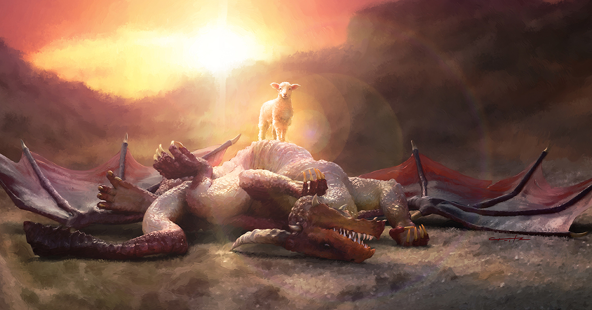
THE COSMIC CONFLICT
Lesson 9 for March 1, 2025

Slide 2
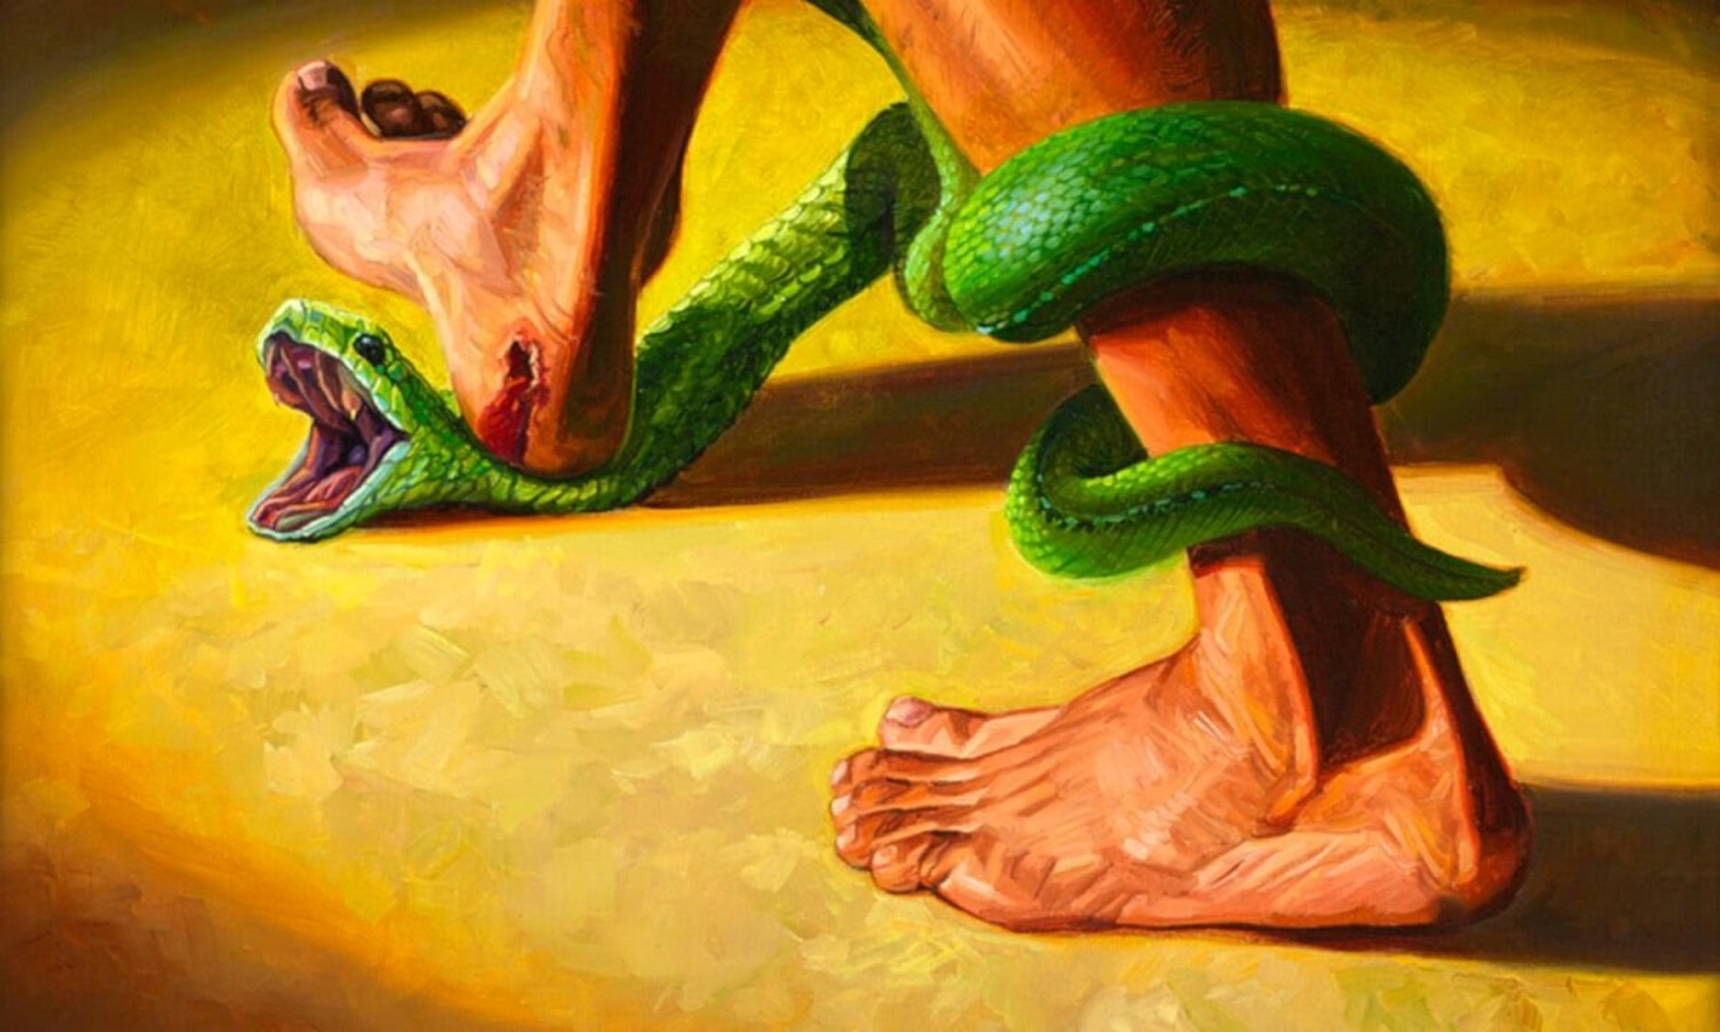
“And I will put enmity between you and the woman, and between your seed and her Seed; He shall bruise your head, and you shall bruise His heel” Genesis 3:15, NKJV

Slide 3



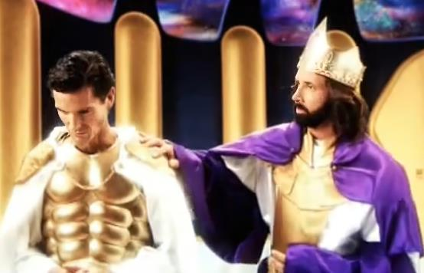



We call the confrontation between God and Satan, between the Creator and a creature dissatisfied with his government, the Cosmic Conflict. With this rebellion, a new concept arose in the universe: evil.
The presence of the deceitful serpent in Eden shows that evil already existed before Adam and Eve's transgression.
Although God could have crushed Satan and his rebellion from the beginning, He did not do so. Why does God still tolerate evil? How does God best show His love—by destroying evil or by allowing it?
The Beginning of the Cosmic Conflict:
  The originator of the Conflict.
The development of the Cosmic Conflict:
  Conflict comes to Earth.
  Jesus and Satan face to face.
The resolution of the Cosmic Conflict:
  The nature of the Conflict.
  Why isn't it over yet?

Slide 4

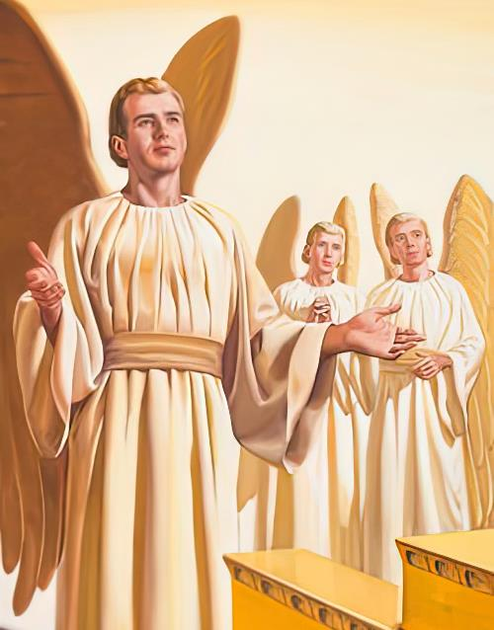
THE BEGINNING OF THE COSMIC CONFLICT

Slide 5











THE ORIGINATOR OF THE CONFLICT
“You were blameless in your ways from the day you were created till wickedness was found in you” (Ezekiel 28:15)
Did God create an evil being?
Ezekiel 28:12-15 sheds light on the nature of Satan when he was created:
The seal of perfection
Full of wisdom
Beauty finish
Gemstone dress
Music teacher
Cherub protector
Walking on fire
Perfect
This perfect being inexplicably sinned and was cast out of Heaven (Ezek. 28:16;
Is. 14:12). The Bible only tells us that it was pride that led his heart astray, and that he decided to slander God and set himself up as the new ruler of the Universe.
(Ezek. 28:17-18; Is. 14:13-14).

Slide 6

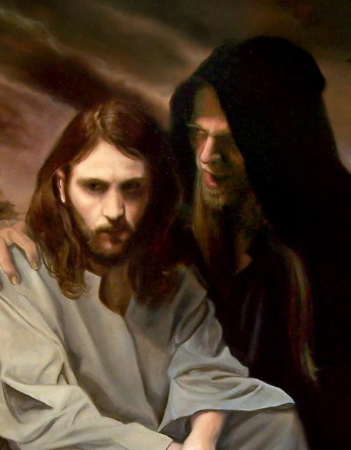
THE DEVELOPMENT OF THE COSMIC CONFLICT

Slide 7



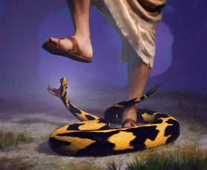
CONFLICT COMES TO EARTH
“You will not certainly die,” the serpent said to the woman. “For God knows that when you eat from it your eyes will be opened, and you will be like God, knowing good and evil. ’” (Genesis 3:4-5)
Did God create Adam and Eve with a tendency toward evil?
After creating the world and everything in it, God clearly states that “what He had made […] was very good” (Genesis 1:31). This included, of course, Adam and Eve.
After gaining Eve's trust, Satan, the ancient serpent, raised doubts about God's character: “You will not certainly die,” the serpent said to the woman. “For God knows that when you eat from it your eyes will be opened, and you will be like God, knowing good and evil” (Gen. 3:4-5).
Now, Eve was faced with a dilemma: who to believe, God or the serpent? The same dilemma that every angel had to face. The very root of the Cosmic Conflict.
Despite their wrong choice, God did not abandon mankind. He promised that Jesus would crush Satan and end the Conflict. Because of Him, we can have hope.

Slide 8

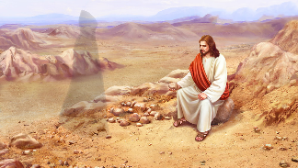
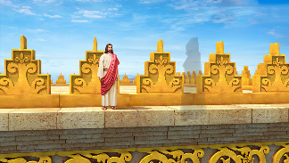



JESUS AND SATAN FACE TO FACE
“And he said to him, “I will give you all their authority and splendor; it has been given to me, and I can give it to anyone I want to. If you worship me, it will all be yours” (Luke 4:6-7)
Despite his delusions of power, Satan had no chance against the Almighty God, who was far superior to him.
But things changed when God became man. Now, in certain ways, Jesus was inferior to him. Satan tried to receive what had been denied him in Heaven: worship (Mt. 4:8-9).
He could not derail Jesus by feeding him (as he did Eve, Mt. 4:3-4). Nor could he derail him by inciting him to presumption (a reflection of his own character, Mt. 4:5-7). Finally, Jesus also resisted direct attack: “If you worship me, it will all be yours” (Lk . 4:6-7).
Jesus won the battles of the Conflict with a weapon that is at our disposal, and we must use it as He did: The Bible.

Slide 9

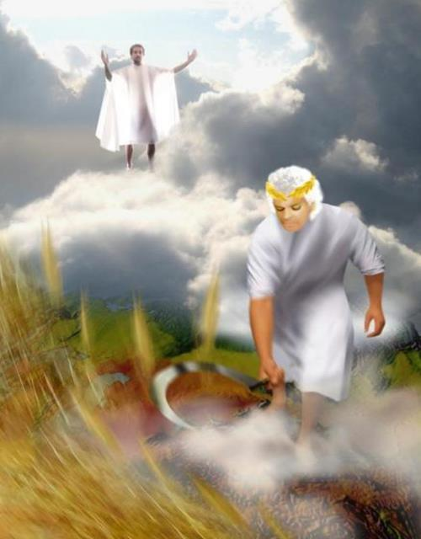
THE RESOLUTION OF THE COSMIC CONFLICT

Slide 10

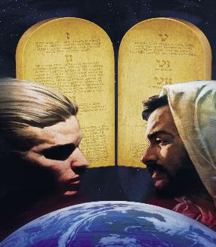
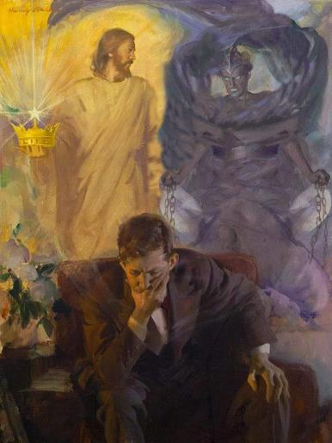
THE NATURE OF CONFLICT
“You belong to your father, the devil, and you want to carry out your father’s desires. He was a murderer from the beginning, not holding to the truth, for there is no truth in him. When he lies, he speaks his native language, for he is a liar and the father of lies!” (John 8:44 NIV)
The Conflict is a dispute over the character of God. Is God loving, or is He a capricious tyrant? Do the laws He imposes on us arise from His love, or from His zeal to maintain authority over His subjects?
The Devil (the adversary) has slandered God. His favorite weapon in this Conflict: lies (Jn. 8:44). But lies so subtle that even the angels –with their great intellect– were not able to differentiate them from the truth.
Satan's strategy has been to project his own character onto God, presenting Him as selfish, oppressive, lying, vengeful, cruel... And he seems to have been quite successful in our world!
The Cosmic Conflict is not a physical war. It has to do with beliefs. Who are we going to believe, the one who only thinks of harming us, or the one who, out of love, gave himself to save us?

Slide 11

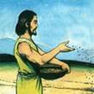
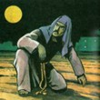
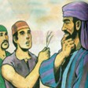
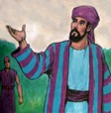
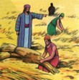
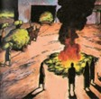
WHY HASN'T IT OVER YET?
“The owner’s servants came to him and said, ‘Sir, didn’t you sow good seed in your field? Where then did the weeds come from?’” (Matthew 13:27)
Through a parable, Jesus clearly explained the nature of the Conflict and its final resolution (Mt. 13:24-30).
Mt. 13:27
Mt. 13:25
Mt. 13:28a
Mt. 13:28b
Mt. 13:29
Mt. 13:30a
Mt. 13:30b
God created everything perfect, but someone planted the seed of evil
The only person responsible for evil is the one who planted it.
The author of evil is identified as “an enemy” of God, Satan
The angels, not understanding the nature of evil, wanted to eradicate it.
God does not want to end evil before it is fully understood.
God lets evil develop so that there is no doubt among His children.
Finally, the time will come to eradicate evil; its author; and all those who cling to it.

Slide 12

“Even when it was decided that he could no longer remain in heaven, Infinite Wisdom did not destroy Satan. Since the service of love can alone be acceptable to God, the allegiance of His creatures must rest upon a conviction of His justice and benevolence. The inhabitants of heaven and of other worlds, being unprepared to comprehend the nature or consequences of sin, could not then have seen the justice and mercy of God in the destruction of Satan. Had he been immediately blotted from existence, they would have served God from fear rather than from love. […] Evil must be permitted to come to maturity. For the good of the entire universe through endless ages, evil must be allowed to mature, […] that the justice and mercy of God and the immutability of His law might forever be placed beyond all question.”
EGW (The Great Controversy, pg. 498)

