Slide 1


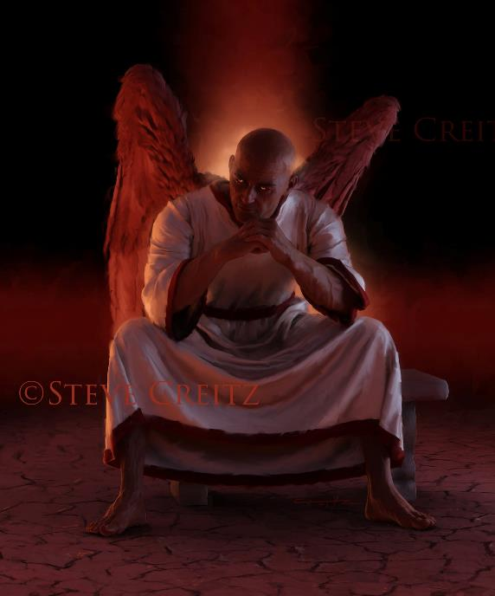
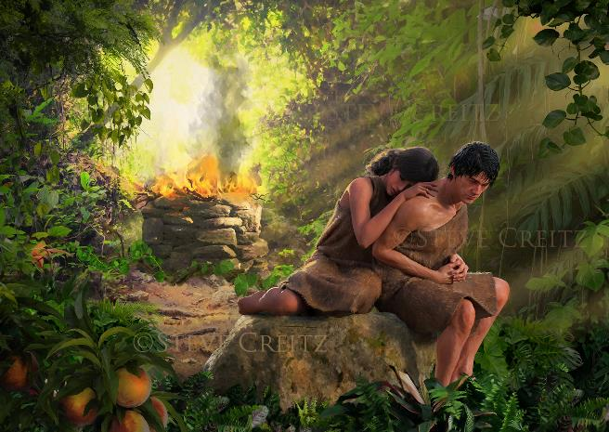
THE PROBLEM OF EVIL
Lesson 7 for February 15, 2025

Slide 2

“And God will wipe away every tear from their eyes; there shall be no more death, nor sorrow, nor crying. There shall be no more pain, for the former things have passed away”
Revelation 21:4, NKJV

Slide 3

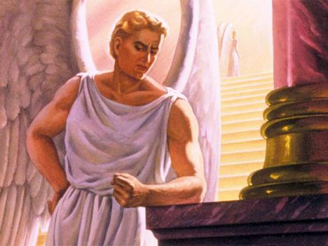
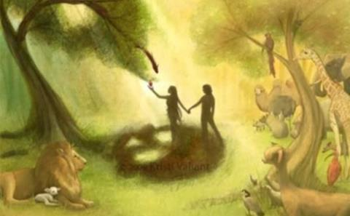
Thanks to the Bible, we know much about the origin of evil, its development on this Earth, and its end.
Lucifer, a perfect angel, rebels against God's perfect government. He gains dominion over the Earth thanks to the transgression of Adam and Eve. After many centuries of dominion, we know that evil will finally disappear. But it is one thing to know all this, and another to face evil and its terrible effects every day.
Why did God allow evil? Why does He continue to allow it today after the victory of Jesus Christ on the cross? How long will we continue to live with evil?
Evil from the human perspective:
  Divine answers to human questions.
  Is it worth continuing to be good?
Evil from the divine perspective:
  Evil, love and freedom.
  The end of evil.

Slide 4
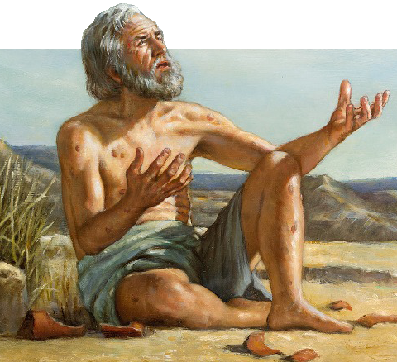
EVIL FROM THE HUMAN PERSPECTIVE

Slide 5


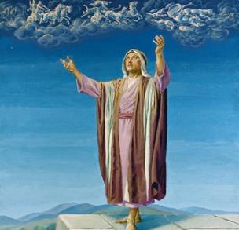

DIVINE ANSWERS TO HUMAN QUESTIONS
“How long, Lord, will you look on? Rescue me from their ravages,
my precious life from these lions” (Psalm 35:17 NIV)
Many questions can come to mind when we are faced with the results of evil. Is it right to question God on this issue? The prophets did, and they received surprising and unexpected answers!
JEREMIAH
QUESTION: “You are always righteous, Lord,
when I bring a case before you.
Yet I would speak with you about your justice: Why does the way of the wicked prosper? Why do all the faithless live at ease?” (Jer. 12:1)
ANSWER:
“If you have raced with men on foot and they have worn you out, how can you compete with horses? If you stumble in safe country,
how will you manage in the thickets by the Jordan?” (Jer . 12:5)
HABAKKUK
QUESTION: “How long, Lord, must I call for help, but you do not listen? Or cry out to you, “Violence!” but you do not save? (Hab. 1:2)
ANSWER: “For the revelation awaits an appointed time;
it speaks of the end
and will not prove false.
Though it linger, wait for it;
it will certainly come
and will not delay.” (Hab. 2:3)

Slide 6

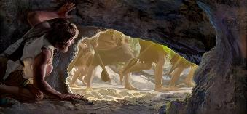
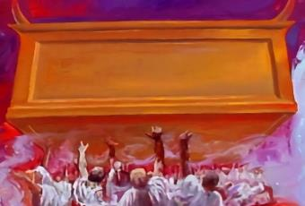
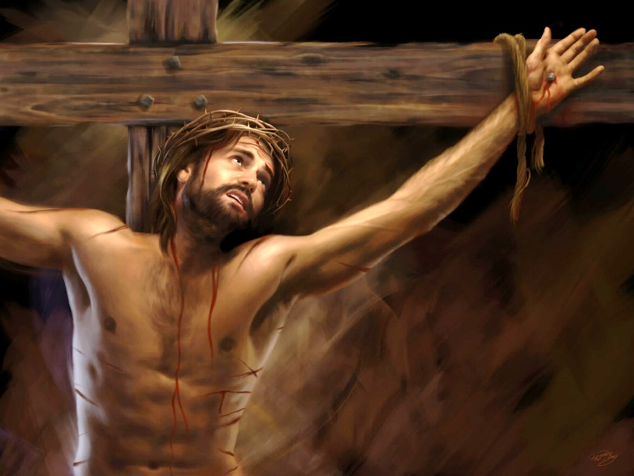
DIVINE ANSWERS TO HUMAN QUESTIONS
DAVID
QUESTION: “Lord, how long will you watch this? Rescue my soul from their destruction, my life from the lions” (Ps. 35:17)
ANSWER: “Let them shout for joy and be glad, all who favor my righteous cause; let them continually say, ‘Let the LORD be magnified, for he loves the peace of his servant! ’”
(Ps. 35:27)
MARTYRS
QUESTION: “And they cried with a loud voice, saying, How long, O Lord, holy and true, dost thou not judge and avenge our blood on them that dwell on the earth?”
(Rev. 6:10)
ANSWER: “And white robes were given to them, and they were told to rest yet a little while, until the number of their fellow servants and their brothers, who were to be killed as they were, was complete” (Rev. 6:11)
Why do those who do evil do well? Why do those of us who want to follow God suffer? Where is God when I am suffering?
Jesus himself felt helpless when sin fell upon him (Mt. 27:46.) Evil is not trivial: it hurts, and often we have no answers. But think of God as wanting to eradicate it from the universe even more than we do.

Slide 7

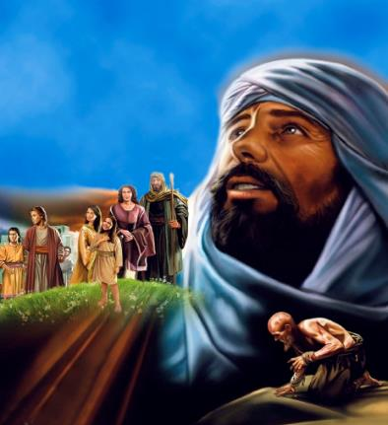
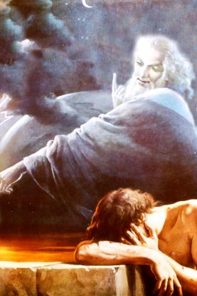
DIVINE ANSWERS TO HUMAN QUESTIONS
JOB
QUESTION: “Mortals, born of woman,
are of few days and full of trouble.” (Job 14:1 NIV)
“Why do the wicked live on, growing old and increasing in power?” (Job 21:7)
ANSWER: “Who is this that obscures my plans with words without knowledge? […] Where were you when I laid the earth’s foundation? Tell me, if you understand” (Job 38:2, 4)
Are we capable of knowing what God knows? Can we hold God accountable for things we do not know? Are we capable of handling evil and its consequences better than He?
As Job admitted: ‘ “Who is this,” you said, “who darkens my counsel without knowledge?” I know that I have spoken of things I do not understand, of things too wonderful for me to understand” ’ (Job 42:3 NIV.) Until evil is eradicated, we will not understand it. We must trust in divine goodness.

Slide 8



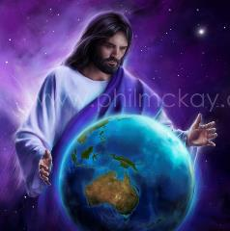

IS IT WORTH BEING GOOD?
“Surely in vain I have kept my heart pure and have washed my hands in innocence?” (Psalm 73:13 NIV)
Seeing those who did evil prosper, while he himself suffered despite his attempts to do good, Asaph wondered, “Is it worth it to continue being good?” (Ps. 73:2-14.)
When you're walking down the street, you only see what's around you. But from a helicopter, you can see what's happening on all the adjacent streets. What's the best perspective when deciding which direction to go in?
Now imagine that you could see everything that is happening around the world simultaneously, even in the future. How would that change your perspective? That's how God is (Isa. 55:8-9.) We can't understand His decisions because we can't see what He sees. So we must trust Him.
When Asaph looked out from the perspective revealed in the sanctuary, he exclaimed: “I was so foolish that I did not understand; […] You have guided me according to Your counsel, and afterward You will receive me into glory. […] It is good to draw near to God” (Ps. 73:22-28.) It pays to continue being good!

Slide 9
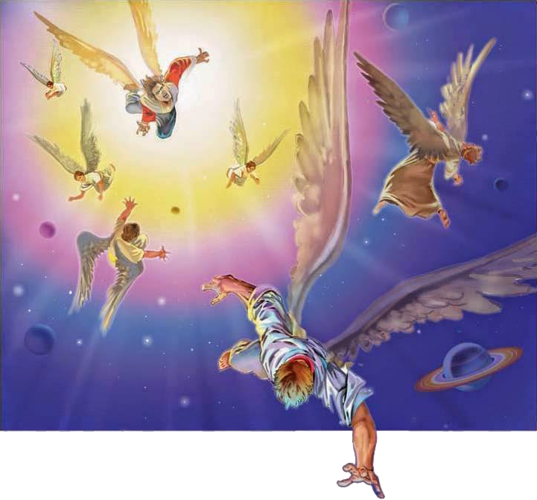
EVIL FROM THE DIVINE PERSPECTIVE

Slide 10


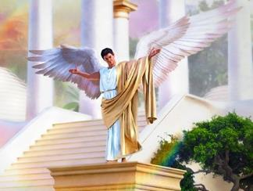
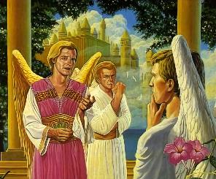
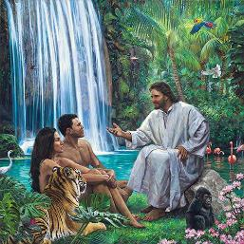
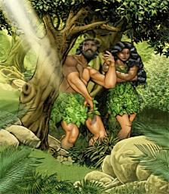
EVIL, LOVE AND FREEDOM
“But if serving the Lord seems undesirable to you, then choose for yourselves this day whom you will serve, whether the gods your ancestors served beyond the Euphrates, or the gods of the Amorites, in whose land you are living. But as for me and my household, we will serve the LORD.” (Joshua 24:15)
Did God create evil? Certainly not. God is love, and evil is the opposite of love.
The being in whom evil arose was perfect when it was created; there was no evil in it
(Ezek. 28:15.) But Lucifer, like Adam and Eve, decided to do evil. They decided to distrust God, to doubt His love, and to disobey Him (Gen. 3:4-6.)
If God had not given us the ability to decide whether to obey Him or not, evil would not exist. But then, love would not exist either, because love cannot be forced, but must be offered voluntarily.
By offering them the opportunity to disobey Him by eating from a particular tree, God gave our parents the gift of voluntary love, the ability to love Him, or – on the contrary – to hide from Him (Gen. 2:16-17; 3:7-8.)

Slide 11


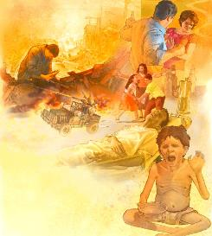
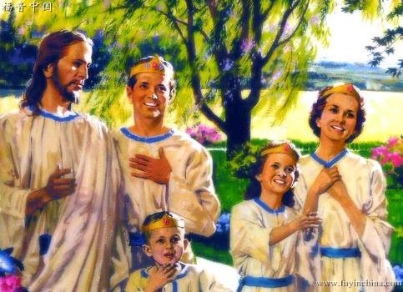
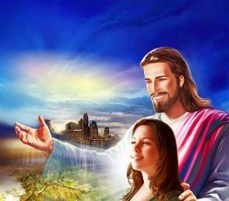
“I consider that our present sufferings are not worth comparing with the glory that will be revealed in us.” (Romans 8:18)
THE END OF EVIL
When we are suffering the consequences of evil (an illness, an accident, etc.), we are distressed and perhaps think that we will never feel well again. But there comes a time when we think: it's finally over. Maybe we will be left with after-effects or maybe not.
Ultimately, when evil attacks us, we think it is eternal… until it passes. But what if it doesn't pass?
But God sees the end from the beginning, and He also sees the eternal bliss promised to all who trust in Jesus.
Our focus in analyzing the problem of evil must be on the loving character of God. He has promised that one day evil will be no more (Rev. 21:4); that unimaginable glory awaits us. (Rom. 8:18.) Trust His promise!

Slide 12

“God is love. The evil that is in the world comes not from His hands, but from our great adversary, whose work it has ever been to deprave man, and enfeeble and pervert his faculties. But God has not left us in the ruin wrought by the fall. […] We are His—His purchased possession. The human family cost God and His Son Jesus Christ an infinite price.”
EGW (Fundamentals of Christian Education, p. 429)

