Slide 1
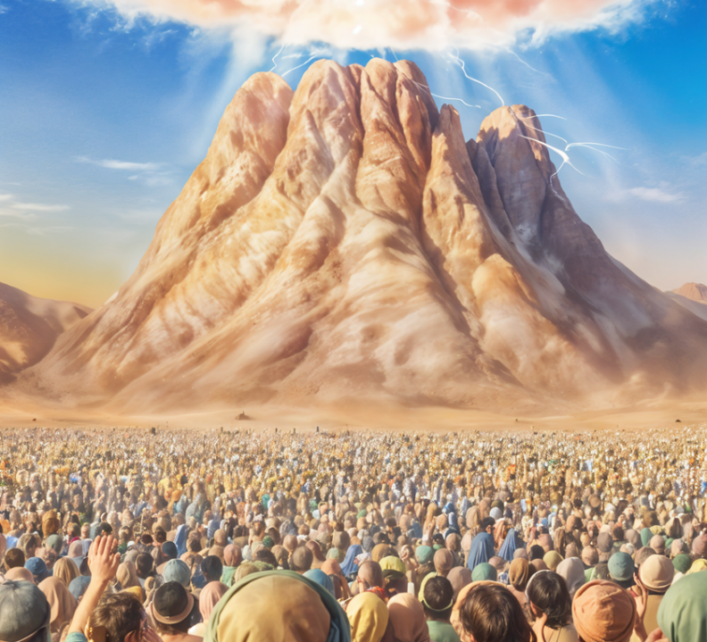
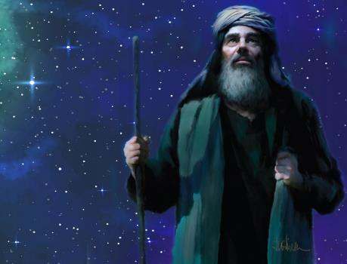
COVENANTAL LOVE
Lesson 2 for January 11, 2025

Slide 2
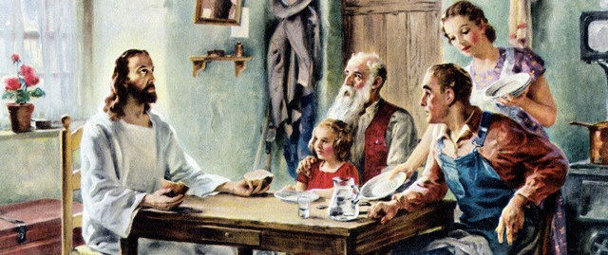
“Jesus answered and said to him, ‘If anyone loves Me, he will keep My word; and My Father will love him, and We will come to him and make Our home with him’ ” John 14:23, NKJV

Slide 3
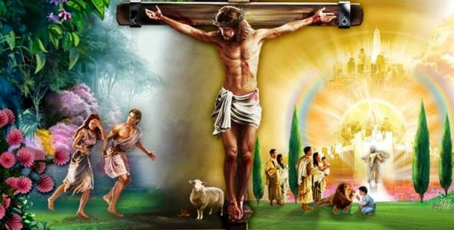
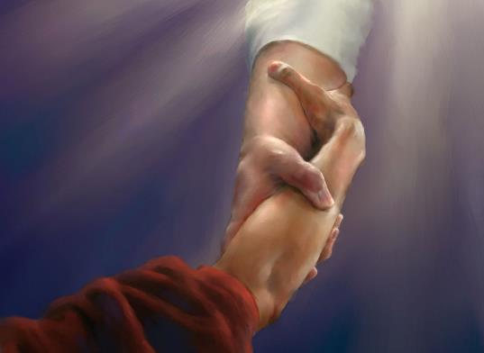
Love permeates everything related to God, because He is love.
When sin separated humanity from God, God made a covenant with humanity.
What is the reason for this covenant? What role does God's love play in it? What are the conditions of the covenant?
God's unconditional love:
God wants everyone to be saved.
The reason for the covenant.
The conditions of God's love:
The conditions of the covenant.
Respond to God's love.
Our response to God's love:
Transmitters of God's love.

Slide 4
THE UNCONDITIONAL LOVE OF GOD

Slide 5
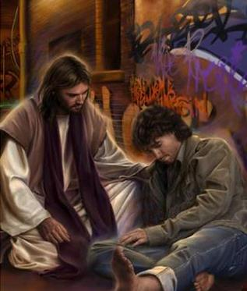
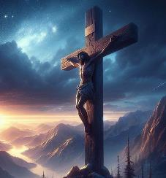
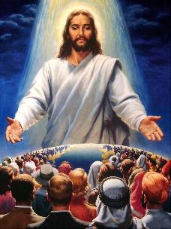
GOD WANTS EVERYONE TO BE SAVED
“This is good, and pleases God our Savior, who wants all people to be saved and to come to a knowledge of the truth” (1 Timothy 2:3-4)
God loves us so much that He made an immense sacrifice (His own life) so that all may be saved from sin (Jn. 3:16.)
There is no one who, in the eyes of God, can be considered unworthy of attaining the salvation offered. God's love embraces all (Ps. 145:9.)
If salvation depended only on the will of God, we would all be saved (1 Tim. 2:3-4.)
But He has given us freedom to decide whether or not we want to be saved; whether or not we want to respond to His love. We can imagine Him crying out with tears in His eyes, “Please accept my invitation… LIVE!” (Ezek. 33:11.)

Slide 6
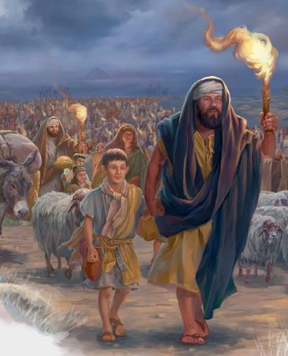
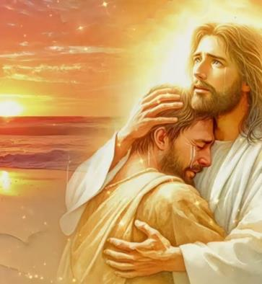
THE REASON FOR THE COVENANT
“But it was because the Lord loved you and kept the oath he swore to your ancestors that he brought you out with a mighty hand and redeemed you from the land of slavery, from the power of Pharaoh king of Egypt” Deuteronomy 7:8 NIV
When God brought Israel out of Egypt to renew the covenant He had made with Abraham, Isaac, and Jacob, He did not do so merely to fulfill His word: “it was because the Lord loved you” (Deut. 7:8 NIV.)
The word used to define the reason why God makes a covenant with us is hesed, which means:
The mercy, kindness and love of God
Loving-kindness or loyal love for another person within a relationship of reciprocal love
Love shown with the intention that the other person manifests that same kindness and love in return
God’s love is reliable, constant, and enduring. But the benefits we can receive from that love are conditional, depending on our response (Ps. 25:10 NIV.)

Slide 7
THE CONDITIONS OF GOD'S LOVE

Slide 8
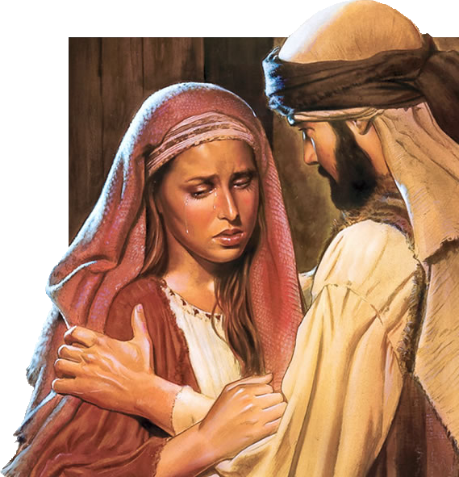
THE CONDITIONS OF THE COVENANT
“keep yourselves in God’s love as you wait for the mercy of our Lord Jesus Christ to bring you to eternal life” (Jude 21)
Some Bible verses may give us the impression that God stops loving us when we turn away from Him (Jer. 16:5 NIV.)
However, let us look at the example in the book of Hosea, where God says categorically: “I will love them no more” (Hos. 9:15.) Shortly after, God will say: “I will love them freely” (Hos. 14:4.)
God's love is eternal; He never stops loving us (Ps. 136:1 NIV.) But He has set conditions so that we can receive the benefits of that love:
Love Him (Jn. 16:27)
Continue to love Him (Jn. 15:9; Jude 21)
Keep His commandments (Jn. 14:21; 1Jn. 5:3)
Loving one another (Jn. 15:17; 1Jn. 4:12)

Slide 9
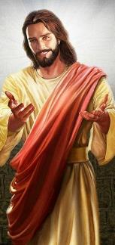
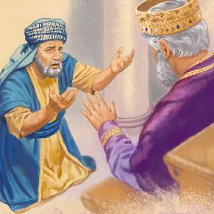
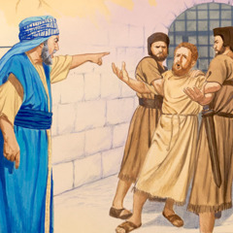
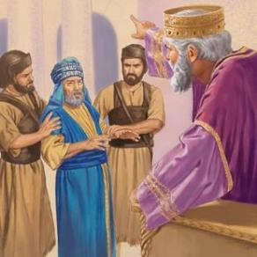
RESPOND TO GOD'S LOVE
“We love because he first loved us” (1 John 4:19)
God always makes the first move. He loves us before we can do anything about it (Jer. 31:3.)
When we perceive God's love and the great sacrifice He made for us, our natural reaction is to love Him and to love one another (1Jn. 4:9-10, 19.)
Unfortunately, not everyone reacts the same way. Sometimes, we can forget how much God loves us. Jesus exemplified this with a parable (Mt. 18:23-35.)
A man's debt to his lord was the equivalent of 200,000 years of work! But his lord, out of love, forgave him.
Forgetting the love he had received, this servant demanded from his fellow servant the equivalent of just over three months of work. What ingratitude! “Should you not also have had compassion on your fellow servant, just as I had pity on you?” (Mt. 18:33.)

Slide 10
OUR RESPONSE TO GOD'S LOVE

Slide 11
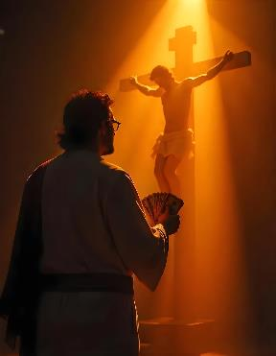
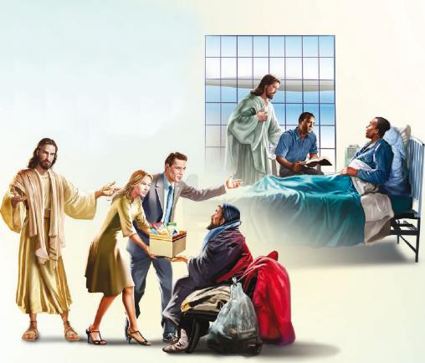
TRANSMITTERS OF GOD'S LOVE
“…Freely you have received; freely give” (Matthew 10:8b NIV)
How can we compensate God for what He has done for us? Can we repay Him in any way?
Totally impossible (Ps. 49:7-8.) But God does not ask us to pay or compensate him for the love received.
He is content that we are transmitters of what we have received freely: “Beloved, if God so loved us, we also ought to love one another” (1Jn. 4:11; Mt. 10:8b.)
We cannot repay what God has done, but we can thank Him by behaving toward others as He has behaved toward us.
If loving God means loving others, we must urgently share the message of God's love with everyone.

Slide 12
“God has a deep and earnest love for every member of the human family; not one is forgotten, not one is left helpless and deceived to be overcome by the enemy. […] I can trust God; for He so loved me that He gave His only-begotten Son to die for me.”
EGW (Fundamentals of Christian Education, pg. 299)
“When Christ dwells in the heart, the soul will be so filled with His love, with the joy of communion with Him, that it will cleave to Him; and in the contemplation of Him, self will be forgotten. Love to Christ will be the spring of action. Those who feel the constraining love of God, do not ask how little may be given to meet the requirements of God; they do not ask for the lowest standard, but aim at perfect conformity to the will of their Redeemer. With earnest desire they yield all and manifest an interest proportionate to the value of the object which they seek.”
EGW (Steps to Christ, pg. 44)

