Slide 1
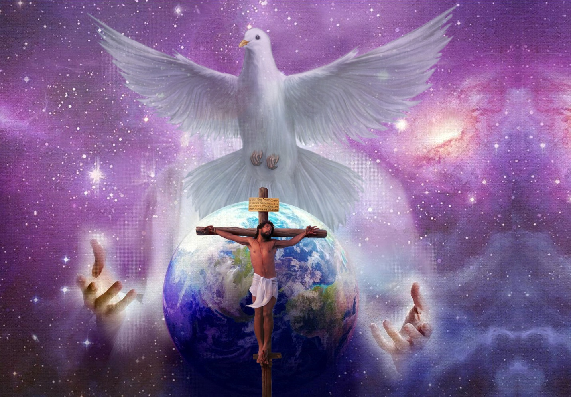
THE FATHER, THE SON AND THE SPIRIT
Lesson 11 for December 14, 2024

Slide 2
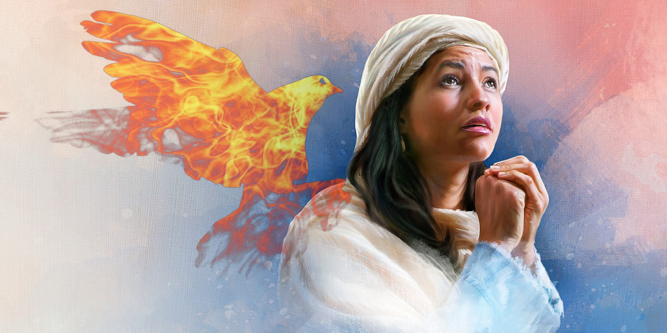
“ ‘The Helper, the Holy Spirit, whom the Father will send in My name, He will teach you all things, and bring to your remembrance all things that I said to you’.” John 14:26

Slide 3
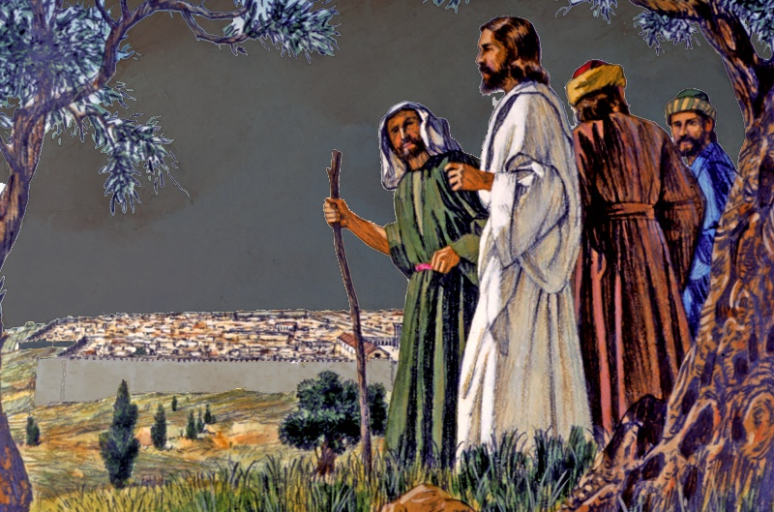
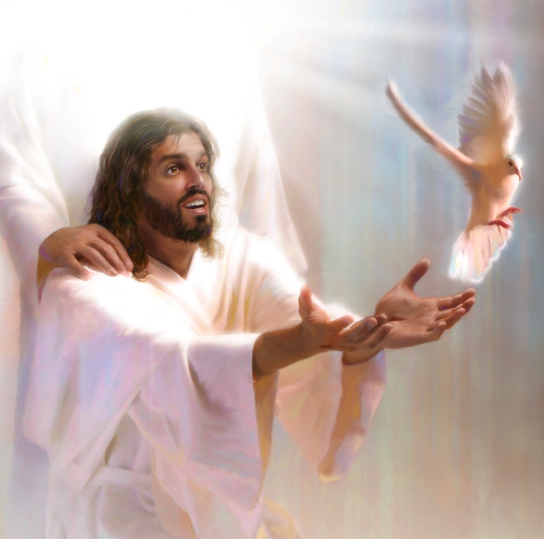
From the time Judas left the upper room until he reached the vicinity of Gethsemane, Jesus spoke to his disciples about his imminent departure and eventual return.
He also spoke to them about His relationship with the Father, and the coming of the Spirit.
Finally, he opened his heart to the Father and – in the presence of his apostles – he made a prayer in which we were also included: the high priestly prayer (John 17).
Jesus and the Father:
Who is the Father?
What is the relationship between Jesus and the Father?
How to know the Father?
Jesus and the Spirit:
Who is the Spirit?
Jesus and us:
What request did Jesus make for us?

Slide 4
JESUS AND THE FATHER

Slide 5
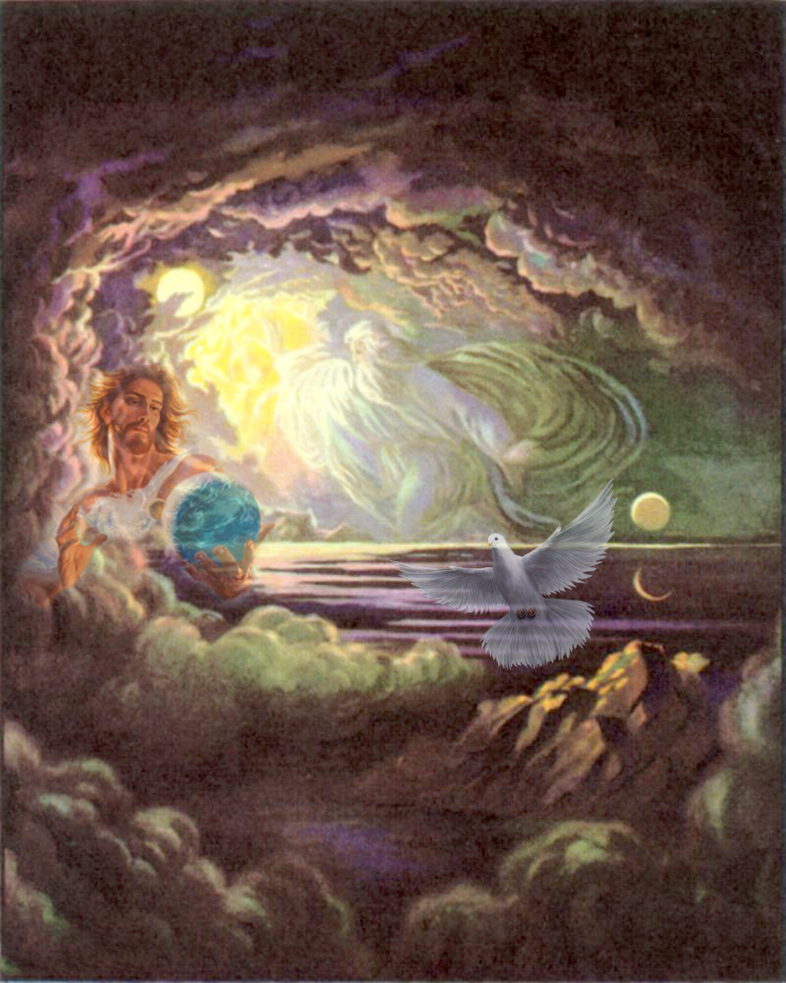
WHO IS THE FATHER?
“I came from the Father and I came from the Father and entered the world; now I am leaving the world and going back to the Father.” (John 16:28)
From eternity, the three Persons of the Godhead have been united. Together they created all that exists (Gen. 1:1-2; Jn. 1:1-3.)
They created this world and every living thing in it. But they made us in their image and put us in charge of it all (Gen. 1:26-28.)
After sin entered, they decided to take on different roles to redeem us. The “Son” humbled himself and submitted to the “Father” (Phil. 2:5-8.) What role did the Father take on?
He sent the Son to die for us (Jn. 3:16; 6:57)
He assumes the role of Judge, and delegates it to the Son (Jn. 5:22)
He directed the ministry of Jesus (Jn. 6:32; 14:10, 24)
He is ultimately responsible for our teaching (Jn. 6:45)
He receives our prayers and answers them (Jn. 16:23)

Slide 6
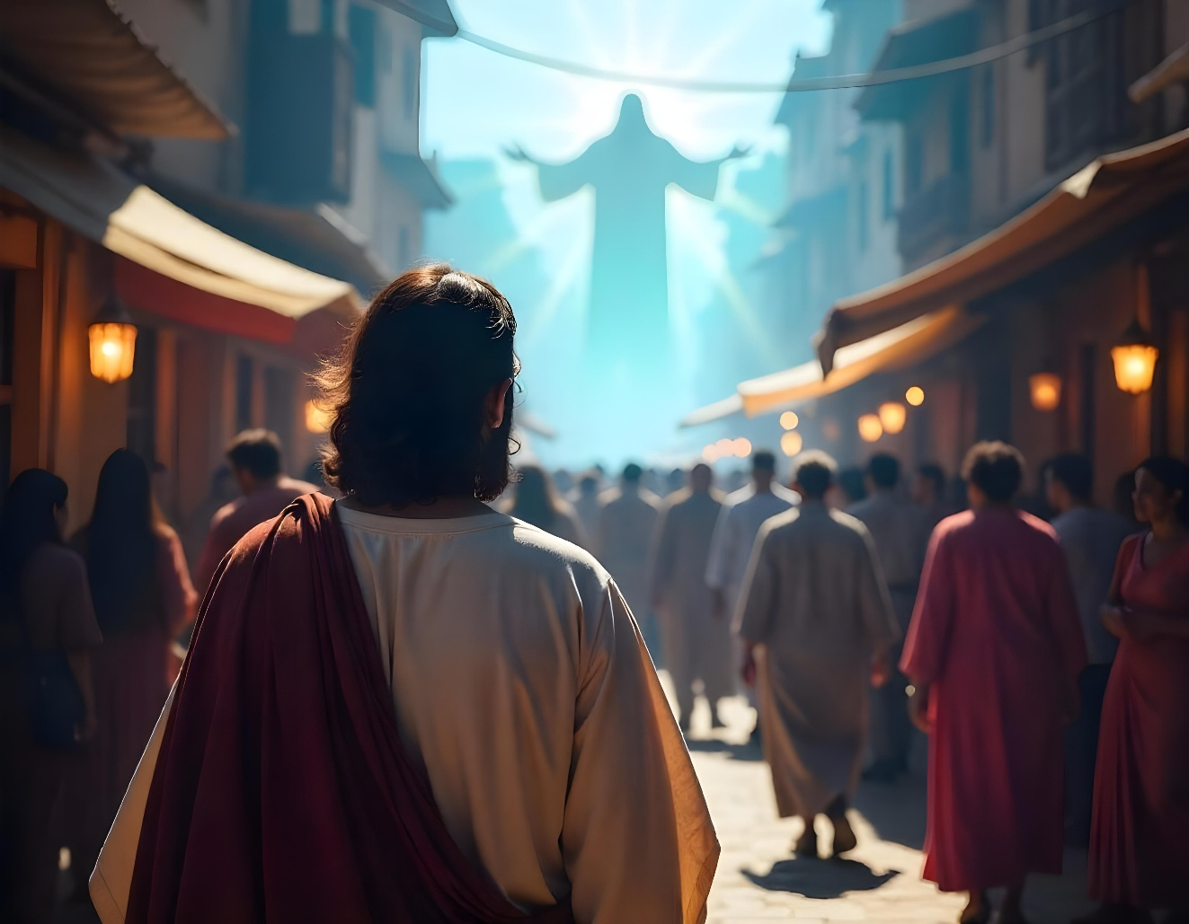
WHAT IS THE RELATIONSHIP BETWEEN JESUS AND THE FATHER?
“I and the Father are one” (John 10:30)
Since the relationship between God and humanity was broken, God has persistently sought us out and called us to return to Him (Gen. 3:9; Is. 65:1.)
God has been misunderstood and rejected throughout history. But the time came when He decided to become man and live among us (Jn. 1:14.) He wanted to offer us salvation, even if we did not accept it (Jn. 1:10-12.)
Jesus made it clear that He was equal with God (John 10:30,) although He was temporarily subject as Son to the Father. His life was a reflection of the Father (John 14:9.) With every step He took, He was doing the will of His Father (John 5:30.)
How would your life be changed if your thoughts and actions were
fully an expression of God’s will for your life?

Slide 7
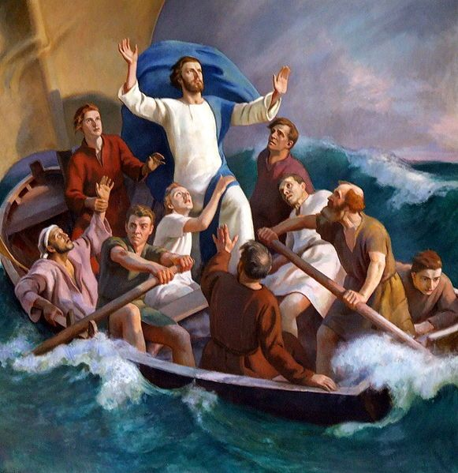
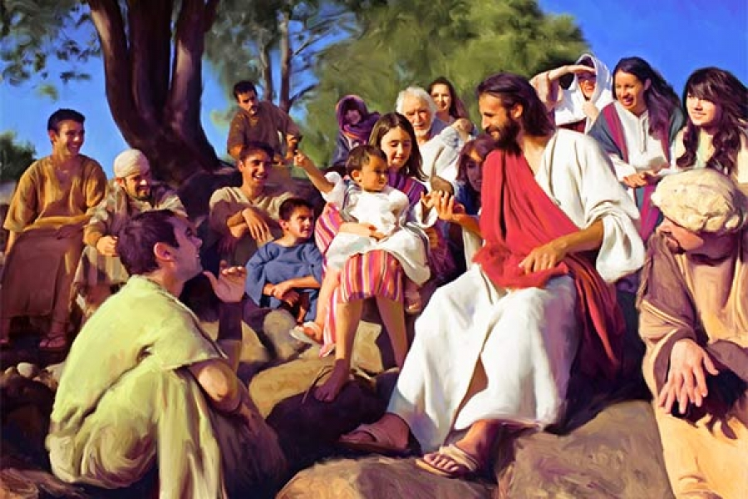
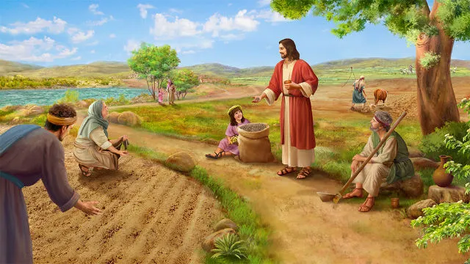
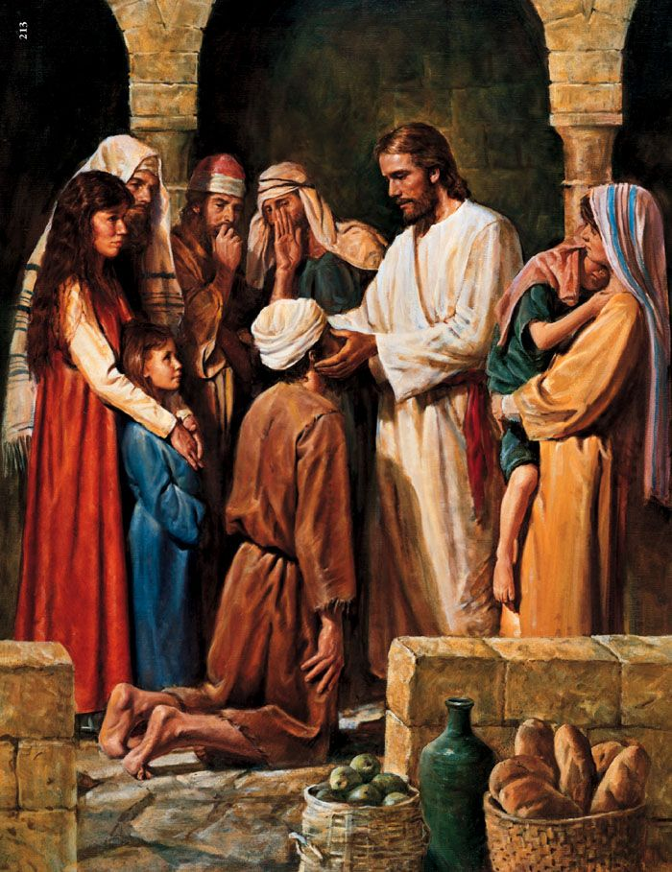
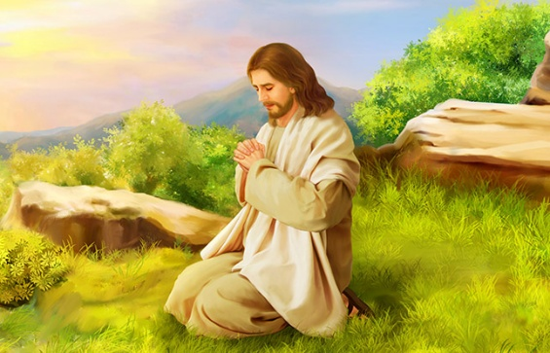
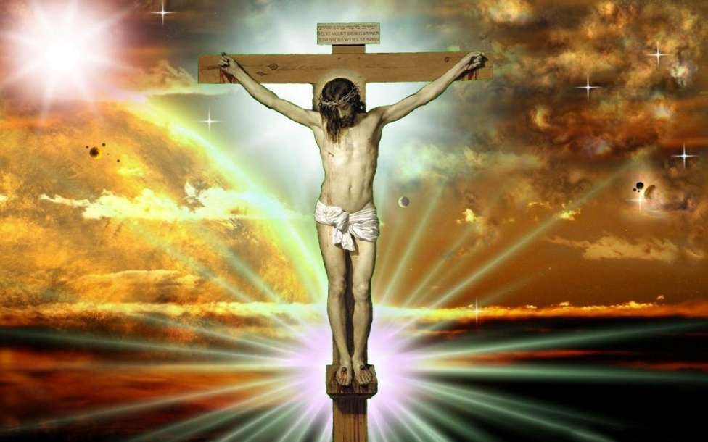
HOW TO KNOW THE FATHER?
“No one has ever seen God, but the one and only Son, who is himself God and is in closest relationship with the Father, has made him known” (John 1:18)
Knowing the Father is synonymous with eternal life (Jn. 17:3.) And the only way to know the Father is to know Jesus, who is the one who has revealed him to us (Jn. 1:18; 8:19; 14:7.)
Jesus was the Father's representative on Earth. He did the Father's will (Jn. 5:30; 6:38.) He was sent by Him to save us, and to become the means by which we are resurrected and receive eternal life (Jn. 6:40.)
What relationship existed between Jesus and the Father?
All his teachings came from the Father
Everything he said he heard from the Father
Believing in Him is the same as believing in the Father
His miraculous works came from the Father
He was closely linked to the Father
Is it possible that we can experience both here and in Heaven the same intimacy with the Father that He and Jesus had?

Slide 8
JESUS AND THE SPIRIT

Slide 9
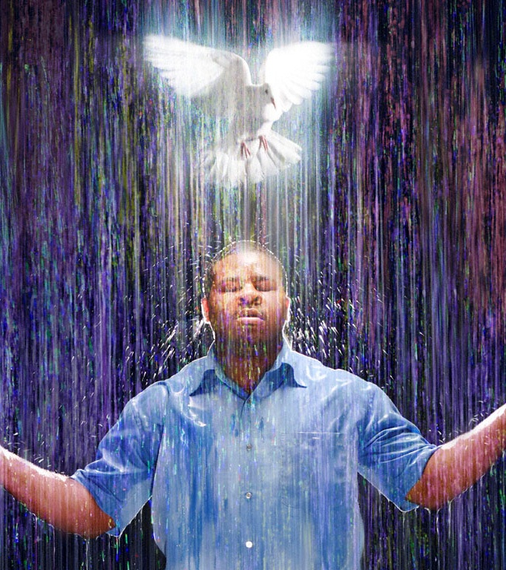
WHO IS THE SPIRIT?
“When the Advocate comes, whom I will send to you from the Father—the Spirit of truth who goes out from the Father—he will testify about me” (John 15:26)
John introduces the Holy Spirit by showing us one of his most prominent works: the regeneration of our being (John 3:5-6; 1:12-13; 6:63a.)
But that is not His only function. Jesus spoke at length of the work of the Spirit in His final discourse. And when He did so, He did not speak of Him as a power or a force. He is our Advocate, One equal to Jesus Himself, that is, a divine Person (John 14:16.)
What is the role of the Holy Spirit?
He teaches us (Jn. 14:26)
Bears witness to Jesus (Jn. 15:26)
Convicts of sin, of righteousness and of judgment (Jn. 16:8-11)
He guides us to the truth (Jn. 16:13)
Glorify Jesus (Jn. 16:14)

Slide 10
JESUS AND US

Slide 11
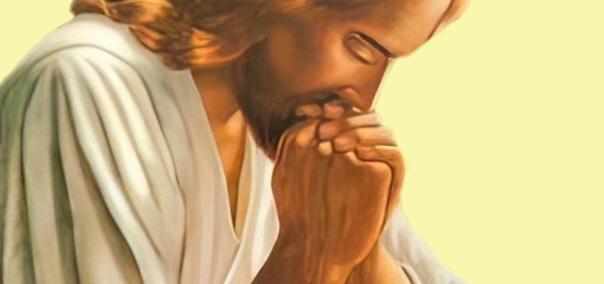
WHAT REQUEST DID JESUS MAKE FOR US?
“My prayer is not for them alone. I pray also for those who will believe in me through their message” (John 17:20)
In the prayer with which he concluded his discourse (John 17,) Jesus stated that:
For our protection from the harassment of the world
For our unity among ourselves and with God
For our sanctification
Because we are a testimony of God's love before the world
May we come to be with Him
So that the love of God may dwell in us
He had received power from the Father to give eternal life (v. 2-3)
He had finished the work that was entrusted to him (v. 4)
He was pre-existent, and would regain his first glory with the Father (v. 5)
He had made the Father known to his disciples (v. 6-8)
Then He began to pray for His disciples, and He also included all of us who have come to know Him and believe in Him (John 17:9, 20.) He asked:
How can you better reflect the love of God, such as exists between Jesus and the Father, in your own life?

Slide 12
EGW (Evangelism, pg. 4614)
“The Father cannot be described by the things of earth. The Father is all the fullness of the Godhead bodily, and is invisible to mortal sight.”
“The Son is all the fullness of the Godhead manifested. The Word of God declares Him to be “the express image of His person.” Hebrews 1:3. […]
The Comforter that Christ promised to send after He ascended to heaven, is the Spirit in all the fullness of the Godhead, making manifest the power of divine grace to all who receive and believe in Christ as a personal Saviour. There are three living persons of the heavenly trio; in the name of these three great powers—the Father, the Son, and the Holy Spirit—those who receive Christ by living faith are baptized, and these powers will co-operate with the obedient subjects of heaven in their efforts to live.”

