Slide 1
Lesson 9 for November 30, 2024
THE SOURCE OF LIFE

Slide 2
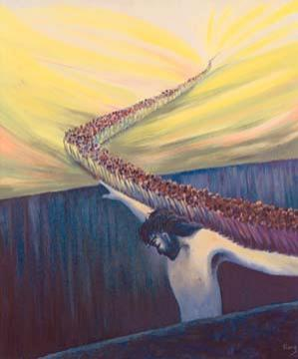
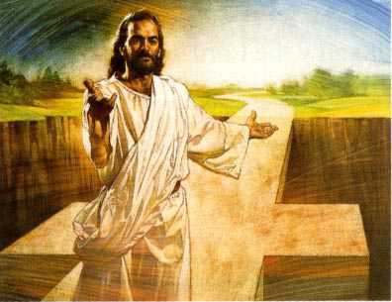
“I am the way, the truth, and the life. No one comes to the Father except through Me”
John 14:6, NKJV
“Pero yo tengo un testimonio mayor que el de Juan. Las mismas obras que el Padre me encomendó realizar, esas mismas obras que hago testifican que el Padre me envió” Juan 5:36

Slide 3
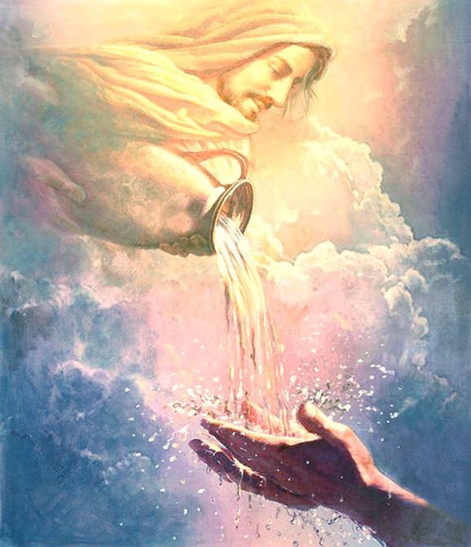
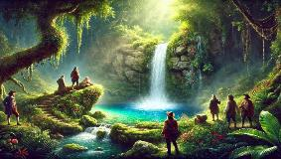
Many have tried to find the source of eternal life in unknown or mythical places. Most of them lost their time, and even their lives, in this attempt.
They forgot the main thing: the source of eternal life is not hidden. It has already been revealed to us, so that anyone who wants to can find it and drink from it.
The source of eternal life is not found anywhere. It is a person: Jesus Christ. In Him there is life for all who desire to obtain it.
The source of LIFE:
“I am… the life.”
Jesus offers us life.
LIFE in us:
Receive life.
Accept or reject life.
Rejection results.

Slide 4
THE SOURCE OF LIFE

Slide 5
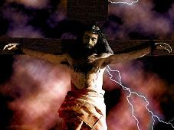
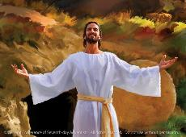
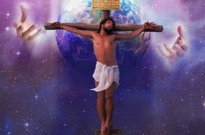
“I AM… THE LIFE”
“Jesus said to him, ‘I am the way, and the truth, and the life. No one comes to the Father except through me. ’” (John 14:6)
Jesus has a characteristic that sets him apart from all created beings: he has life in himself (Jn. 5:26.) Thanks to this quality, he was able to give up his life and take it up again (Jn. 10:17-18.)
What motivated Jesus to come to Earth to give his life?
Revealing the Father to us (Jn. 14:8-9.) We had forgotten what God is like
Give us abundant life (Jn. 10:10.) In Jesus we can truly enjoy life here and now
Taking our place (Is. 53:5.) He suffered the punishment that we should suffer
Dying to give us salvation (Acts 4:12.) Only in Jesus we can obtain salvation
Take away the sin of the world (Jn. 1:29.) Not only does it erase our sin, but it will finally remove it
Resurrect us on the “last day” (Jn. 5:28-29; 6:54.) When Jesus comes, we will be resurrected by Him
Give us eternal life (Jn. 3:14-15.) Finally, He will give eternal life to all of us who have believed in Him

Slide 6
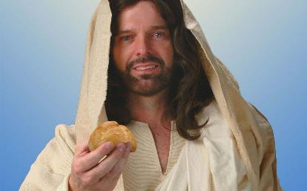
JESUS OFFERS US LIFE
“Simon Peter answered him, ‘Lord, to whom shall we go? You have the words of eternal life. ’” (John 6:68)
When Jesus spoke of himself as the “bread of life” (Jn. 6:35,) he invited his listeners (and us) to “eat” that bread [that is, to know him and assimilate his words] (Jn. 6:51.)
Through his words (Jn. 5:24)
By working to feed ourselves on Him (Jn. 6:27)
By believing in Him (Jn. 6:47)
By following him (Jn. 10:27-28)
Desiring it more than physical life (Jn. 12:25)
By giving us the Father's commandment (Jn. 12:49-50)
When we come to know Him (Jn. 17:3)
Many did not understand the depth of his words and decided to stop following him (Jn. 6:66.) But the apostles did understand: Jesus is the only one who can impart eternal life (Jn. 6:68.)
And how does Jesus impart eternal life to us?
And the best news is that Jesus offers eternal life freely to those who want it.

Slide 7
LIFE IN US

Slide 8
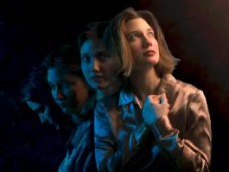
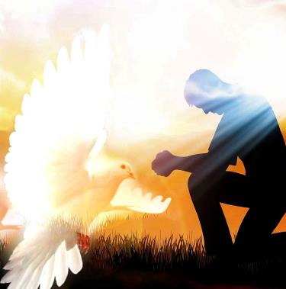
RECEIVE LIFE
“Yet to all who did receive him, to those who believed in his name, he gave the right to become children of God— children born not of natural descent, nor of human decision or a husband’s will, but born of God.” (John 1:12-13)
In these verses (Jn. 1:12-13) we can clearly see which is the human and which is the divine part in the process of salvation: we receive Jesus and believe in Him; Jesus makes us children of God by transforming us into new creatures.
Receiving eternal life today is an interactive process between the Holy Spirit and us:
The Spirit gives us faith (Eph. 2:8)
We grow in it (Rom. 10:17)
The Spirit convicts us of our sin (Jn. 16:8)
We repent (Ps. 51:3)
The Spirit leads us to Jesus (Jn. 15:26)
We accept it (Acts 16:31)
The Spirit makes us born again (Jn. 3:5-6)
We recognize him by being baptized (Mt. 28:19)

Slide 9
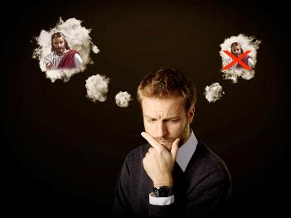
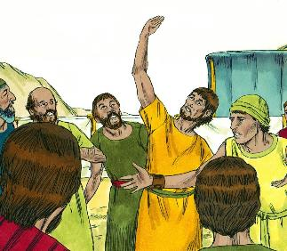
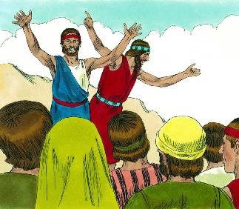
ACCEPT OR REJECT LIFE
“Whoever believes in the Son has eternal life, but whoever rejects the Son will not see life, for God’s wrath remains on them” (John 3:36)
Encountering Jesus leads to a dichotomy: accepting or rejecting him. And this implies accepting or rejecting life… eternal life!
How do we determine whether to accept or reject it?
Many make this decision out of doubt. They expect to believe in Jesus if science, philosophy, archaeology, or any other modern science can support the evidence for Jesus.
This is nothing new. For example, 10 of the 12 spies sent by Moses to scout the Promised Land analyzed the evidence and came to a conclusion: God has no power to conquer this land (Num. 13:31-33.)
But two of them analyzed God, and found the evidence: He has the power to overcome (Num. 14:6-9.)
What will your decision be, and on what basis will you make it?

Slide 10
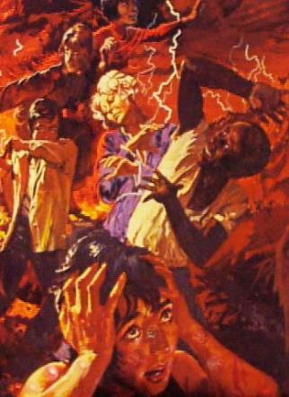
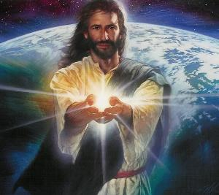
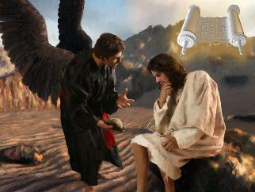
RESULTS OF REJECTION
“Whoever believes in him is not condemned, but whoever does not believe stands condemned already because they have not believed in the name of God’s one and only Son.” (John 3:18)
The Bible is clear about the result of rejecting Jesus: falling under God's wrath and being condemned (Jn. 3:18-19, 36.)
Given such a bleak outlook, why do so many reject Jesus?
Jesus is light. His light illuminates us, and we can see ourselves as we really are. All the bad things in us (and there is a lot of them) are exposed.
Therefore, “Everyone who does evil hates the light, and will not come into the light for fear that their deeds will be exposed” (John 3:20.)
The worst thing is that remaining in darkness puts us on Satan's turf. He hates and destroys all his subjects. On the contrary, being in the light is taking refuge in the shelter of a loving God (Ps. 91:1-4.)
Let us follow Jesus' example to remain in the light and reject darkness: to take hold of the Word of God (Mt. 4:1-4.)

Slide 11
«“All created beings live by the will and power of God. They are recipients of the life of the Son of God. However able and talented, however large their capacities, they are replenished with life from the Source of all life. He is the spring, the fountain, of life.... The life which He had laid down in humanity, He again took up and gave to humanity. “I am come,” He says, “that they might have life, and that they might have it more abundantly.”»
EGW (Sons and Daughters of God, August 18)

