Slide 1
FULFILLMENT OF OLD TESTAMENT PROPHECIES
Lesson 8 for November 23, 2024

Slide 2
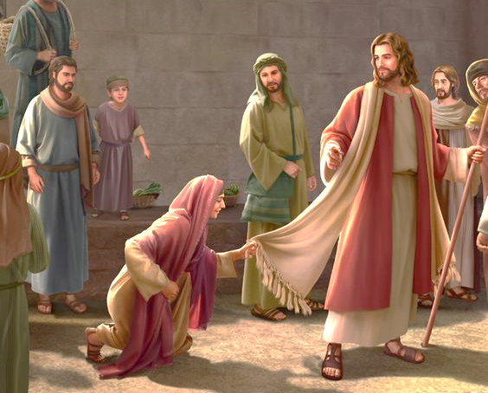
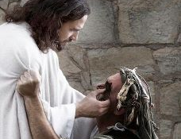
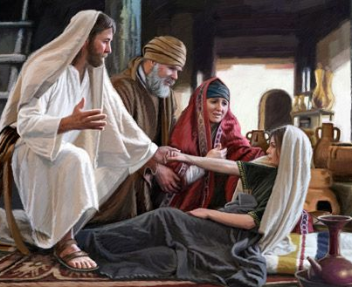
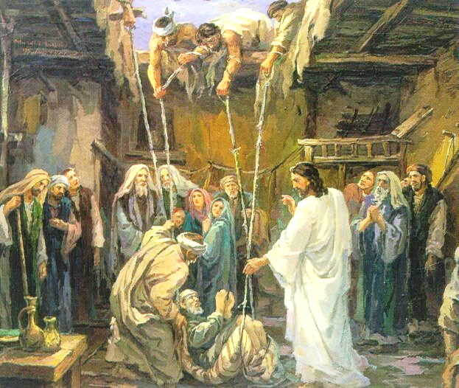
“But I have a greater witness than John’s; for the works which the Father has given Me to finish—the very works that I do—bear witness of Me, that the Father has sent Me”
John 5:36, NKJV

Slide 3
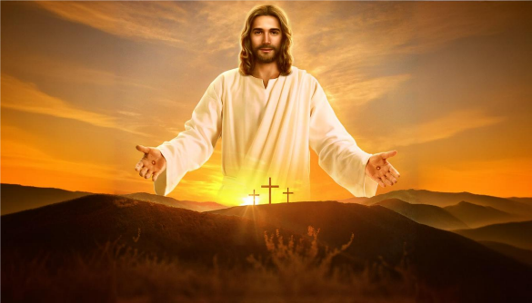
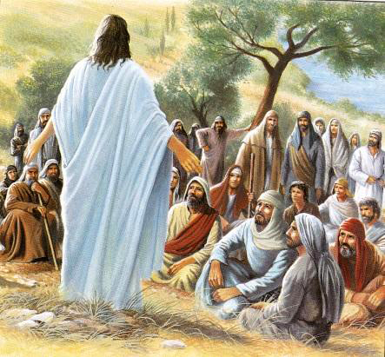
Jesus is the Christ, the Anointed One of God, the Savior of the world. He is pre-existent and divine. This is how we have accepted and believed.
But what did his contemporaries, those who spoke and interacted with him, think of these statements?
Some accepted it, and others rejected it. On what evidence did they make their choice?
Reasons to accept Jesus as the Christ:
Evidence of the Father.
Evidence from the Scriptures.
Evidence of the prophecies.
Reasons to reject Jesus as the Christ:
Being “from below” and not “from above.”

Slide 4
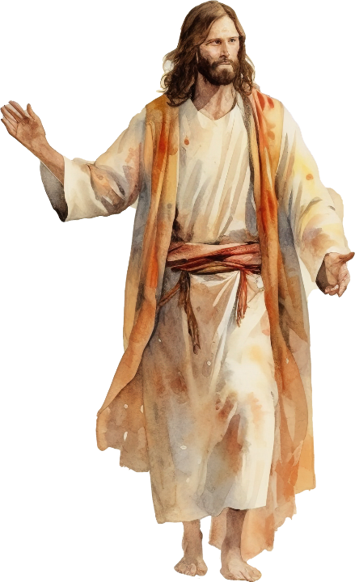
REASONS TO ACCEPT JESUS AS THE CHRIST

Slide 5
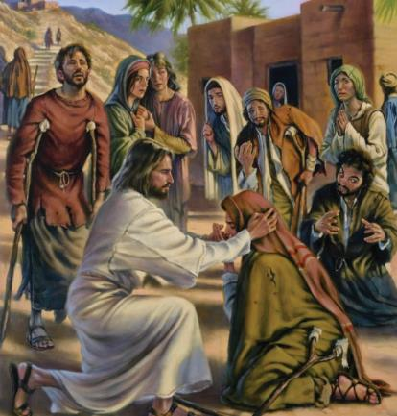
EVIDENCE OF THE FATHER
“I have testimony weightier than that of John. For the works that the Father has given me to finish—the very works that I am doing—testify that the Father has sent me” (John 5:36)
Jesus performed many signs that made Him a special person. Undoubtedly, no one could deny the evidence: “The blind receive sight, the lame walk, the lepers are cleansed, the deaf hear, the dead are raised, and the poor have the gospel preached to them” (Mt. 11:5.)
At this, many wondered if Jesus was not the Christ. When asked directly about this matter, Jesus presented all these signs as evidence of his union with the Father, and that he had been sent by Him (John 10:24-25; John 5:36.)
In this way, he left it to his investigators to draw their own conclusions. If they wanted to stone him by saying this (John 10:31-33), what would they have done if he had openly declared that he was the Christ?

Slide 6
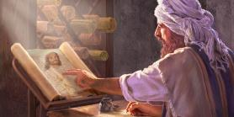
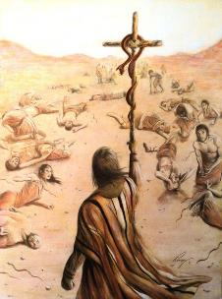
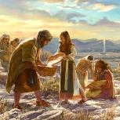
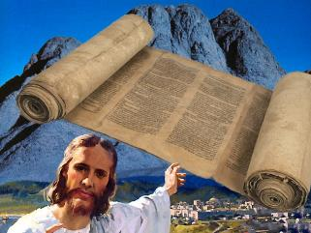
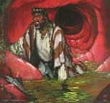
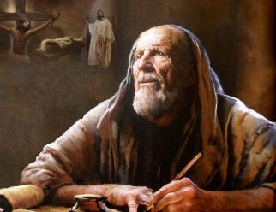
SCRIPTURAL EVIDENCE
“You study the Scriptures diligently because you think that in them you have eternal life. These are the very Scriptures that testify about me” (John 5:39 NIV)
A second evidence that Jesus presented as proof of his divine mission was the testimony of the Scriptures, that is, the Old Testament.
Jesus used Bible stories to explain his mission. For example, he spoke of the serpent lifted up by Moses, thus declaring how he would die, and the meaning of that sacrifice (John 3:14-15.)
Some recognized in Jesus the Messiah announced by Moses and the prophets (Jn. 1:45; 4:25-26.)
Matthew, Mark, Luke, John, Paul, Peter, and the rest of the New Testament writers, underline again and again, under the inspiration of the Holy Spirit, how the life, death, resurrection and ascension of Jesus to the Throne of God are the fulfillment of what was announced in the Old Testament.

Slide 7
EVIDENCE OF THE PROPHECIES
“These things happened so that the scripture would be fulfilled…” (John 19:36a)
The Old Testament has hundreds of prophecies and allusions concerning Christ, which were fulfilled in the life and ministry of Jesus. John mentions some of them.
John 1:23
The work of his predecessor
John 2:17
The zeal of Jesus in expelling the merchants from the Temple
John 7:38
The provision of living water
John 7:42
John 12:13
John 12:14-15
The birth in Bethlehem
The greeting of the crowd upon entering Jerusalem
The triumphal entry into Jerusalem
Isaiah 40:3
Psalm 69:9
Jeremiah 2:13
Micah 5:2
Psalm 118:26
Zechariah 9:9

Slide 8
EVIDENCE OF THE PROPHECIES
“For these things happened that the Scripture might be fulfilled…” (John 19:36a)
The Old Testament has hundreds of prophecies and allusions concerning Christ, which were fulfilled in the life and ministry of Jesus. John mentions some of them.
John 13:18
The betrayal of a friend
John 19:24
The soldiers divide up Jesus' clothes
John 19:28
Thirst during the crucifixion
John 19:36
John 19:37
John 20:9
No bones are broken in his death
Pierced by a spear
The resurrection
Psalm 41:9
Psalm 22:18
Psalm 69:20-21
Numbers 9:12
Zechariah 12:10
Psalm 16:10

Slide 9
REASONS TO REJECT JESUS AS THE CHRIST

Slide 10
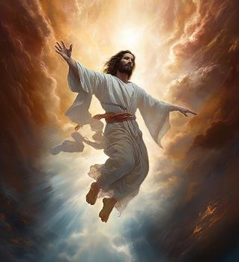
BEING “FROM BELOW” AND NOT “FROM ABOVE”
“But he continued, “You are from below; I am from above. You are of this world; I am not of this world” (John 8:23)
They did not know the Father (Jn. 8:19, 27, 55.) They professed to believe in God, but they had only a theoretical knowledge of Him
They were “from below” (John 8:23.) They thought about earthly things, not heavenly things
They had put their traditions above the Word of God (Mt. 15:3)
They clung to the letter of the Law and stripped it of its spiritual meaning (Rom. 2:27; Mt. 5:20-22)
They came to think that the mere knowledge of the Scriptures could save them (Jn . 5:39)
They believed in Moses, but they did not accept that the Prophet he had announced had arrived (Jn. 5:46)
They had forgotten mercy (Mt. 23:23)
Why did the religious leaders reject Jesus?
Thus, even despite bad leadership, many Jews were able to get
beyond it and see, for themselves, who Jesus was.

Slide 11
“The apostles accepted Christ by the testimony of prophecy, which was confirmed to them by their seeing and touching the Word of life. We also have the testimony of the prophets of the Old Testament, and we have, in addition, the testimony of the apostles and believers of the New. The prophets pointed to a Saviour who was to come; the apostles spoke of a Saviour who had come in exact fulfillment of prophecy. Thus the chain of evidence is complete and thorough. It is sufficient to convince all who will believe. God has given men ample testimony to establish their faith in His power, in the divine mission of His Son, and in the authority and work of the Holy Spirit.”
The Desire of Ages, note 2 (Spanish version)

