Slide 1
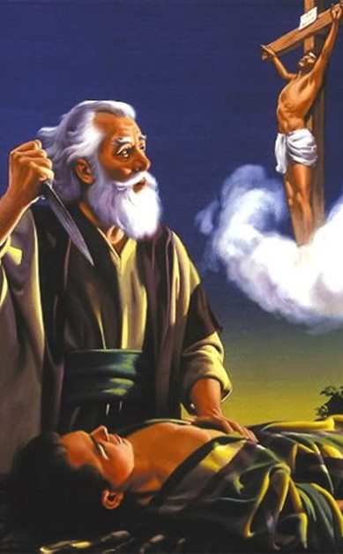
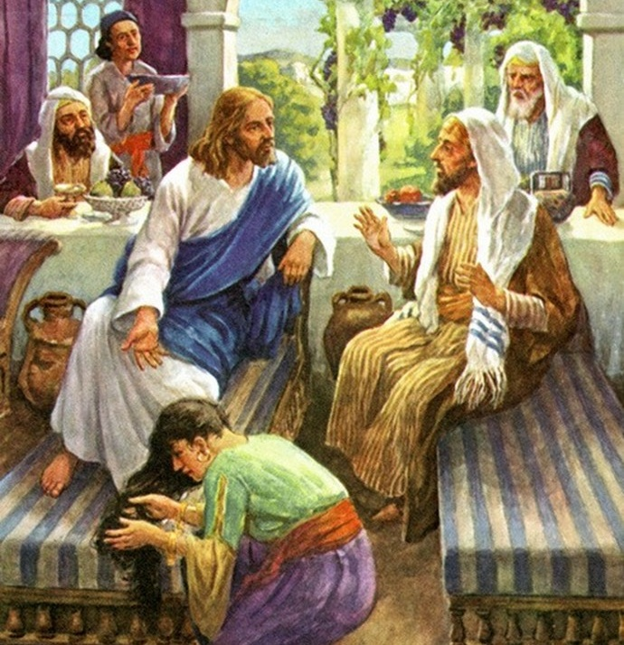
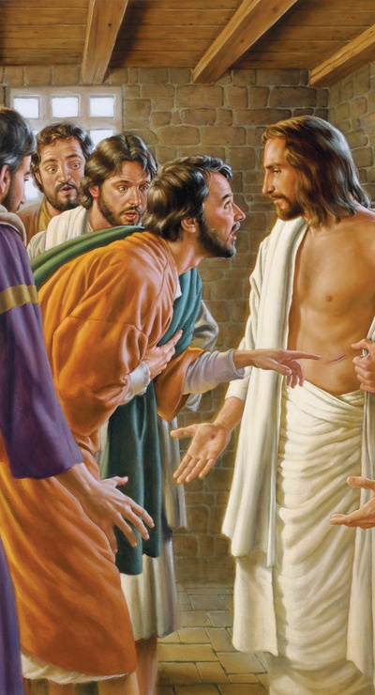
BLESSED ARE THOSE WHO BELIEVE
Lesson 7 for November 16, 2024

Slide 2
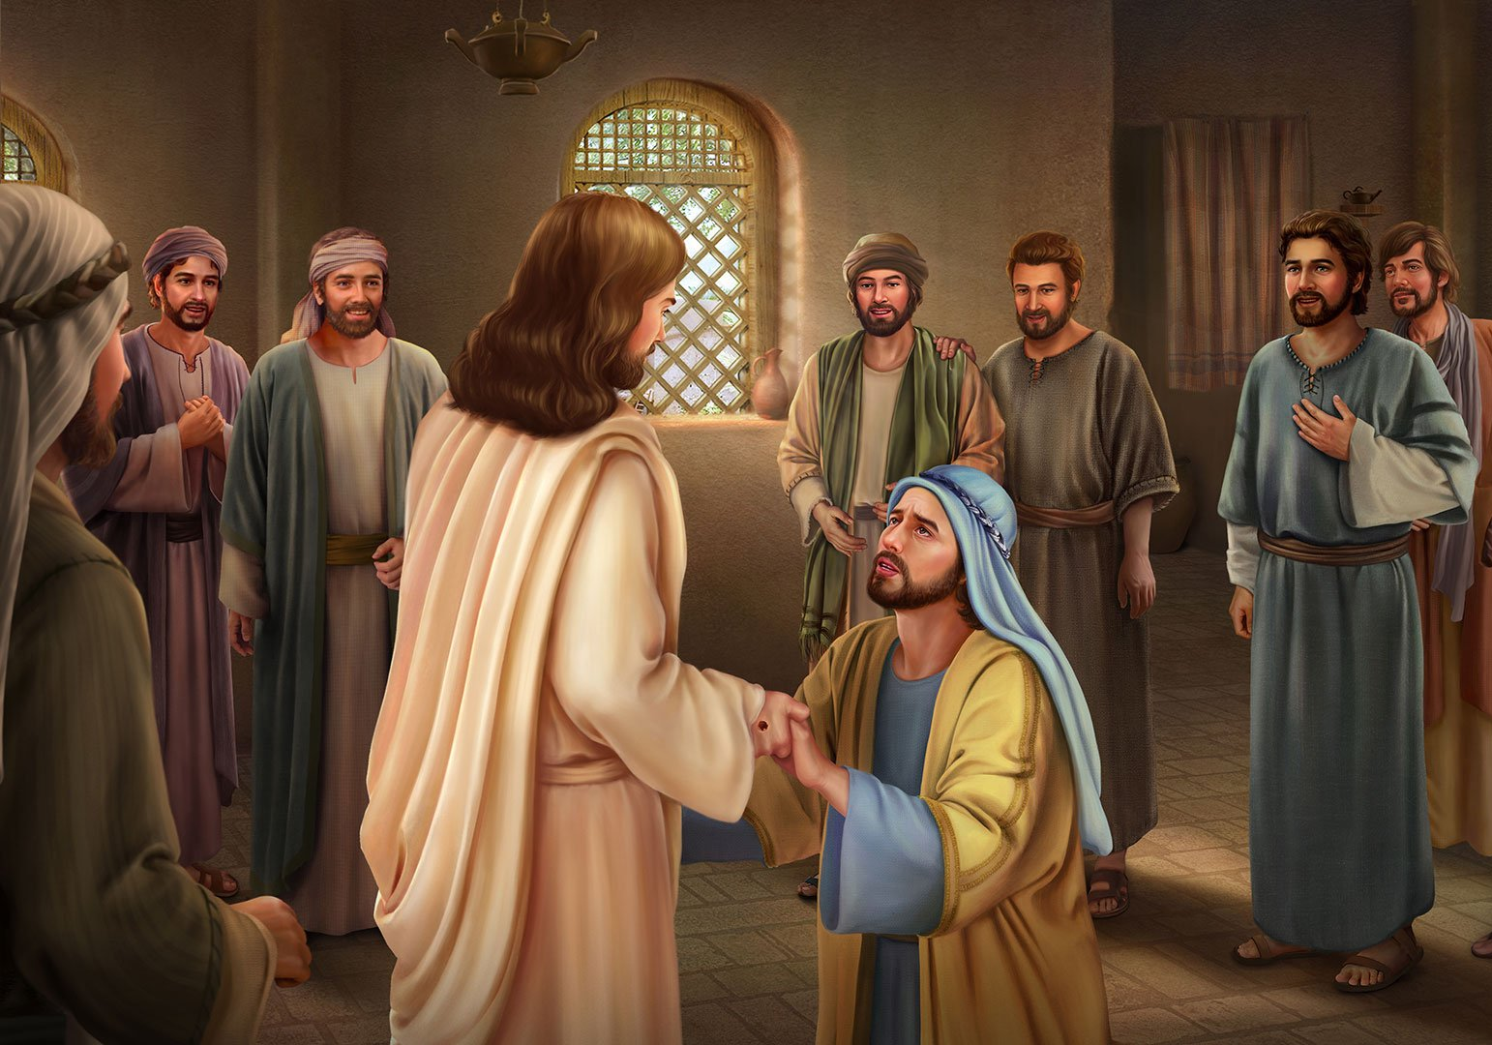
“Jesus said to him, ‘Thomas, because you have seen Me, you have believed. Blessed are those who have not seen and yet have believed’ ”
John 20:29, NKJV

Slide 3
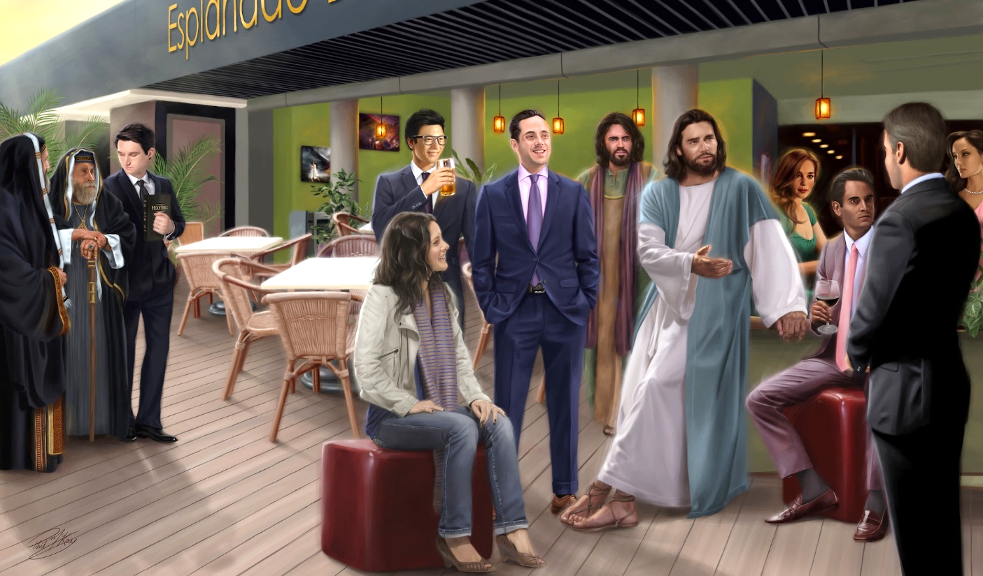
John mentions many testimonies of people who believed in Jesus.
ABRAHAM: Believe by faith
MARY: Believe and give thanks
PILATE: Believe and yield
THOMAS: Believing by seeing
YOU AND I: Believing without seeing
Some believed without hesitation, others with doubts. There were those who believed but hesitated, and acted against their own convictions.
There are also those who believed without seeing, like Abraham, and like the believers of the 21st century.

Slide 4
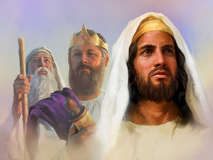
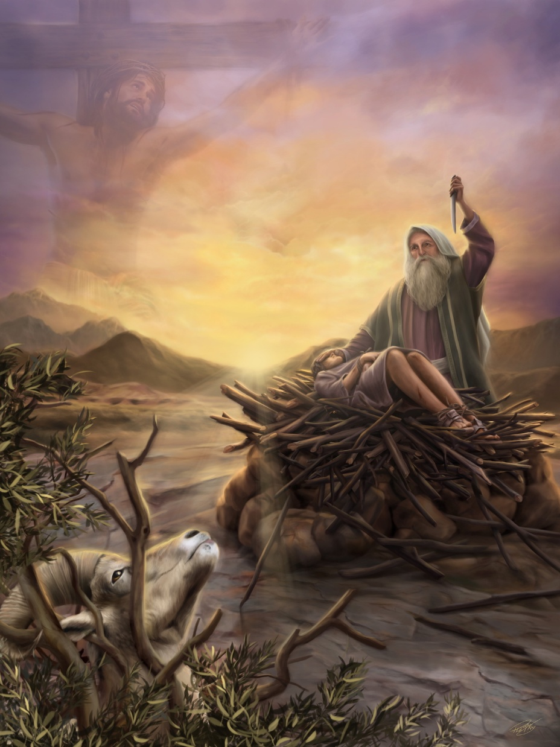
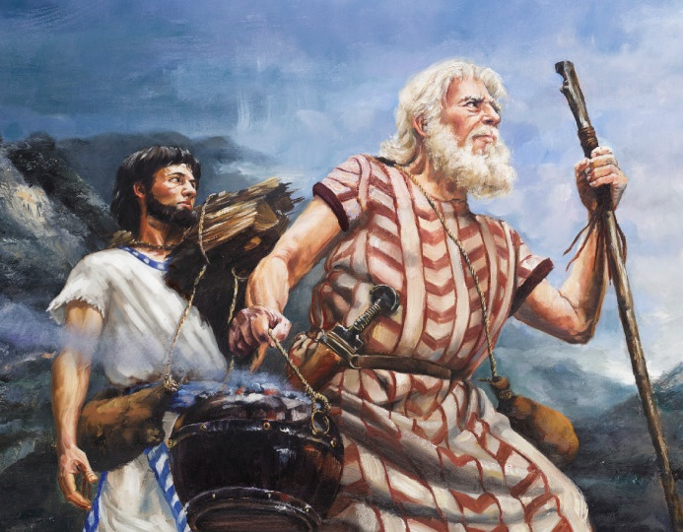
ABRAHAM: BELIEVE BY FAITH
“Your father Abraham rejoiced at the thought of seeing my day; he saw it and was glad.”(John 8:56)
What did Jesus mean by the expression “seeing my day”?
Abraham was given a wonderful promise: “and through your offspring all nations on earth will be blessed” (Gen. 22:18.)
He was aware that this promise did not refer only to his abundant offspring. It referred to the seed promised to Eve, that is, to the Savior of the world (Gen. 3:15.)
Unbeknownst to him, Isaac represented Jesus, ascending the mountain carrying the wood on which he was to be sacrificed (Gen. 22:6.)
Only when he was stopped from sacrificing his son, and the latter was replaced by a ram, did Abraham understand the mission of the Savior (Gen. 22:11-14.) By faith, he saw the day of Jesus Christ (His redemptive death), believed, and rejoiced.

Slide 5
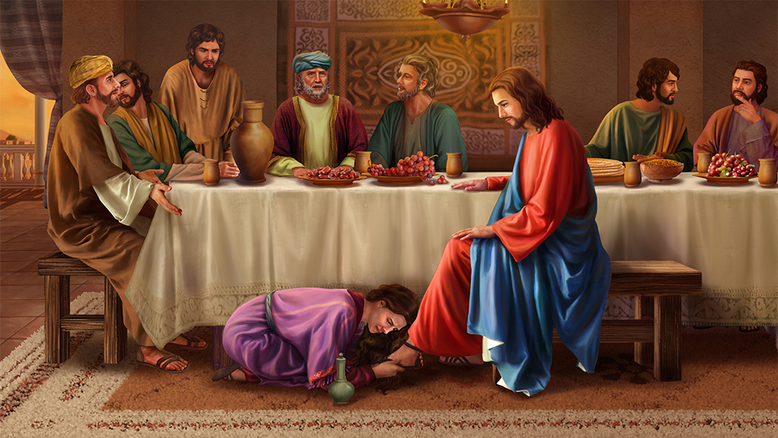
MARY: BELIEVE AND GIVE THANKS
“Then Mary took about a pint of pure nard, an expensive perfume; she poured it on Jesus’ feet and wiped his feet with her hair. And the house was filled with the fragrance of the perfume” (John 12:3)
There were several reasons that led Mary to offer Jesus an expensive perfume, and anoint him with it (Jn. 12:1-3.)
Jesus had forgiven her sins (Lk. 7:44-48)
Jesus had raised her brother from dead (Jn. 11:1-2)
Jesus had spoken of his own death (Jn. 12:7)
But those invited to the party did not understand Mary's motivation.
Simon, the host, thought only of her sins (Lk. 7:39.) Judas thought only of the benefit he could have gained from such a costly gift (Jn. 12:4-6.)
But Jesus knew the hearts of all. He made Simon see his lack of gratitude. He told Judas not to use the poor as an excuse.
He had only words of affection for Mary. He rewarded her faith by reminding her that her sins were forgiven, and he praised her action before Judas and the others.

Slide 6
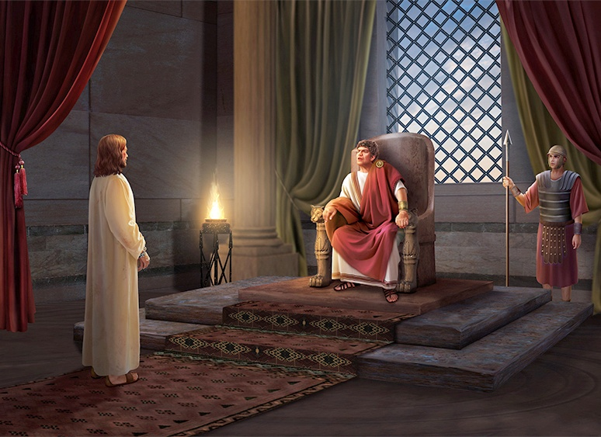
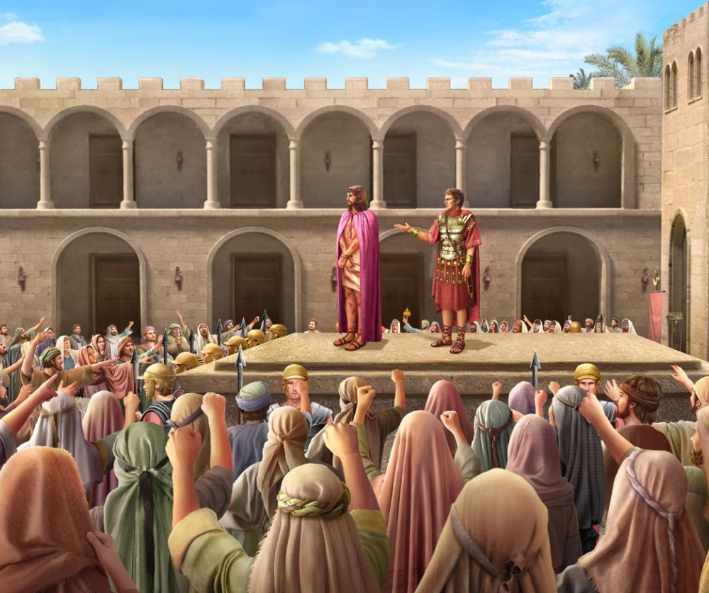
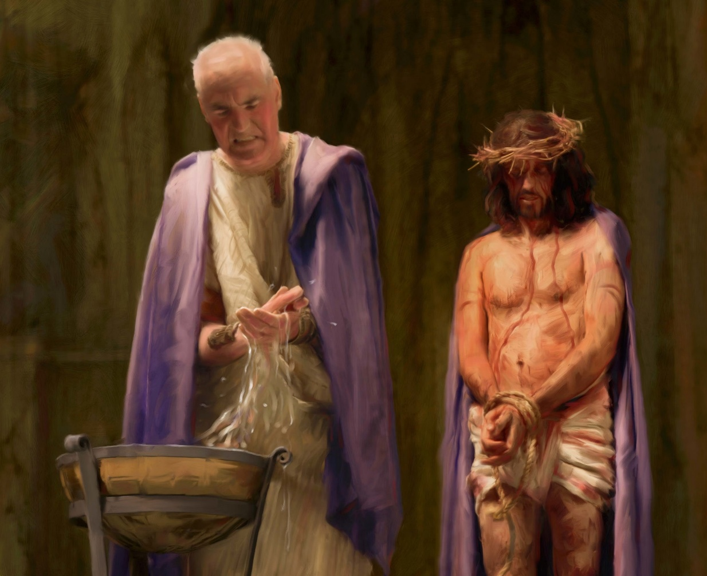
PILATE: BELIEVE AND YIELD
“What is truth?” retorted Pilate. With this he went out again to the Jews gathered there and said, “I find no basis for a charge against him.’” (John 18:38)
After hearing Jesus speak about the truth, Pilate was convinced of his innocence (Jn. 18:37-38.)
Later, he again declared that Jesus had committed no crime (Jn. 19:4.) He even tried to appeal to the humanity of the crowd, and again declared his innocence (Jn. 19:5-6.)
But the climax was when he learned that Jesus declared himself to be the Son of God. Pilate panicked (Jn. 19:7-8.) As he spoke to Jesus, he became convinced of the reality of this claim (Jn. 19:9-11.)
If Jesus was what He claimed to be, then he had to make a choice: believe Him and let Him go; or reject Him and let Him die.
The pressure of the mob was stronger than his own conviction. He believed, but he gave in to the pressure. He lost his eternal life to preserve his power (John 19:15-16.) Will you deny your faith to please those around you?

Slide 7
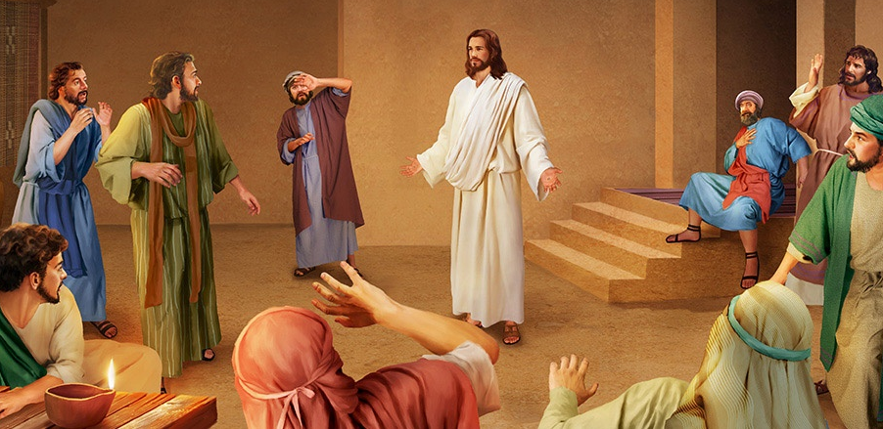
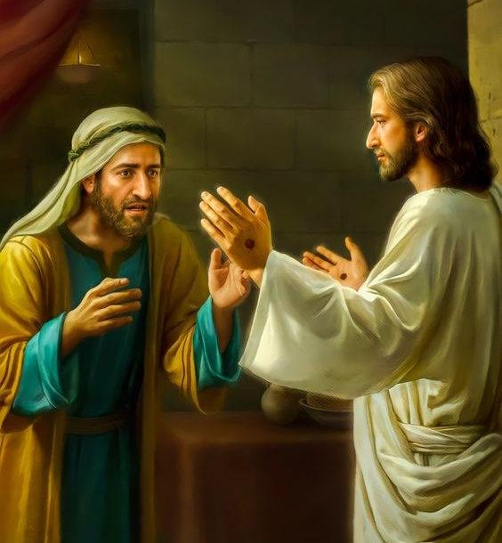
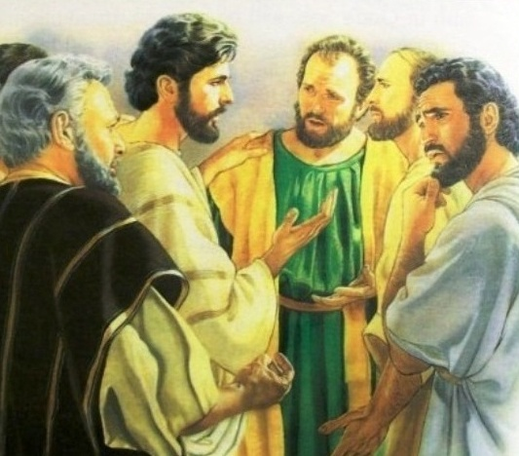
THOMAS: BELIEVE BY SEEING
“Then he said to Thomas, “Put your finger here; see my hands. Reach out your hand and put it into my side. Stop doubting and believe.’” (John 20:27)
Thomas was not present when Jesus appeared in the upper room after his resurrection (Jn . 20:19, 24.)
Although the apostles and other witnesses assured him that they had seen the resurrected Jesus, Thomas did not believe them. Instead of accepting their testimony, he set his own conditions for belief (Jn. 20:25.)
He was not the only one who set his conditions: the king's officer, Nicodemus... Despite the three and a half years he spent with Jesus, Thomas did not seem to have enough evidence to believe in his resurrection.
Despite his unbelief, Jesus gave him new evidence by appearing before him, answering the exact doubt he had expressed, and inviting him to believe (Jn. 20:26-27.)
Even with all the evidence God gives us to believe, there is always room for doubt. It is our choice to accept that evidence and believe in Him.

Slide 8
«In His treatment of Thomas, Jesus gave a lesson for His followers. His example shows how we should treat those whose faith is weak, and who make their doubts prominent. Jesus did not overwhelm Thomas with reproach, nor did He enter into controversy with him. He revealed Himself to the doubting one. Thomas had been most unreasonable in dictating the conditions of his faith, but Jesus, by His generous love and consideration, broke down all the barriers. Unbelief is seldom overcome by controversy. It is rather put upon self-defense, and finds new support and excuse. But let Jesus, in His love and mercy, be revealed as the crucified Saviour, and from many once unwilling lips will be heard the acknowledgment of Thomas, "My Lord and my God!” »
EGW (The Desire of Ages, pg. 808)

Slide 9
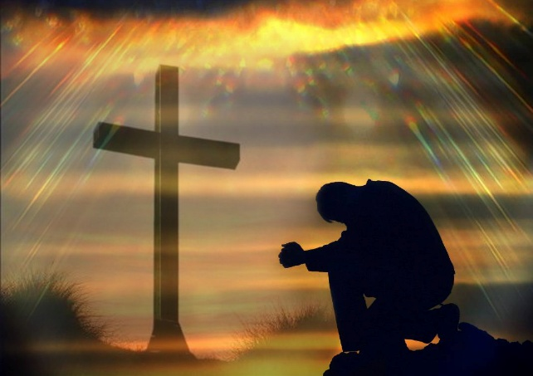
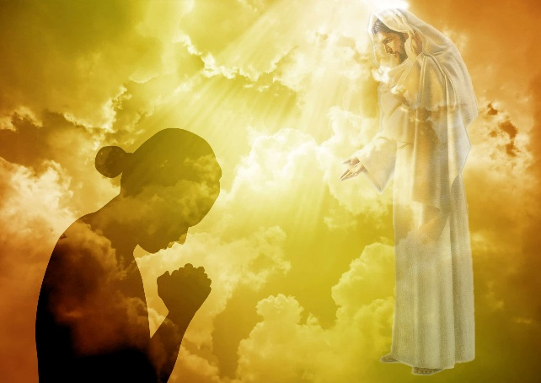
YOU AND I: BELIEVING WITHOUT SEEING
“[…] blessed are those who have not seen, and yet have believed” (John 20:29b)
What evidence does God give us to believe in Him?
Nature
The Word of God
The prophecies
Personal experience
Although imperfect and affected by sin, nature teaches us the intelligent design with which it was endowed by its Creator
In the Bible we find abundant testimonies of the powerful works of God in history and in people. We have in it, especially, the testimony of Jesus himself
The fulfillment of prophecies that announced historical events many centuries before their fulfillment (Greece invading Persia; Tyre devastated; the destruction of the Temple of Jerusalem; etc.)
How is our heart transformed?
How have we seen the hand of God at work?
What answers do we get to our prayers?
To believe, in short, is to see a greater reality that is beyond our immediate circumstances.

Slide 10
“You may say that you believe in Jesus, when you have an appreciation of the cost of salvation. You may make this claim, when you feel that Jesus died for you on the cruel cross of Calvary; when you have an intelligent, understanding faith that his death makes it possible for you to cease from sin, and to perfect a righteous character through the grace of God, bestowed upon you as the purchase of Christ's blood.”
EGW ( The Review and Herald, July 24 , 1888)

