Slide 1
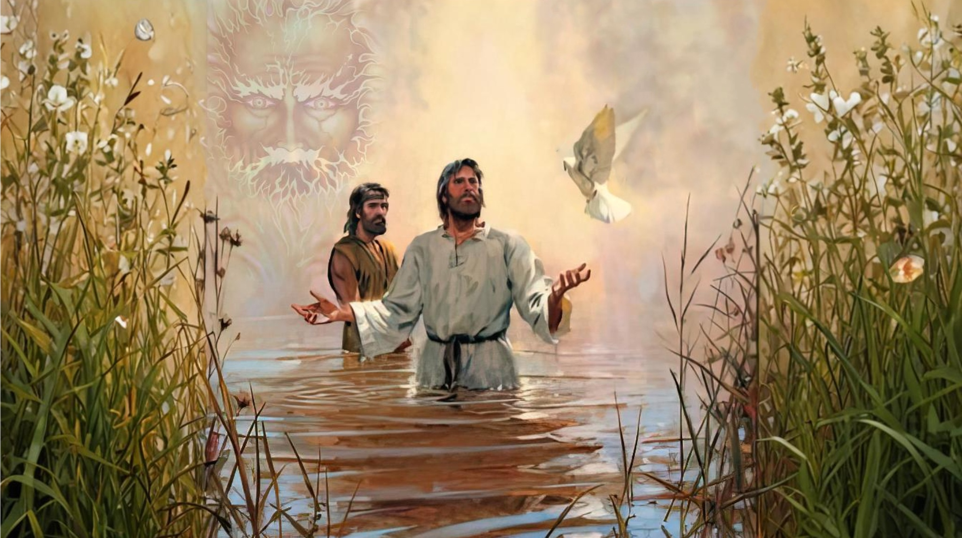
MORE TESTIMONIES ABOUT JESUS
Lesson 6, for November 9, 2024

Slide 2
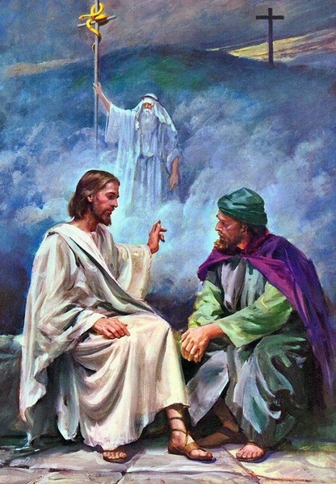

“And I, if I am lifted up from the earth, will draw all peoples to Myself”
John 12:32, NKJV

Slide 3

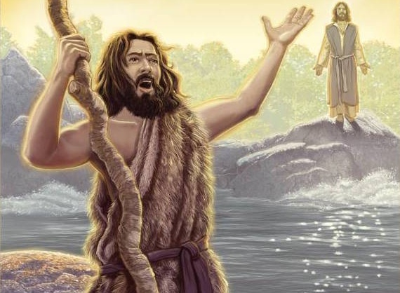
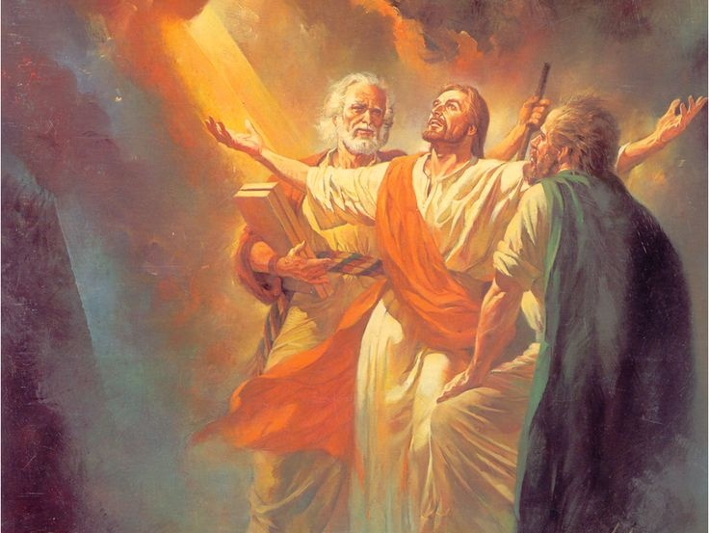







There are many testimonies that John collects about Jesus. Among them, the one that stands out is that of John the Baptist, who spoke repeatedly about Jesus and his work. He also emphasized the One who had commissioned him and indoctrinated him about Jesus' mission.
Those who heard Jesus also gave testimonies about Him. Some rejected Him and others accepted Him. But without a doubt, the greatest testimony comes from the Father, whose audible voice spoke about his beloved Son.
The testimony of John the Baptist:
  The humility of the witness. John 3:25-36.
  The origin of the testimony. John 1:29-36.
The testimony of the crowd:
  “This is a hard teaching.” John 6:51-71.
  “No man ever spoke like this Man!” John 7:37-53
The testimony of the Father. John 5:36-38; 12:27-30.

Slide 4

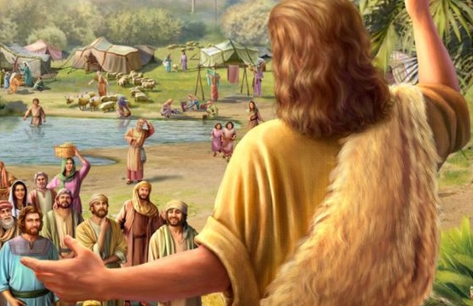
THE TESTIMONY OF JOHN THE BAPTIST
“The bride belongs to the bridegroom. The friend who attends the bridegroom waits and listens for him and is full of joy when he hears the bridegroom’s voice. That joy is mine, and it is now complete.” (John 3:29)

Slide 5

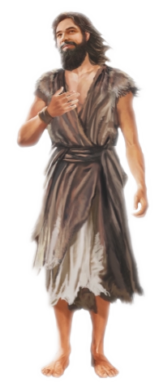
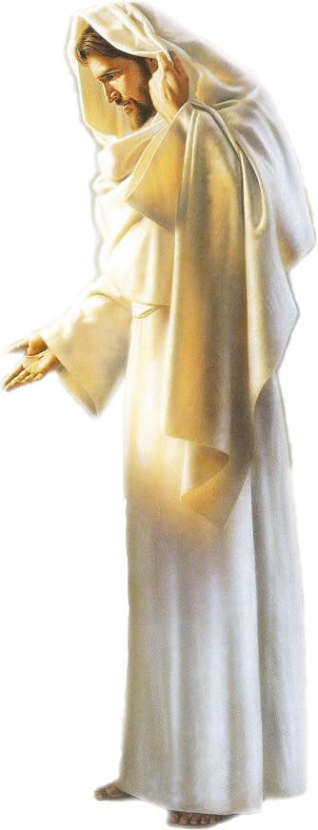
THE HUMILITY OF THE WITNESS
“He must become greater; I must become less” (John 3:30)
A dispute arose between John's disciples and the Jews about the purification of baptism. The disciples' minds turned to Jesus, who also baptized as John, and whose fame was growing (Jn. 3:25-26.)
John made it clear that it is God who decides the work of each one (Jn. 3:27.)
JESUS
JOHN THE BAPTIST
John 3:28
He is the Christ
He is sent before Him
John 3:29
He is the Husband
He is the friend of the Husband
John 3:30
He must become greater
He must become less
He is heavenly, it is above all
John 3:31
He is earthly, he speaks earthly things
John 3:32-36
He speaks the words of God. He is filled with the Spirit of God. He is loved by his Father, from whom he has received everything. Whoever believes in him has eternal life.
He is a witness whom no one believes. Whoever listens to him testifies that God is true.

Slide 6

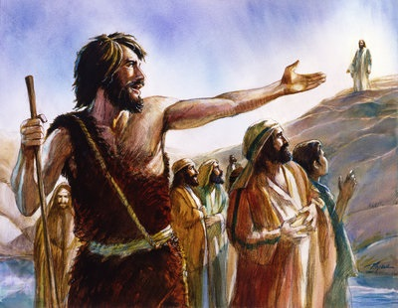
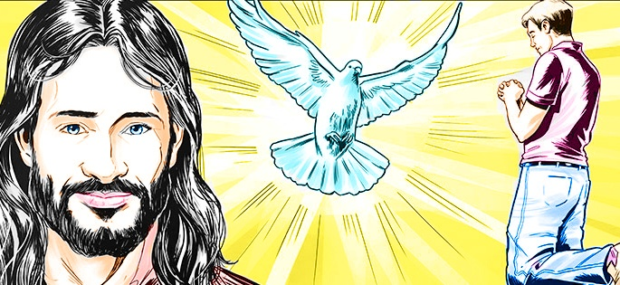
THE ORIGIN OF THE TESTIMONY
“And I myself did not know him, but the one who sent me to baptize with water told me, ‘The man on whom you see the Spirit come down and remain is the one who will baptize with the Holy Spirit.’ ” (John 1:33)
John identified Jesus as the one of whom he had said, “A man who comes after me has surpassed me” (John 1:30 NIV .) He even announced his preexistence (John 1:30b.) Yet he repeatedly declared, “I myself did not know him” (John 1:31, 33.) How could John know that Jesus was the expected Messiah?
His parents had told him that his cousin was the Messiah. But John had never met Jesus. It was God Himself who told him who the Messiah was (Jn. 1:33.)
Likewise, we listen to those who speak to us about Jesus, but we can only recognize Him as our Savior through the conviction that the Holy Spirit instills in us.
The important point is: will we accept or reject this conviction that the Spirit places in our minds?

Slide 7
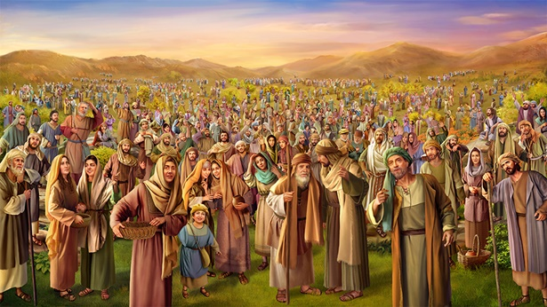
THE TESTIMONY OF THE CROWD
“On hearing his words, some of the people said, “Surely this man is the Prophet. […] Thus the people were divided because of Jesus.”
(John 7:40,43)

Slide 8

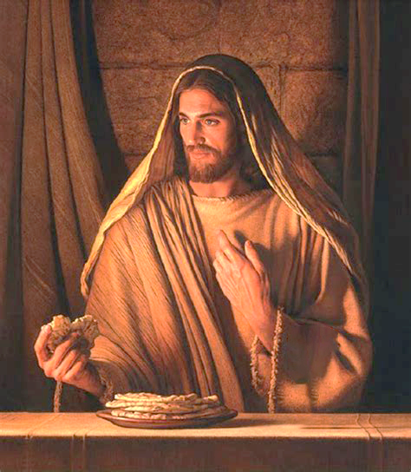

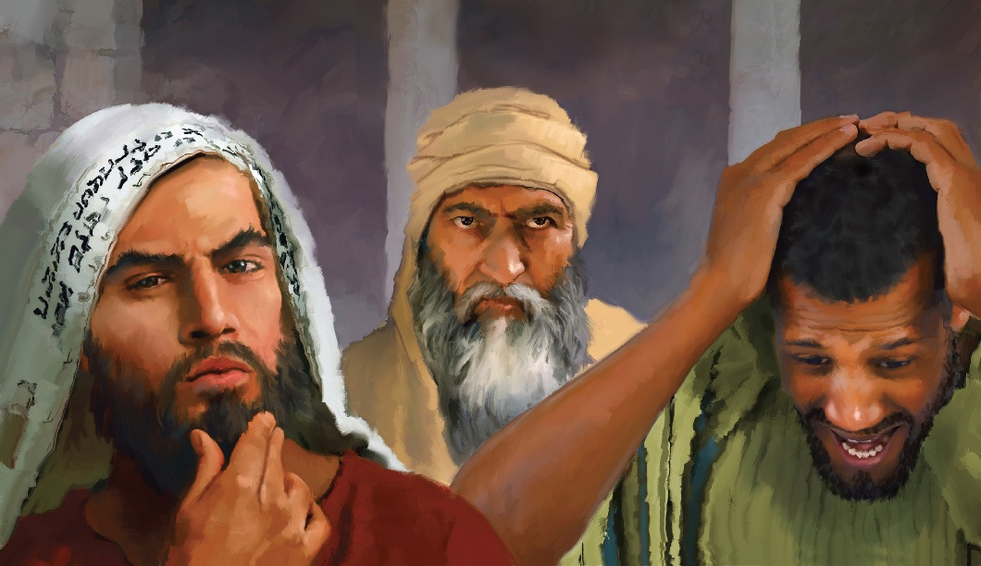
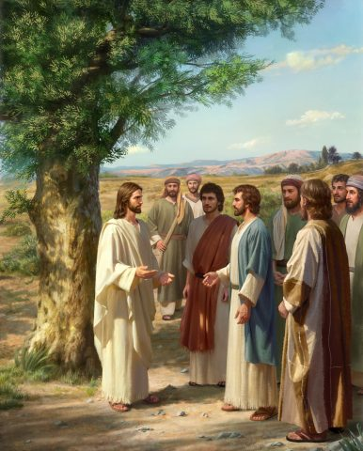
“THIS IS A HARD TEACHING”
“On hearing it, many of his disciples said, “This is a hard teaching. Who can accept it?’” (John 6:60 NIV)
After the feeding of the 5,000, the crowd believed that Jesus was the Messiah and wanted to make Him king (Jn. 6:14-15.) The next day, while He was teaching in the synagogue in Capernaum, He spoke to them about the bread of life, awakening in them a desire to know more (Jn. 6:32-34.)
But it seems that they did not want to hear deep spiritual truths. They wanted a king to lead them in their struggle against the Romans. They closed their minds, and refused to follow Jesus, or to accept Him as a soul-regenerating and converting Messiah (John 6:60-66.)
When Jesus was forsaken, he spoke to the 12, giving them the opportunity to leave him too, if they so desired (John 6:67.) Their response reflects the feelings of all of us who have found in Jesus our Redeemer, our Liberator, our personal Savior: “Lord, to whom shall we go? You have the words of eternal life. And we have believed and have come to know that you are the Christ, the Son of the living God” (John 6:68-69.)

Slide 9


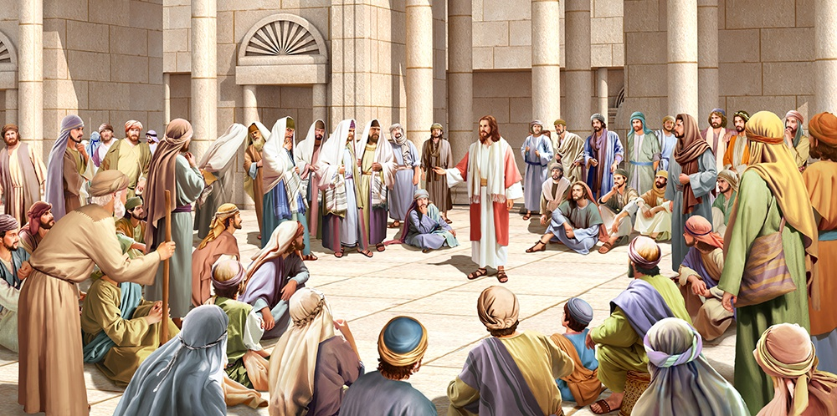
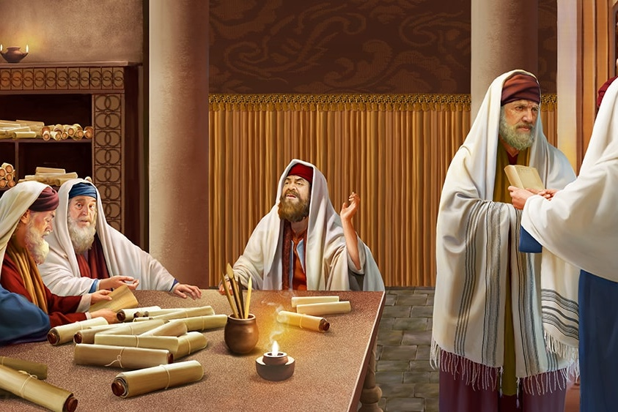
“NO MAN EVER SPOKE LIKE THIS MAN!”
“The officers answered, “No man ever spoke like this Man! ’” (John 7:46 NKJV)
Like the 12, there were others who were willing to accept Jesus as the Prophet (Jn. 7:40.) Some believed that he could be the Christ, however, they still had some doubts
(Jn. 7:41-43.)
Everyone was fascinated by his words. Even those who had been sent by the Sanhedrin to arrest Jesus were unable to carry out the orders they had received (Jn. 7:44-46.)
Disappointed, the members of the Sanhedrin attacked the officers and called them ignorant (Jn. 7:47-49.) Their argument was based on the fact that they themselves had not accepted Him. But they were wrong. At least one of them believed. And Nicodemus did not miss the opportunity to defend Jesus
(Jn. 7:50-51.)
Again they failed in their argument against Nicodemus (John 7:52.) At least one prophet had come from Galilee: Jonah (2 Kings 14:25.) In any case, their plans to arrest Jesus were frustrated (John 7:53.)

Slide 10
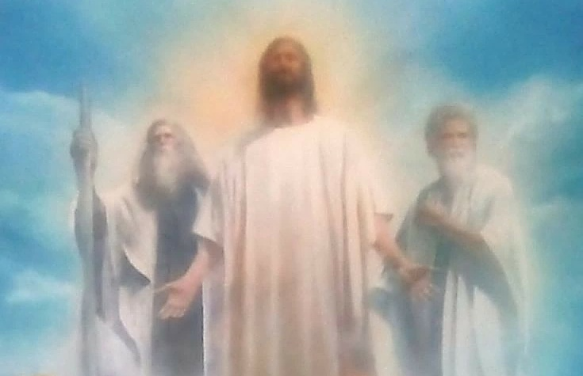
THE FATHER'S TESTIMONY
“He received honor and glory from God the Father when the voice came to him from the Majestic Glory, saying, “This is my Son, whom I love; with him I am well pleased. ’”
(2 Peter 1:17)

Slide 11

“And the Father who sent me has himself testified concerning me. You have never heard his voice nor seen his form” (John 5:37)
The first audible testimony of the Father was at the baptism of Jesus, at the beginning of his ministry
(Mark 1:11)
The second, to the small group who witnessed the transfiguration (Mt. 17:5.) These words were deeply engraved in their minds (2P. 1:17)
The third and last was shortly before the crucifixion, in response to Jesus' anguished request
(Jn. 12:27-28)
Jesus knew three things about the Father (Jn. 5:36-37)
He had given him power to perform miracles
He had sent him the world
He had given testimony of him

Slide 12

“ ‘To whom shall we go?’ Not from the teaching of Christ, His lessons of love and mercy, to the darkness of unbelief, the wickedness of the world. While the Saviour was forsaken by many who had witnessed His wonderful works, Peter expressed the faith of the disciples, —‘Thou art that Christ.’ The very thought of losing this anchor of their souls filled them with fear and pain. To be destitute of a Saviour was to be adrift on a dark and stormy sea.”
EGW (The Desire of Ages, pg. 393)

