Slide 1
Lesson 5 for November 2, 2024
THE TESTIMONY OF THE SAMARITANS

Slide 2
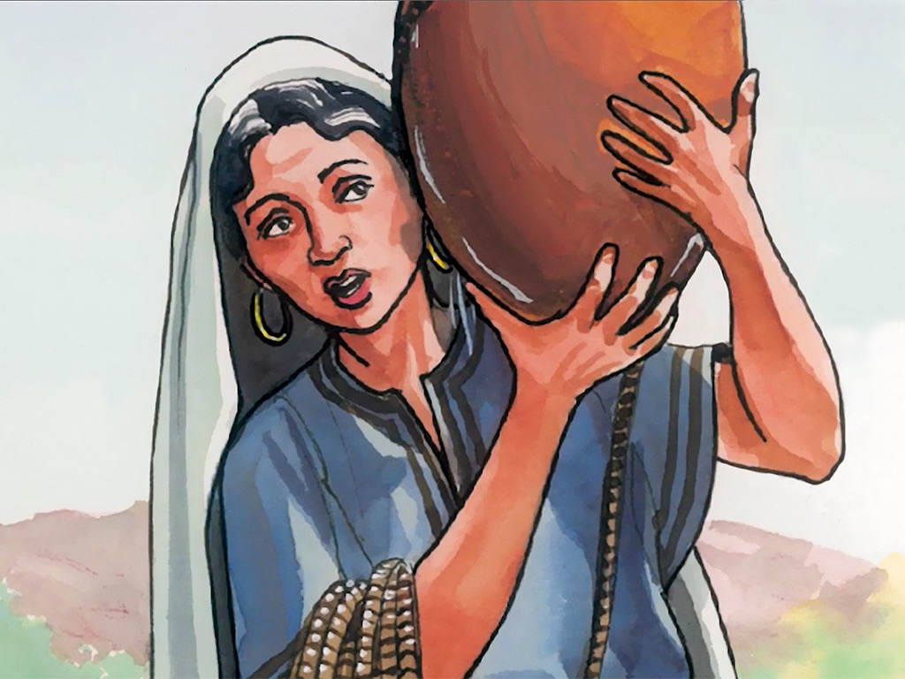
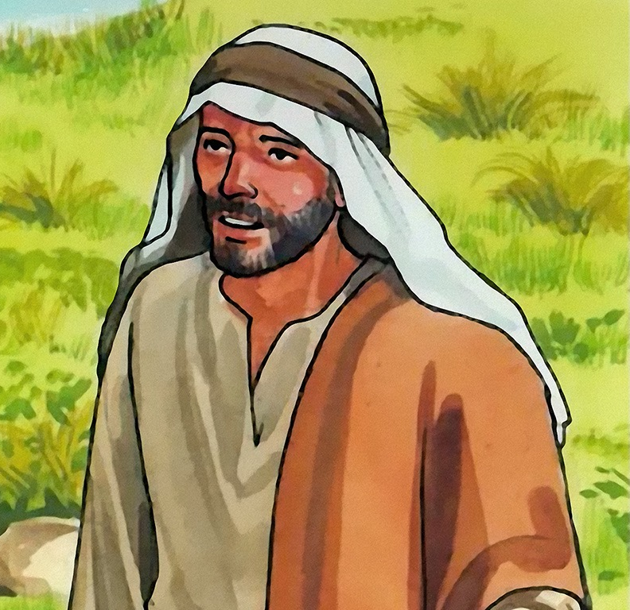
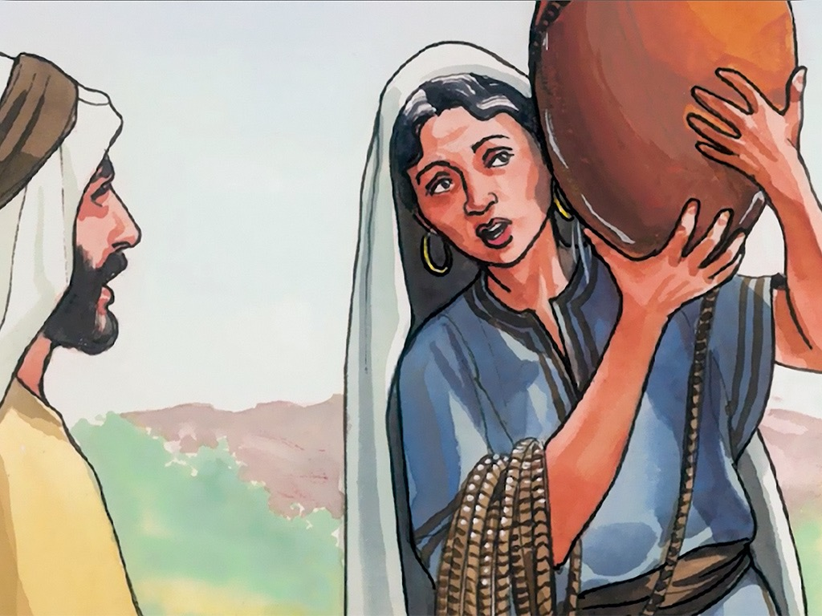
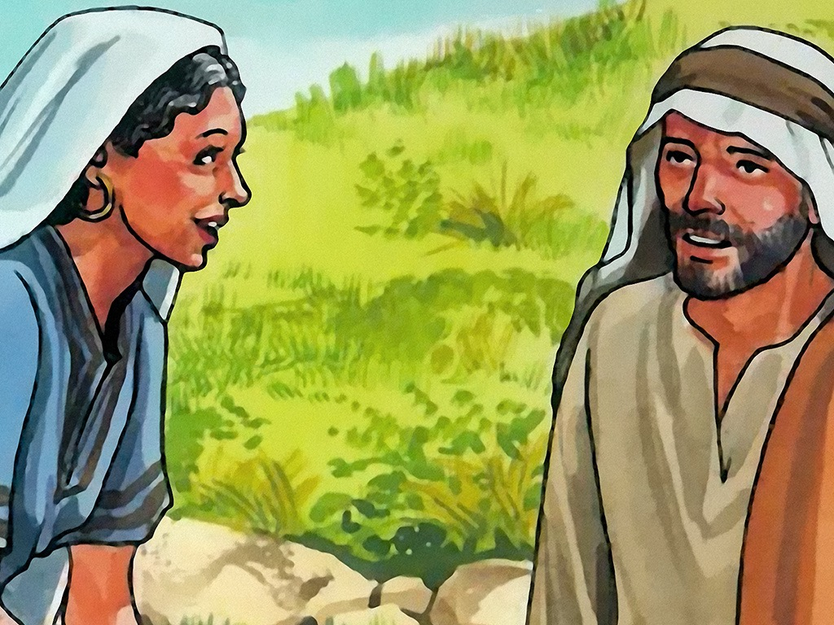
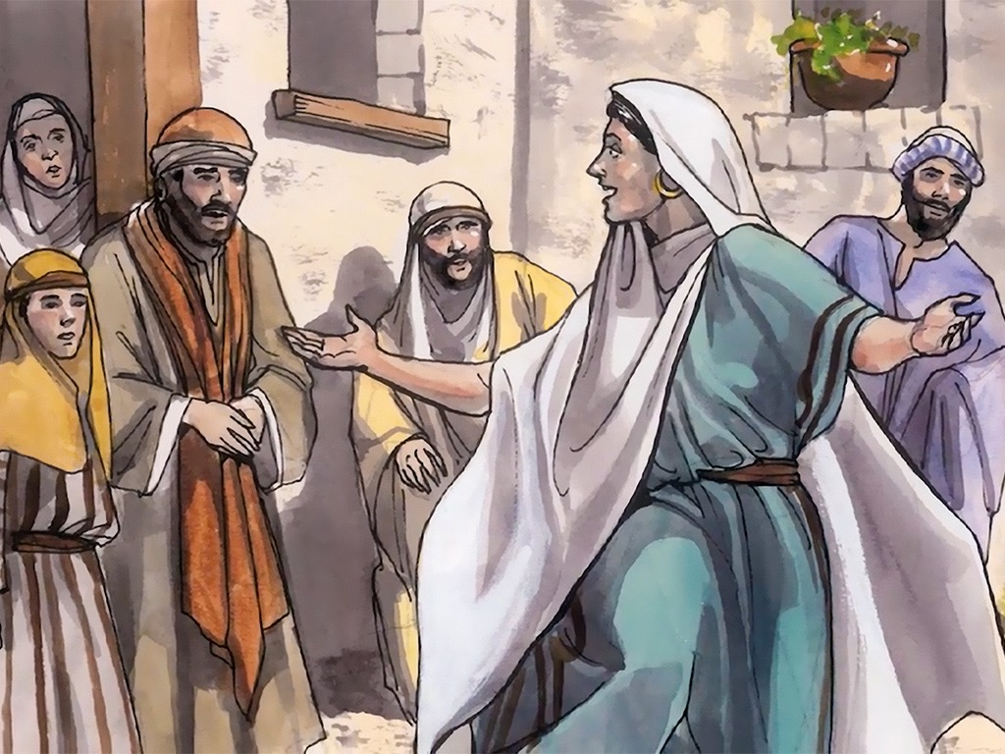
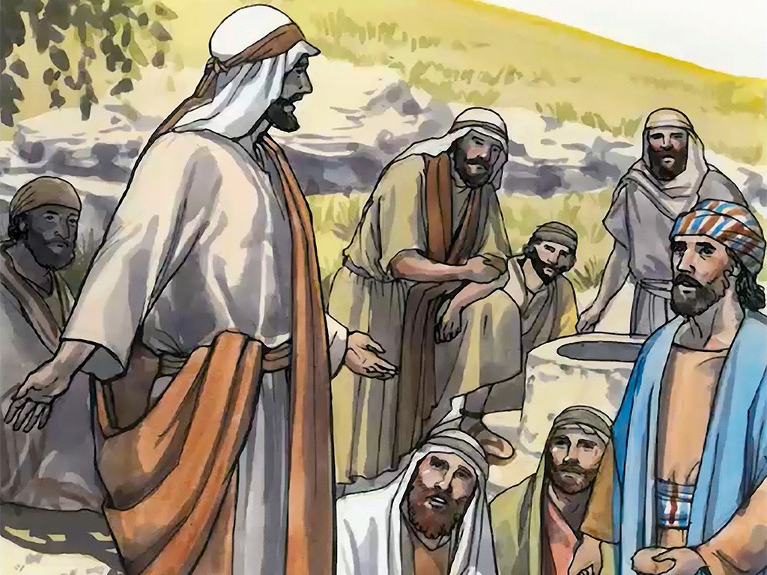
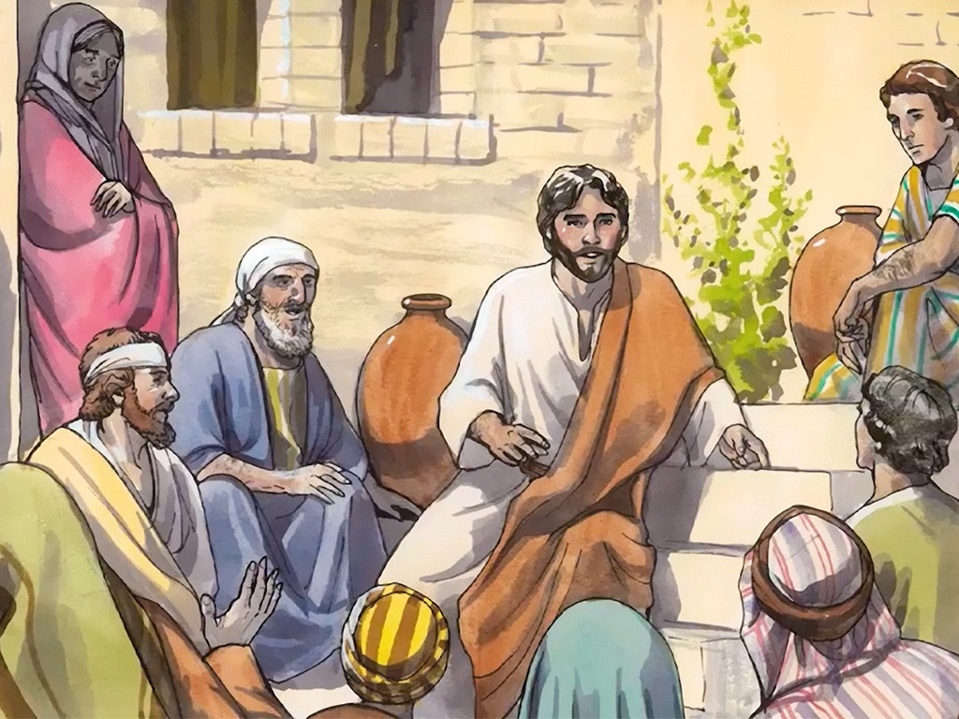
“Then they said to the woman, ‘Now we believe, not because of what you said, for we ourselves have heard Him and we know that this is indeed the Christ, the Savior of the world’ ”
John 4:42, NKJV

Slide 3
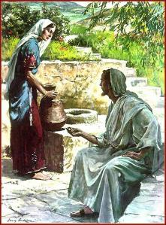
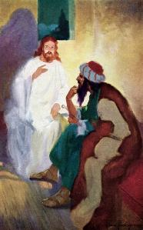
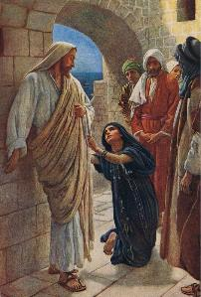
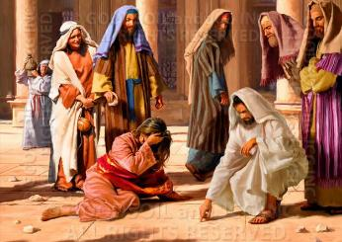
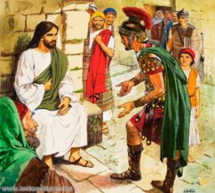
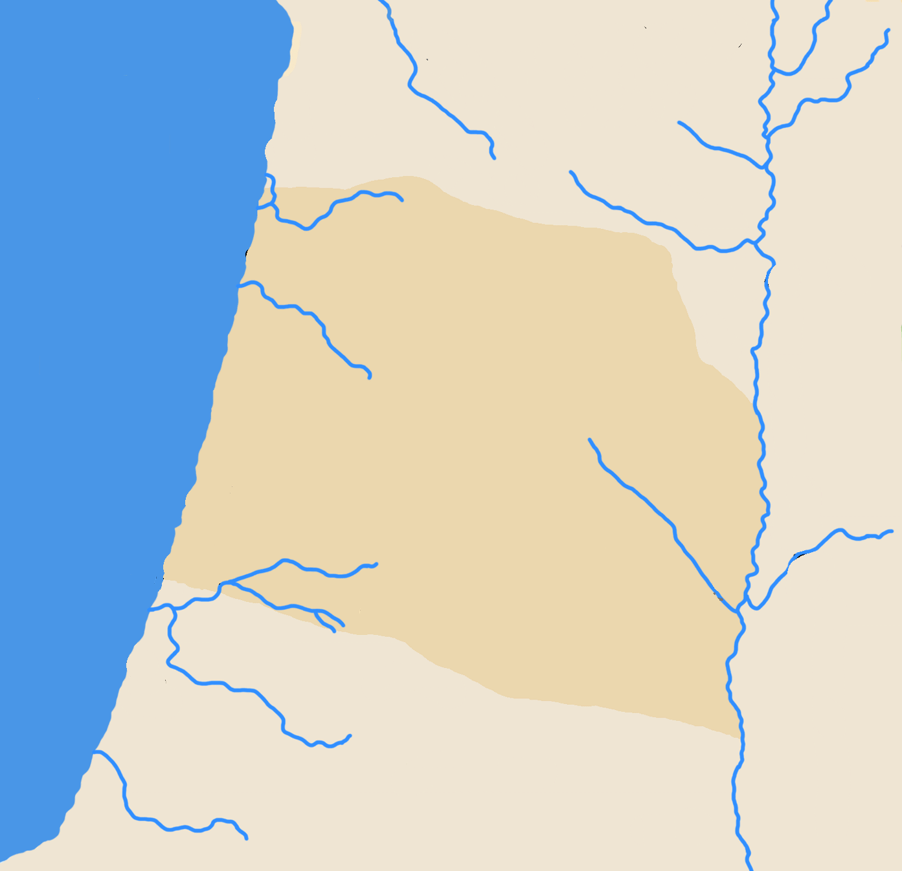
For Jesus, there are no barriers that separate people. We are all equal for Him.
While he lived among us, he had to confront existing barriers… and break them down. How did he do it? How did he bring salvation to those to whom no one else was willing to offer it?
“It was necessary for him to pass through Samaria” (John 4:4). What need did Jesus have of doing this when He could have taken the route east of the Jordan? He needed to have a personal interview with a special person…
GALILEE
Jews and Samaritans:
The story of the Samaritans. John 4:1-7.
The Samaritan woman and the thirsty Jew. John 4:7-14.
The Samaritans accept the Savior:
Thirst for living water. John 4:15-16.
Discovering the Savior. John 4:17-26.
Proclaiming the Savior. John 4:27-42.
SAMARIA
PEREA
JUDEA

Slide 4
JEWS
AND
SAMARITANS

Slide 5
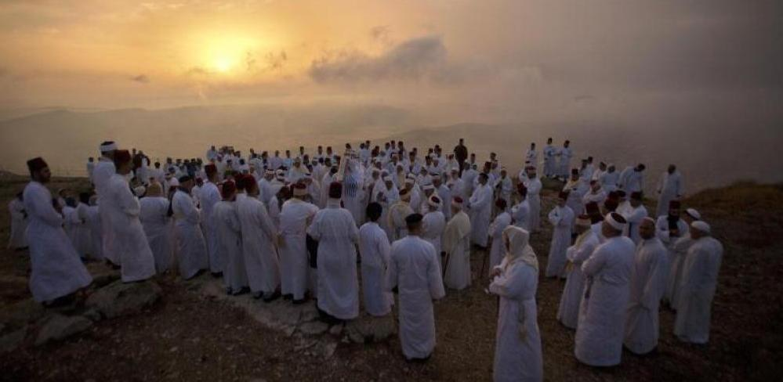
THE STORY OF THE SAMARITANS
Who were the Samaritans?
926 BC
10 of the 12 tribes of Israel rebel against Solomon's son Rehoboam and establish the northern kingdom [Israel] (1Kings 12:1, 16-17)
875 BC
Omri moves the capital of Israel to Samaria (1 Kings 16:23-24)
732 BC
Tiglath Pileser III deports part of the population, and makes Hoshea a puppet king of Israel (2 Kings 15:29-30 NIV)
722 BC
Sargon II finally conquers Samaria and deports a large part of its population (2 Kings 17:6)
± 721 BC
They repopulate Samaria with deportees from other countries (2 Kings 17:24)
± 720 BC
Some priests (not Levites) are brought to Samaria to explain the religion to the new inhabitants (2 Kings 17:27)
557 BC
The Samaritans slyly offer to help rebuild the Temple in Jerusalem, but are rejected (Ezra 4:1-3). Hostility spreads.
Nehemiah expels Manasseh from the priesthood, and his father-in-law Sanballat builds him a temple in Samaria, on Mount Gerizim (Neh. 13:28)
± 430 BC
128 BC
John Hyrcanus (ethnarch of Judea) destroys the Samaritan temple.

Slide 6
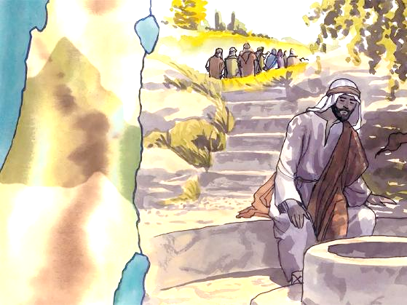
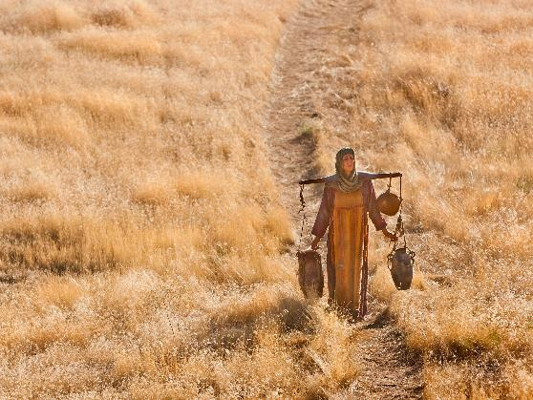
THE STORY OF THE SAMARITANS
“Now it was necessary for him to pass through Samaria” (John 4:4)
To avoid tensions between John's followers and his own, Jesus decides to go from Judea to Galilee, passing through the region of Samaria (Jn . 4:1-4).
On the way, He stops about a mile from Sychar, where Jacob had bought a piece of land and given it as an inheritance to Joseph (John 4:5; Gen. 33:18-19; Josh. 24:32). Once there, Jesus sits down by Jacob's well. It was midday, the hottest time of the day (John 4:6).
While the disciples go out to buy food, a Samaritan woman comes to the well to draw water. At midday, when it is hottest? She hides from the others, she does not want to be seen or to associate with the other women who, early in the morning or at dusk, go to draw water (Jn . 4:7-8).
Prejudices raised by so many centuries of history prevent women from speaking or offering their water to a Jew.
What are some prejudices in your own culture that might hinder your witness to others? How can you overcome them?

Slide 7
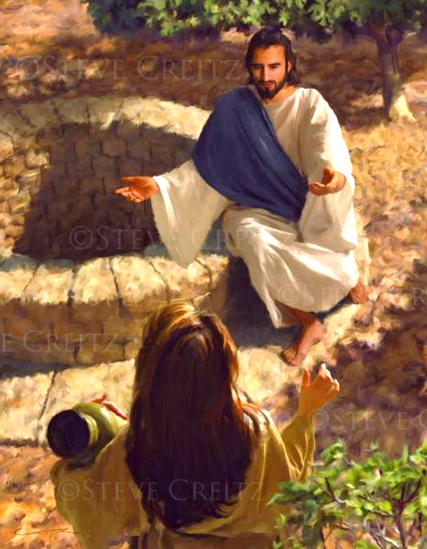
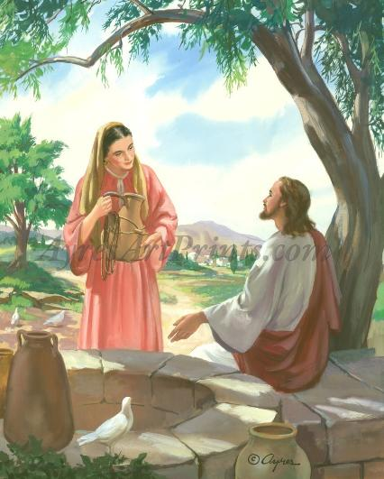
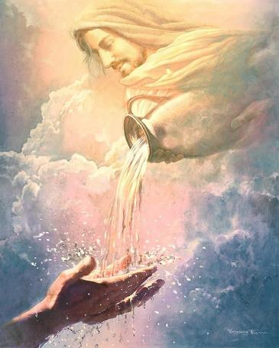
THE SAMARITAN WOMAN AND THE THIRSTY JEW
“The Samaritan woman said to him, “You are a Jew and I am a Samaritan woman. How can you ask me for a drink?” (For Jews do not associate with Samaritans)” (John 4:9)
Since the woman was not willing to engage in conversation, Jesus decides to break the ice by asking for a favor: “Give me a drink” (Jn . 4:7).
In response, the Samaritan woman reminds him of the two reasons why Jesus should not ask her for favors, or even speak to her: she was a woman and a Samaritan (Jn . 4:9).
At least he had managed to start the conversation. As with Nicodemus, Jesus got straight to the point: “I am someone special, and I can give you water to quench all thirst” (John 4:10).
Like Nicodemus, the Samaritan woman intended to interpret his words literally (John 4:11-12). Jesus kindled in her the desire to obtain that living water (John 4:13-15).
Are you thirsty for the water that quenches the thirst of your soul? Jesus offers it freely (Rev. 21:6).

Slide 8
THE SAMARITANS ACCEPT THE SAVIOUR

Slide 9
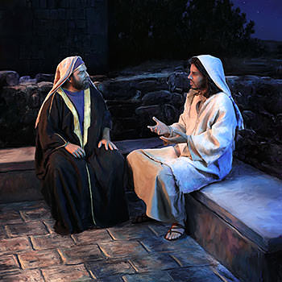
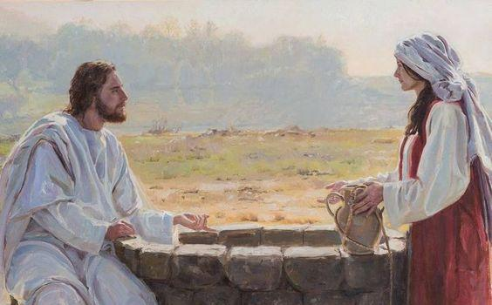
THIRST FOR LIVING WATER
“The woman said to him, ‘Sir, give me this water so that I won’t get thirsty and have to keep coming here to draw water.’ ” (John 4:15)
Nicodemus
He hides in the night
He interpreted the new birth literally
Samaritan woman
She hides at noon
She interpreted the water of life literally
Jesus led her to the desire to know more
Jesus pointed out to him the spiritual truth
Let's review the similarities between Nicodemus and the Samaritan woman:
When He got the woman’s attention, Jesus did not directly answer her request. If she wanted the living water, she had to come with her “husband” (John 4:16).
Suddenly, all his sins flashed through his mind.
How do you react when God confronts you with your sin? Do you avoid the situation, or do you hand it over to Him for forgiveness?

Slide 10
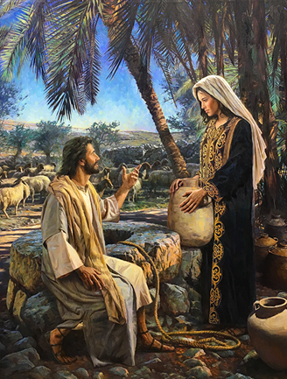
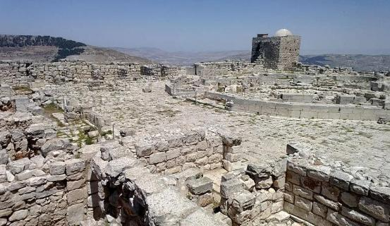
DISCOVERING THE SAVIOR
“The woman said, “I know that Messiah” (called Christ) “is coming. When he comes, he will explain everything to us.” Then Jesus declared, “I, the one speaking to you—I am he” (John 4:25-26)
The first reaction was denial: “I have no husband” (Jn. 4:17). But Jesus showed her that he knew her intimate life. At this, the woman recognized him as a prophet (Jn. 4:17-19).
For the second time, the woman attempted to avoid any reference to her sin, leading Jesus into a theological dispute over whether they should worship in the temple in Jerusalem, or on the ruins of the temple on Mount Gerizim (Jn. 4:20).
Patiently, Jesus answered her question and led her to decide to be a true worshiper of God (Jn . 4:21-24).
Now, the Samaritan woman asked Jesus for a clarification that expressed her thoughts: Was He a prophet, or the expected Messiah? (Jn. 4:25). She was the only woman who heard Jesus declare Himself to be the Christ, the expected Messiah (Jn. 4:26 ).
How did you discover Christ and accept Him as your Savior?

Slide 11
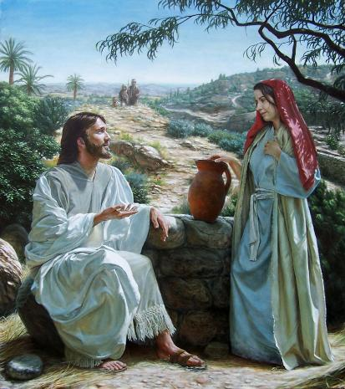
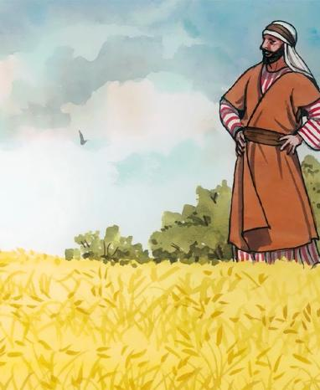
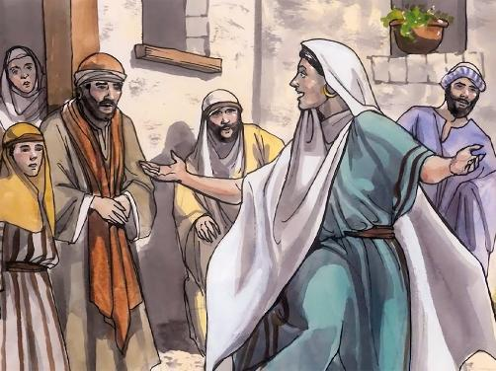
PROCLAIMING THE SAVIOUR
“Come, see a man who told me everything I ever did. Could this be the Messiah?” (John 4:29)
The arrival of the disciples interrupts the conversation. The woman, filled with joy, forgets her water jar (the reason she went to the well) and returns to Sychar (Jn. 4:27-28).
Knowing what was going to happen next, Jesus prepared his disciples. First, he showed them that there is something more satisfying than physical food: the joy of making salvation known to others (John 4:31-34).
Second, He told them that they were going to reap what others had sown (Jn . 4:35-38). The woman shared her testimony and planted the seed (Jn. 4:29-30, 39). Jesus watered it and caused the harvest to sprout (Jn. 4:40-42).
Personal testimony is the best seed we can sow in people's hearts. How powerful is your testimony about what Jesus did in your life?

Slide 12
“As soon as she had found the Saviour the Samaritan woman brought others to Him. She proved herself a more effective missionary than His own disciples. The disciples saw nothing in Samaria to indicate that it was an encouraging field. Their thoughts were fixed upon a great work to be done in the future. They did not see that right around them was a harvest to be gathered. But through the woman whom they despised, a whole cityful were brought to hear the Saviour. She carried the light at once to her countrymen.
This woman represents the working of a practical faith in Christ. Every true disciple is born into the kingdom of God as a missionary. He who drinks of the living water becomes a fountain of life. The receiver becomes a giver. The grace of Christ in the soul is like a spring in the desert, welling up to refresh all, and making those who are ready to perish eager to drink of the water of life.”
EGW (The Desire of Ages, pg. 195)

Slide 13
“Christ recognized no distinction of nationality or rank or creed. The scribes and Pharisees desired to make a local and a national benefit of the gifts of heaven and to exclude the rest of God's family in the world. But Christ came to break down every wall of partition. He came to show that His gift of mercy and love is as unconfined as the air, the light, or the showers of rain that refresh the earth.
The life of Christ established a religion in which there is no caste, a religion by which Jew and Gentile, free and bond, are linked in a common brotherhood, equal before God. […] That which appealed to His heart was a soul thirsting for the waters of life.”
EGW (The Ministry of Healing, pg. 25)

