Slide 1
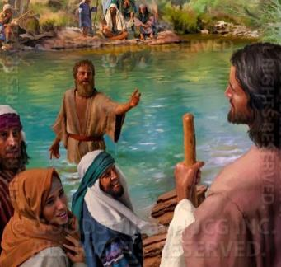
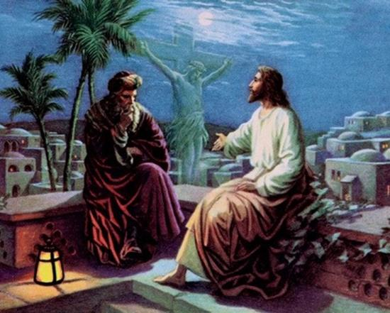
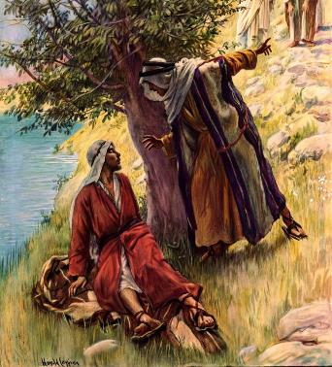
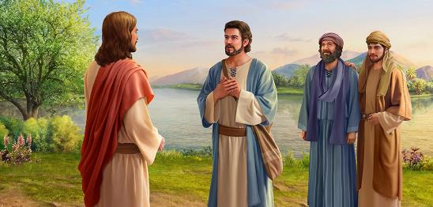
WITNESSES OF CHRIST AS THE MESSIAH
Lesson 4 for October 26, 2024

Slide 2
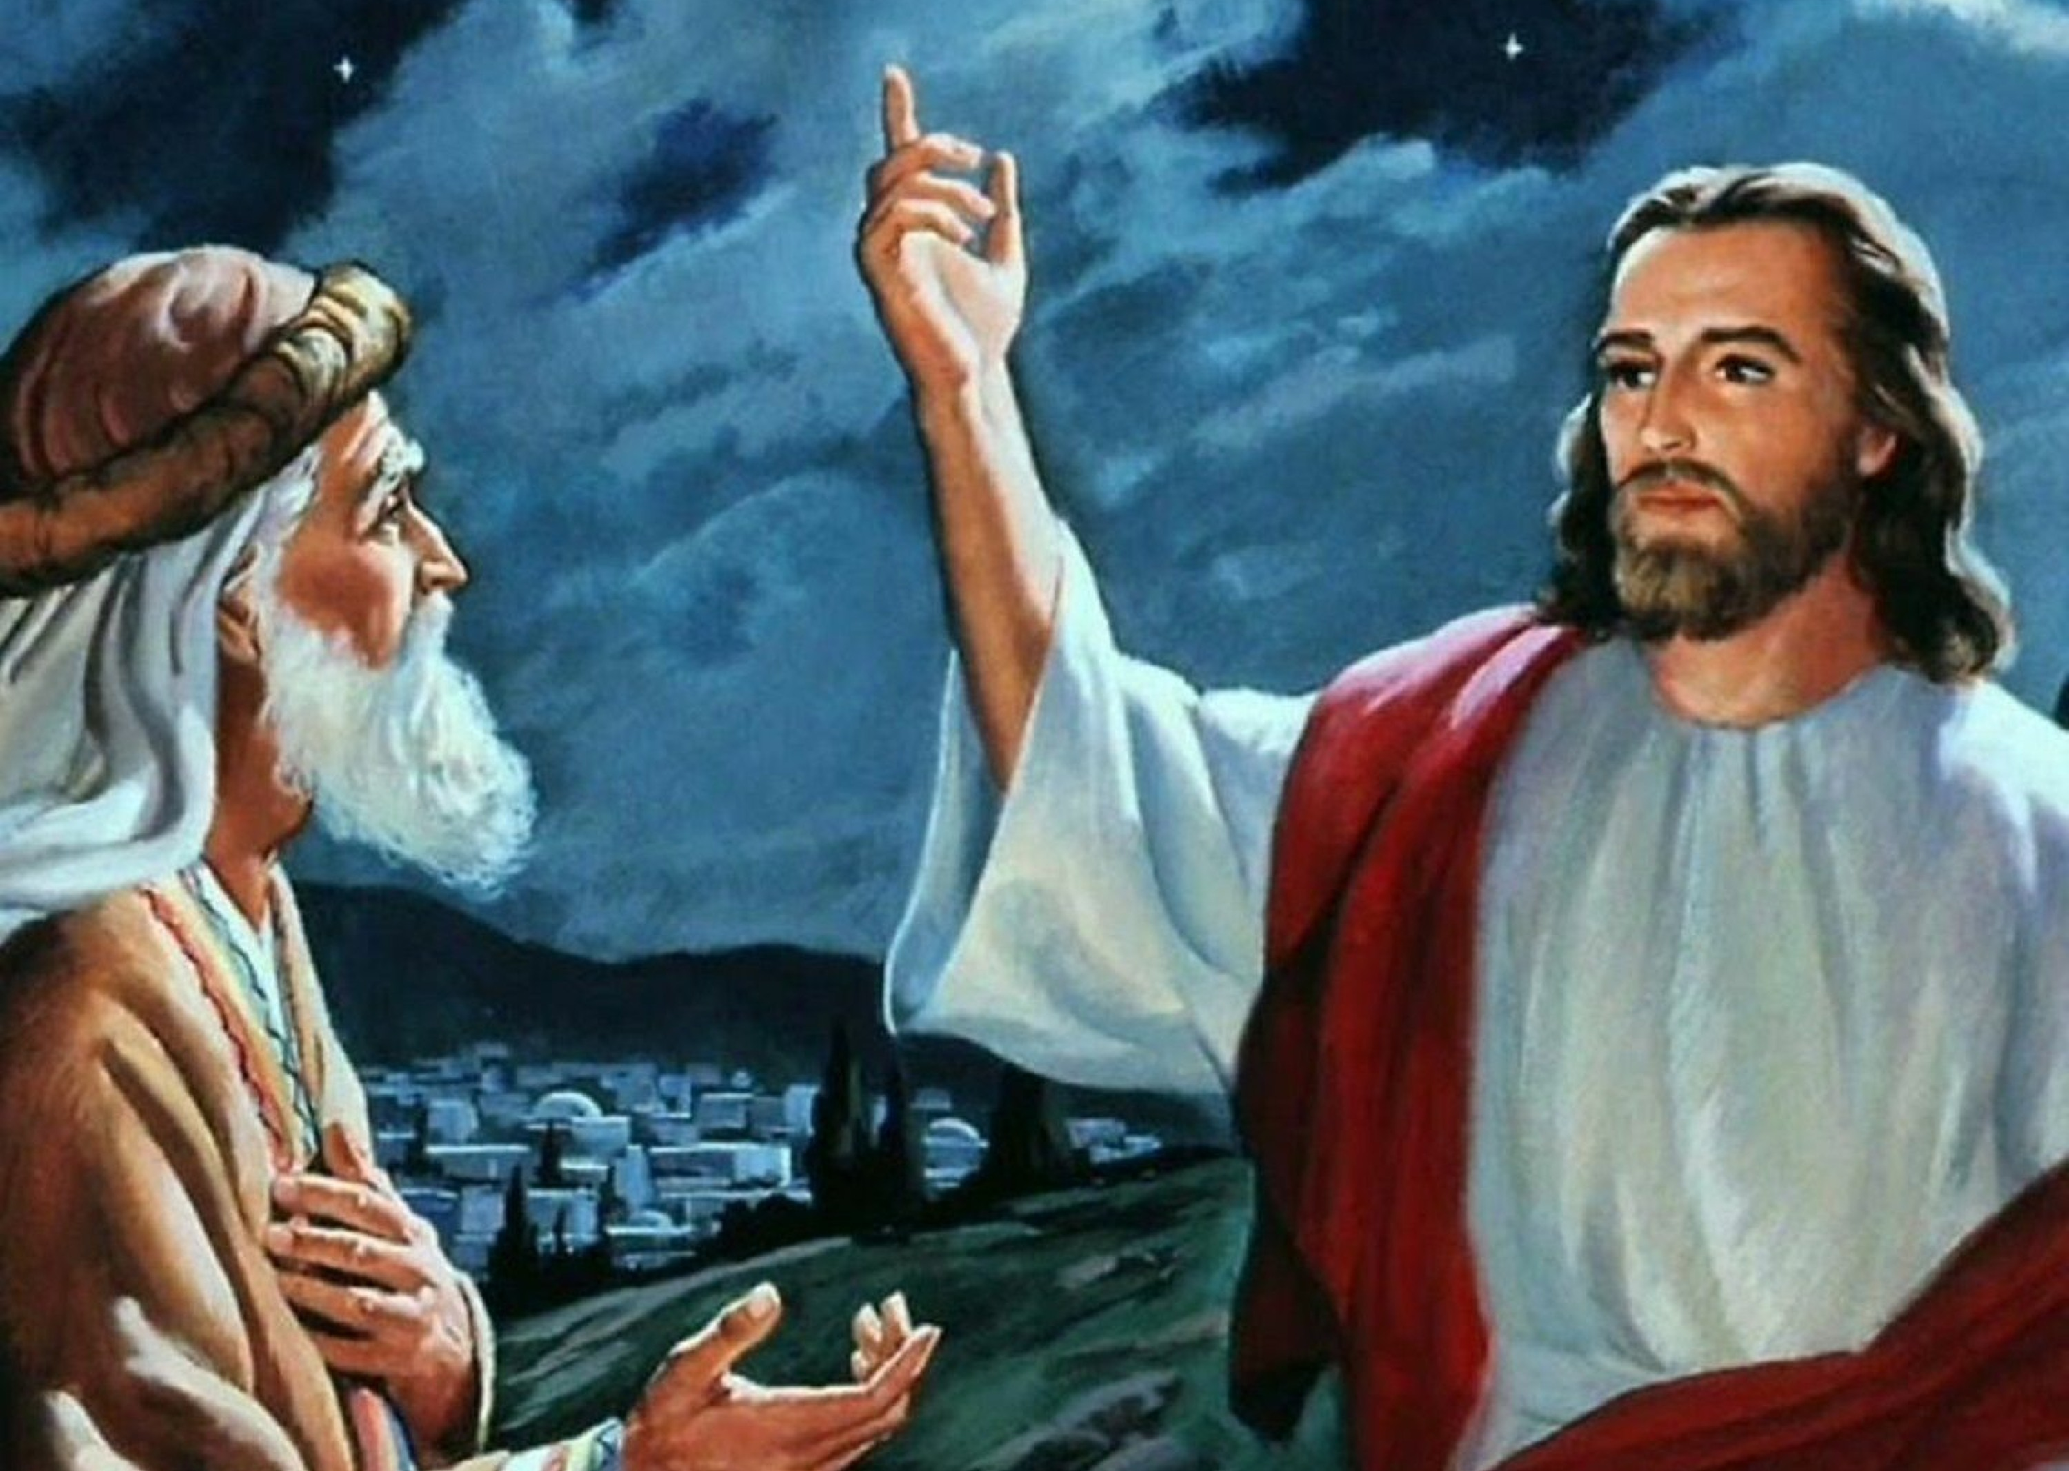
“Jesus answered and said to him, ‘Most assuredly, I say to you, unless one is born again, he cannot see the kingdom of God’ ”
John 3:3, NKJV

Slide 3
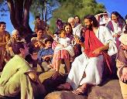
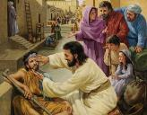
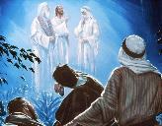
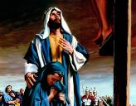
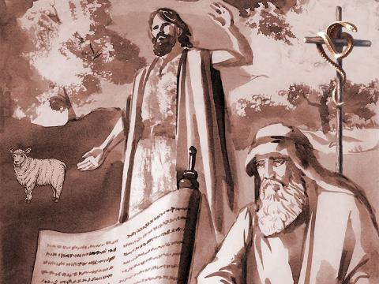
“That which was from the beginning, which we have heard, which we have seen with our eyes, which we have looked upon, and our hands have handled, concerning the Word of Life […] we declare unto you” (1 John 1:1, 3).
From the beginning of Jesus' ministry, John was with Him and believed in Him as the Messiah. But in his gospel, he did not limit himself to transmitting his own testimony, but added the testimony of many others who testified that Jesus was the Messiah, the Savior, the Lamb who died for the sin of the world.
The testimony of John the Baptist:
Introducing the Messiah. John 1:19-23.
Introducing the Lamb of God. John 1:29-37.
The testimony of the first disciples:
Following the Messiah. John 1:35-39.
Bringing others to the Messiah. John 1:43-51.
The testimony of Nicodemus:
Discovering the Messiah. John 3:1-21.

Slide 4
THE TESTIMONY OF JOHN THE BAPTIST

Slide 5
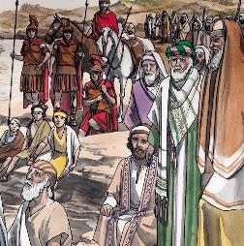
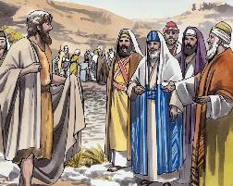
INTRODUCING THE MESSIAH
“He is the one who comes after me, the straps of whose sandals I am not worthy to untie” (John 1:27)
Bethabara, where John baptized, was near Jericho and Jerusalem (Jn . 1:28). Many came to hear him and be baptized by him. Among them were scribes and Pharisees.
The report of these leaders alerted the Sanhedrin to the point of sending delegates to ask John if he considered himself the Messiah, the Christ (Jn. 1:19). But John was not the Messiah. He had a particular mission: to prepare the people to receive the true Messiah (Jn. 1:22-23).
John testified that Christ was superior to him:
John 1:27
John 1:34
John baptized with water
Christ would do it with the Spirit
Christ is the Son of God
John simply pointed it out as such.
John considered himself an unworthy servant of the One who existed before him.
John 1:33

Slide 6
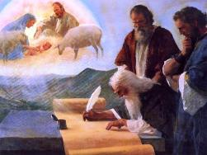
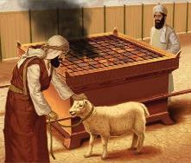
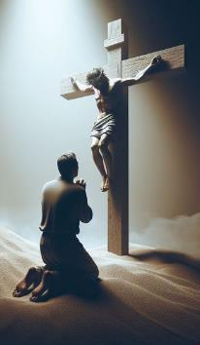
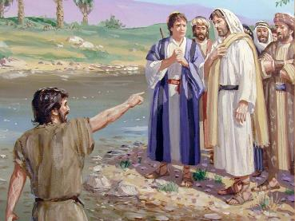
INTRODUCING THE LAMB OF GOD
“The next day John saw Jesus coming toward him and said, “Look, the Lamb of God, who takes away the sin of the world!’” (John 1:29)
John the Baptist was of priestly lineage and had a clear understanding of the work of the Messiah. For him, Christ was not a national liberator, but the one of whom Isaiah said, “He was led like a lamb to the slaughter” (Is. 53:7).
How many times did John confess his sins by placing his hand on the lamb and then slaying it with his knife? Each time he did so, he thought of the One who would bear his sins and die for them.
This statement gives us light on the meaning of the sacrificial system that God commanded Israel. In the shed blood of the Lamb of God there is power to cleanse every confessed sin.
Warned by God, he recognized Jesus as the expected Lamb (Jn. 1:31-33). Of course, he did not remain silent. He proclaimed to everyone who the Christ was, and what his role was as the Lamb of God (Jn. 1:29).

Slide 7
THE TESTIMONY OF THE FIRST DISCIPLES

Slide 8
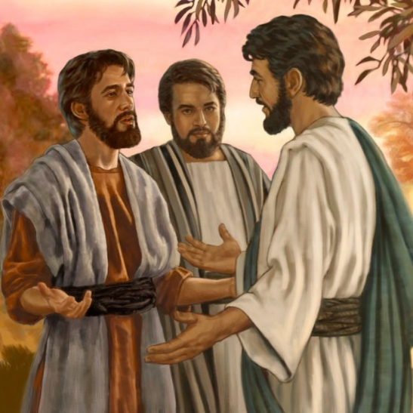
FOLLOWING THE MESSIAH
“The next day John was there again with two of his disciples. […] When the two disciples heard him say this, they followed Jesus” (John 1:35,37)
Who were the first two disciples to follow Jesus (Jn. 1:35-37)? John only identifies one, Andrew, omitting his own name (Jn. 1:40).
In fact, they literally followed Jesus. That is, they walked behind Him for a while, until Jesus Himself turned and spoke to them (Jn. 1:38).
Jesus’ question – What are you looking for? – allowed them to express what they expected from Him. What would you have answered? Why do you follow Jesus?
The two disciples had already accepted Jesus as the Messiah. Now they just wanted to be with Him. They sought His company; to hear His teachings; to drink from His wisdom.
Overjoyed at having found the Messiah, Andrew introduced his brother Simon to Jesus. Jesus demonstrated that he knew Simon Peter's heart and temperament perfectly (Jn. 1:40-42).

Slide 9
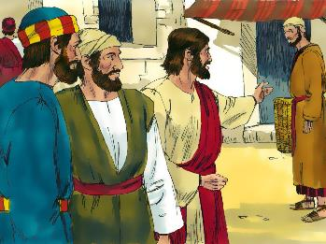
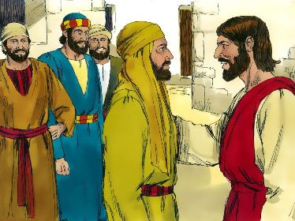
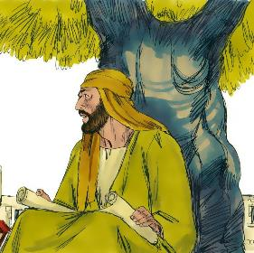
LEADING OTHERS TO THE MESSIAH
“Philip found Nathanael and told him, “We have found the one Moses wrote about in the Law, and about whom the prophets also wrote—Jesus of Nazareth, the son of Joseph.’” (John 1:45)
The third disciple who followed Jesus was called directly by Him: Philip (Jn. 1:43-44).
Like Andrew, Philip feels that he must lead others to Jesus. Unlike Andrew, Philip does not directly identify Jesus as the Messiah, but as the one who was foretold by Moses and the prophets, thus leaving Nathanael (Bartholomew) to draw his own conclusions (John 1:45). But Jesus did not fit the stereotype of the Messiah that Nathanael expected .
Born in Nazareth, a place of such bad reputation? Philip did not enter into the discussion. It was not a theoretical problem. He would only be convinced by seeing Jesus (Jn. 1:46).
Nathanael had prayed under the fig tree for an encounter with the Christ announced by John (DA 140) . When Jesus told him, “I saw you,” all doubt was dispelled (Jn. 1:47-49).

Slide 10
THE TESTIMONY OF NICODEMUS

Slide 11
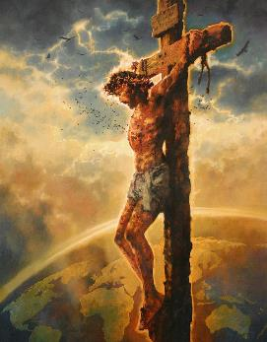
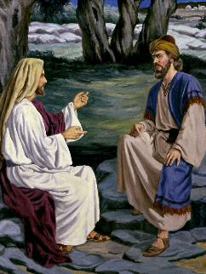
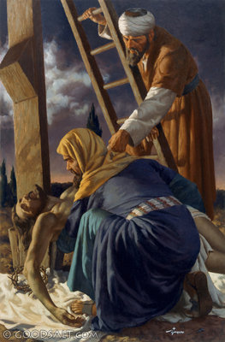
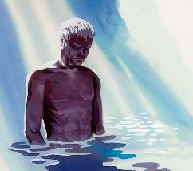
DISCOVERING THE MESSIAH
“For God did not send his Son into the world to condemn the world, but to save the world through him” (John 3:17)
Nicodemus, a Pharisee and member of the Sanhedrin, was amazed by Jesus' miracles. He became convinced that Jesus was a great prophet sent by God… but not the Messiah (John 3:1-2).
Jesus confronted him directly with his greatest need (which is also ours): a change of heart (Jn . 3:3-5).
Although he tried to avoid the issue, Nicodemus received from Jesus the highest teachings about his mission as Messiah, and heard the most sublime words ever spoken (John 3:16).
He also received a small reprimand, with which Jesus wanted to open his mind to the truth (Jn. 3:9-12).
Little by little, Nicodemus discovered the Messiah, until he openly accepted him at the foot of the cross (Jn. 7:50-51; 19:39).

Slide 12
“While they trust to the guidance of human authority, none will come to a saving knowledge of the truth. Like Nathanael, we need to study God's word for ourselves, and pray for the enlightenment of the Holy Spirit. He who saw Nathanael under the fig tree will see us in the secret place of prayer. Angels from the world of light are near to those who in humility seek for divine guidance.”
EGW (The Desire of Ages, pg. 141)

