Slide 1
Lesson 2 for October 12, 2024
SIGNS OF DIVINITY

Slide 2
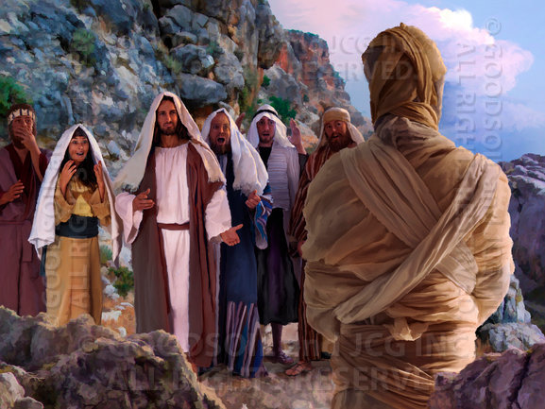
“Jesus said to her, ‘I am the resurrection and the life. He who believes in Me, though he may die, he shall live. And whoever lives and believes in Me shall never die. Do you believe this?’ ”
John 11:25, 26, NKJV

Slide 3
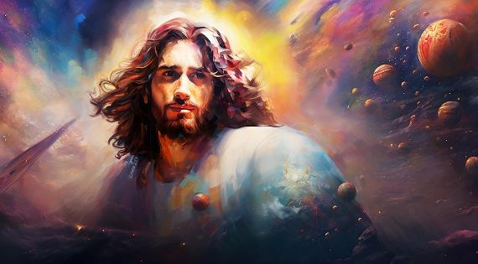
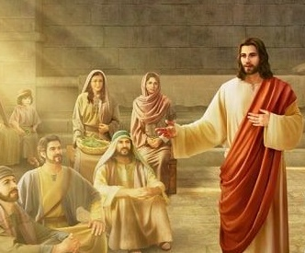
From the beginning of his Gospel, John wants to make one thing clear: Jesus is God (John 1:1).
It does not limit itself to narrating the evidence or signs of that divinity (such as the resurrection of Lazarus), but rather complements them with the words of Jesus himself (such as the sermon that followed the feeding of the five thousand), or with the words of his followers (as in the case of the man born blind).
Who is Jesus? What did He say about Himself?
“I am the bread of life”:
The prophet who was to come. John 6:1-15.
The bread that came down from Heaven. John 6:16-36.
“I am the light of the world”:
An enlightened life. John 9:1-16.
Choosing darkness. John 9:17-34.
“I am the resurrection and the life”:
The resurrection of Lazarus. John 11:1-44.

Slide 4
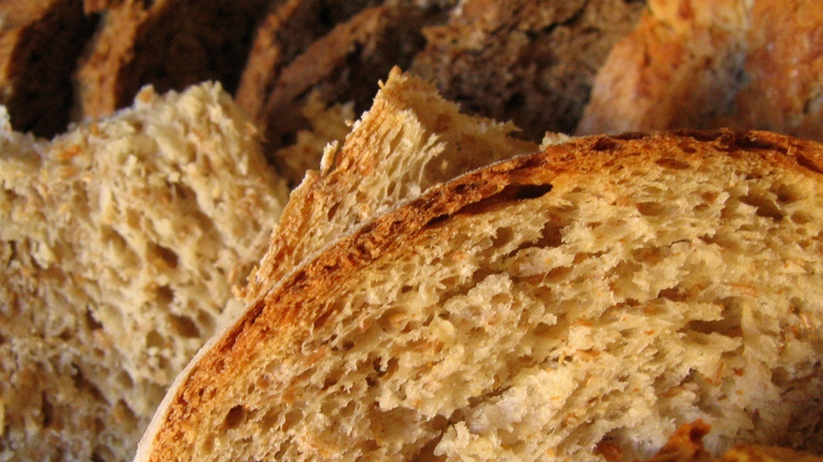
“I AM
THE BREAD OF LIFE”

Slide 5
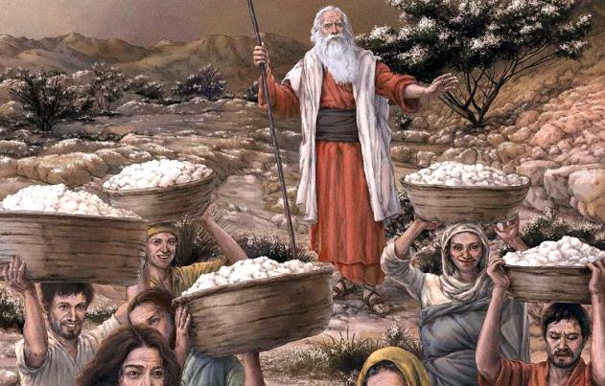
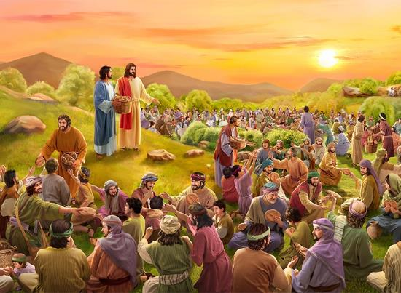
THE PROPHET WHO WAS TO COME
“After the people saw the sign Jesus performed, they began to say, “Surely this is the Prophet who is to come into the world” (John 6:14)
Elisha multiplied the barley loaves, but no one thought he was “the prophet who was to come” (2 Kings 4:42-44). Why did the crowd associate Jesus with the prophet (Messiah) announced by Moses after multiplying the loaves?
Moses
He brought Israel out of Egypt at Passover (Ex. 12:12-14, 29-32)
He went up to Sinai (Ex. 34:2)
Jesus
The Passover was near (Jn. 6:4)
He went up the mountain (Jn. 6:3)
The Israelites were put to the test (Dt. 8:2-3)
He fed them with manna, “bread of angels” (Ps. 78:25 NIV)
He ordered to gather the manna (Ex. 16:15-16)
He announced the arrival of “the prophet” (Dt. 18:15)
He led the 12 tribes of Israel (Ex. 24:4)
He tested Philip (Jn . 6:5-6)
He multiplied the loaves (Jn. 6:11)
He ordered to collect the leftovers (Jn. 6:12)
12 baskets were collected (Jn. 6:13)
They recognized him as “the prophet” (Jn. 6:14)

Slide 6
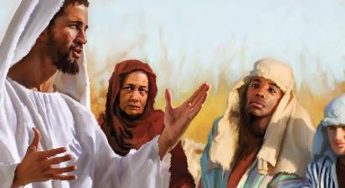
THE BREAD THAT CAME DOWN FROM HEAVEN
John 6:35 I AM the bread of life
John 8:12 I AM the light of the world
John 10:7, 9 I AM the door
John 10:11, 14 I AM the good shepherd
John 11:25 I AM the resurrection
John 14:6 I AM the way
John 15:1, 5 I AM the true vine
“For the bread of God is the bread that comes down from heaven and gives life to the world” (John 6:33)
The crowd saw Jesus as the perfect leader to free them from Rome: he would feed the troops and heal their wounds. But Jesus refused to be crowned king (Jn. 6:14-15).
When He met the crowd again the next day, Jesus spoke to them clearly (Jn. 6:22-26). He did not want to meet only their physical needs. He had come to give them eternal life: “I am the bread of life” (Jn. 6:35).
With this expression, and others like it, Jesus identified himself with God, the “I AM” who spoke face to face with Moses (Ex. 3:13-14).

Slide 7
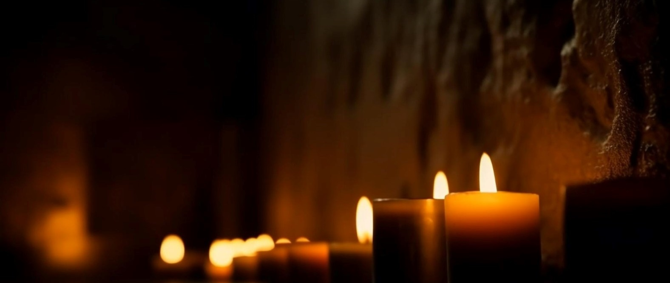
“I AM
THE LIGHT OF THE WORLD”

Slide 8
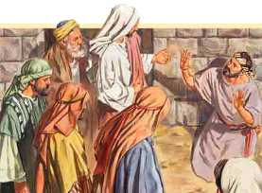
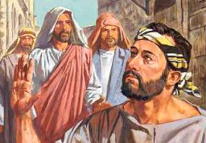
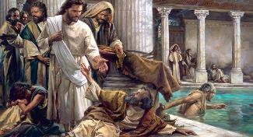
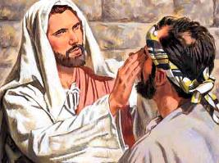
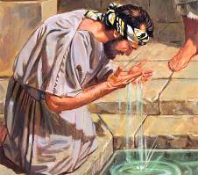
AN ILLUMINATED LIFE
“Neither this man nor his parents sinned,” said Jesus, “but this happened so that the works of God might be displayed in him. ’” (John 9:3)
Do we get sick because we have sinned? Do our children get sick because of our sins? These were the questions on the disciples' minds when Jesus called their attention to a person who had been born blind (John 9:1-2).
The relationship between sin and illness was made clear, for example, in the healing of the paralytic at Bethesda (John 5:14). However, this illness – like many others that affect us – was of a different origin, related to the sin that surrounds us, but without any relation to any personal or parental sin.
With an act that recalled the creation of man, Jesus illuminated the life of this blind man by giving him sight (Jn. 9:6-7; Gn. 2:7). After the miracle, John tells us of its consequences (Jn . 9:8-16).
The former blind man believes in Jesus as the One Sent (Siloam), and the Pharisees reject him because he heals on the Sabbath. But… “How can a sinful man perform these signs?” (Jn . 9:16).

Slide 9
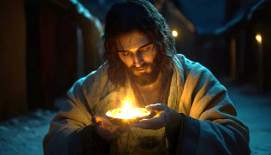
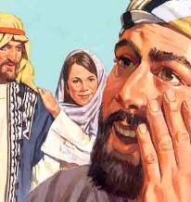
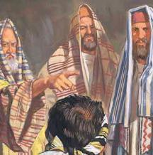
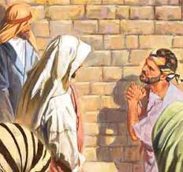
CHOOSING DARKNESS
“We know that God spoke to Moses, but as for this fellow, we don’t even know where he comes from.” (John 9:29)
Before performing the miracle, Jesus had declared: “While I am in the world, I am the light of the world” (Jn. 9:5).
Blind
He is becoming increasingly spiritually better (Jn. 9:17, 38)
He knows that Jesus is a holy man (Jn. 9:30-31)
Pharisees
They are spiritually confused (Jn . 9:16)
They believe that Jesus is a sinner (Jn. 9:24)
He knows that Jesus came to give him light (Jn. 9:25)
They do not know where or why Jesus comes (Jn . 9:29)
Affirms his faith in Jesus (Jn . 9:32-33)
They refuse to believe and expel the “sinner” (Jn. 9:34)
Jesus is the light that enlightens every person and guides them to salvation (Jn. 1:4, 9; 3:21). But unfortunately, there are those who prefer to live in darkness and reject salvation (Jn. 1:11; 3:19-20).
This was the case with the Pharisees. They had before them the evidence of someone who, having been born blind, now saw (Jn. 9:25, 30, 32). But, despite all the evidence, they persisted in rejecting the light.

Slide 10
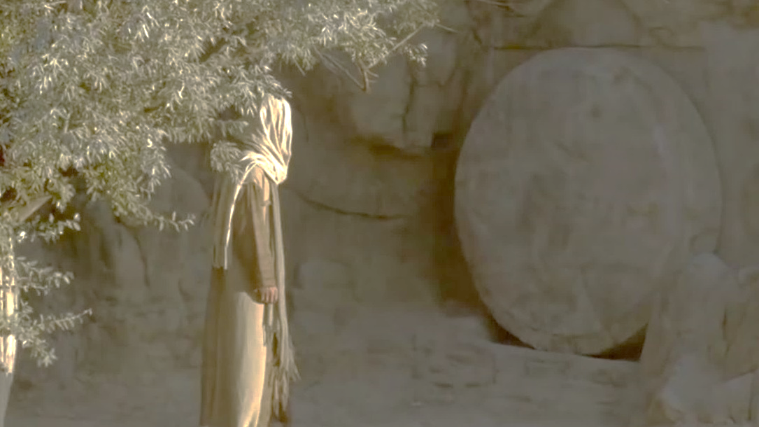
“I AM
THE RESURRECTION AND THE LIFE”

Slide 11
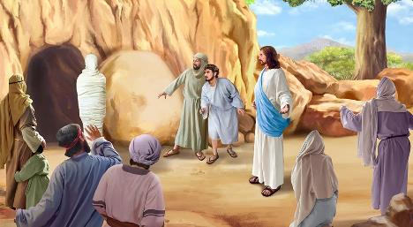
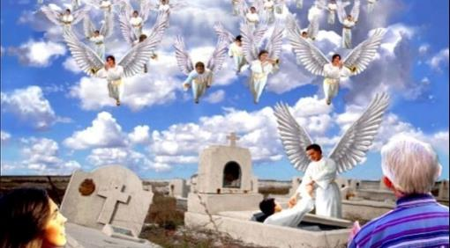
THE RESURRECTION OF LAZARUS
“Jesus said to her, “I am the resurrection and the life. The one who believes in me will live, even though they die. ’” (John 11:25)
John 11 is full of sadness and tears (Verses 1, 14, 19, 21, 31, 32, 35, 38). But, just as in the case of the man born blind, God was going to turn all this evil into a reason for Himself to be glorified (Jn. 11:4, 15).
Jairus' daughter and the widow's son from Nain had been resurrected shortly after they died. However, Lazarus had already begun to decompose. Everyone thought it was impossible for Jesus to resurrect him (Jn. 11:24, 37).
What is the difference between resurrecting a person who has just died or one who has been dead for 5,000 years? For Jesus, there is no difference. He is the resurrection and the life. All will be resurrected by the power of his voice (Jn. 5:28-29).
Sadly, some thought it was better for Jesus to die than to give life (John 11:46-50). But others believed, and one day they will be resurrected – along with us – to eternal life (John 11:45).

Slide 12
“The workers will meet with many who will harden their hearts against the conviction of God’s Spirit; but they will meet also with many who are hungering for the bread of life, and who, receiving the message, will go forth to sow the seeds of truth..”
EGW (Testimonies for the Church, volume 7, page 202)

