Slide 1
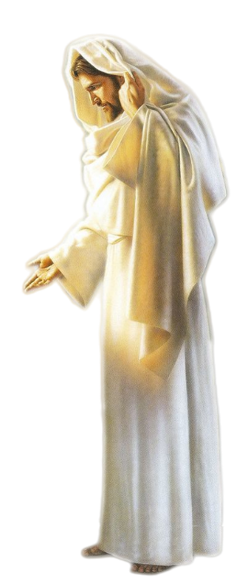
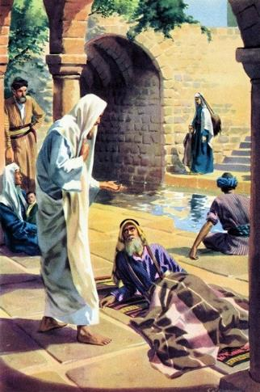
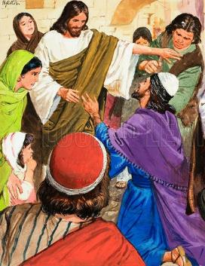
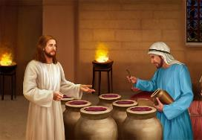
SIGNS THAT POINT THE WAY
Lesson 1 for October 5, 2024

Slide 2
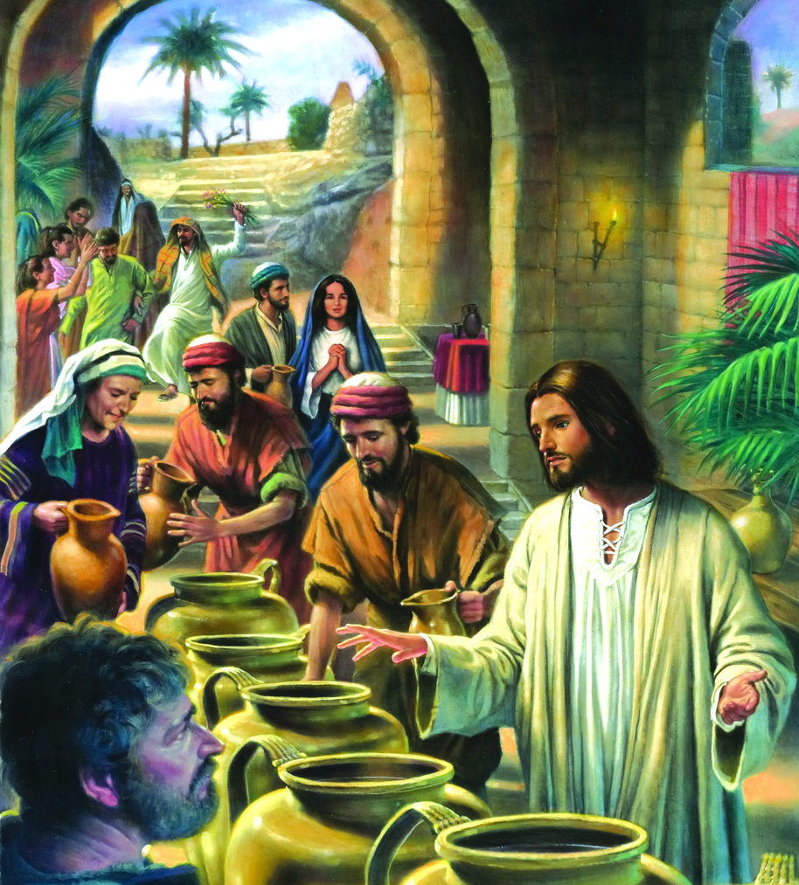
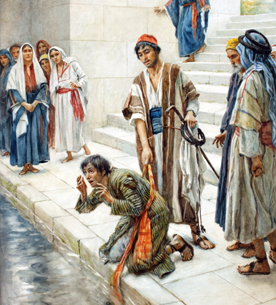
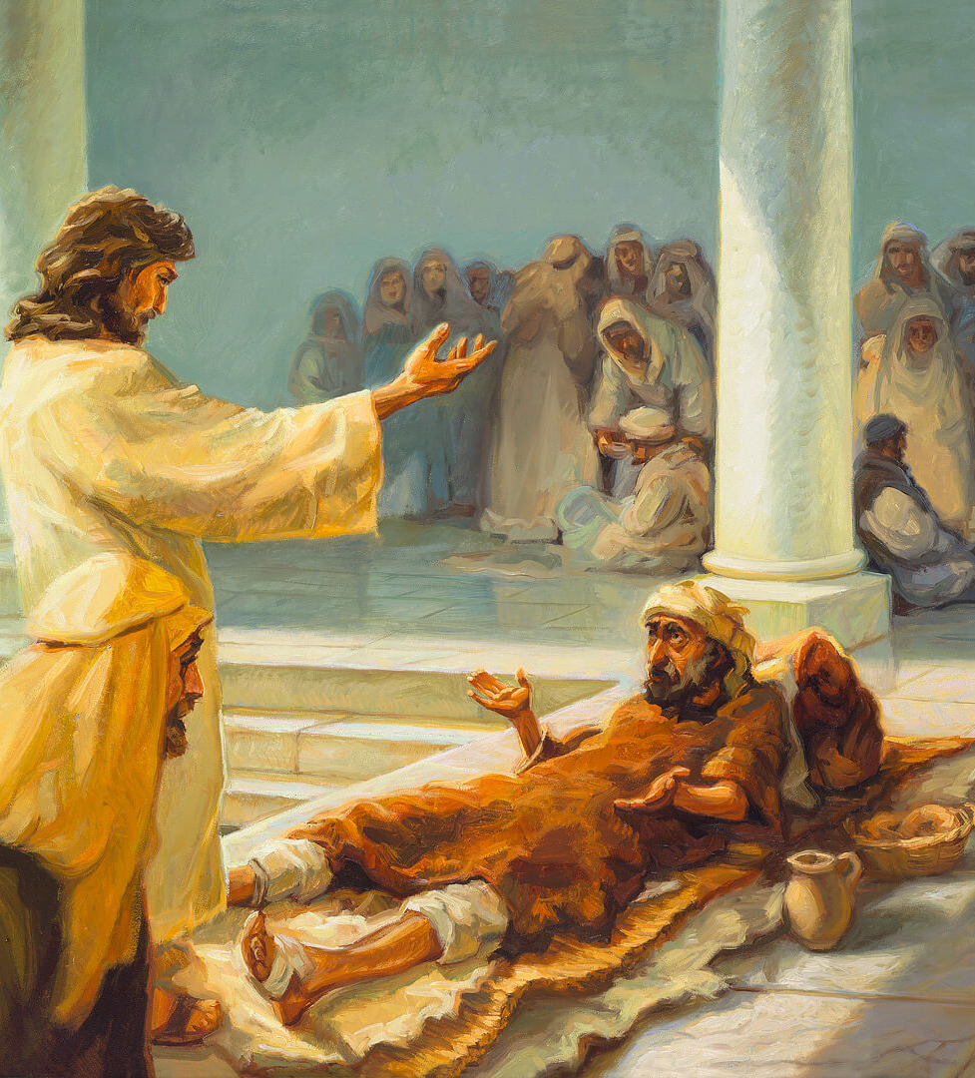
“And truly Jesus did many other signs in the presence of His disciples, which are not written in this book; but these are written that you may believe that Jesus is the Christ, the Son of God, and that believing you may have life in His name”
John 20:30, 31, NKJV

Slide 3
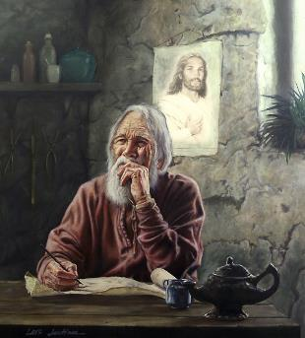
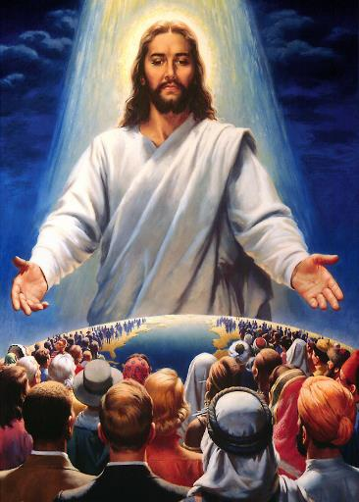
When John began writing his gospel, there were already three versions of Jesus' life recognized as inspired (the gospels of Matthew, Mark, and Luke). For this reason, John repeats very little of the material already included in the other gospels. 66% of his account is unique. The way he presents Jesus is also unique.
For John, the miracles of the Master are “signs.” These signs were selected by John for a purpose: that everyone who reads them may believe that Jesus is their Savior, and therefore have eternal life (John 20:30-31).
The miracle of the wedding at Cana (John 2:1-11):
The sign that marks the beginning of the path.
The miracle of the official's son (John 4:46-54):
The sign for those without faith.
The miracle of the pool of Bethesda (John 5:1-47)
The signal for the desperate.
The sign for those who do not want to understand.
The sign supported by witnesses.

Slide 4
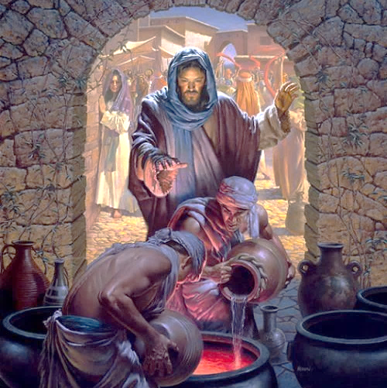
THE MIRACLE OF THE WEDDING AT CANA
John 2:1-11

Slide 5
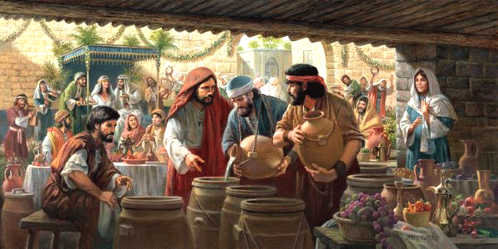
THE SIGN THAT MARKS THE BEGINNING OF THE ROAD
“What Jesus did here in Cana of Galilee was the first of the signs through which he revealed his glory; and his disciples believed in him” (John 2:11)
Running out of wine during the wedding feast was embarrassing for the bride and groom. But thanks to Jesus' intervention, they were able to present “the good wine” as the culmination of their party (John 2:1-10).
In describing this miracle, John directs our minds from water—a symbol of purification (Jn. 2:6)—to the new wine—a symbol of redemption (1 Cor. 11:25).
This miracle is also a sign that links Jesus to Moses and, therefore, identifies him with the Prophet/Messiah announced by him (Dt . 18:15).
Moses turns the “holy” water of the Nile into blood
Jesus turns “purified” water into wine, a symbol of his own blood

Slide 6
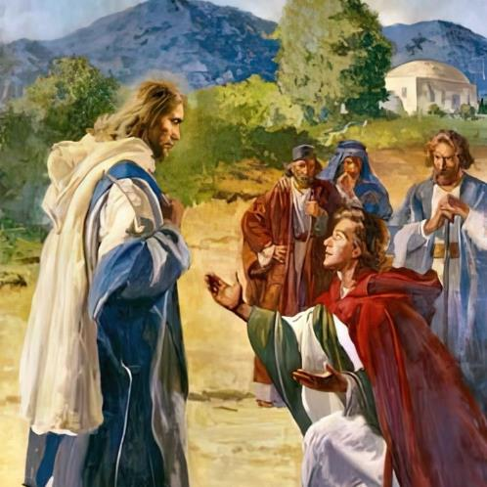
THE MIRACLE OF THE OFFICER'S SON
John 4:46-54

Slide 7
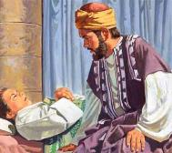
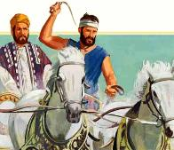
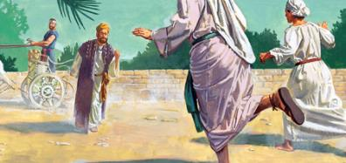
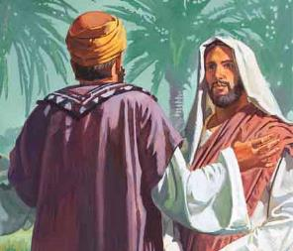
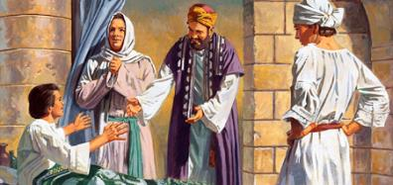
THE SIGN FOR THOSE WHO HAVE NO FAITH
“This was the second sign Jesus performed after coming from Judea to Galilee” (John 4:54)
A royal official living in Capernaum, distressed about his sick son, decided to travel to Cana and ask Jesus to come and heal his son (Jn. 4:46-47). If Jesus did this, he would believe in Him.
Jesus' response indicated that He was well aware of the officer's thoughts (Jn. 4:48). Miracles in themselves did not prove that Jesus was the Messiah (Satan himself can perform miracles [Ex. 7:22; Rev. 13:13]).
The officer had to decide whether or not to believe in Jesus before the miracle could be performed. Although the narrative does not say so, we can imagine the officer's tears as he pleaded for his son's life, which now depended on his own faith (John 4:49).
At Jesus' words, and without any evidence of the miracle, he believed (Jn. 4:50). Such was his confidence that he made the journey, spending the night on the road. When they announced to him that his son had been healed, he only cared to verify that he had indeed been healed at the moment when Jesus had spoken his words (Jn. 4:51-53).

Slide 8
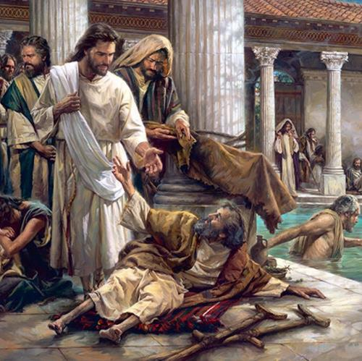
THE MIRACLE OF THE POOL OF BETHESDA
John 5:1-47

Slide 9
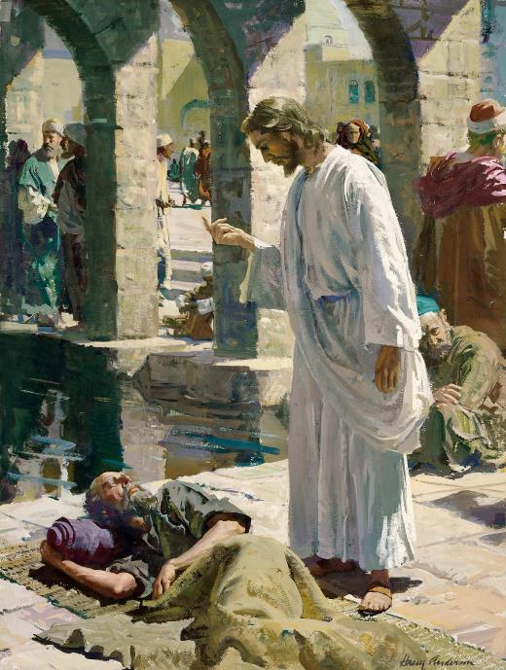
THE SIGNAL FOR THE DESPERATE
“When Jesus saw him lying there and learned that he had been in this condition for a long time, he asked him, “Do you want to get well?’” (John 5:6)
38 years is a long time of illness. Among the multitude of sick people gathered at the pool of Bethesda, Jesus chose the most desperate one (Jn. 5:1-5).
The sick man recognized in Jesus' loving question someone who wanted to help him (John 5:6-7). But Jesus did not help him perform a superstitious rite. He simply ordered him: “Get up! Pick up your mat and walk” (John 5:8).
At this command, the sick man responded. He stood up, and his limbs, paralyzed for 38 years, regained strength. He who made his legs had restored his own.
Later, Jesus identified his illness as a consequence of his sins (Jn. 5:14). Illness may or may not be a direct consequence of our sin. But regardless of its origin, God has the power to heal our illnesses (James 5:14-15).

Slide 10
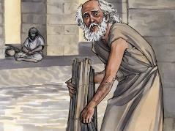
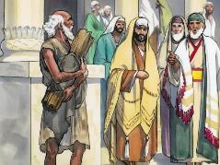
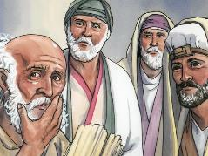
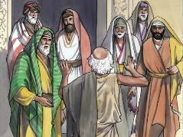
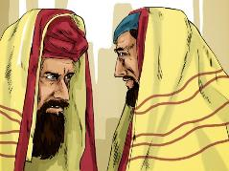
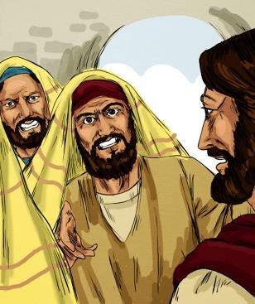
THE SIGNAL FOR THOSE WHO DO NOT WANT TO UNDERSTAND
“So, because Jesus was doing these things on the Sabbath, the Jewish leaders began to persecute him.” (John 5:16)
It was logical that, once healed, the sick man would return home carrying his belongings. But… he was breaking the Sabbath! (Jn. 5:10). Faced with this accusation, the man defended himself by saying that his healer had ordered him to do so, and the matter was settled (Jn. 5:11-13).
Thinking that they wanted to praise their healer, when he heard that Jesus had healed him, he ran to tell those who had asked him (Jn. 5:14-15).
But not everyone reacted the same way to Jesus' signs (John 5:16). Jesus knew that He would arouse prejudice when He ordered the paralytic to carry his bed on the Sabbath. His purpose was to make His antagonists think about what was more important, His tradition or the healing of a man. Why did they not want to understand this?

Slide 11
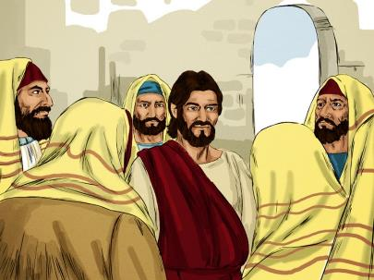
THE SIGNAL SUPPORTED BY WITNESSES
“For this reason they tried all the more to kill him; not only was he breaking the Sabbath, but he was even calling God his own Father, making himself equal with God” (John 5:18)
When accused of being a Sabbath-breaker, Jesus replied, “My Father is always at his work to this very day, and I too am working” (John 5:17). This statement was interpreted as an affirmation of His divinity (John 5:18).
Jesus now defends himself in three steps:
His relationship with the Father (Jn. 5:19-30). This gives him the power to even judge and raise the dead.
Witnesses who corroborate his claims:
John the Baptist (John 5:31-35)
The miracles he performs (John 5:36)
The Father (John 5:37-38)
The Scriptures (John 5:39)
The hardness of heart of his accusers (Jn. 5:40-47). Moses himself, in whom they claim to believe, will condemn them, because they do not believe in the One of whom he spoke.

Slide 12
“In the gospel the character of Christ is portrayed. As He descended step by step from His throne, His divinity was veiled in humanity; but in His miracles, His doctrines, His sufferings […] are inexhaustible treasures of wisdom, recorded for us by inspiration in the Word of God. […] Time will not be sufficient to exhaust the wonders of salvation, but through everlasting ages, Christ will be the science and the song of the redeemed soul. New developments of the perfection and glory of God in the face of Jesus Christ will be forever unfolding. And now there must be perfect reliance upon His merit and grace; there must be distrust of self, and living faith in Him.”
EGW (Lift Him Up, January 26)

