Slide 1
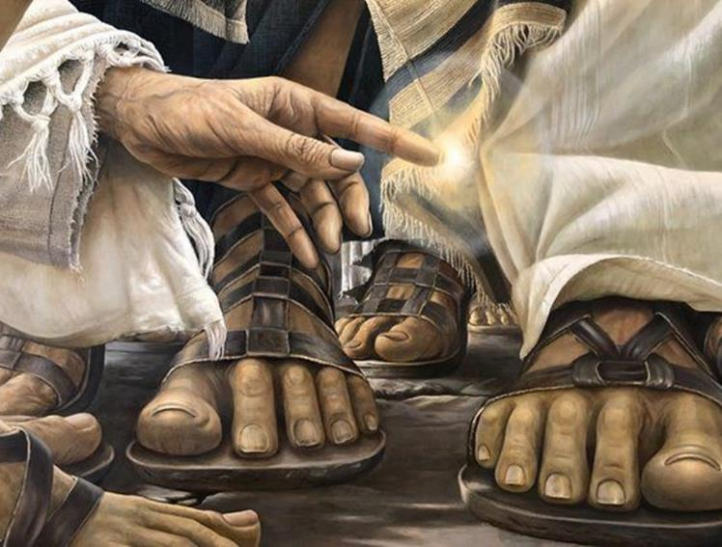
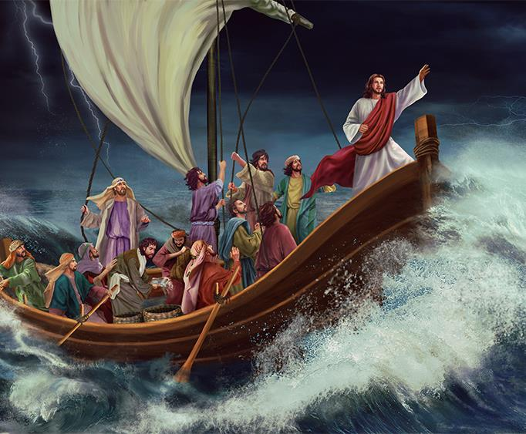
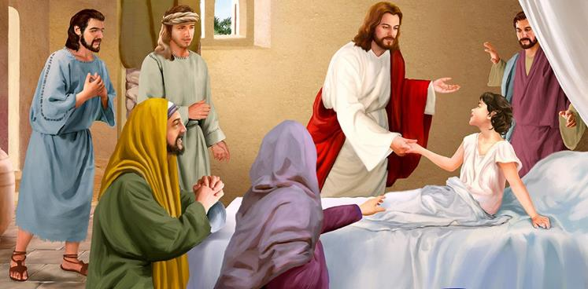
Lesson 5 for August 3, 2024
MIRACLES AROUND THE LAKE

Slide 2
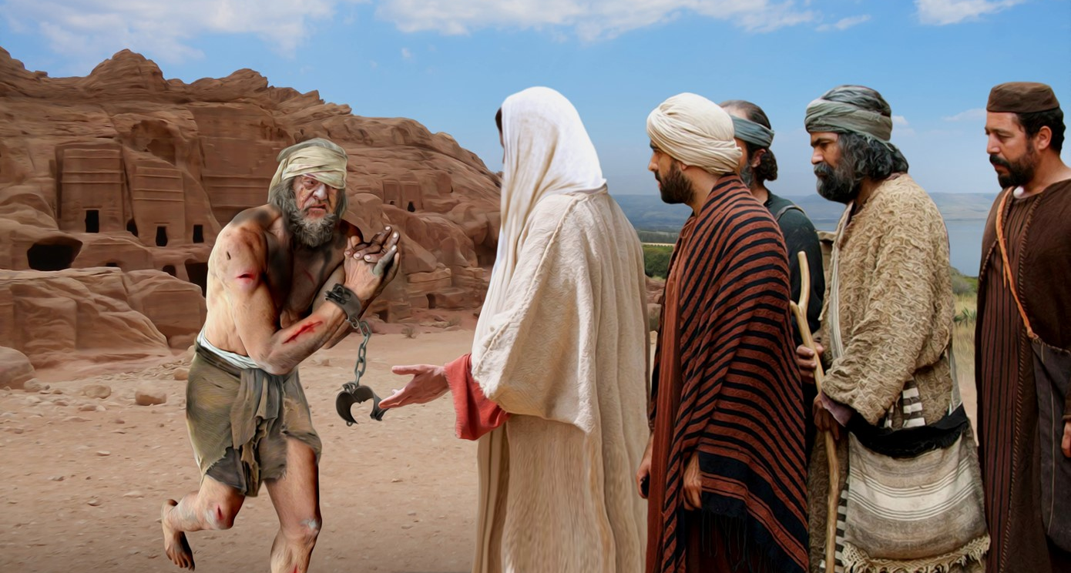
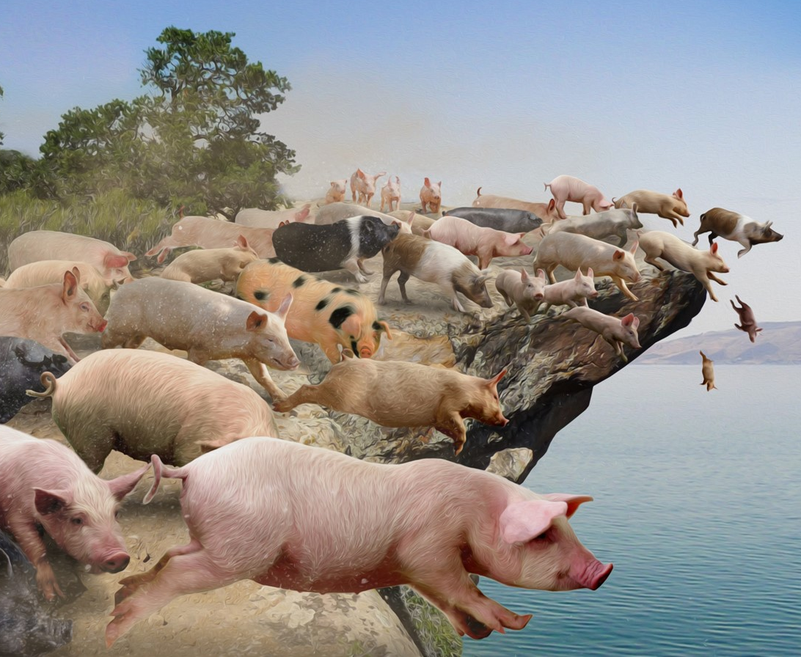
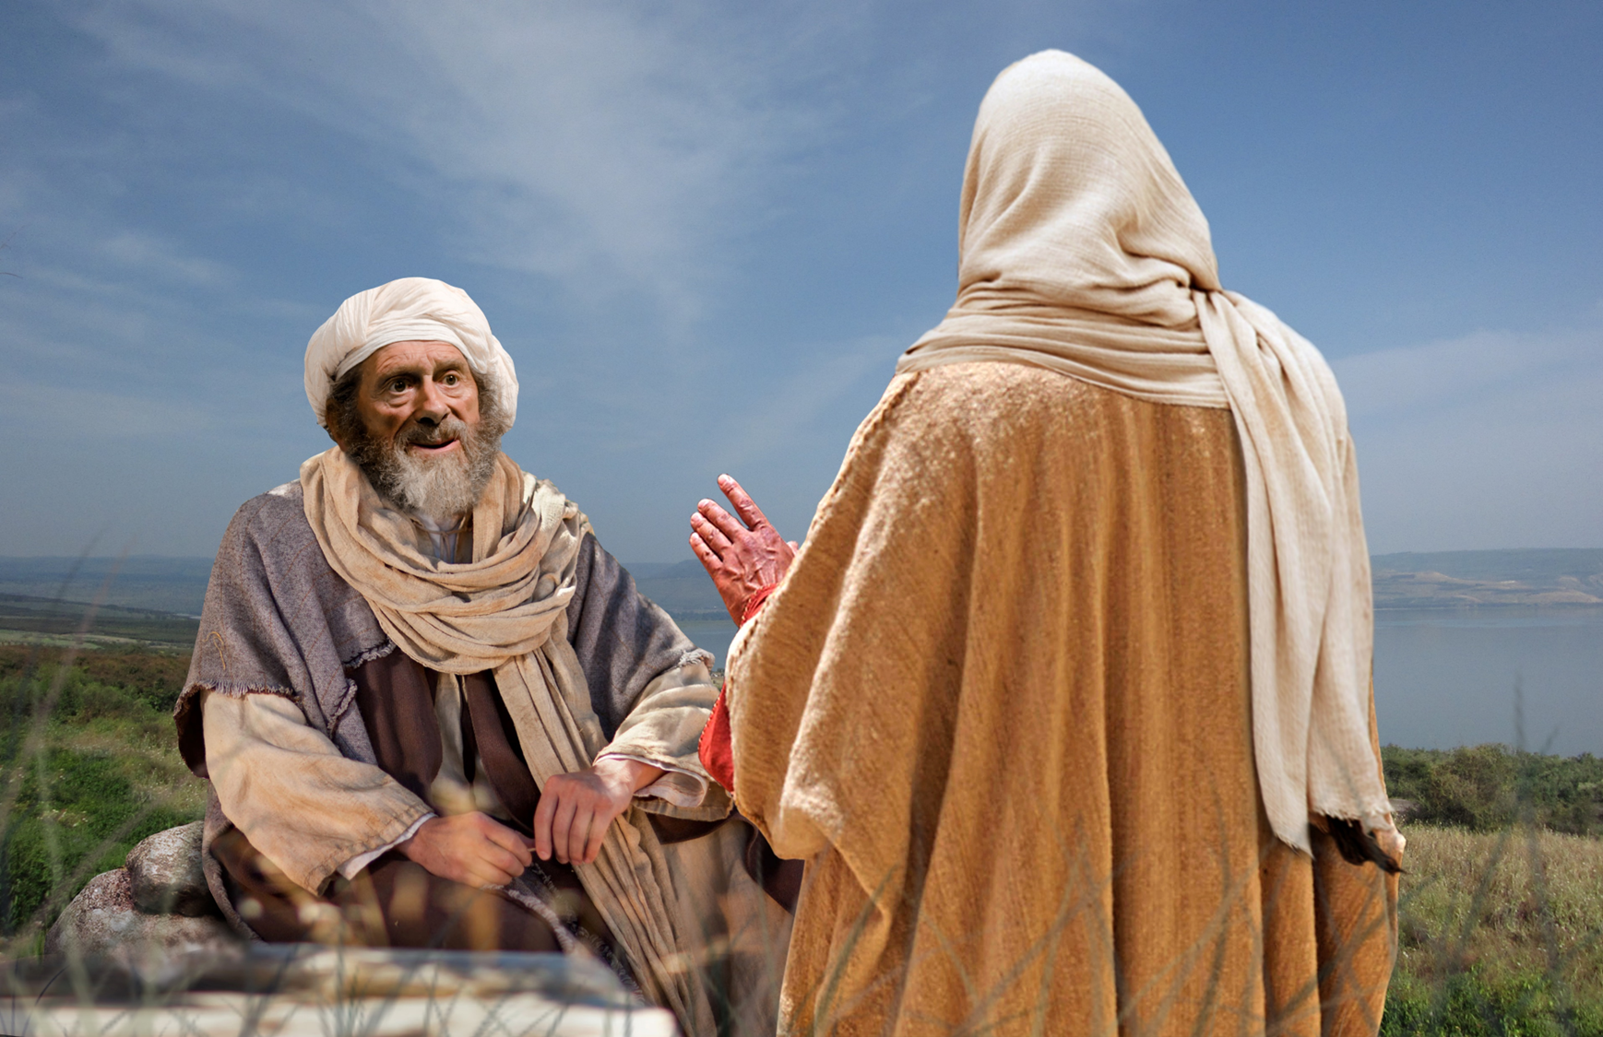
“However, Jesus did not permit him, but said to him, ‘Go home to your friends, and tell them what great things the Lord has done for you, and how He has had compassion on you’ ”
(Mark 5:19, NKJV)

Slide 3

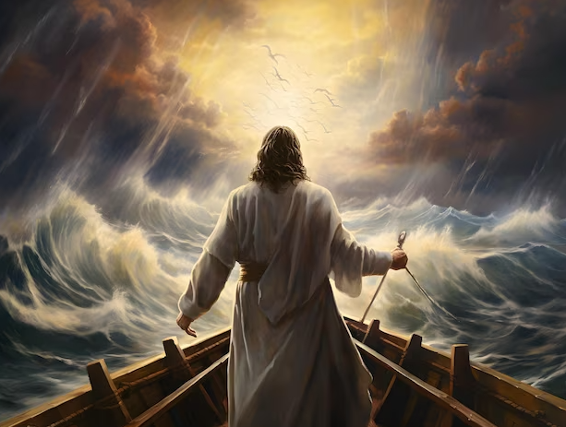
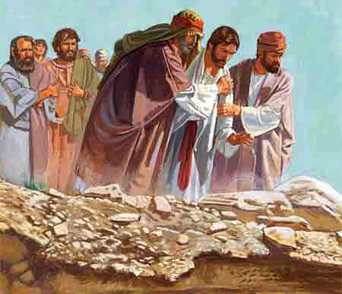
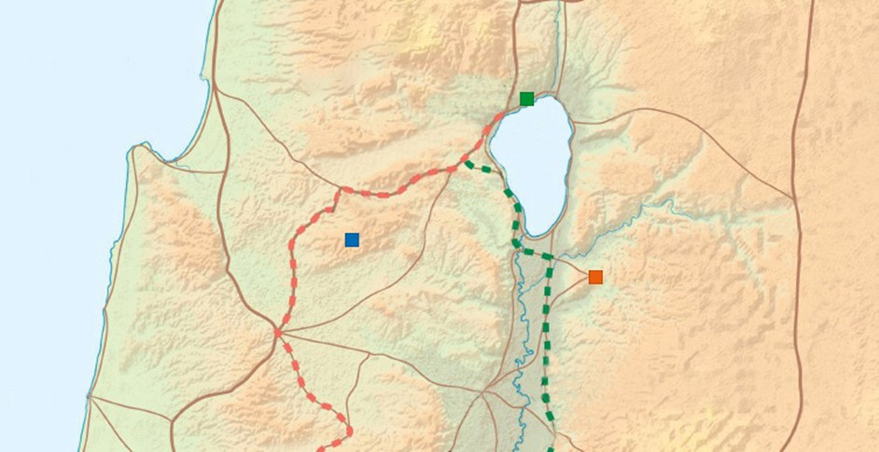
The Sea of Galilee, also called the Sea of Tiberias, bordered the regions of Galilee, Decapolis and Trachonitis. This lake and its nearby cities witnessed many of Jesus' activities.
According to his custom, Mark has us travel quickly with Jesus from the lake to the shore of Gadara; then he crosses the lake again to Capernaum; from there he travels to Nazareth; then he crosses the lake again to a secluded place (Mark 4:35-6:52).
In each of his stages, Jesus faced challenges and won victories.
3. Overcoming illness
(Mark 5:21-34)
1. Overcoming the storm
(Mark 4:35-41)
Capernaum
3
1
5
5. Overcoming misunderstanding
(Mark 6:31-52)
Nazareth
4
2
4. Overcoming rejection and challenges
(Mark 6:1-30)
Gadara
2. Defeating demons
(Mark 5:1-20)

Slide 4

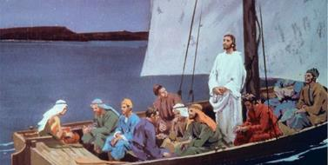
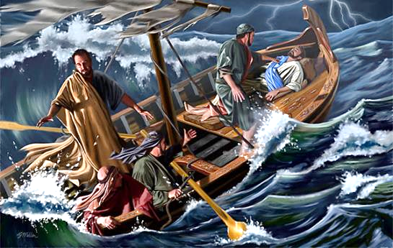
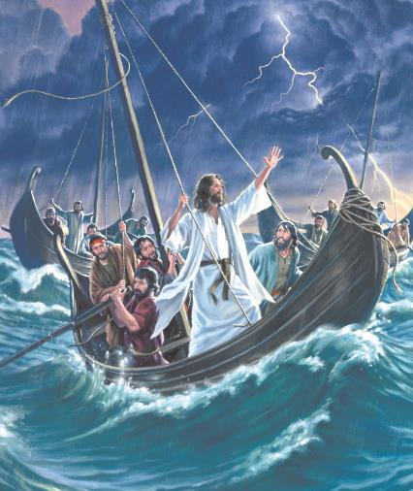
BEATING THE STORM
“e got up, rebuked the wind and said to the waves, “Quiet! Be still!” Then the wind died down and it was completely calm” (Mark 4:39 NIV)
Tired after a tiring day, Jesus fell into a deep sleep as they traveled to the other side of the lake (Mark 4:35-36, 38a).
Revelation of God
Demonstration of power
Human fear
Mark 4:40-41
"Who is this?"
“He said to the sea: Be silent, be still.”
Human response
"Do not worry"
Revelation or message
“They feared with great fear”
“Why are you so frightened?”
“How do you not have faith?”
This passage follows the common pattern for a revelation from God:
A strong wind arose that endangered the boats that were traveling (Mark 4:37).
The disciples woke up Jesus and he calmly silenced the wind (Mark 4:38-40).

Slide 5

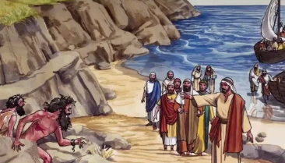
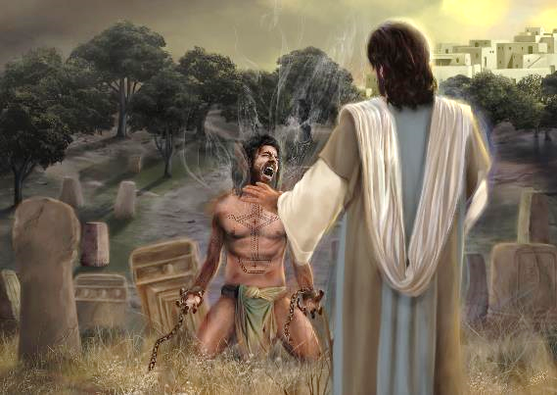
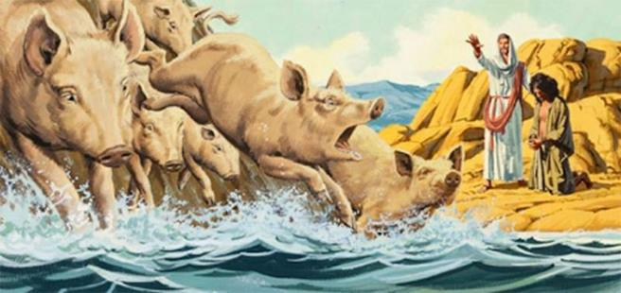
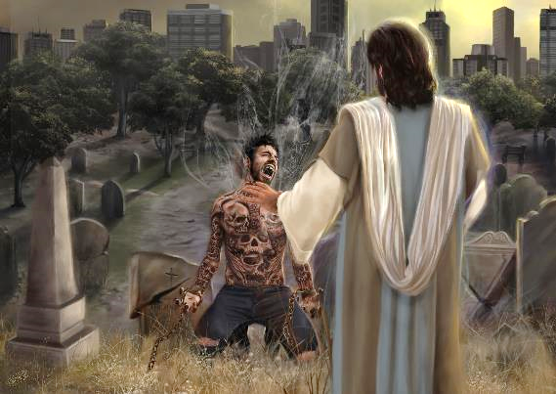
BEATING THE DEMONS
“When Jesus got out of the boat, a man with an impure spirit came from the tombs to meet him” (Mark 5:2)
The landing was spectacular. Within a few minutes, everyone was running scared toward the boats. And Jesus? He discussed with the devil the conditions of his surrender.
Under his harsh manners, the demon-possessed man recognized in Jesus the one who could free him. Although his cry was drowned out by the demon's voice, Jesus was able to hear it clearly, and responded to the man's faith.
Jesus brought man out of his unclean home (the tombs), and the inhabitants of the region from their unclean work (the pigs). The man was clean, his fellow citizens remained in their filth.
Therefore, Jesus sent this liberated man as his representative, to finish what He started.
This story teaches us that Jesus hears our request, and can help us overcome any difficulty we struggle with.

Slide 6


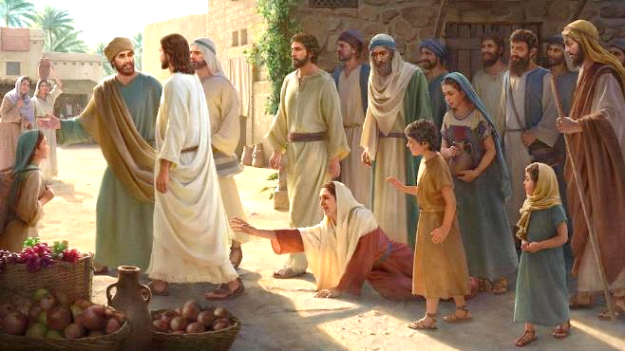
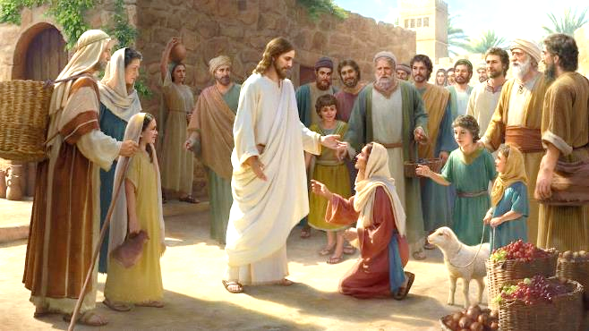
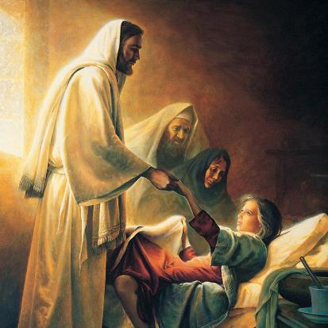
OVERCOMING THE DISEASE
“He took her by the hand and said to her, “Tabitha koum!” (which means “Little girl, I say to you, get up!” (Mark 5:41)
We once again find ourselves with a second “sandwich” story:
Jairus looks for Jesus
Mark 5 :21-24
Despite the seriousness of the situation, Jesus interrupts his journey for something seemingly trivial: someone has touched him (Mark 5:30-32).
A woman is healed
Mark 5:25-34
Couldn't he have resolved that later? Wasn't the girl's life more important?
Jesus heals Jairus' daughter
Mark 5:35-43
But God does not see as we see. If the girl died, he could resurrect her. If the woman walked away, she would be left in spiritual darkness, thinking that a magical power had healed her.
“Daughter, your faith has healed you”
(Mark 5:34). Believing in Jesus is the main point. For her and for Jairus: “Do not fear, only believe” (Mark 5:36). And also for you and me.

Slide 7

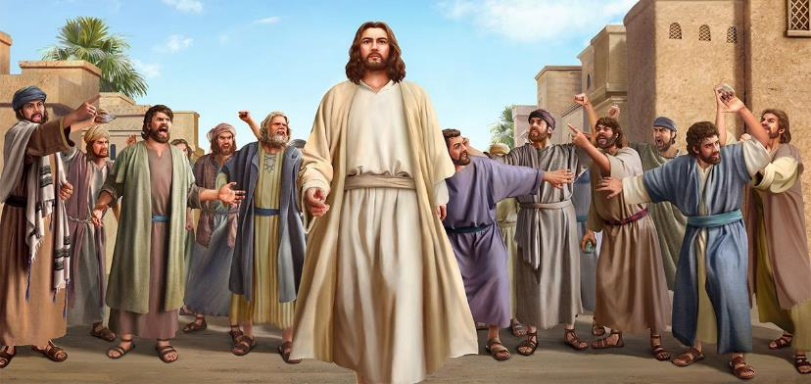
OVERCOMING REJECTION AND CHALLENGES (1)
“And He marveled because of their unbelief. Then He went about the villages in a circuit, teaching” (Mark 6:6)
Why did the Nazarenes reject Jesus (Mark 6:1-6)?
They were surprised that Jesus taught
They knew him as a carpenter, not as a teacher/healer
They knew his family (with whom Jesus had disagreed)
How did Jesus react? He simply left and headed to other fields of work. And this was the pattern of action that he taught his disciples (Mark 6:11).
Have you ever been rejected like Jesus was, or had to go through some crisis that is difficult to understand? What did you learn from that experience that you can use to help someone going through the same experience?

Slide 8

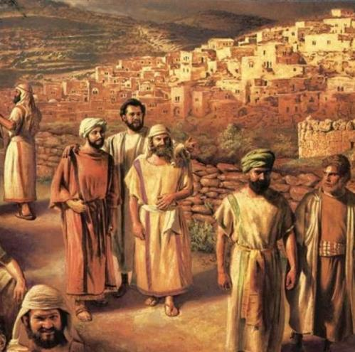
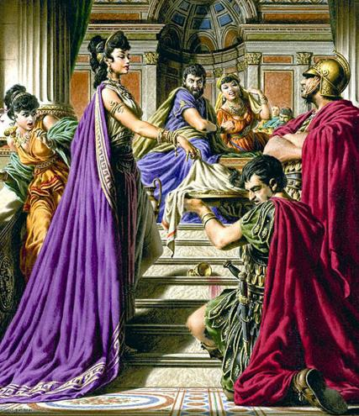
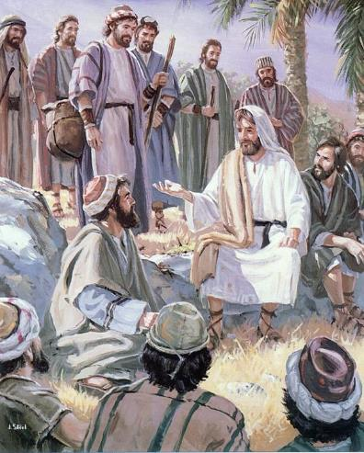
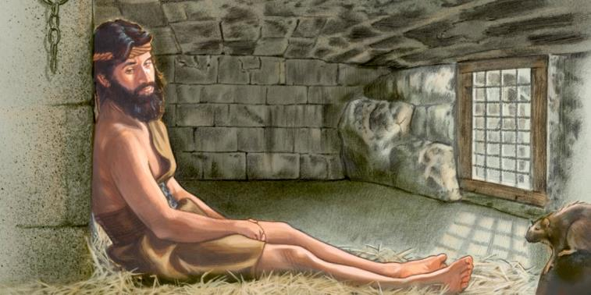
OVERCOMING REJECTION AND CHALLENGES (2)
“And He marveled because of their unbelief. Then He went about the villages in a circuit, teaching” (Mark 6:6)
We come to the third “sandwich” story:
Mission of the disciples
Mark 6 :7-13
Death of John the Baptist
Mark 6:14-29
Disciples Report
Mark 6:30
Jesus proposes to his disciples a great challenge: to be sent to preach in pairs, after receiving some practical advice (Mark 6:7-10).
While they preach freely, John remains in prison.
In contrast to the success of the disciples, John seals his testimony with death.

Slide 9

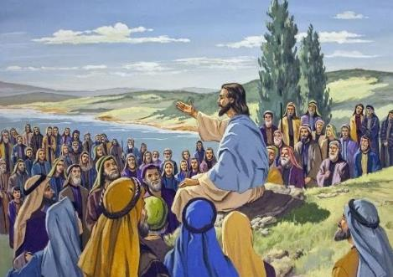
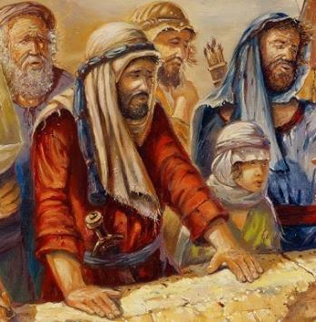
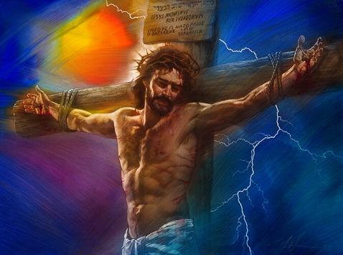
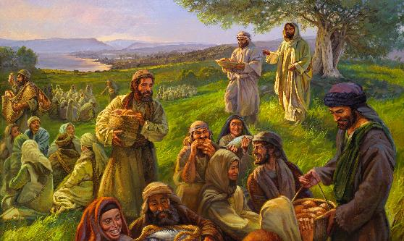
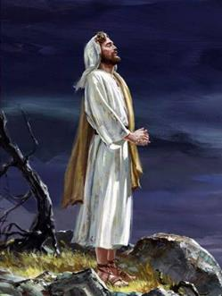
OVERCOMING INCOMPREHENSION
“For they had not understood about the loaves, because their heart was hardened” (Mark 6:52)
Jesus' disciples needed to share with him at length the details of their mission; and John's disciples needed to understand why their teacher had died.
Jesus withdrew with them, but a large crowd came forward and waited for him on the shore. When he saw them, “he had compassion on them, because they were like sheep without a shepherd” (Mark 6:34).
They were a leaderless people, with no one to guide them
(1 Kings 22:17). They were looking for a Messiah to free them from Rome. But Jesus offered them a Messiah who would free them from sin (Mark 10:45).
Faced with the miracle of the fish, the crowd wanted to make Jesus their political leader (Jn. 6:14-15). The disciples, for their part, had not understood Jesus' role either (Mark 6:52).
What did Jesus do? He refused the honors, and prayed (Mark 6:45-46).

Slide 10

“The strength of every soul is in God and not in man. Quietness and confidence is to be the strength of all who give their hearts to God. Christ has not a casual interest in us but an interest stronger than a mother for her child.... Our Saviour has purchased us by human suffering and sorrow, by insult, reproach, abuse, mockery, rejection and death. He is watching over you, trembling child of God. He will make you secure under His protection."
EGW (Dependence Upon God, January 9)

