Slide 1
PARABLES
Lesson 4 for July 27, 2024

Slide 2
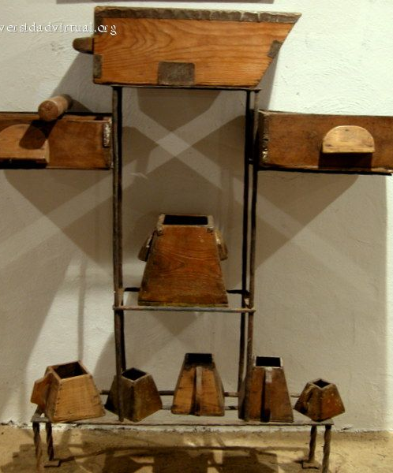
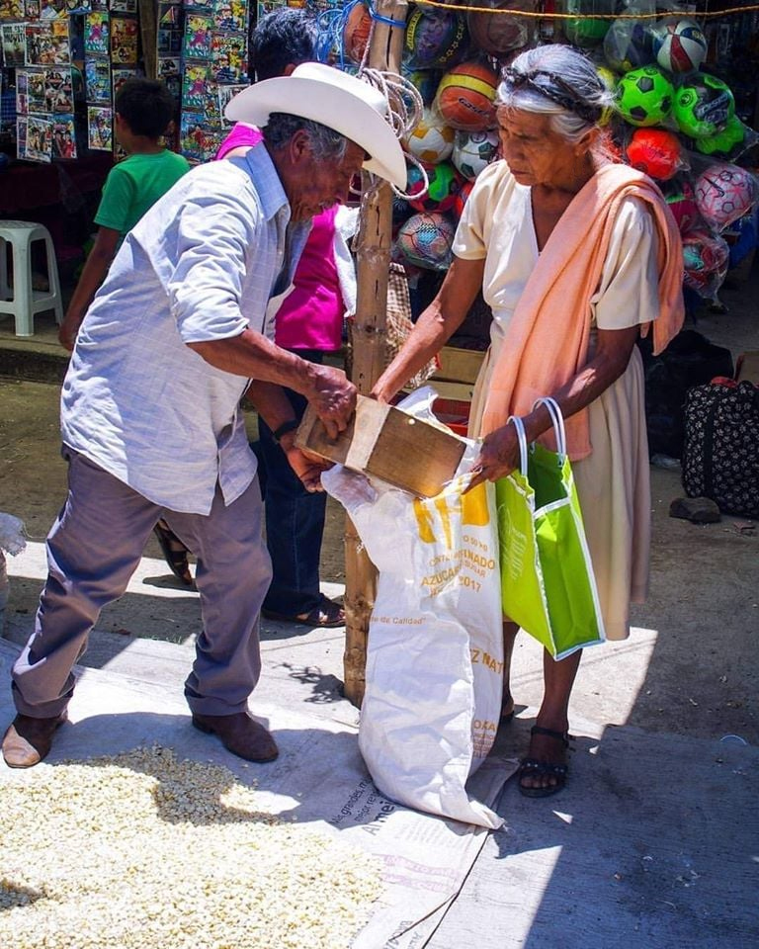
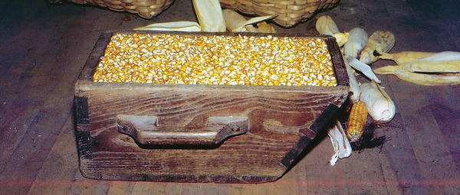
“Then He said to them, ‘Take heed what you hear. With the same measure you use, it will be measured to you; and to you who hear, more will be given. For whoever has, to him more will be given; but whoever does not have, even what he has will be taken away from him’ ”
(Mark 4:24, 25, NKJV)

Slide 3
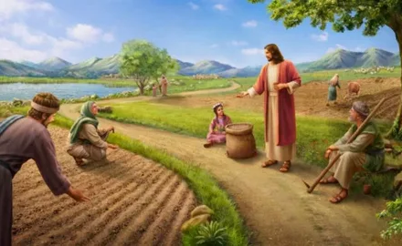
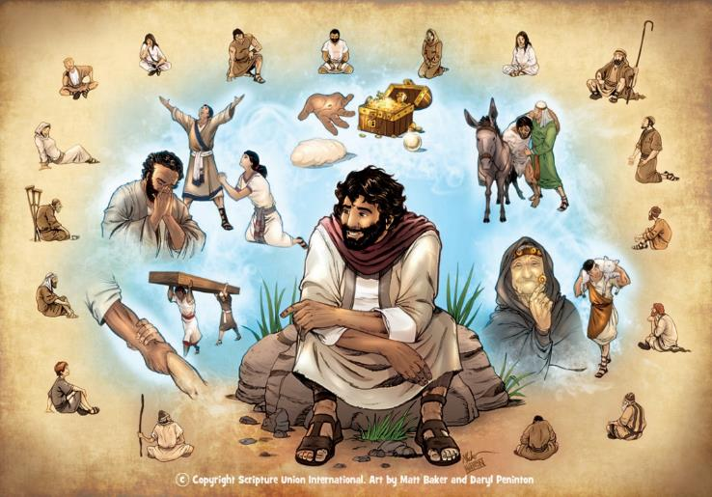
A parable is a narration of a fictional event (based or not on real events) from which an important truth or moral teaching is deduced by comparison or similarity.
This is the system that Jesus primarily used in his teachings (Mark 4:34). His parables were generally taken from everyday life and, therefore, easy to remember and apply.
When his listeners returned home, they shared what they learned with their family and friends.
The reason of existing of parables. Mark 4:10-12.
The parable of the sower:
The sower went out to sow… Mark 4:1-9.
The explanation of the parable. Mark 4:13-20.
Other parables:
The lamp and the measurement. Mark 4:21-25.
Growth and mustard. Mark 4:26-32.

Slide 4
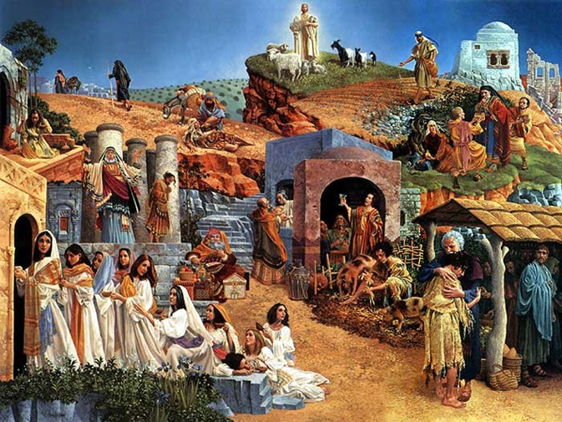
THE REASON OF EXISTING OF PARABLES
“they may be ever seeing but never perceiving, and ever hearing but never understanding; otherwise they might turn and be forgiven!” (Mark 4:12)
Jesus' preaching revolved around the Kingdom of Heaven (Mark 1:14-15). Many of his parables were told to explain the nature of said Kingdom (Mark 4:30).
Interestingly, the reason Jesus himself gave for using parables is truly astonishing: lest they understand, or be converted, or be forgiven! (Mark 4:12).
This was nothing new. When commanding him to preach, God told Isaiah: “Hear well, and do not understand; see indeed, but do not understand. […] lest he see with his eyes, nor hear with his ears, nor understand with his heart, nor be converted, and there be healing for him” ( Is. 6:9-10).
He who hungers for the Word of God will hear the truth and rejoice. But those who do not want to hear, no matter how simple this truth is presented, will refuse to understand, to change, and to achieve salvation.

Slide 5
THE PARABLE OF THE SOWER

Slide 6
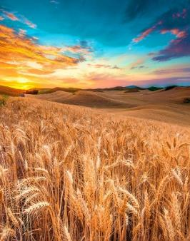
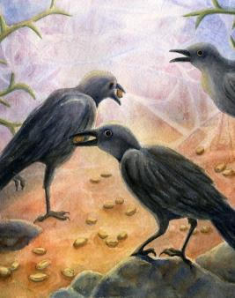
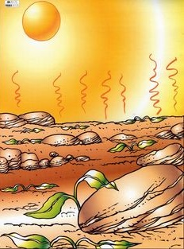
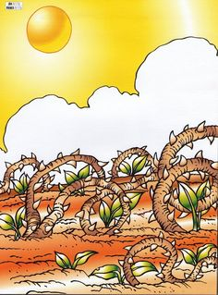
THE SOWER CAME OUT TO SOW...
“He taught them many things by parables, and in his teaching said: “Listen! A farmer went out to sow his seed” (Mark 4:2-3)
In the path
In a few days, the seed dies (Mark 4:4)
between stones
In a few weeks, the seed dies (Mark 4:5-6)
among thorns
In a few months, the seed dies (Mark 4:7)
on good land
At the end of the season, the seed bears fruit (Mark 4:8)
The sower and the seed do not vary. However, the result is totally different for each of the four terrains. It all depends on the way the seed is received.

Slide 7
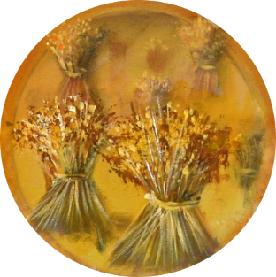
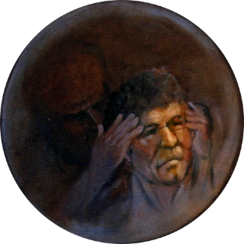
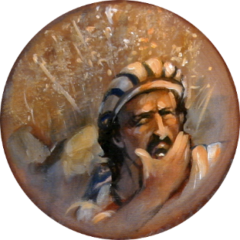
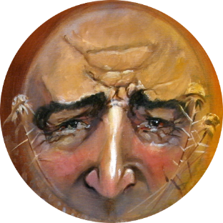
THE EXPLANATION OF THE PARABLE
“The farmer sows the word” (Mark 4:14)
The seed is the Word of God, and the sower is anyone who transmits it.
In the path
They have no interest, and Satan leads them astray (Mark 4:15)
between stones
They receive the word, but do not endure the trials (Mark 4:16-17)
among thorns
They receive the word, but they become comfortable (Mark 4:18-19)
on good land
They resist the tests and do not settle.They bear fruit (Mark 4:20)
What type of soil am I? What should I do to be fruitful?

Slide 8
OTHER PARABLES

Slide 9
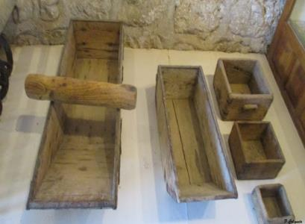
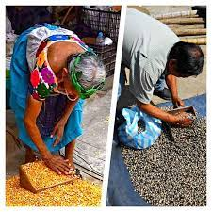
THE LAMP AND THE MEASURE
“He said to them, “Do you bring in a lamp to put it under a bowl or a bed? Instead, don’t you put it on its stand? (Mark 4:21)
“Consider carefully what you hear,” he continued. “With the measure you use, it will be measured to you—and even more” (Mark 4:24).
Visualize the conversation: “Do you bring in…?” "No!"; “don’t you put it…?" "Well of course!"
On the city streets, merchants sold their products using more or less standard measurements to gauge the amount of product the buyer wanted.
Jesus knew how to get the attention of his audience. Now they were ready to receive the spiritual lesson.
Little by little, Jesus revealed the truth of the gospel so that it would be known to all (Mark 4:22).
If the seller was good, he would add a little more product to the measure to satisfy his customer.
That night, as they lit their lamps at home, “those who have ears to hear” (Mark 4:23) undoubtedly remembered the lesson.
If someone is receptive to the truth, they will get even more. But if you reject it, even the truth you have will be lost (Mark 4:25).

Slide 10
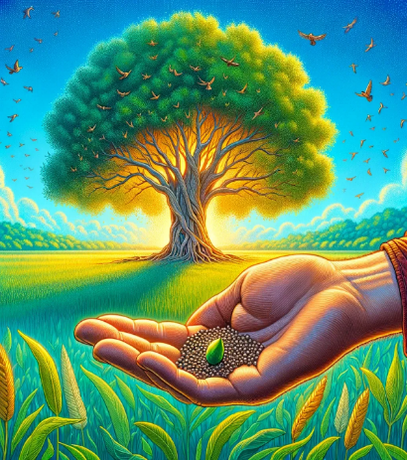
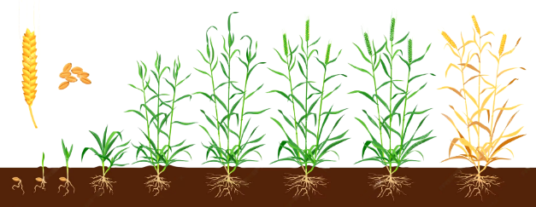
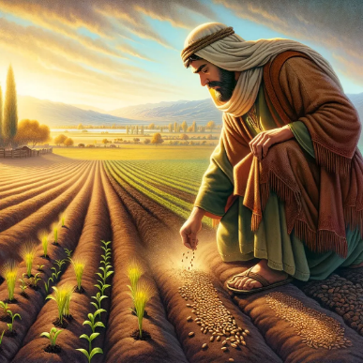
GROWTH AND MUSTARD
“He also said, “This is what the kingdom of God is like. A man scatters seed on the ground” (Mark 4:26)
“It is like a mustard seed, which is the smallest of all seeds on earth” (Mark 4:31)
The Kingdom of Heaven is comparable to a tiny mustard seed (Mark 4:30-31).
Jesus remembers the cycle of grain growth (Mark 4:28):
Grass
Spike
Grain
After 50 days of sowing, mustard reaches 30-40 cm in height, and is already capable of producing harvestable fruit. It can grow up to 7 meters high (23 Ft.).
It is a process that depends on God, not man (Mark 4:27).
This is the seed of the gospel planted in the fertile soil of the believer.
Small, of course, was the beginning: 120 “unlettered” people hidden in a room in Jerusalem.
Through the action of the Holy Spirit we grow more and more in the truth... until Jesus comes (Mark 4:29; Mt. 13:39).
But its expansion has reached the entire world, becoming the religion with the largest number of believers.

Slide 11
“In parables and comparisons, He found the best method of communicating divine truth. In simple language, using figures and illustrations drawn from the natural world, He opened spiritual truth to His hearers, and gave expression to precious principles that would have passed from their minds, and left scarcely a trace, had He not connected His words with stirring scenes of life, experience, or nature. In this way He called forth their interest, aroused inquiry, and when He had fully secured their attention, He decidedly impressed upon them the testimony of truth. In this way He was able to make sufficient impression upon the heart so that afterward His hearers could look upon the thing with which He connected His lesson, and recall the words of the divine Teacher.
EGW ( Fundamentals of Christian Education, 236)

