Slide 1
LIGHT SHINES
IN THE DARKNESS
Lesson 3 for April 20, 2024

Slide 2
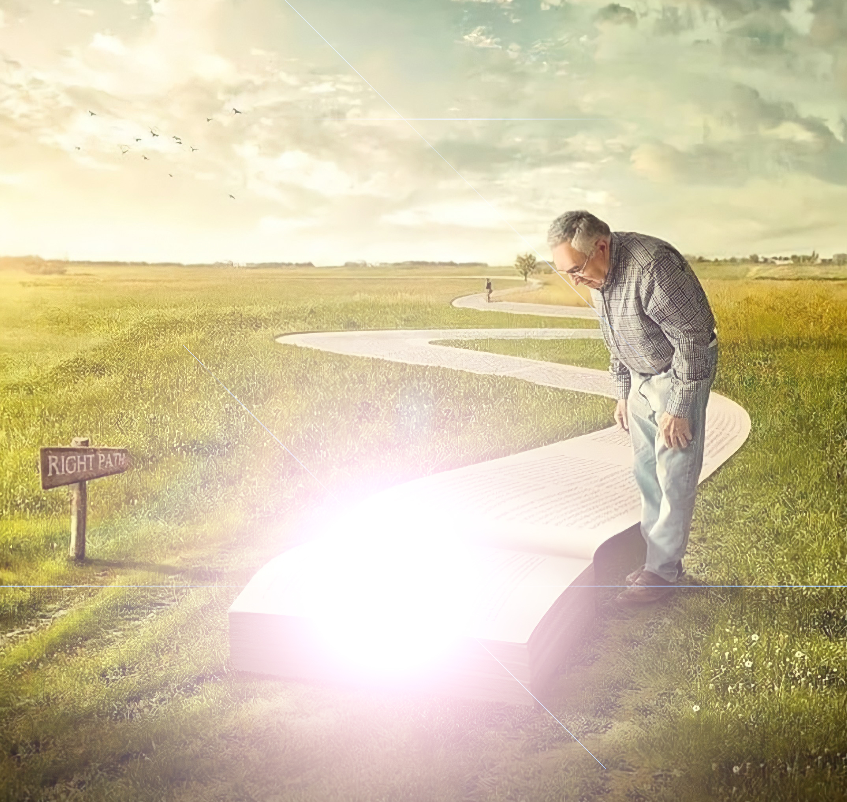
“Then Jesus said to them, ‘A little while longer the light is with you. Walk while you have the light, lest darkness overtake you; he who walks in darkness does not know where he is going’ ”
(John 12:35, NKJV)

Slide 3
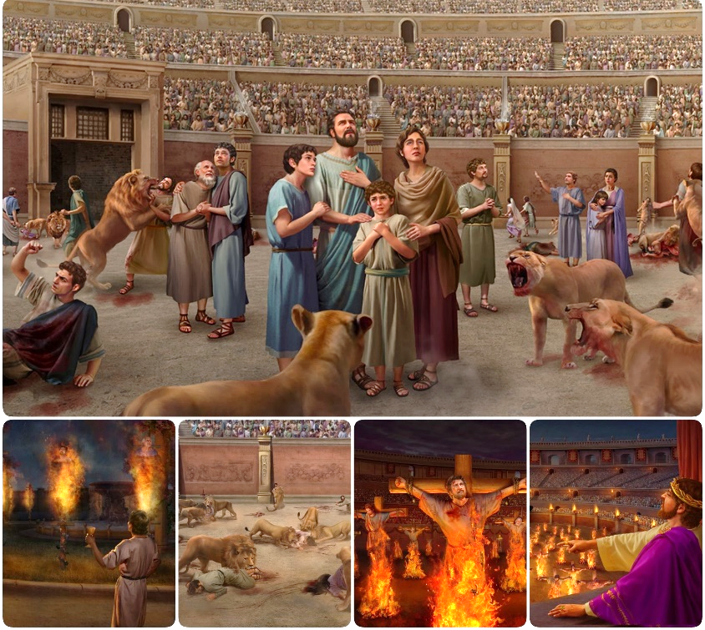
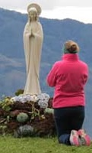
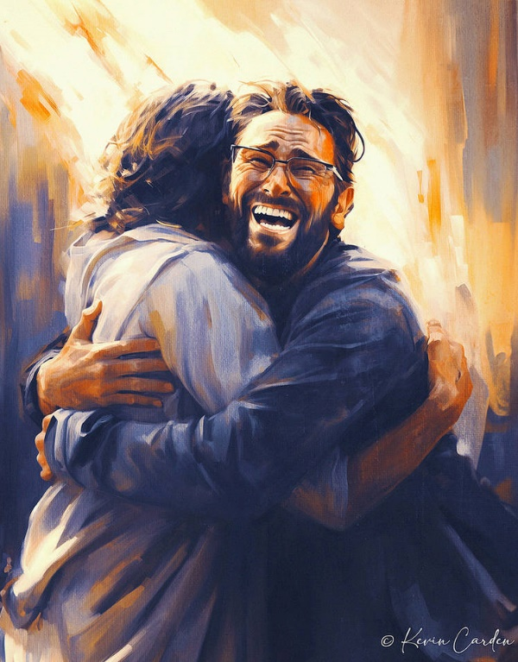
A war is won or lost battle by battle.
When Satan lost the battle of persecution he devised a new plan: compromise. The mixture of truth and lies has dragged millions to embrace an adulterated, lifeless truth.
Our only safeguard in this battle is to cling to Jesus, who is the Truth and the Life, and his Holy Word.
Battle for the truth:
The truth vs. the lie.
The compromise of the church.
Battle for the Word of God:
Security in the Bible.
Human reasoning.
Battle for the mind.

Slide 4
BATTLE FOR THE TRUTH

Slide 5
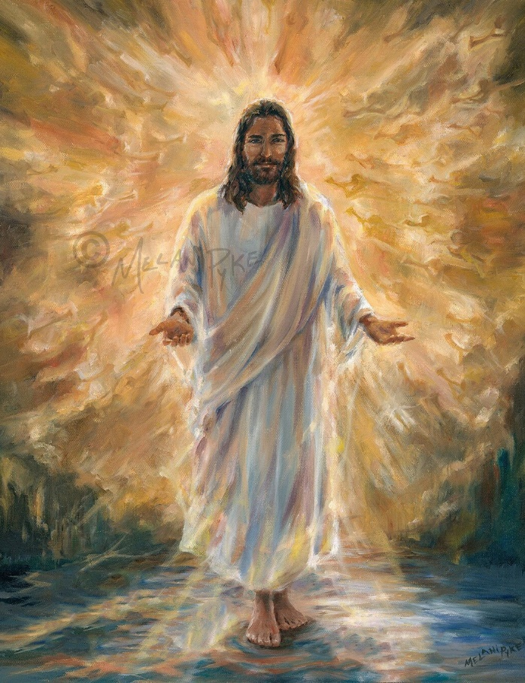
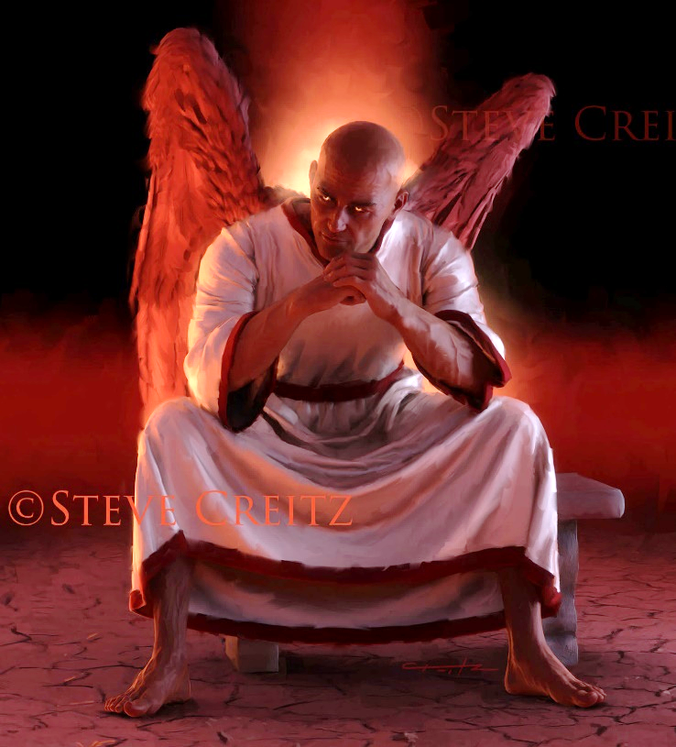
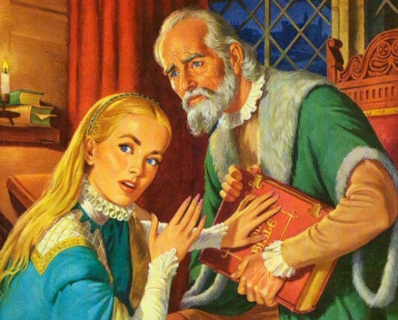
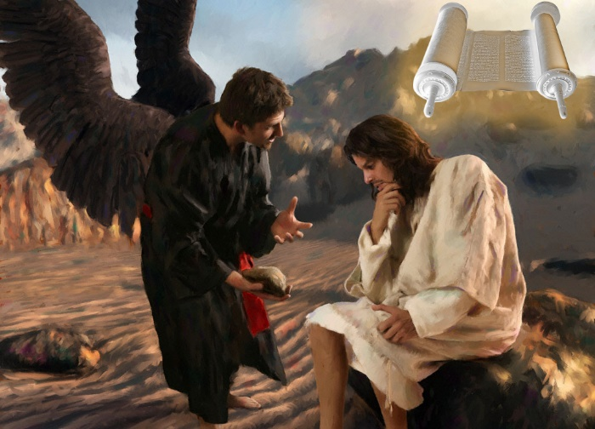
THE TRUTH VS. THE LIE
“Jesus answered, ‘I am the way and the truth and the life. No one comes to the Father except through me’ ” (John 14:6)
Jesus is the Truth and therefore the father of all truth (John 14:6). Everything true, everything trustworthy, everything that is true, comes from Him. And His truth produces life in us.
On the contrary, Satan is the father of lies (Jn. 8:44). All deception, all malicious subtlety, all adulterated truth, comes from him. And their lies produce death in us.
In his confrontations with the enemy, Jesus used the Bible as a source of all truth: “It is written” (Mt. 4:4; 21:13).
Therefore, the devil has worked to destroy the Bible, either by hiding it or distorting it. And he achieved it (although not completely) through the Roman Church, during the Middle Ages (also called the “Dark Ages”).

Slide 6
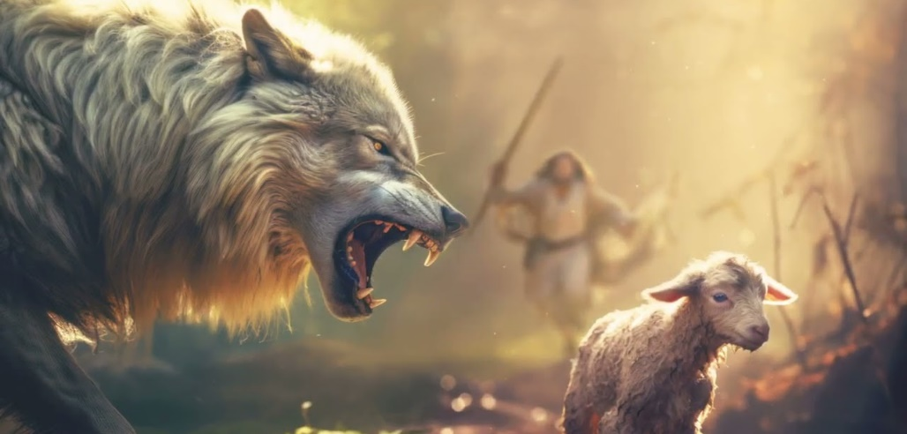
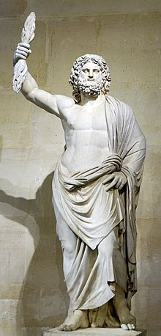
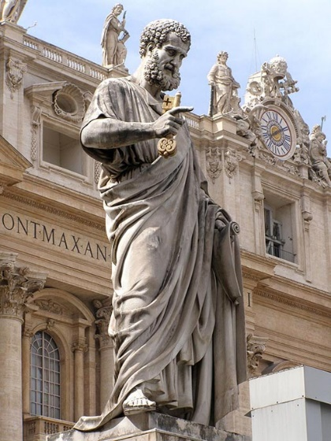
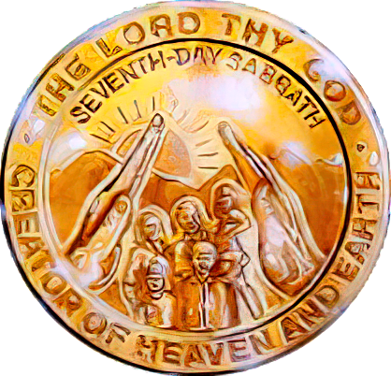
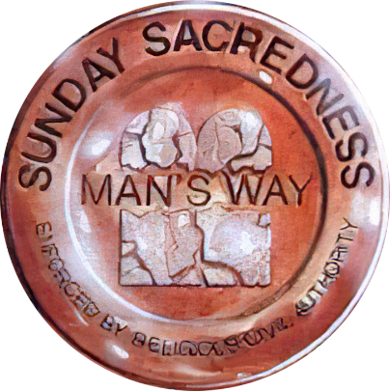
THE TRANSIGENCE OF THE CHURCH
“I know that after I leave, savage wolves will come in among you and will not spare the flock. Even from your own number men will arise and distort the truth in order to draw away disciples after them” (Acts 20:29-30).
In bidding farewell to the Ephesian elders, Paul expressed his concern for the external and internal problems they would face in the future ( Acts 20:29-30).
Predatory wolves . From the year 64 to 311 ( Serdica edict of tolerance ), the Church suffered fierce persecution from the Roman Empire.
Perverse men . Starting in the 4th century, unconverted men were introduced into the Church who mixed their paganism with the truth.
The statue of the Roman god Jupiter on the Capitoline Hill in Rome was reused and turned into a statue of Saint Peter
Satan used his “internal” strategy to corrupt the truth and introduce idolatry and Sunday observance into the Church.
As Paul prophesied, these errors were accepted, and will remain to the end among those who do not want to know the truth (2 Thes. 2:7-12). The final battle will be based on compromise with the Sabbath.

Slide 7
BATTLE FOR THE WORD OF GOD

Slide 8
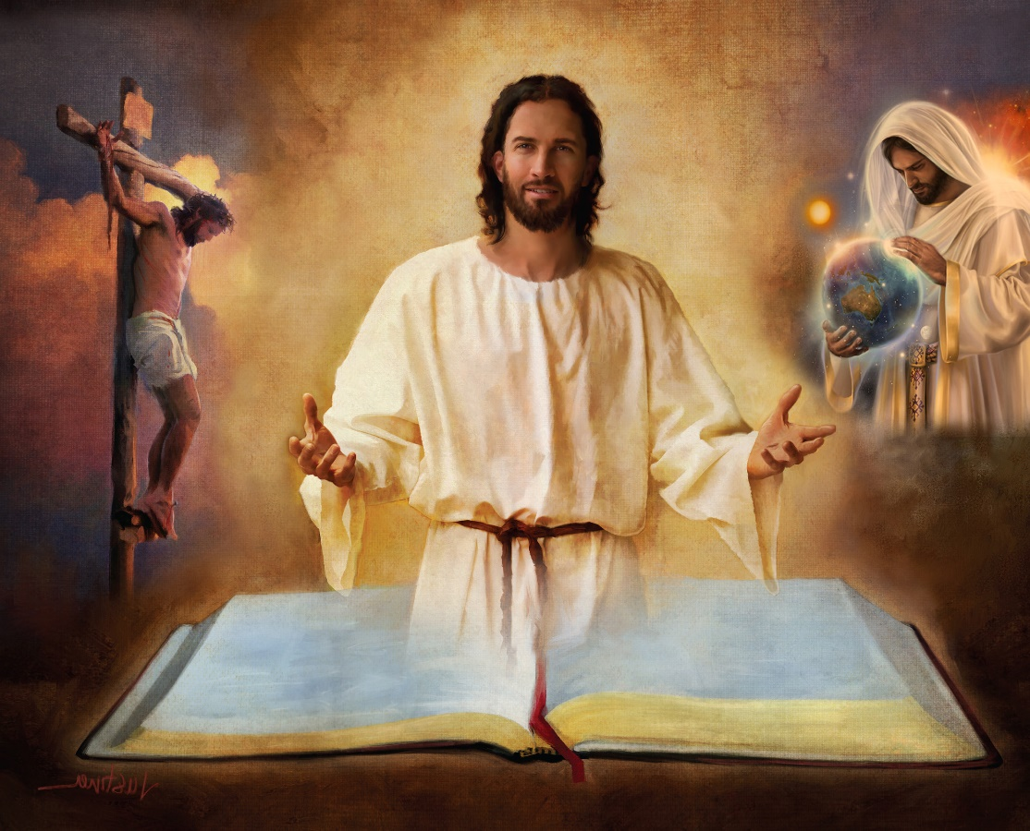
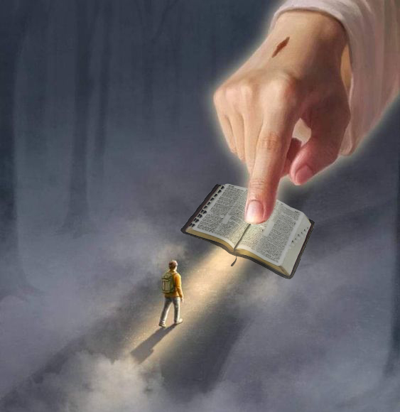
SECURITY IN THE BIBLE
“Sanctify them by the truth; your word is truth” (John 17:17)
The Bible is the infallible revelation of God’s will. It presents Heaven’s plan for humanity’s salvation.
Therefore, our security is found only in the Bible, and in each of its books, chapters and verses (2Tim. 3:16).
In it we find the devil's strategy; the creation; the birth, life, death, resurrection and intercession of Jesus; forgiveness of sins; the Second Coming; eternal life on the New Earth…
“Your word is a lamp for my feet, a light on my path” (Ps. 119:105 NIV)
If we reject part of it (for example, the Creation account of Genesis 1 and 2), we may come to reject any of the doctrines it teaches. And then... what security could we have to trust the rest of the Bible?
“The unfolding of your words gives light; it gives understanding to the simple” (Ps. 119:130 NIV)

Slide 9
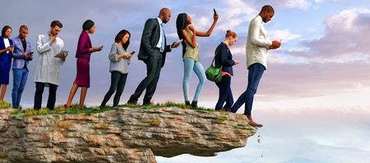
HUMAN REASONING
“There is a way that appears to be right,
but in the end it leads to death” (Proverbs 16:25)
If God is the one who inspired the Bible, who can interpret it (2 Pet. 1:20; John 14:26)?
The person without the Spirit does not accept the things that come from the Spirit of God but considers them foolishness, and cannot understand them because they are discerned only through the Spirit (1Co. 2:14 ).
An example of human reasoning is the higher criticism that, since the 18th century, has proposed an “academic” interpretation of the Bible.
Its basic approach is the denial of miracles and the impossibility of predicting the future. Under this approach, what benefit can we derive from the word of God if we deny its power or its ability to know the future that awaits us?
Without a doubt, the enemy devises paths that seem right, but their end is death (Prov. 16:25).

Slide 10
EGW (Selected Messages, volume 1, page 17)
“Spiritual darkness has covered the earth and gross darkness the people. There are in many churches skepticism and infidelity in the interpretation of the Scriptures. Many, very many, are questioning the verity and truth of the Scriptures. Human reasoning and the imaginings of the human heart are undermining the inspiration of the Word of God[…]
This Holy Book has withstood the assaults of Satan, who has united with evil men to make everything of divine character shrouded in clouds and darkness. But the Lord has preserved this Holy Book by His own miraculous power in its present shape—a chart or guidebook to the human family to show them the way to heaven.

Slide 11
BATTLE FOR THE MIND

Slide 12
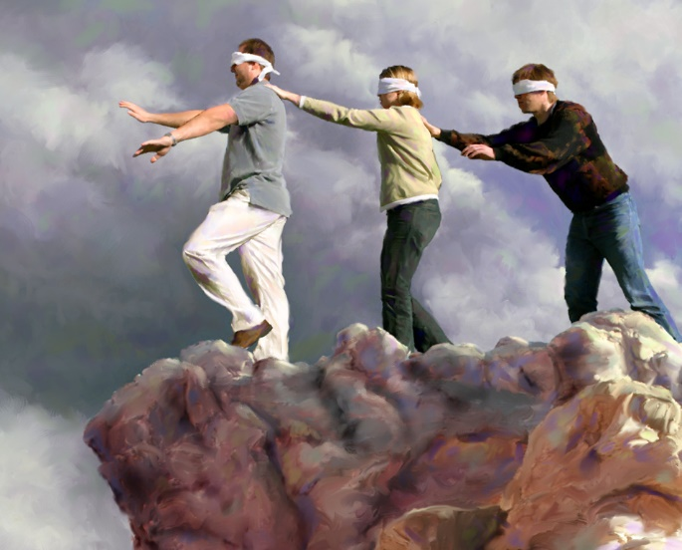
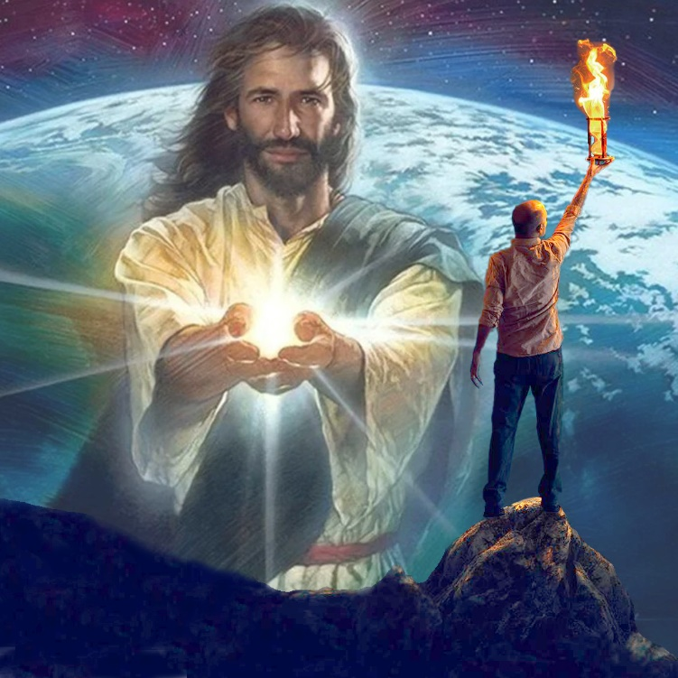
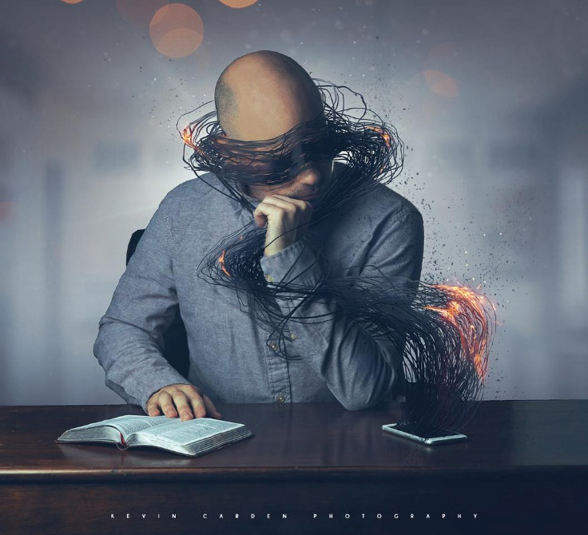
“The god of this age has blinded the minds of unbelievers, so that they cannot see the light of the gospel that displays the glory of Christ, who is the image of God” (2 Corinthians 4:4 NIV )
A Spanish saying says: “There is no worse blind man, than the one who does not want to see.” That is, it is useless to convince someone to see what they do not want to see. So it is with those whom “the god of this world” has blinded (2Co. 4:4).
The lack of knowledge on the part of those who are lost is not because they do not have the capacity to know. It's because they don't want to know. The devil has occupied their minds with many things that prevent them from thinking about what is truly important: their salvation.
But no one needs to remain in this state. When the mind is in spiritual darkness, there is a light that can and will shine in it: “The light [Jesus] shines in the darkness, and the darkness did not prevail against it” (John 1:5).
Those of us who accept this light can undo the work of the enemy, and make the light of Jesus shine through the darkness.

Slide 13
“All who are traveling the road to heaven need a safe guide. We must not walk in human wisdom. It is our privilege to listen to the voice of Christ speaking to us as we walk the journey of life, and His words are always words of wisdom. ...
Our only safety lies in following closely after Christ, walking in His wisdom, and practicing His truth. We cannot always readily detect the working of Satan; we do not know where he lays his traps. But Jesus understands the subtle arts of the enemy, and He can keep our feet in safe paths."
EGW (Our High Calling, January 10)

