Slide 1
THE SEAL OF GOD AND MARK OF THE BEAST: PART 1
Lesson 11 for June 10, 2023

Slide 2
“Then I saw another angel ascending from the east, having the seal of the living God. And he cried with a loud voice to the four angels to whom it was granted to harm the earth and the sea, saying, ‘Do not harm the earth, the sea, or the trees till we have sealed the servants of our God on their foreheads’”
(Revelation 7:2, 3)

Slide 3
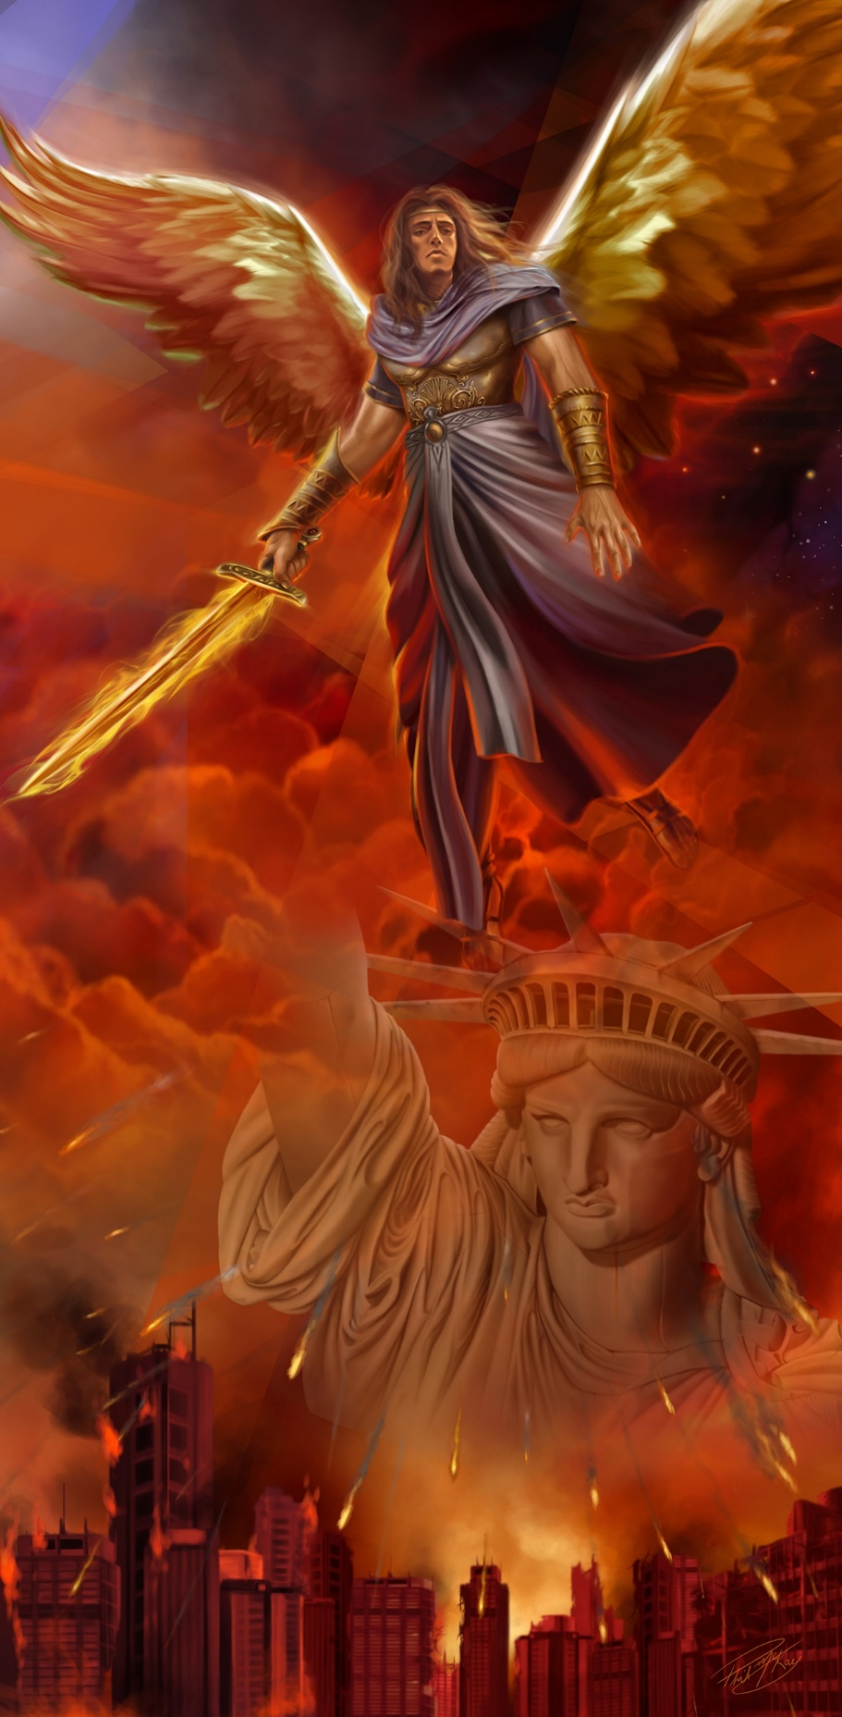
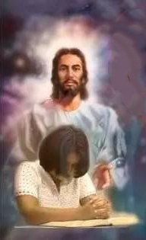
The message of the third angel is the longest one (Rev. 14:9-13). It’s a warning against worshipping the beast and receiving its mark, as well as a message about the patience (or perseverance) of the saints.
The “saints” are those who remain faithful to God in the context of the conflict between good and evil.
This message must be studied in the context of the events in Revelation 13.
The perseverance of the saints:
Keeping the commandments
Keeping the faith of/in Jesus
The issues the saints will face:
Not receiving the mark
Following the Lamb
Opposing the blasphemous power

Slide 4
THE PERSEVERANCE OF THE SAINTS

Slide 5
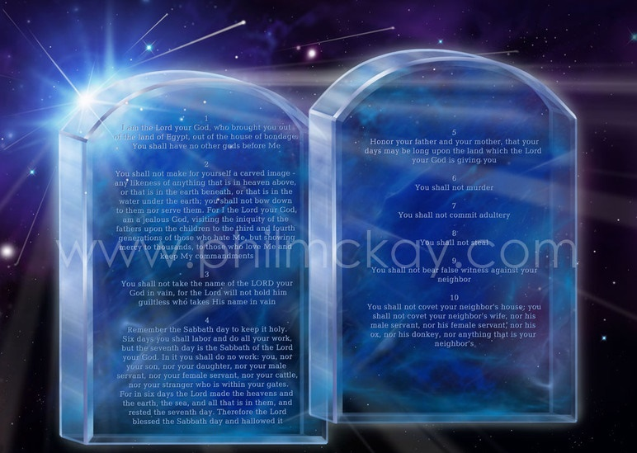
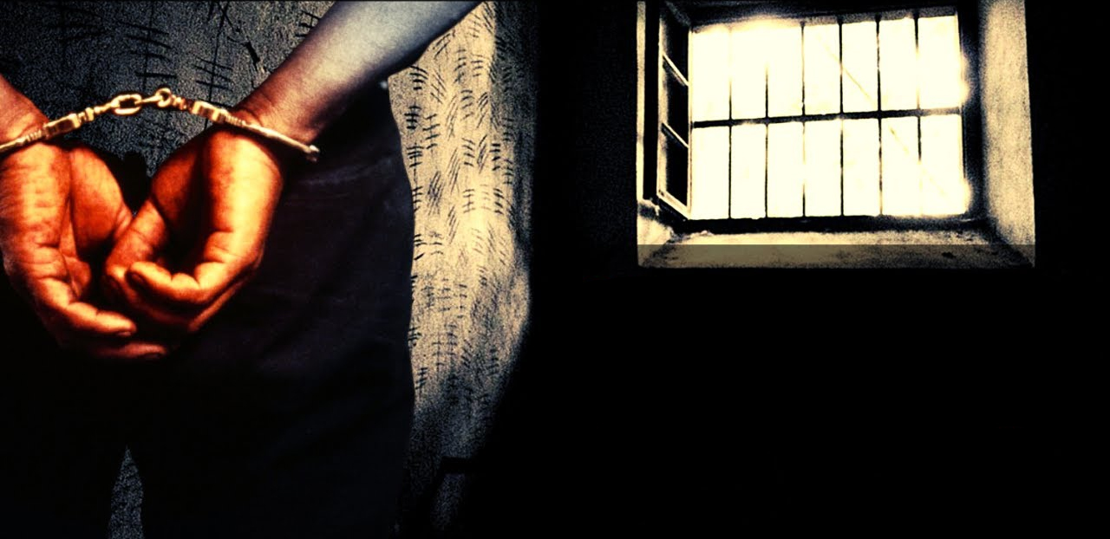
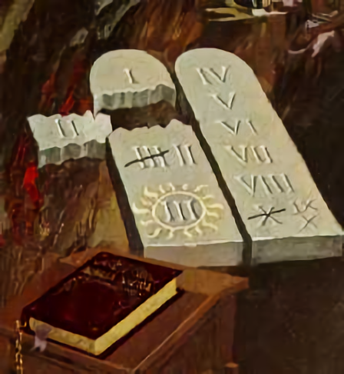
KEEPING THE COMMANDMENTS
“This calls for patient endurance on the part of the people of God who keep his commands […]” (Revelation 14:12 NIV)
Why do the saints need endurance (Mr. 13:13)?
Jesus warned us that we would be “hated by all” for His name’s sake. We must stand firm when that time comes.
Why will we be hated? According to Revelation 14:12, because we obey God’s commandments as written in Exodus 20:2-17.
The beast teaches altered commandments. Worshipping the beast involves following its commandments and accepting Sunday as the day of worship instead of the Sabbath.
We will be persecuted and taken away from society in that time if we keep worshipping God (Rev. 13:15-17). Therefore, endurance is particularly important.

Slide 6
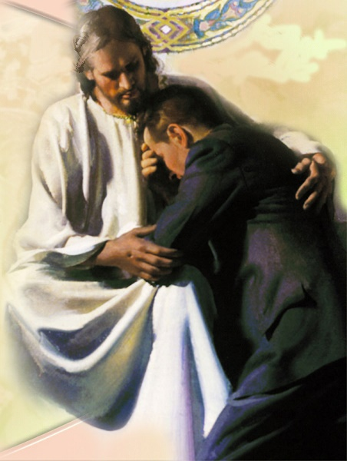
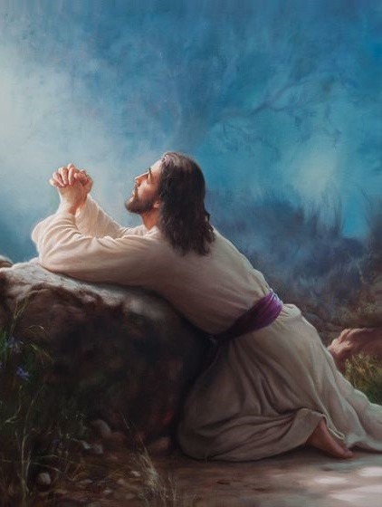
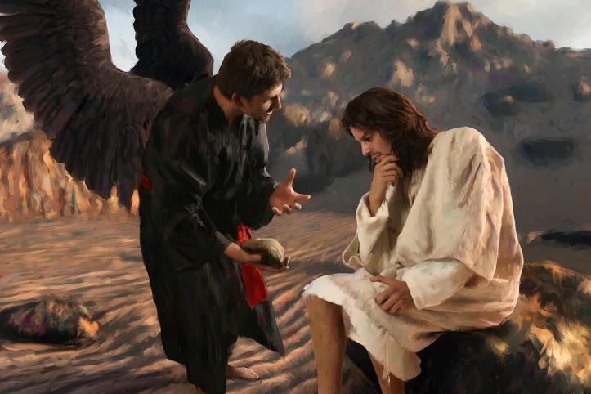
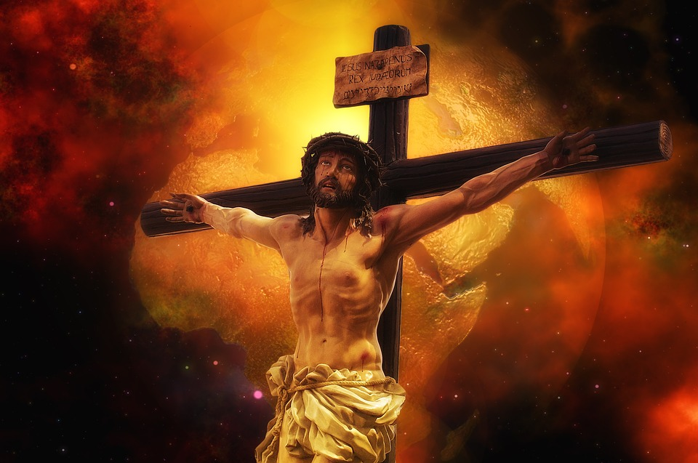
KEEPING THE FAITH OF/IN JESUS
“Here is the patience of the saints; here are those who keep […] the faith of Jesus.” (Revelation 14:12)
This Greek expression can be translated both as “faith in Jesus” and “the faith of Jesus.”
Having faith “in” Jesus involves accepting His grace and forgiveness, and being transformed by Him. Keeping the faith “of” Jesus means to live our faith as He did. What was the faith of Jesus?
Jesus kept His focus in His mission during His time on earth (Lk. 2:49). He stood firm when facing doubts (Mt. 4:3-4).
He felt abandoned by the Father on the cross, but He kept His faith and gave His life away for us (Mt. 27:46, 50). Now is the time to prepare so we can keep the faith of Jesus and have faith in Him.

Slide 7
THE ISSUES THE SAINTS WILL FACE

Slide 8
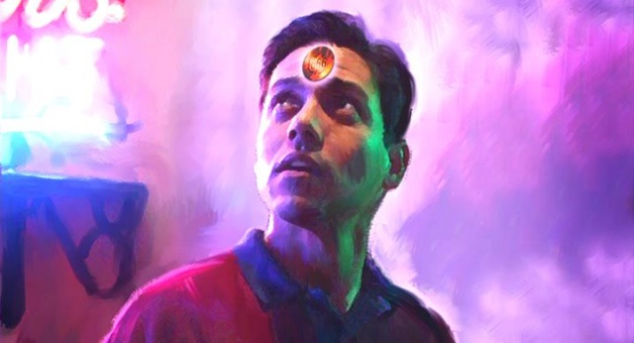
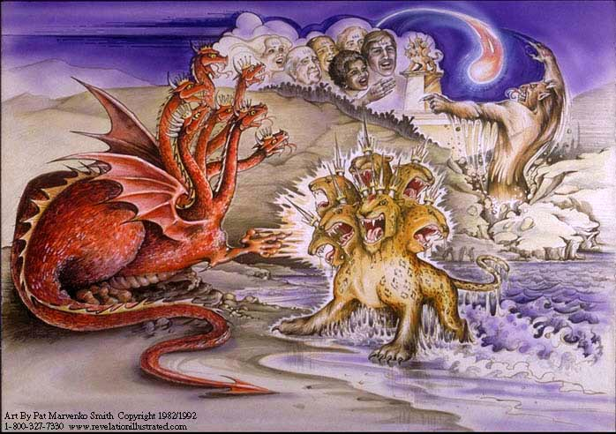
NOT RECEIVING THE MARK
“They will put you out of the synagogues; yes, the time is coming that whoever kills you will think that he offers God service.” (John 16:2)
The dragon (Satan) gives its power to the beast (Rev. 13:2)
The whole earth worships the dragon thanks to the beast (Rev. 13:4)
A second beast (a false prophet) applies the power of the beast and moves everyone to worship it (Rev. 13:12)
Besides, it makes an image that is also worshipped (Rev. 13:14)
Then everyone believes that they’re worshipping God by worshipping the image, the false prophet, or the beast! However, they’re actually worshipping the source of that power: Satan.
The beast will impose its mark and will force everyone to worship on Sunday. Then, economic measures will be taken, and the death decree will be promulgated eventually (Rev. 13:15-17). God will protect His faithful children.

Slide 9
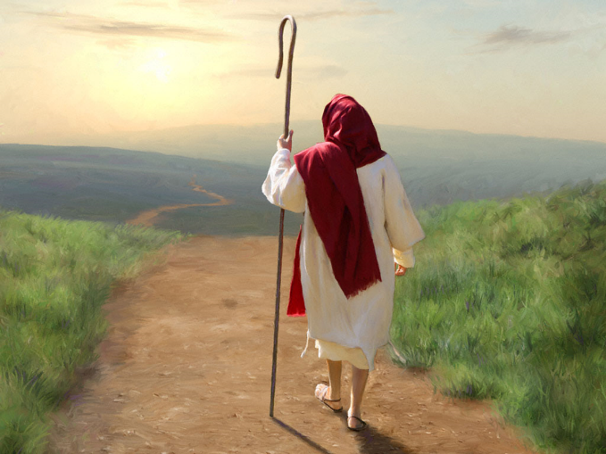
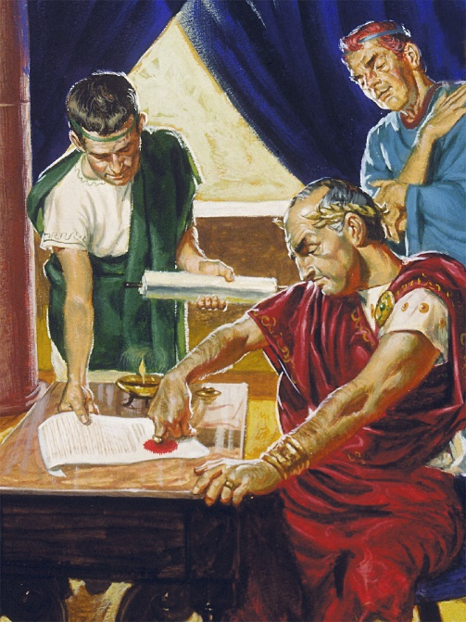
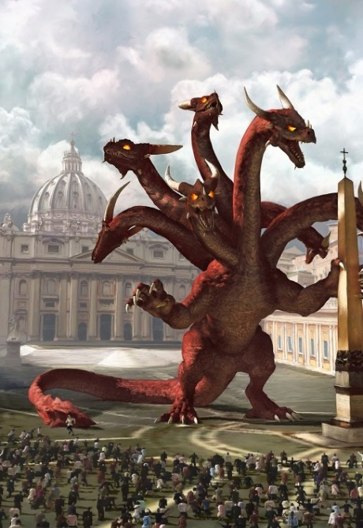
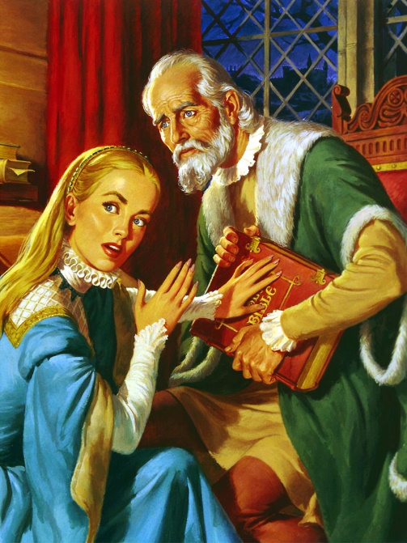
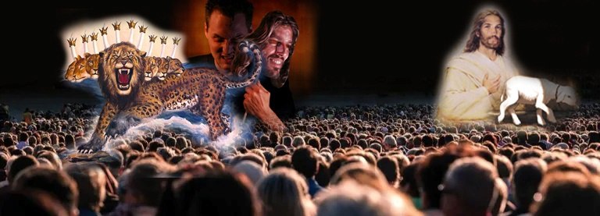
FOLLOWING THE LAMB
“[…] These are the ones who follow the Lamb wherever He goes […]” (Revelation 14:4)
Those who will remain faithful during the final conflict “follow the Lamb” (Rev. 14:4).
However, “all whose names have not been written in the Lamb’s book of life” (Rev. 13:8 NIV) follow the beast. Who or what is that beast?
Satan used the Roman Empire to persecute Jesus (Rev. 12:3-4). Then, “gave the beast his power and his throne and great authority” (Rev. 13:2 NIV). The throne of this beast is located in Rome (Rev. 17:9), and it has used its authority to persecute the faithful people of God for a long time (Rev. 13:7).
There will be no neutral zone in the final conflict. We will follow either the Lamb or the beast (that “all inhabitants of the earth” will follow [Rev. 13:8]).

Slide 10
“It is not the fear of punishment, or the hope of everlasting reward, that leads the disciples of Christ to follow Him. They behold the Saviour's matchless love, revealed throughout His pilgrimage on earth, from the manger of Bethlehem to Calvary's cross, and the sight of Him attracts, it softens and subdues the soul. Love awakens in the heart of the beholders. They hear His voice, and they follow Him.”
E. G. W. (The Desire of Ages, cp. 52, p. 480)

Slide 11
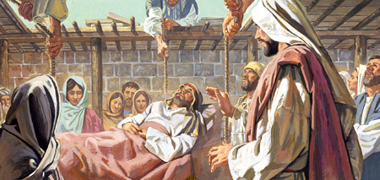
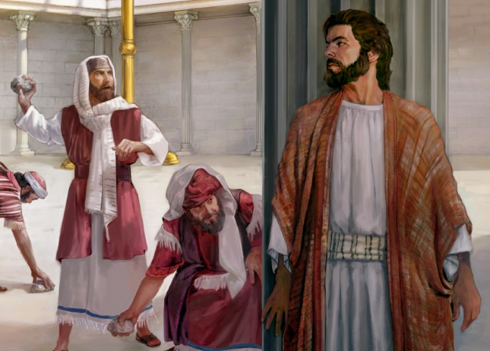
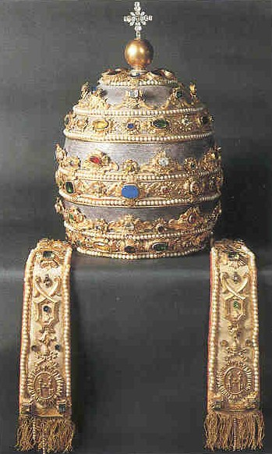
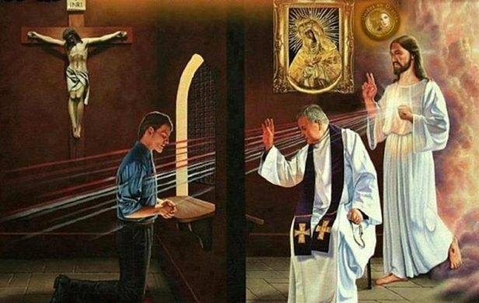
OPPOSING THE BLASPHEMOUS POWER
“And he was given a mouth speaking great things and blasphemies […]” (Revelation 13:5)
Jesus was accused of two types of blasphemy:
Forgiving sins (Lk. 5:21)
Making Himself God (Jn. 10:33)
Jesus was not blaspheming, because He was God. However, anyone who claims to do both things without actually being God is blasphemous.
The Roman Church teaches that priests can forgive sins. Besides, they teach that their most important leader takes God’s place on Earth [“We [the popes] hold upon this earth the place of God Almighty.” —The Great Encyclical Letters of Pope Leo XIII, p. 193].
This blasphemous power will force everyone to worship them. God doesn’t request a forced worship but a sincere one.

Slide 12
“There are two great principles, one of loyalty, the other of disloyalty. We all need greater Christian courage, that we may uplift the standard on which is inscribed the commandments of God and the faith of Jesus.... The line of demarcation between the obedient and the disobedient must be plain and distinct. We must have a firm determination to do the Lord's will at all times and in all places.”
E. G. W. (My life today, March 10)

