Slide 1
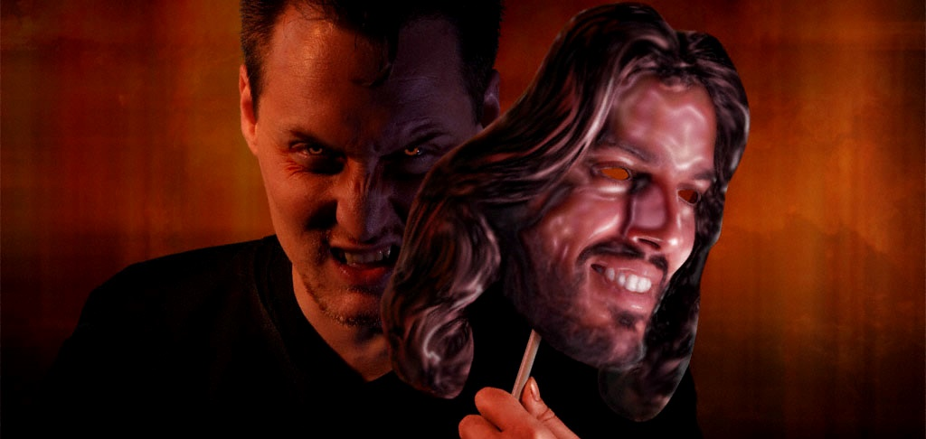
Lesson 10 for June 3, 2023
SATAN’S FINAL DECEPTIONS

Slide 2
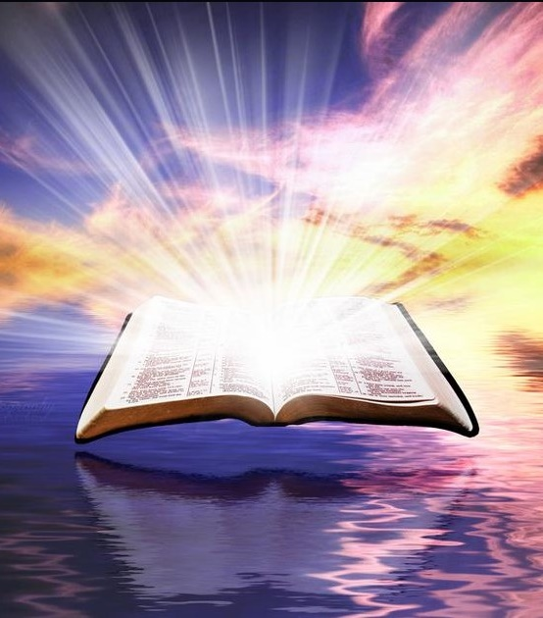
“Sanctify them by Your truth.
Your word is truth” (John 17:17)

Slide 3
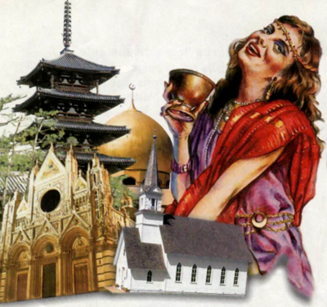
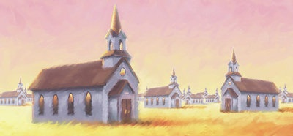
What does Babylon stand for? “‘Babylon the great’ in the book of Revelation designates in a special sense, the united apostate religions at the close of time […] The term ‘Babylon’ refers to the organizations themselves and to their leaders, not so much to the members as such. The latter are referred to as ‘many waters.’ (Rev. 17:1, 15).” (SDA Bible Commentary, vol. 7, p. 851-852).
What’s wrong with Babylon? Why did God announce its fall and invited us to get out of it? (Revelation 14:8; 18:4)?
The deceptions of Babylon:
A universal deception
The immortality of the soul
The false day of rest
Staying safe from these deceptions:
The true day of rest
A call to obedience

Slide 4
THE DECEPTIONS OF BABYLON

Slide 5
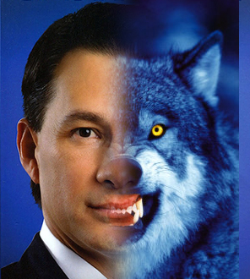
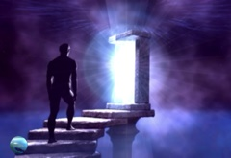
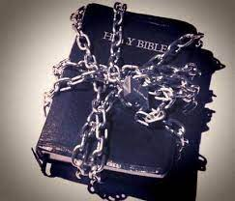
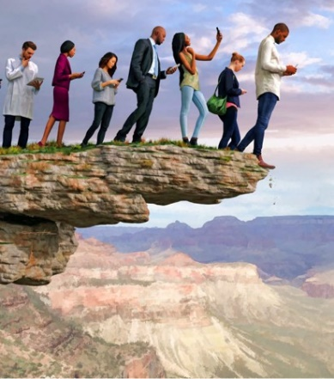
A UNIVERSAL DECEPTION
“There is a way that appears to be right, but in the end it leads to death.” (Proverbs 14:12 NIV)
Jesus foretold that false prophets would deceive the world with signs and miracle. They would deceive even those who want to remain faithful to God (Mr. 13:22). How will they do it?
In the past, “Babylon” made people ignorant by moving them away from the Bible and teaching false human philosophies.
It still acts the same way today. It uses false human thoughts to move people away from the biblical truth (Pr. 14:12). Almost everyone will follow its leaders and worship Satan eventually (Rev. 13:3-4, 14-15).
Only Bible study with the help of the Holy Spirit can help us to distinguish truth from falsehood.

Slide 6
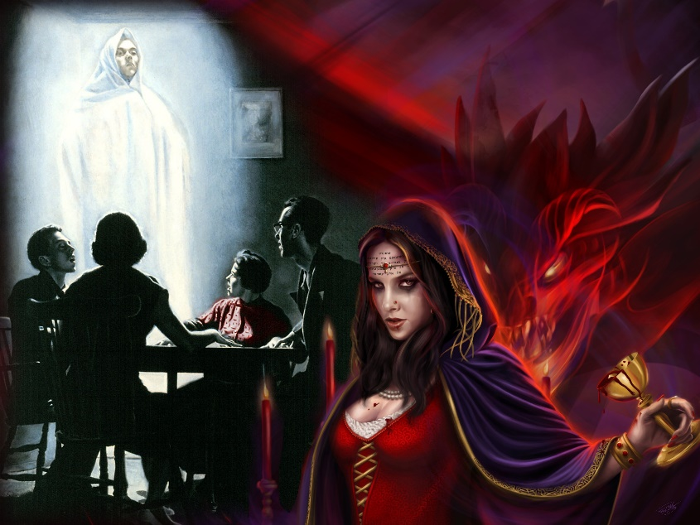
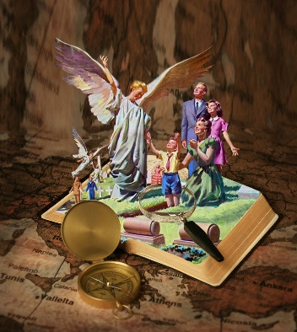
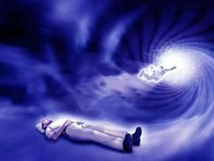
THE IMMORTALITY OF THE SOUL
“Then the serpent said to the woman, ‘You will not surely die.’” (Genesis 3:4)
Babylon and spiritism are clearly related (Rev. 18:2). Thus, most of today’s Christians are accepting “doctrines of demons” (1Ti. 4:1).
One of the most common is that we are immortal, that we cannot die, like Satan told Eve). They believe that we go straight to Heaven once we die if we’ve accepted Jesus as our Savior. If we haven’t, then we go straight to hell, or we just wander as a bodyless spirit, or…
The Word of God explains that death is like a dream, that our souls are mortal. We will wake up from this “dream” on the day of resurrection (Eccl. 9:5; Ps. 115:17; Rev. 20:5-6).

Slide 7
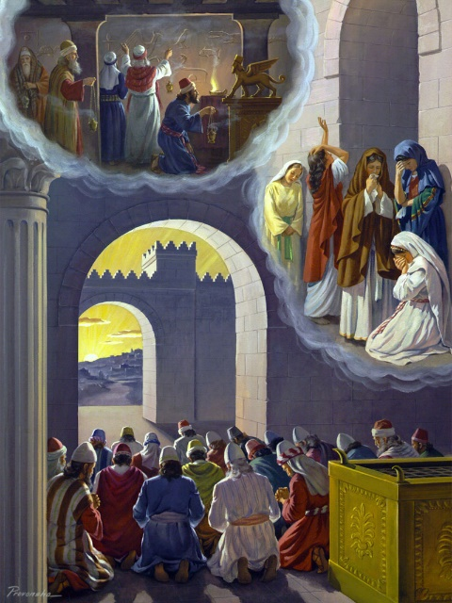
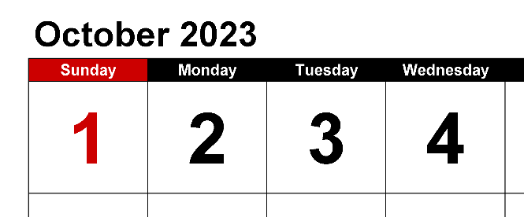
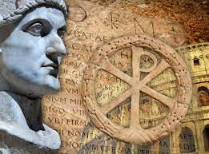
THE FALSE DAY OF REST
“So He brought me into the inner court of the Lord’s house; and there, at the door of the temple of the Lord, between the porch and the altar, were about twenty-five men with their backs toward the temple of the Lord and their faces toward the east, and they were worshiping the sun toward the east.” (Ezequiel 8:16)
The Jewish people became corrupted by worshipping the sun as Babylonians and other nations did (Ez. 8:16).
The Christian Church has never openly worshipped the Sun, but they started to worship in the day that Rome used as the “day of the Sun” (Constantine’s edict, 321 AD). Some languages still keep that meaning, like Sunday in English.
This change of the day of worship has never been questioned in mainstream Christianity, although it has no biblical roots.

Slide 8
STAYING SAFE FROM THESE DECEPTIONS

Slide 9
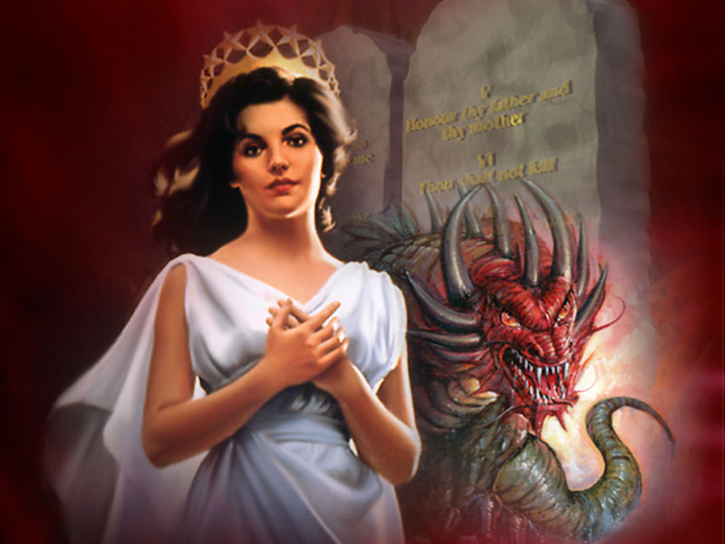
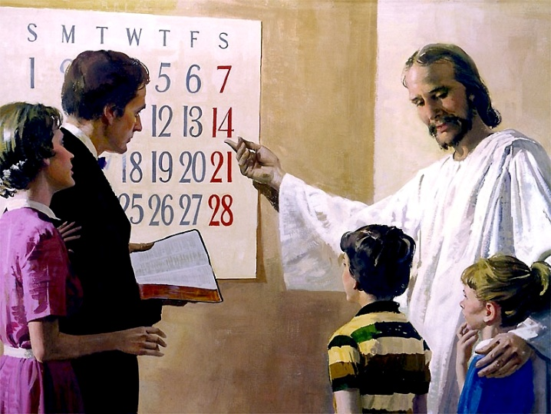
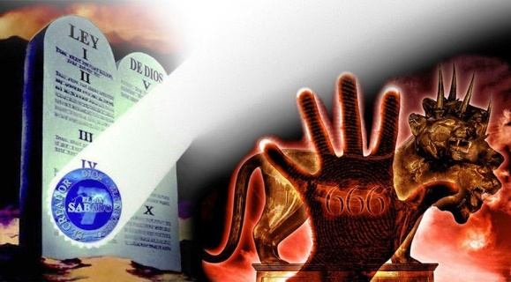
THE TRUE DAY OF REST
“hallow My Sabbaths, and they will be a sign between Me and you, that you may know that I am the Lord your God.” (Ezekiel 20:20)
Demons have led Babylon, and they have deceived the world with their “wine” of human doctrines (Rev. 18:2-3; 14:8). They also mock and persecute the minority that still worship God in a different way (Rev. 12:17).
However, this little group are still worshipping God like He encouraged us to do in His Word, on the Sabbath day (Ex. 20:8-11; Ez. 20:20).
The faithful remnant call the world to worship our Creator. They also announce the fall of Babylon, who have taught a false day of worship (Rev. 14:7-8).

Slide 10
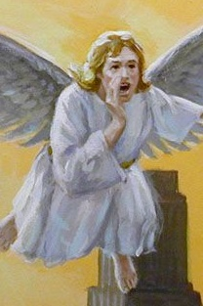
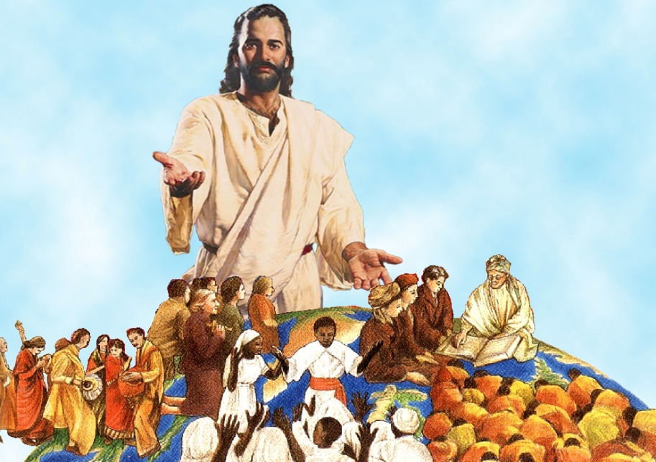
A CALL TO OBEDIENCE
“And I heard another voice from heaven saying, ‘Come out of her, my people, lest you share in her sins, and lest you receive of her plagues.’” (Rev. 18:4)
The remnant who are faithful to God’s doctrines are only a small portion of the people of God. Most of them are still inside Babylon.
They’re not aware that they’re worshipping God in the wrong day, or that they’re accepting Satan’s deceptions as truth (like the immortality of the soul).
Therefore, they need someone to teach them the truth and invite them to exit Babylon. They must be taught that transgressing God’s Law is sin (1Jn. 3:4; James 2:10-11).
All faithful people must be taught that obedience just reflects the grace of Christ, who liberates us from condemnation and the dominion of sin.

Slide 11
“The wine of Babylon is the exalting of the false and spurious sabbath above the Sabbath which the Lord Jehovah hath blessed and sanctified for the use of man, also [it is] the immortality of the soul. These kindred heresies, and the rejection of the truth, convert the church into Babylon. Kings, merchants, rulers, and religious teachers are all in corrupt harmony.”
E. G. W. (Selected Messages, book 2, cp. 7, p. 68)

