Slide 1
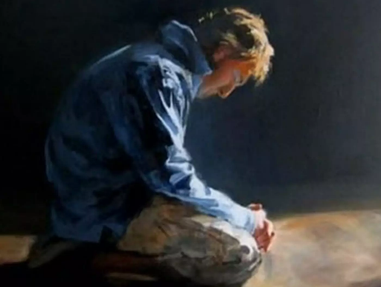
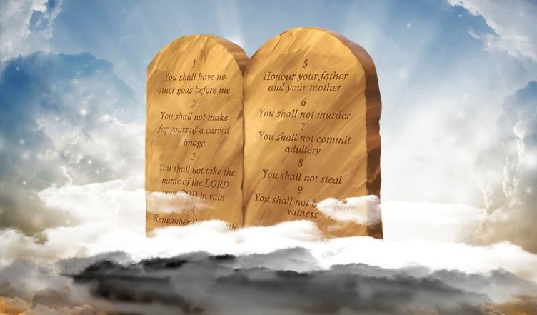
FEAR GOD AND GIVE GLORY TO HIM
Lesson 4 for April 22, 2023

Slide 2
“Here is the patience of the saints; here are those who keep the commandments of God and the faith of Jesus”
(Revelation 14:12)

Slide 3
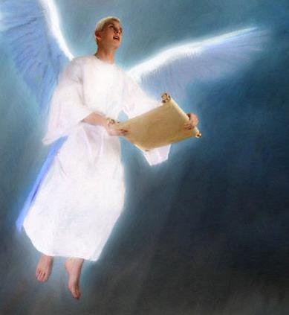
The angel with the everlasting gospel began proclaiming his message: “Fear God and give glory to Him” (Revelation 14:7).
We must understand the meaning of this message in order to preach it. How should we fear god? How should we give glory to Him?
After answering those questions, a new one will arise: Who can fear God and give glory to Him?
How should we fear God?
What does fearing God mean?
Fearing God in a practical way
Fearing God every day
How can we give glory to God?
Who can fear God and give glory to Him?

Slide 4
HOW SHOULD WE FEAR GOD?

Slide 5
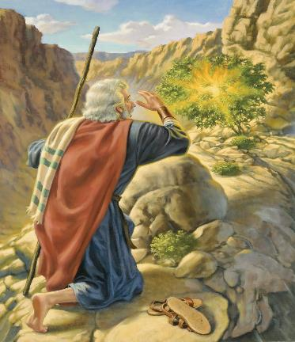
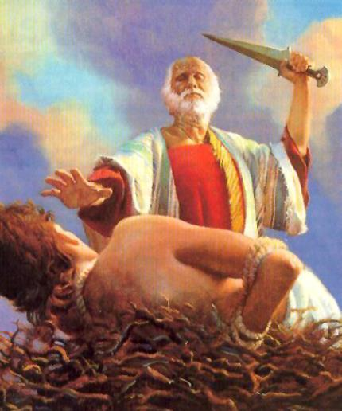
WHAT DOES FEARING GOD MEAN?
“[…] but I did not do so, because of the fear of God.” (Nehemiah 5:15)
Fearing God means to revere Him, to respect Him, and to admire Him. It involves being loyal to God and surrendering to His will.
We must know God in order to fear Him. We must understand who He is and what He can do in our lives. Like Abraham, we must put our focus on God instead of on ourselves. God must be first (Gn. 22:12).
We fear God, we respect Him, and we revere Him because of His infinite wisdom, His unbelievable power, and his amazing grace. Fearing God involves submitting to His will and living for Him.

Slide 6
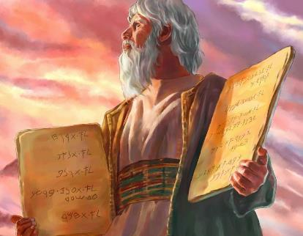
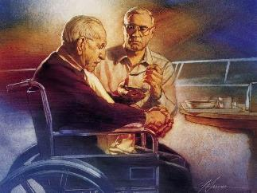
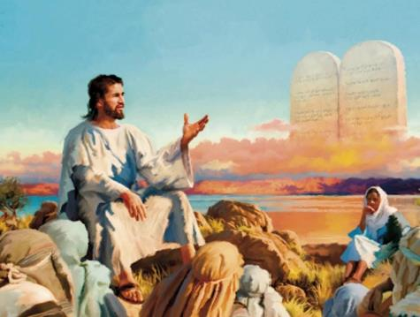
FEARING GOD IN A PRACTICAL WAY
“[…] Fear God and keep His commandments, for this is man’s all.” (Ecclesiastes 12:13)
Moses explained that fearing God is to keep His commandments (Dt. 6:2). Solomon wrote that fearing God and thus keeping His commandments “is man’s all.” (Eccl. 12:13)
Doesn’t grace exempt us from keeping God’s commandments (Eph. 2:8-9)? No. Paul said that “we are […] created in Christ Jesus for good works” (Eph. 2:10).
Jesus didn’t play His Law down. He exalted it and encouraged us to obey it (Mt. 5:17-19). We show that we fear God (we respect Him and revere Him) by keeping His commandments by His grace.

Slide 7
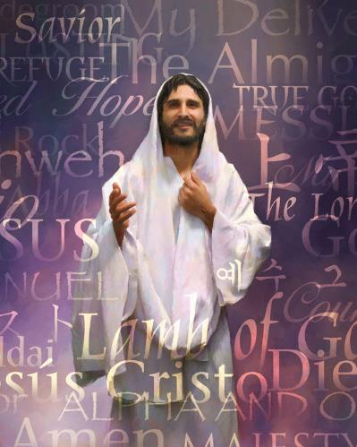
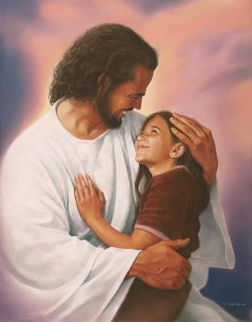
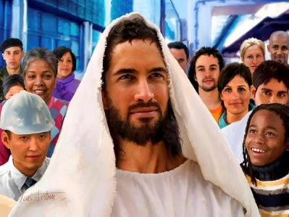
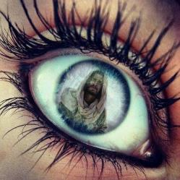
FEARING GOD EVERY DAY
“You shall fear the Lord your God and serve Him, and shall take oaths in His name.” (Deuteronomy 6:13)
Fearing God goes beyond keeping His commandments. If we fear God, we will make Him our only Lord and we will live to serve Him (Dt. 6:13; Mt. 6:33).
Jesus will be the center of our lives. Our eyes (our thoughts, our goals) will be set on Him (Heb. 12:2).
It’s a matter of will. We must decide to remain faithful to the One we fear.
This is what the cosmic conflict is about. Therefore, the first angel encourages us to abandon the ranks of the enemy and to be at God’s side.

Slide 8
HOW CAN WE GIVE GLORY TO GOD?

Slide 9
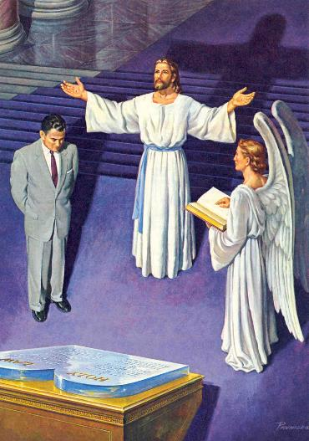
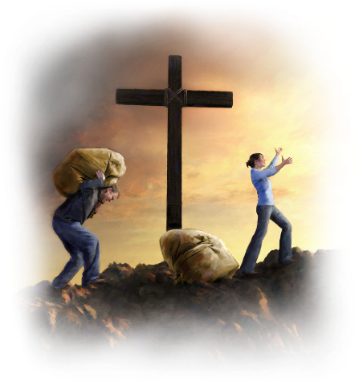
“Give glory to the Lord your God before He causes darkness, and before your feet stumble on the dark mountains, and while you are looking for light, He turns it into the shadow of death and makes it dense darkness.” (Jeremiah 13:16)
Giving glory to God is closely related to the judgment, like in Revelation 14:17 (Jos. 7:19; Jer. 13:16; Mal. 2:2; Acts 12:23). It’s also an expression of repentance and abandoning sin (Ezra 10:11; Rev. 16:9).
We give glory to God by accepting His forgiveness and by living according to His principles. Paul encouraged us to give glory to God in everything we do (1Co. 10:31).
We respond to God’s love by giving glory to Him with our thoughts and acts. This liberates us from fearing the judgment (1Jn. 4:17-19).

Slide 10
WHO CAN FEAR GOD AND GIVE GLORY TO HIM?

Slide 11
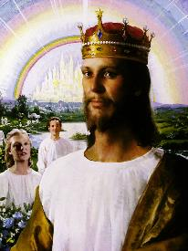
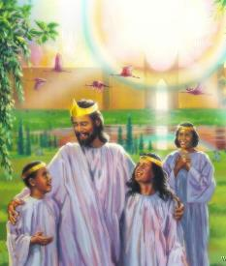
“Here is the patience of the saints; here are those who keep the commandments of God and the faith of Jesus.” (Revelation 14:12)
Accepting the call of the first angel to “fear God and give Him glory” sanctifies us by the grace of God. The saints keep the commandments of God and the faith (or faithfulness) of Jesus (Rev. 14:12).
Jesus overcame Satan thanks to His faithfulness to God (Heb. 4:15). We can also overcome thanks to His victory.
Revelation explains that the future glory will be reserved for the victors (Rev. 2:7, 11, 17, 26-28; 3:5, 12, 21; 12:11; 21:7). This is not legalism. It is victory through Jesus Christ, whose perfect life of perfect righteousness, and that alone, is what gives them the promise of eternal life. It is faith in action. It is transforming, life-changing, miraculous grace in the life of the believer.

Slide 12
“All true obedience comes from the heart. It was heart work with Christ. And if we consent, He will so identify Himself with our thoughts and aims, so blend our hearts and minds into conformity to His will, that when obeying Him we shall be but carrying out our own impulses. The will, refined and sanctified, will find its highest delight in doing His service. When we know God as it is our privilege to know Him, our life will be a life of continual obedience. Through an appreciation of the character of Christ, through communion with God, sin will become hateful to us.”
E. G. W. (The Desire of Ages, cp. 73, p. 668)

