Slide 1
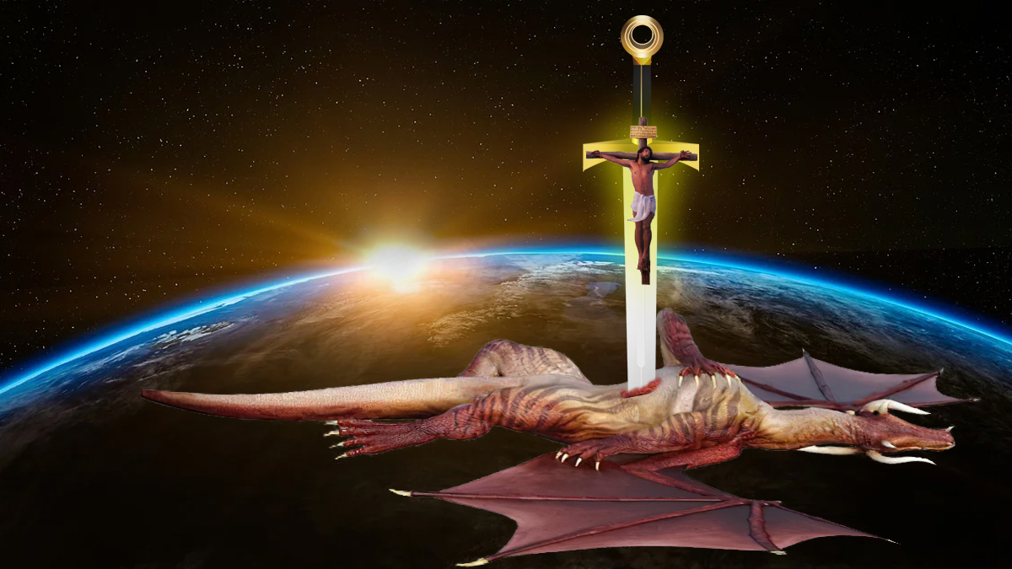
JESUS WINS – SATAN LOSES
Lesson 1 for April 1, 2023

Slide 2
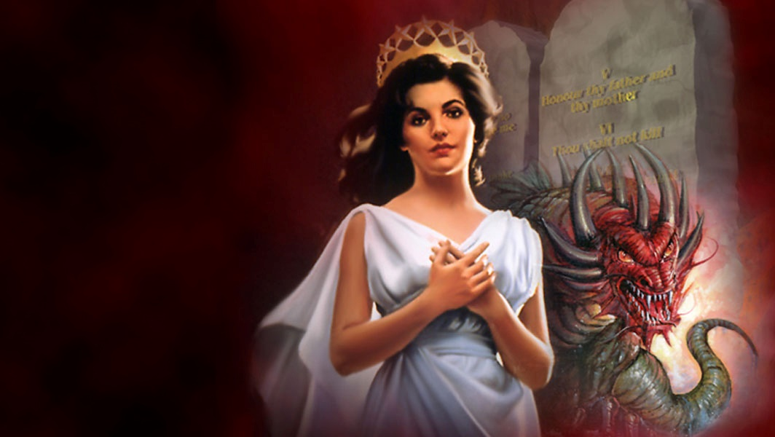
“And the dragon was enraged with the woman, and he went to make war with the rest of her offspring, who keep the commandments of God and have the testimony of Jesus Christ”
(Revelation 12:17)

Slide 3


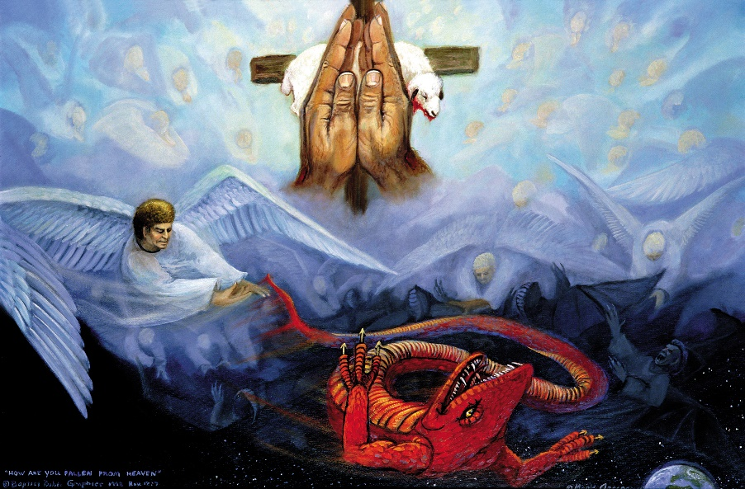





Paul warned us: “Our struggle is not against flesh and blood, but against the rulers, against the authorities, against the powers of this dark world and against the spiritual forces of evil in the heavenly realms.” (Ephesians 6:12 NIV)
Revelation 12 explains who are those powers that are fighting against us, how this controversy began, and how it will end: Jesus wins, Satan loses.
The cosmic conflict. Revelation 12:7-8
The decisive battle. Revelation 12:1-5, 9
The winners. Revelation 12:10-11
Satan counterattacks. Revelation 12:6, 12-16
The remnant is attacked. Revelation 12:17

Slide 4

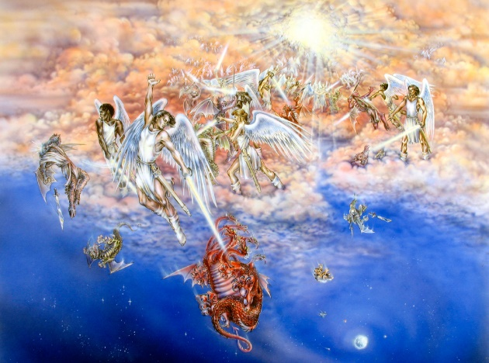
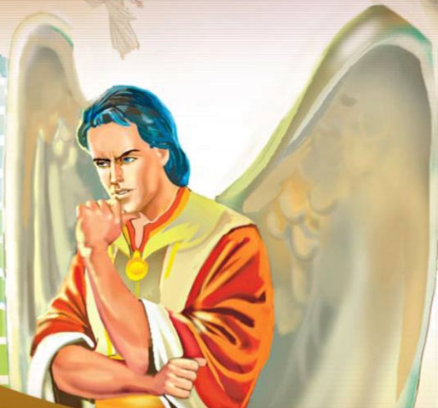
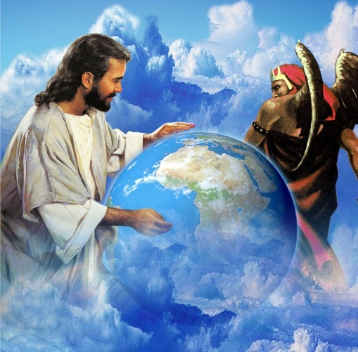
THE COSMIC CONFLICT
“And war broke out in heaven: Michael and his angels fought with the dragon; and the dragon and his angels fought,” (Revelation12:7)
Revelation 12:7-8 uses symbols to tell how a conflict began in heaven. It was a conflict between two people (symbolized by “Michael” and “the dragon”) and their supporters (their angels). Michael won and the dragon was expelled from heaven.
Why did this war begin? God had given Lucifer free will, and he chose to usurp the throne of the Universe (Is. 14:12-14).
There were no neutral angels, they had to choose between Michael and the dragon. This conflict continued on Earth, so we must choose to support Michael or to fight against Him (Lk. 11:23).

Slide 5

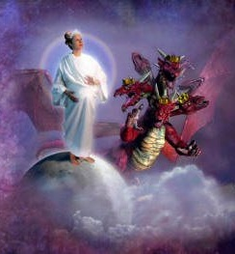
THE DECISIVE BATTLE
“[…] And the dragon stood before the woman who was ready to give birth, to devour her Child as soon as it was born.” (Revelation 12:4)
We have to interpret the symbols in Revelation 12 properly in order to understand the decisive battle in the cosmic conflict.
The dragon
Satan (Rev. 12:9), supported by a third of the angels (v. 4)
The woman
The Church of God, both in the Old and New Testaments (Ez. 16:46; 2Co. 11:2)
The male Child
Jesus Christ, persecuted since He was born (Mt. 2:13). He ascended to heaven (Mr. 16:19) and was given authority over all nations (Rev. 2:26-27; 19:15)

Slide 6

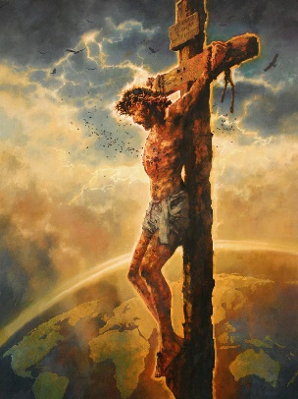
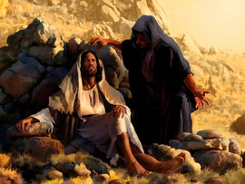
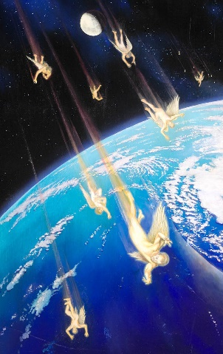
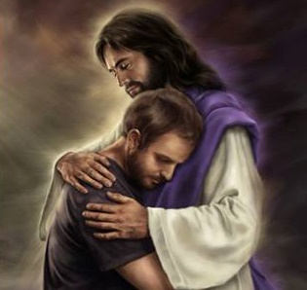
THE DECISIVE BATTLE
“[…] And the dragon stood before the woman who was ready to give birth, to devour her Child as soon as it was born.” (Revelation 12:4)
Satan tried to stop Jesus from fulfilling His mission since He was born as a man (Heb. 4:15).
Jesus overcame by dying on the cross (Col. 2:15).
Satan had been allowed to enter heaven (Job 1:6),
but he was not anymore since Jesus won the decisive battle. Satan was thrown to Earth for good
(Rev. 12:9).
We are victorious in Jesus’ victory (Ro. 8:37). Our sins are forgiven when we accept Jesus, so Satan “the accuser” (Rev. 12:10) can no longer accuse us.

Slide 7

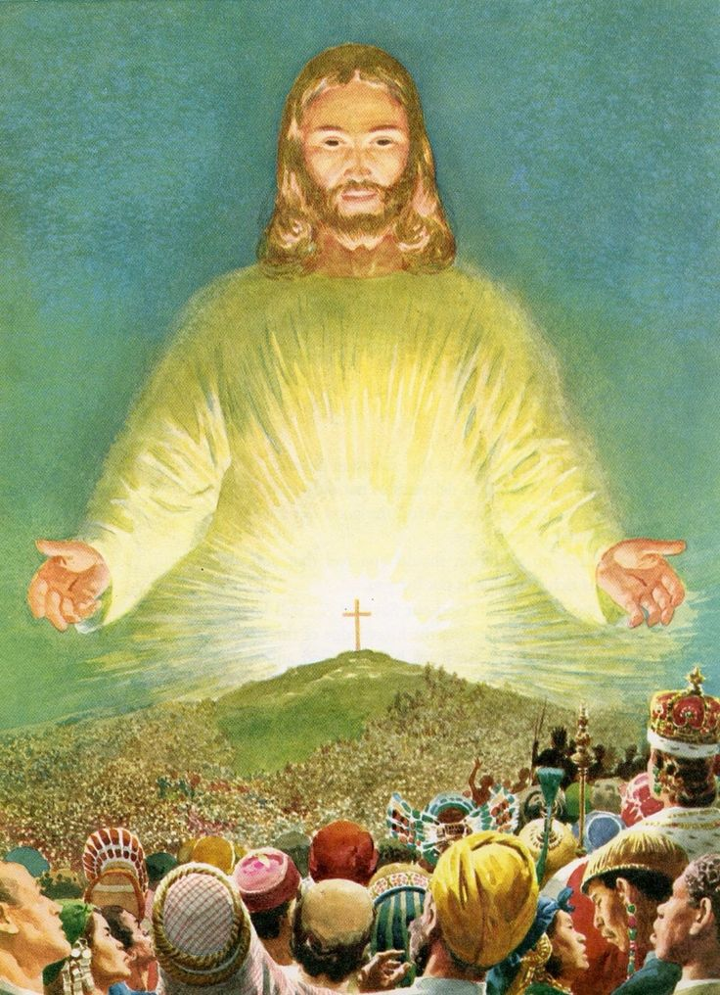
THE WINNERS
“And they overcame him by the blood of the Lamb and by the word of their testimony, and they did not love their lives to the death.” (Revelation 12:11)
Jesus won, and we’ve also won “through the blood” of Jesus (Col. 1:20).
We’ve already won, but the final triumph of Jesus is yet to come (1Co. 15:22-26).
Although the end of the conflict is yet to come, we are already victorious. Our debts are cancelled, and we’re made perfect before God when we accept what Christ did for us by faith (Col. 1:14, 22).
We have won! And God will give all things to those who have overcome (Rev. 21:7).

Slide 8

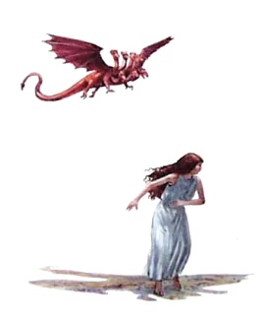
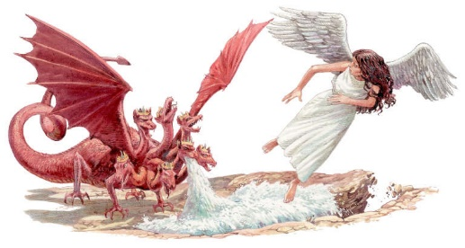
SATAN COUNTERATTACKS
“Now when the dragon saw that he had been cast to the earth, he persecuted the woman who gave birth to the male Child.” (Revelation 12:13)
How long was Satan persecuting the Church (Rev. 12:6, 14)?
42 months
Rev. 11:2
Rev. 13:5
1,260 days
Rev. 11:3
The holy city is trod
The authority of the beast
The two witnesses
Rev. 12:6
The woman in the desert
A time and times
and half a time
Dan. 7:25
The authority of the beast
Rev. 12:14
The woman in the desert
Prophetic time
42 months = 1,260 days = A time and times and half a time.
All the persecution periods in Daniel and Revelation are the same.

Slide 9

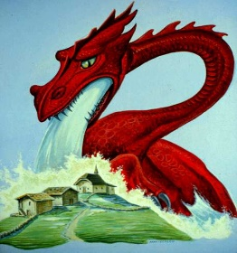
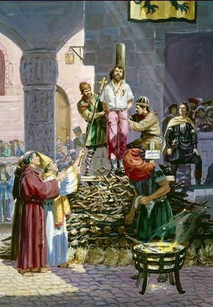
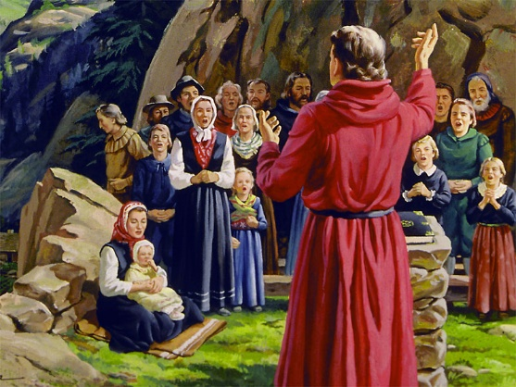
SATAN COUNTERATTACKS
“Now when the dragon saw that he had been cast to the earth, he persecuted the woman who gave birth to the male Child.” (Revelation 12:13)
From 538
To 1798
The last Ostrogothic people are eliminated, and the Pope receives political power over the city of Rome
General Berthier imprisons the Pope on Napoleon’s orders
In prophetic times, a day is equivalent to a year (Nm. 14:34, Ez. 4:6). Let’s review when the 1,260 years of persecution began and ended. A corrupted and authoritarian religious power was leading this persecution, Papacy.
During that time, faithful people were sustained by God in the desert [sparsely populated places]
(Rev. 12:6, 14).
God took care of His Church during that time, and He will also take care of the faithful remnant during the End Time.

Slide 10

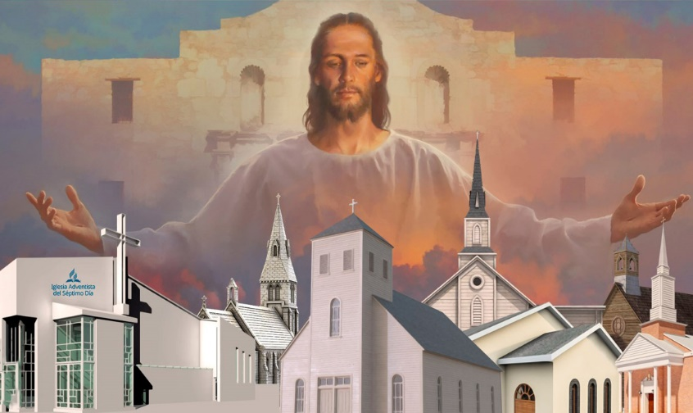
THE REMNANT IS ATTACKED
“And the dragon was enraged with the woman, and he went to make war with the rest of her offspring, who keep the commandments of God and have
the testimony of Jesus Christ.” (Revelation 12:17)
Since 1798, Satan increases His attack on “the rest,” the remnant.
The remnant is a small group with two main characteristics:
They keep the commandments of God. They remember the forgotten law of God
They have the testimony of Jesus Christ. They’re faithful to their Savior
In Jesus, by Jesus, through Jesus, and because of Jesus, our victory is secured.

Slide 11

“God will help us in time of need, but He will not compel us to love and obey Him. We must give Him our undivided love. He wants us to trust Him, and confide in Him. He understands our wants and has ample resources to help in every time of trouble. We are not left to fight our own battles, but we have the help of Christ, and in His name we can come off victorious.”
E. G. W. (Manuscript Releases, book 3, No. 168, p. 109)

