Slide 1
ARE YOU STRESSED?

Slide 3
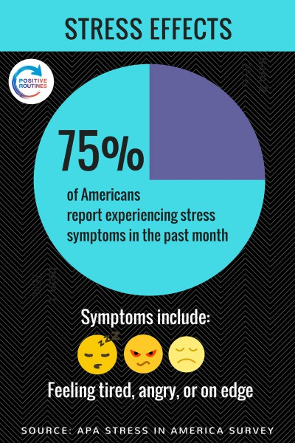

Slide 4
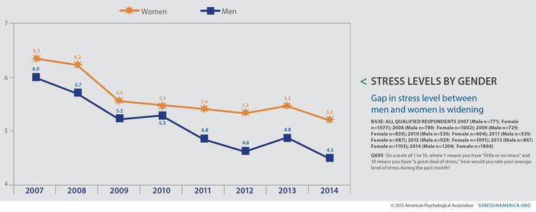

Slide 5
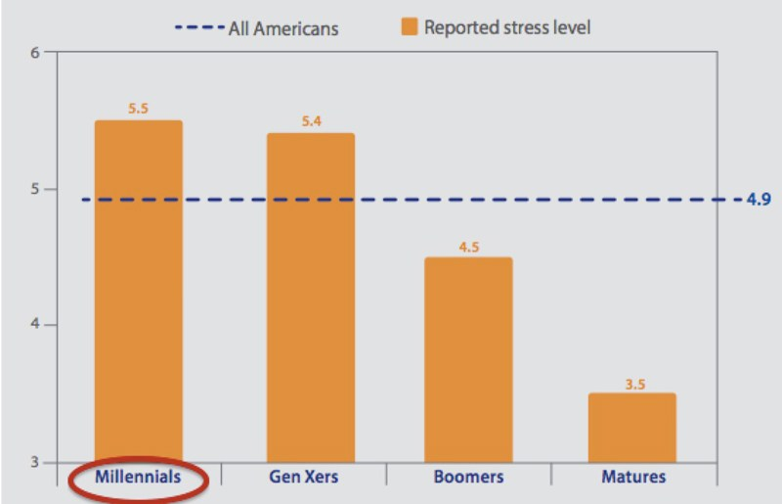

Slide 7
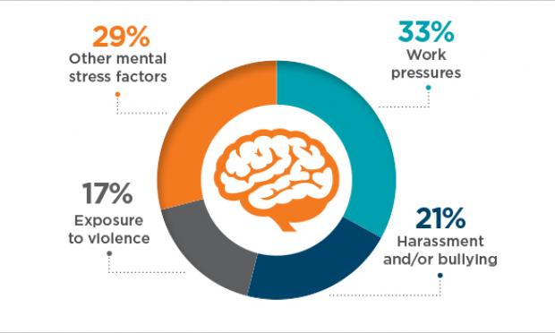
COMMON CAUSES OF STRESS IN ADULTS

Slide 8
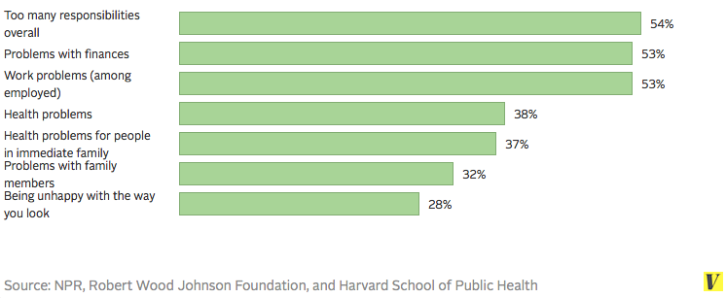
COMMON CONTRIBUTORS OF STRESS IN ADULTS

Slide 12
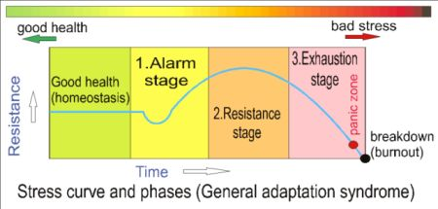

Slide 13
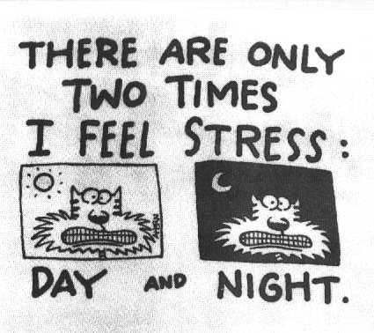

Slide 14
SIGNS & Symptoms

Slide 16
Enteric Nervous System/”Gut Feelings”

Slide 18
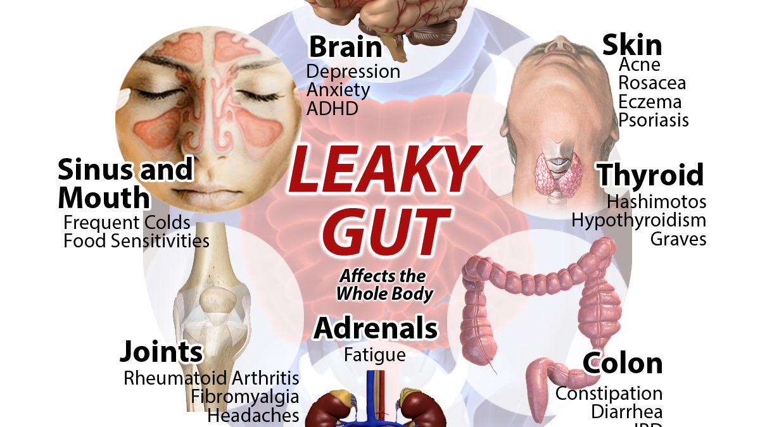

Slide 21
STRESS EFFECTS

Slide 23
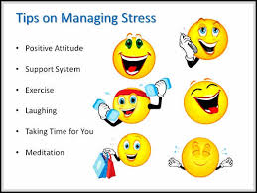

Slide 24
Disconnect to Reconnect

Slide 32
References
Dinan, T. G., & Cryan, J. F. (2012). Regulation of the stress response by the gut microbiota: Implications for psychoneuroendocrinology. Psychoneuroendocrinology, 37, 1369-1378.
Foster, J. A., Rinaman, L., & Cryan, J. F. (2017). Neurobiology of Stress.
Kelly, J. R., Kennedy, P. J., Cryan, J. F., Dinan, T. G., Clarke, G., & Hyland, N. P. (2015). Breaking down the barriers: the gut microbiome, intestinal permeability and stress-related psychiatric disorders. Frontiers in cellular neuroscience, 9, 392.
Lau, W. L., & Vaziri, N. D. (2017). The Leaky Gut and Altered Microbiome in Chronic Kidney Disease. Journal of Renal Nutrition, 27(6), 458-461.
Mu, Q., Kirby, J., Reilly, C. M., & Luo, X. M. (2017). Leaky Gut As a Danger Signal for Autoimmune Diseases. Frontiers in Immunology, 8(598), 1.

